Slide 1
GOES-R for Television Broadcast
Bob Dreisewerd
EVP/CDO

Slide 2
GOES-R Rollout Plan – Phase 1
Ingest full suite of GOES-R products at Baron facility
Productize ABI (Advanced Baseline Imager) Cloud & Moisture Imagery, creating various Infrared and Visible products for the following domains:
Full disk (15 minute update, both native and downscaled resolution)
Full CONUS (5 minute update, both native and downscaled resolution)
CONUS sub-regions (5 minute update, native resolution)
Mesoscale (30 second update, native resolution)
Satellite products will be packaged and delivered directly to customers in real time as GOES-R becomes operational

Slide 3
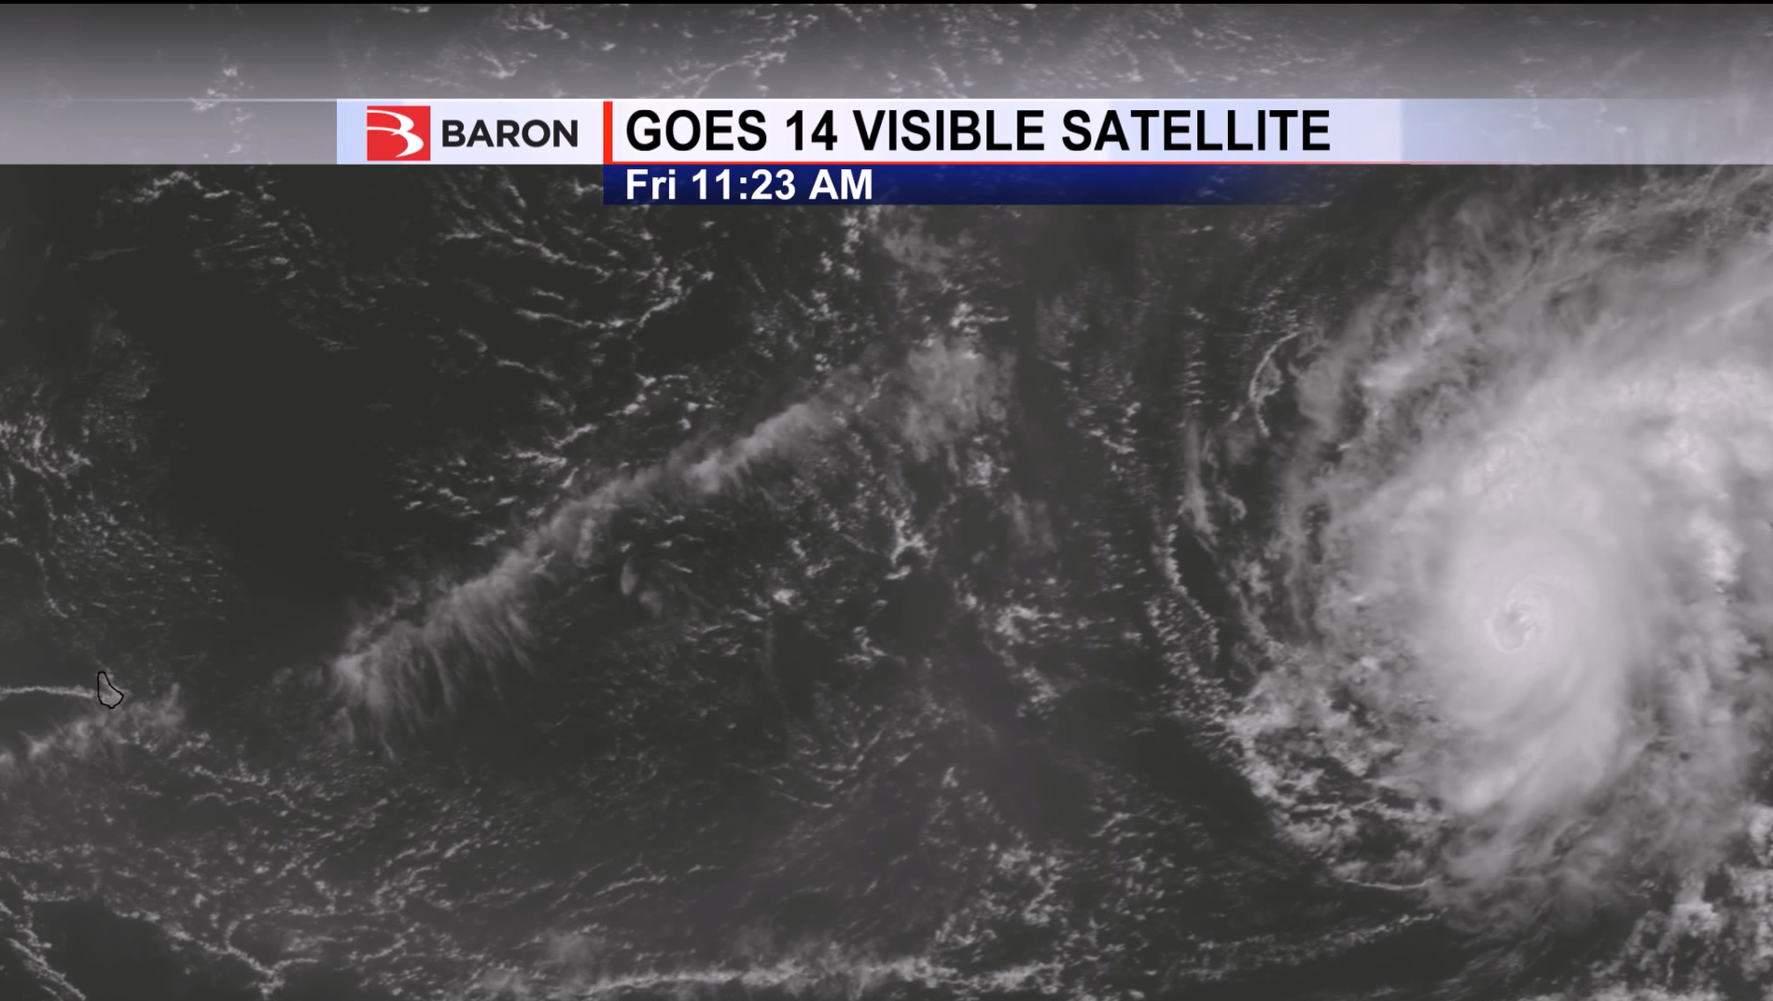
Baron was the first to use GOES-14 SRSOR natively in our broadcast weather display software (October 2012 – Hurricane Sandy) Baron continues to provide SRSOR data (as it is available) to our clients Here was Hurricane Danny on August 21, 2015 in Baron OMNI software:

Slide 4
GOES-R Rollout Plan – Phase 2
Productize L2 (Level 2) products to initially include:
Fire characterization
Sea Surface Temperature
Snow Cover
Rainfall Rate
Volcanic Ash
L2 products will be provided for the following domains:
Full disk
Full CONUS
CONUS sub-regions
Mesoscale
Satellite products will be packaged and delivered directly to customers in real time as they become available

Slide 5
GOES-R Rollout Plan – Phase 3
Provide GLM (Geostationary Lightning Mapper) data to supplement the existing satellite imagery:
Full Disk data
GLM data will be packaged and delivered directly to customers to combine with existing satellite/radar imagery
Data used to visualize location of lightning activity
Data used to illuminate satellite imagery
Data used to illuminate radar data
Note – GLM is not the same as current strike by strike lightning services. It should be considered a supplement

Slide 6
GOES-R Rollout Plan – Phase 4
Create value-added satellite products based on the ABI (Advanced Baseline Imager) radiance products, products to include:
Fog detection
Blended Visible/IR imagery
Satellite masks to improve imagery (remove “cold air” from IR)
Products will be provided for the following domains:
Full disk
Full CONUS
CONUS sub-regions
Mesoscale
Satellite products will be packaged and delivered directly to customers in real time as they become available

Slide 7
Future GOES-R rollout
Creation of value-added products from the available ABI data products
i.e. - Stability Indices
i.e. – Hurricane intensity
Data Fusion - Integration of the GOES-R data to improve existing value-added data products and to integrate with other sensors to create new products
i.e. – Improve Baron Tornado Index with GLM
i.e. – Improve Severe Storm markers/Tracks

Slide 8
Questions?
Bob Dreisewerd
bob.dreisewerd@baronweather.com

