Slide 1
Status of New Products Being Evaluated in the JPSS Proving Ground and Risk Reduction Program
Proving Ground and User Readiness Meeting 10 May 2016

Slide 2
Outline
Introduction
PGRR Background
PGRR Proving Ground Initiative Briefs
Additional JPSS PGRR Project Images
JPSS Science Seminar Schedule
Future Meetings and Conferences
Summary

Slide 3
Introduction
The JPSS Program has funded two Call-for-Proposals (CFP) for Proving Ground and Risk Reduction Projects (PGRR)
The second CFP codified the PGRR Initiative structure for projects to work within
2016 is second year of the second proposal (3-year long)
Over 40 PGRR projects active – quarterly reports primary source of information
User input - Nov 2015 Executive Board Project Review
This second review was a success
Feedback to projects sent, some projects requested clarification
Future review planned (Spring 2017?)
PGRR Initiatives have been meeting regularly. Initiative facilitators established process that works best for each team

Slide 4
PGRR Proving Ground Initiatives
River Ice and Flooding
Fire and Smoke
Sounding Applications including NOAA Unique CrIS/ATMS Processing System (NUCAPS)
NWP impact studies (via HRRR and GFS) and other critical weather applications
OCONUS and NCEP Service Centers AWIPS Initiative
Ocean and Coastal
Hydrology
Cryosphere Initiative
Land Data Assimilation
Atmospheric Chemistry
Aerosol Data Assimilation (w/sounding)
Innovation
Training

Slide 5
River Ice and Flooding Initiative
Initiative began in Nov 2013
Initiative Objectives
Test new River Ice and Flooding Products in operational River Forecast Center (RFC) environments
Determine the value of these products in their use in response to real-world ice jam and flooding events
Implement procedures to transition these research capabilities to operations
Initiative has high interest in NWS River Forecast Centers (RFCs)
Alaska-Pacific and North Central RFCs partners in initial actions
Northeast, West Gulf, and Missouri Basin RFCs became partners in 2014
Products available from Direct Broadcast data through The Community Satellite Processing Package (CSPP) to RFC Systems
Products evaluated during Winter 2013-14 and Winter 2014-2015. Changes made to River Ice Product and Flooding Product algorithms based on forecaster feedback
Flooding Product has been applied year-round to US and international river basins

Slide 6
River Ice and Flooding Initiative Team
Name | Organization | Name | Organization
Naira Chaouch | CCNY (River Ice) | Sanmei Li | GMU
Gene Derner | NWS | Angela Ottoson | NIC
Pat Dills | COMET | Julie Price | JPSS
Sean Helfrich | National Ice Center | Pedro Restrepo | NWS
Jay Hoffman | CIMSS | Bill Sjoberg | JPSS
Eric Holloway | NWS | Donglian Sun | GMU (River Flood)

Slide 7
Initiative Updates
Regional pages for River Ice and Flooding Products created on RealEarth
Ed Plumb from AK took RI&F Product to Russia for Peer-to-Peer Program. Very positive feedback
Initiative Team worked with COMET to produce a River Ice and Flooding Products Training Module
River Ice Product
Major change in product – focus is on ice concentration based on feedback from RFCs
Showed the value of product for the Fall ice-up of rivers
Validated product with aircraft pictures over several rivers
National Ice Center has requested the use of product to support the Coast Guard in their river ice breaking operations (target Winter of 2017)

Slide 8
Initiative Updates
River Flooding
Product used by US Army Corp of Engineers for Jan 2016 Mississippi River Flooding
Effective use of product to identify flooding along AK Dalton Hwy in Winter 2015 and 2016
Sanmei Li gave briefing at NOAA Science Day and Donglian Sun briefed Feb Science Seminar
Sanmei visited AK as part of the Visiting Scientist Program. Briefed NWS AK organizations and AK Ice Center. Flew with the Yukon River with Dr Jessica Cherry

Slide 9
Examples – USACE Inundation Maps Illinois River
30 meter VIIRS Flood Area product in Google Earth overlain with USACE levee information
Very effective in inter-agency coordination of levee breach scenarios
Valuable for determining storage volumes in river forecast model using levee data

Slide 10
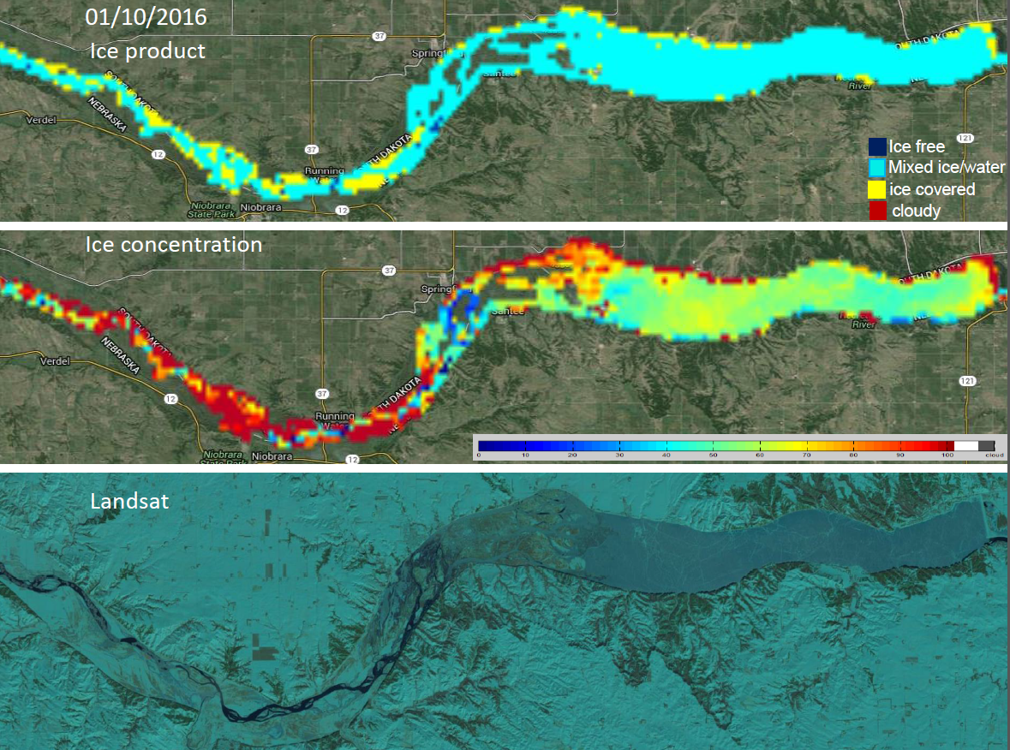
Missouri River Ice Product

Slide 11
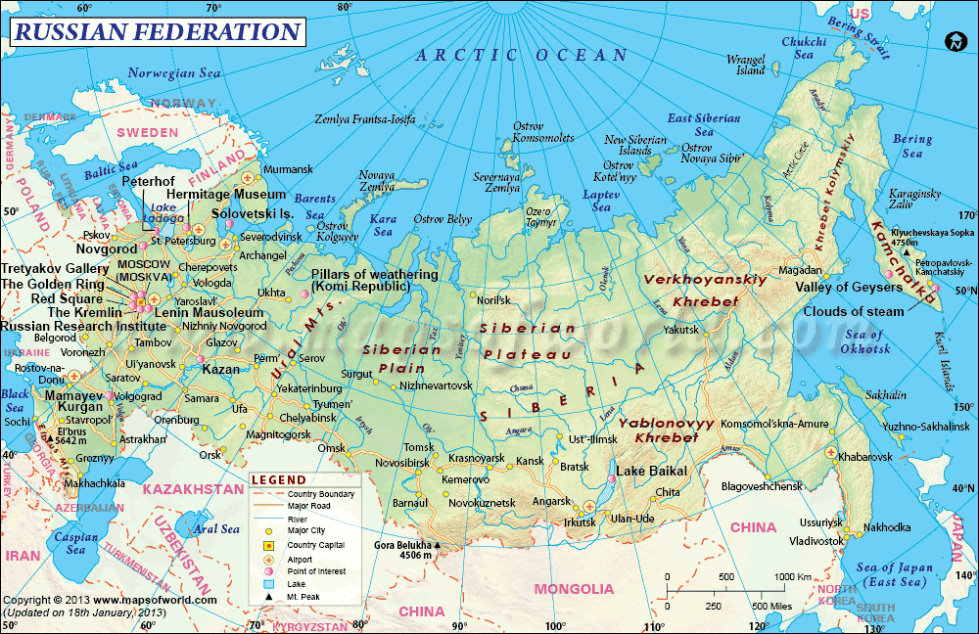
Yakutsk
Edeytsy
Village
Yakutsk
Notes:
The village of Edeytsy is on the Lena River approximately 50 km north of Yakutsk.

Slide 12
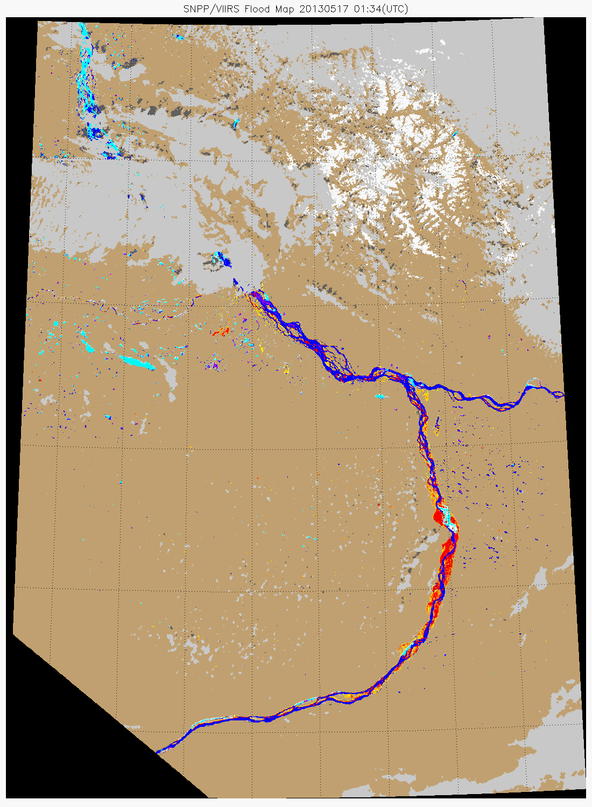
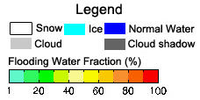
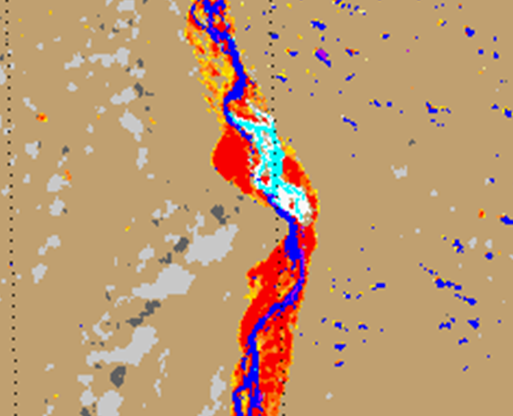
Ice jam
17 Mая 2013
Edeytsy
Lena River
Notes:
River/ice image showing the ice jam and flood inundation on the Lena River in the village of Edeytsy. This new monitoring technique was shared with staff from Roshydromet, Lena River Basin Water Management Staff, and during the Northern Forum Climate and Water Working Group meeting.

Slide 13
Fire and Smoke Initiative
Initiative began in May 2014
Initiative Objectives were established
Evaluate the current use of geostationary and polar orbiting satellite capabilities in support of Fire and Smoke mission
Identify current SNPP/JPSS and new GOES-R data and capabilities with the potential to improve support to this mission
Establish methodologies and procedures for the operational demonstrations of these capabilities
Identify the satellite capabilities whose operational impacts are sufficient to warrant transition from research to operations
Initiative has been working NWS and Air Quality personnel responding to Alaska and Western US Fires in 2014 and 2015
Alaska had 4.7 million acres burned as of late July 2015… second-highest seasonal total on record
US HRRR Model know has smoke window for NWS Western Region
Work has begun on a Blended Fire and Smoke Product development and demonstration at National Interagency Fire Center (NIFC) in Mar 2016

Slide 14
Fire and Smoke Initiative Team
Name | Organization | Name | Organization
Ravan Ahmadov | CIRA | Mark Loefelbein | NWS
Tim Barker | NWS – SOO Boise | Jeff McQueen | NCEP
Russ Dengel | CIMSS | Brad Pierce | STAR
Andy Edman | NWS | Julie Price | JPSS
Evan Ellicott | Uof MD | Pete Roohr | NWS
Robyn Heffernan | NWS | Bill Sjoberg | JPSS
Amy Huff | Penn State U | Eric Stevens | GINA
Georg Grell | ESRL | Jorel Torres | CIRA
Steve Miller | CIRA

Slide 15
Initiative Updates
Amy Huff, AQ Forecaster led team to create beta version of Blended Fire and Smoke Product
Product demonstrated to NWS IMETs during their Mar Annual Meeting in Boise ID
Active Fires declared operational at 20 Jan SPSRB should be in AWIPS in May
Evan Ellicott went to AK in Mar to help AK Fire Service access SNPP Data better
Fire and Smoke Products available on RealEarth
Active Fire capability has been tested for inclusion in HRRR -- Work is ongoing to be able to use VIIRS FRP data in WRF-Chem then rerun HRRR-Smoke with updated WRF-Chem.

Slide 16
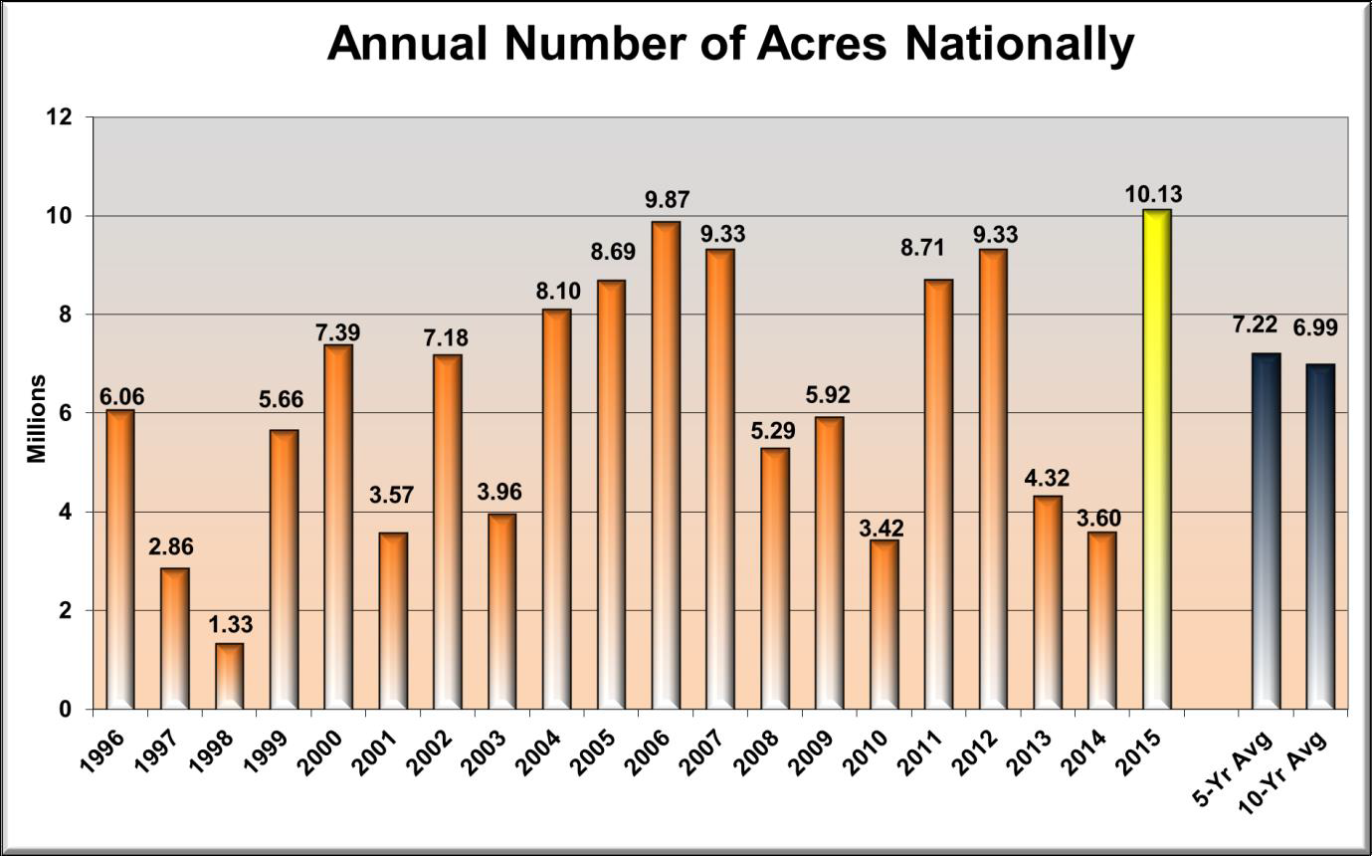
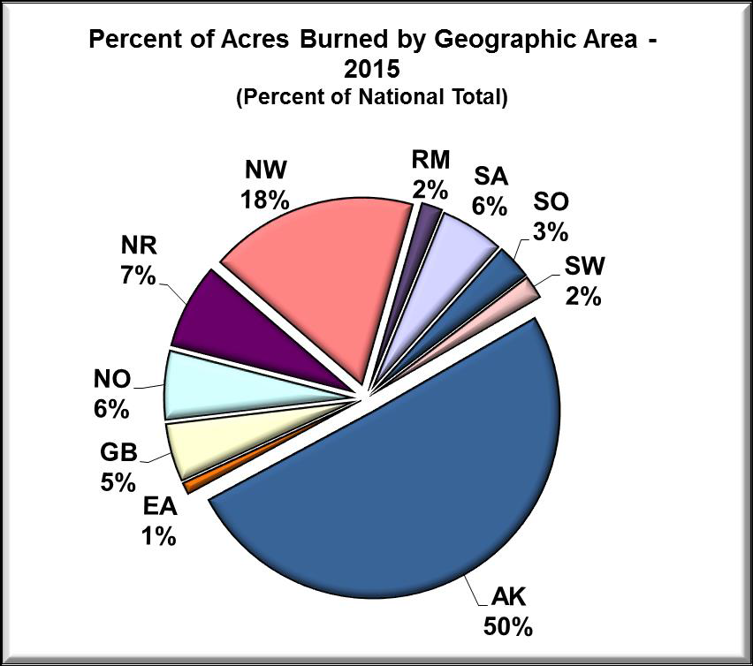
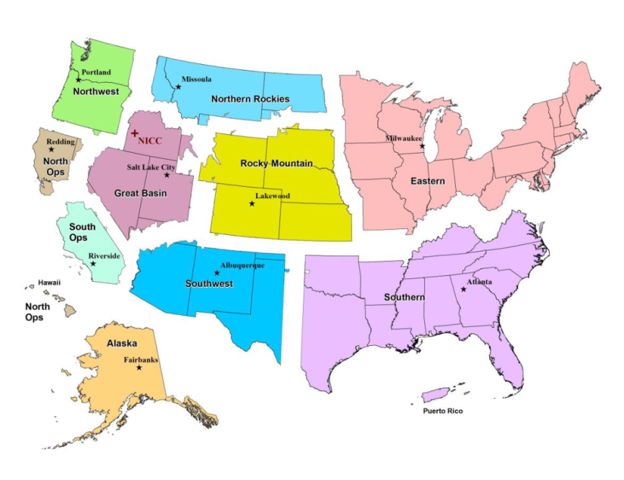
2015 was the highest area burned between 1996-present
50% of area was in Alaska (AK)
36% was in Pacific Northwest (WA, OR, ID, MT, Northern CA)

Slide 17
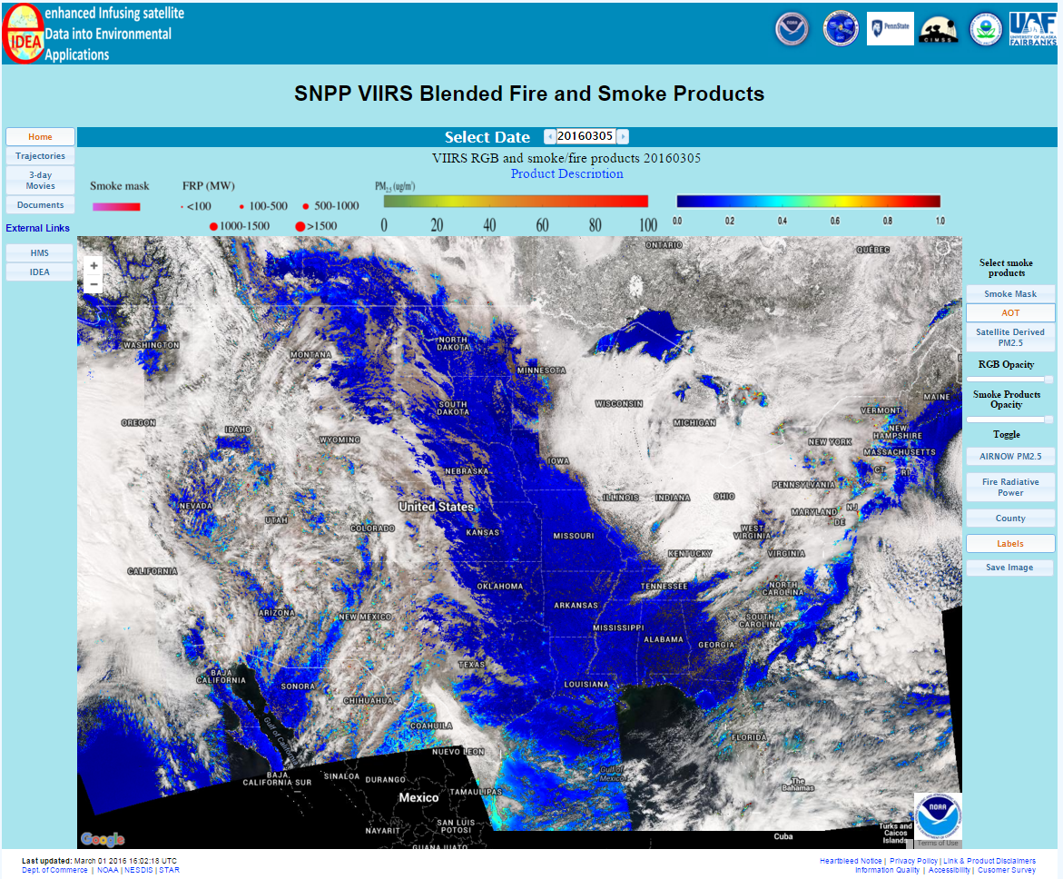
Web-Based Blended F&S Product: eIDEA
http://www.star.nesdis.noaa.gov/smcd/spb/aq/expr/expr2/
calendar to select date of interest
animations and external links
main product overlay buttons

Slide 18
Sounding/NUCAPS Initiative
Initiative began in Jul 2014
NUCAPS Program Objectives.
Generate spectrally and spatially thinned radiances
Provide retrieved products such as profiles of temperature, moisture, trace gases and cloud-cleared radiances to users
Provide global validation products such as radiosonde matchups and gridded radiances and profiles
Initiative Objective: to improve the operational use of SNPP for those NWS offices with AWIPS II and assist those offices that will be getting AWIPS II with NUCAPS.
The initiative will address:
NUCAPS algorithm work (STAR)
Operational application and validation of NUCAPS (Omaha/Boulder WFO)
NUCAPS training (NWS)

Slide 19
Sounding Initiative Team
Name | Organization | Name | Organization
Chris Barnet | STC | Dan Neitfeld | NWS
Emily Berndt | SPORT | Tony Reale | STAR
Jack Dostalek | CIRA | AK Sharma | OSPO
Jim Heil | NWS | Bill Sjoberg | JPSS
Dan Lindsey | CIRA | Nadia Smith | CIMSS
Scott Lindstrom | CIMSS | Eric Stevens | GINA
Bill Line | NWS | Brad Zavodsky | SPoRT
Nick Nalli | STAR

Slide 20
Initiative Updates
Chris Barnet provides NUCAPS support to El Nino Rapid Response Campaign
Eric Stevens established a NUCAPS evaluation initiative for AK Convective Season. NWS AK is very involved!
Information on NUCAPS Soundings presented at Mar IMET Meeting in Boise. Soundings are available on Thin Client. Will work with NIFC to help motivate use of NUCAPS during fire events.
2016 Spring Experiment.
Updated NUCAPS algorithm being evaluated – quality flags included
Two of weekly “Tales from the Testbed” already complete
SPoRT established horizontal NUCAPS cross-sections that are available
NUCAPS Training updated
IASI NUCAPS soundings now available. Working to get them tested during last two weeks of Spring Experiment
NUCAPS Soundings to be evaluated in NHC during Hurricane Season. Focus on extra-tropical transition phase.

Slide 21
NUCAPS Trace Gas Product Evaluation
Initiative is based on 2 recently funded JPSS proposals.
Greg Frost: “Understanding emissions and tropospheric chemistry using NUCAPS and VIIRS”
Brad Pierce: “High Resolution Trajectory-Based Smoke Forecasts using VIIRS Aerosol Optical Depth and NUCAPS Carbon Monoxide Retrievals “
Models are used to interpolate the sparse aircraft observations to the satellite temporal, spatial, and vertical sampling characteristics for detailed validation
NUCAPS (and AOD f/ VIIRS) will be used within IDEA (Infusing Satellite Data into Envir. AQ Applications)
http://www.star.nesdis.noaa.gov/smcd/spb/aq/
Notes:
IDEA (Infusing satellite Data into Environmental air quality Applications) is a NASA- EPA-NOAA partnership to improve air quality assessment, management, and prediction by infusing (NASA) satellite measurements into (EPA, NOAA) analyses for public benefit. In the Summer of 2003, researchers form NASA, EPA, NOAA and academics prototyped the fusion, analysis and visualization of NASA ESE and US EPA data as AIRNow PM2.5 Forecast Tools. After a successful demonstration, EPA and NASA transferred IDEA to the Cooperative Institute for Meteorology and Satellite Studies (CIMSS), a joint University of Wisconsin (UofW)-NASA-NOAA, through the support of EPA and NASA continued to the operation of IDEA until 2007. In 2007 IDEA was transferred to the University of Maryland Baltimore County and eventually to NOAA NESDIS. Since 2008, IDEA has been running at NOAA Center of Satellite Applications and Research (STAR) and has been hosted by its web server

Slide 22
This is a mixture of validation and development of an application
Thermal IR sounding of trace gases is a new application
Trace gases are now part of NOAA JPSS requirements
Users require averaging kernels (AKs)
Users are fully engaged, using their own metrics
Spectral length analysis
Tracer-tracer correlations
Working with users directly to tailor the products
Designing file formats to convey AKs
Working to improve characterization of products
Quality control

Slide 23
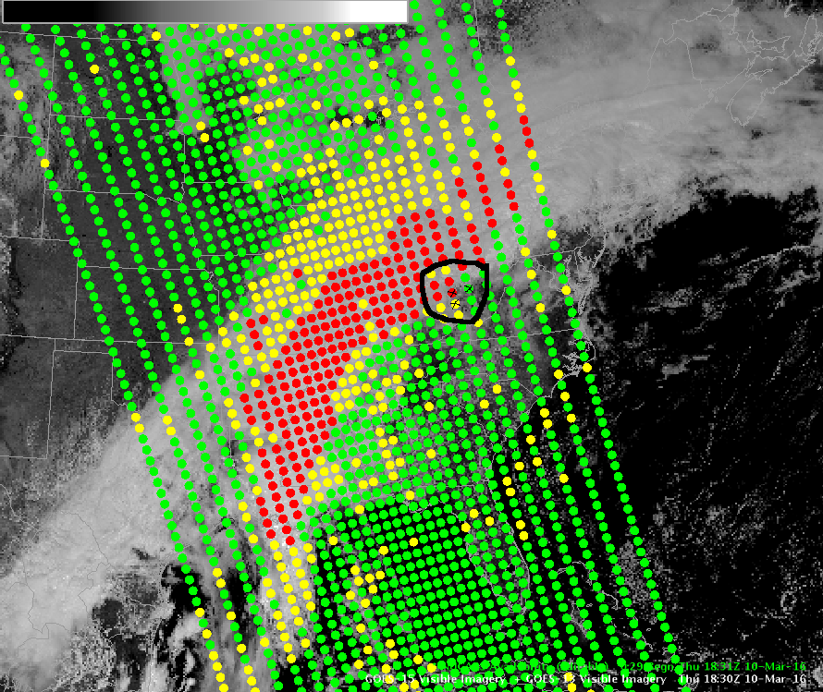
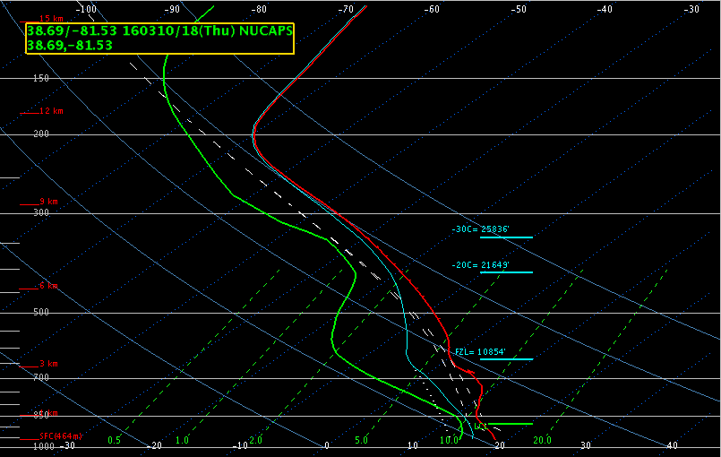
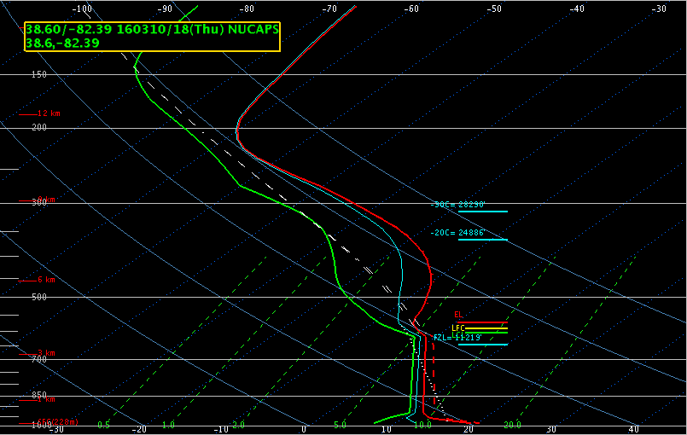
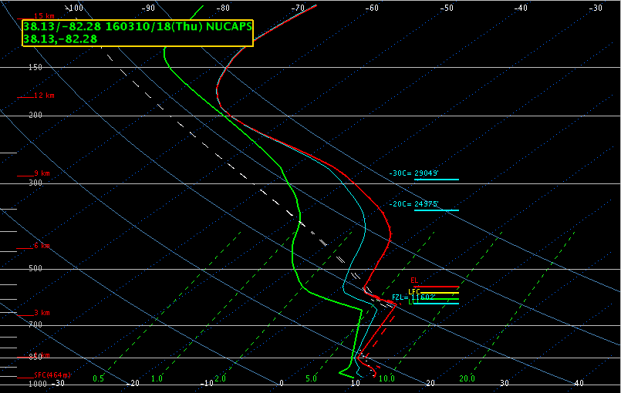
New for 2016: QC Flags
Green
Red
Yellow

Slide 24
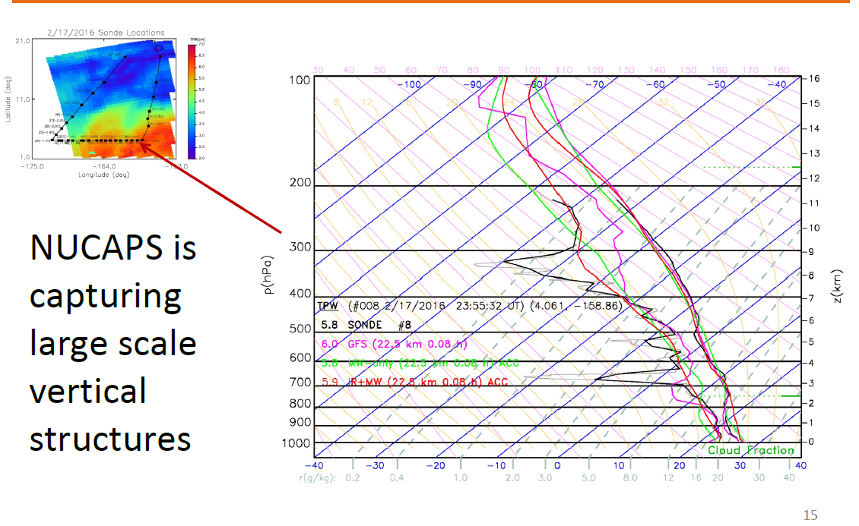
El Nino Rapid Response Campaign Feb 17th Sonde #8, Near Overpass Time

Slide 25
Hydrology Initiative Projects/Participants
Project PI | Organization | Project Title
Dave Gochis | (NCAR) | Applying Snow Products from S-NPP JPSS and SNODAS to Seasonal Streamflow Forecasting at the NWS National Water Center
Huan Meng | (NESDIS/STAR) | Continued expansion, enhancement and evolution of the NESDIS snowfall rate product to support weather forecasting
Pingping Xie | (NWS/NCEP) | Reprocessing of JPSS precipitation and OLR products for improved operational climate applications
Isaac Moradi | (UMD/CICS) | Extending AMSU/MHS FCDR's and TCDR's to S-NPP ATMS
John Forsythe | (CSU/CIRA) | Using JPSS Retrievals to Implement a Multisensor, Synoptic, Layered Water Vapor Product for Forecasters
Tony Wimmers | (UW/CIMSS) | Strengthening TPW visualization in the OCONUS domain with JPSS data products
Tarendra Lakhankar | (CUNY/CREST) | Validation and Application of JPSS/GCOM-W Soil Moisture Data Product for operational flood monitoring in Puerto Rico
Jerry Zhan | (NESDIS/STAR | Enhance Agricultural Drought Monitoring using NPP/JPSS Land EDRs for NIDIS
Andi Walther | (UM/CIMSS) | Further development of the VIIRS Nighttime Lunar Reflectance-derived Cloud Properties and the Demonstration for their use for Precipitation and Icing Applications

Slide 26
Ocean and Coastal Initiative Projects/Participants
PI | Organizaton | Title
Ahmed, Sam | CCNY | A new technique for VIIRS detection and delineation of Karenia brevis HABS in the West Florida Shelf without the need for a fluorescence channel
Bayler Eric | NWS/NCEP/EMC | Using Neural Networks for gap-filling and preliminary short-range (1-2 weeks) to medium-range (3-4 weeks) predictions of satellite-derived ocean color fields (Chl-a, Kd490, KdPAR)
DiGiacomo, Paul | NESDIS/STAR (& NOS/NCCOC) | Enhancing use and access to near-real-time VIIRS ocean color data: Support for harmful algal bloom operational forecast system, water quality and ecological monitoring and forecasting
Elvidge, Chris | NESDIS/STAR | VIIRS boat detection service
Mehra, Avichal | NWS/NCEP/EMC | Initial biogeochemical modeling at NOAA/NCEP: Using VIIRS ocean color data for validation and data assimilation
Tong, Daniel | OAR/ARL | Development, validation, and implementations of three marine isoprene products (isoprene, dimethyl sulfide and primary organic aerosols) using multiple JPSS ocean products

Slide 27
Wx/NWP/DA Initiative Projects/Participants
PI | Organization | Title
Galina Chirokova | CIRA/CSU | Improving Tropical Cyclone Forecast Capabilities Using the JPSS Data Suite
Chris Velden | Univ. of Wisconsin CIMSS | Satellite-Based Hurricane Intensity Estimation in the JPSS/GOES-R Era
Jun Li | Univ. of Wisconsin CIMSS | Enhance the utilization of real time JPSS sounder data in SDAT for tropical cyclone forecast application
Fuzhong Weng | NOAA/NESDIS/ STAR | Improve CrIS Radiance Assimilation in GSI for Better Forecasts of High-Impact Weather Events
James Jung | Univ. of Wisconsin CIMSS | Support for NPP and JPSS Data Assimilation Improvements
Stan Benjamin | NOAA ESRL | Direct readout enhancement of short-range forecast impact for global and regional models
Zhanqing Li | Univ of MD | Retrieving cloud base height and updraft speed for shallow convective clouds and boundary-layer moisture from VIIRS for improving the NCEP-GFS
Benjamin Ruston | NRL | NRL/JPSS Extending CrIS/ATMS Assimilation and Calibration/Validation through correlated error, over clouds and to the surface
Eugenia Kalnay | Univ of MD | Proactive Quality Control (PQC)

Slide 28
Summary
PGRR Initiatives are making great progress. Users are finding new ways to apply capabilities!
Feedback from users is motivating improvements in capabilities that have been proven in additional operational testing
NWS are strong advocates for their users’ application of JPSS Capabilities. USACE an example.
Cross-initiative opportunities are increasing. NUCAPS and Fire; River Flooding and Fire are good examples.
Not all projects are being actively involved in an initiative. Quarterly reports and Science Seminar are key ways to follow progress.
River Ice and Flooding Products are anticipated to be the first products to enter into the JPSS Configuration Change Request Process.

