Slide 1
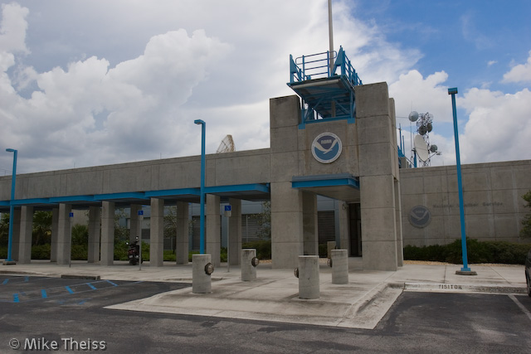
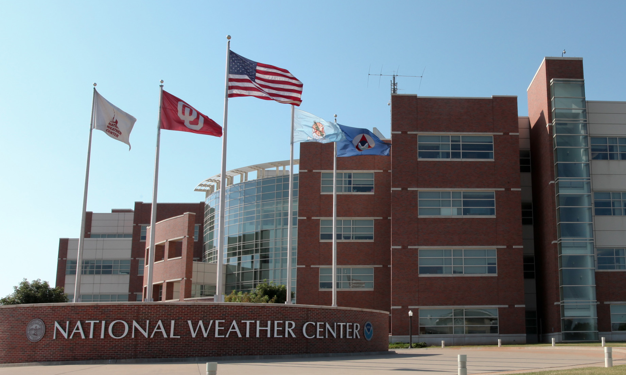
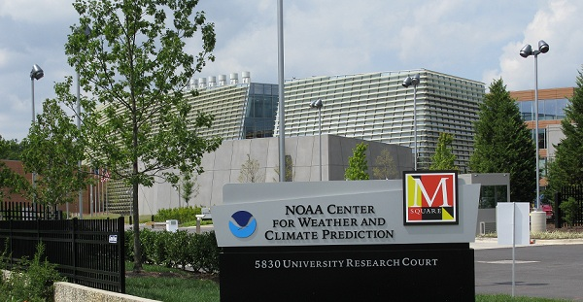
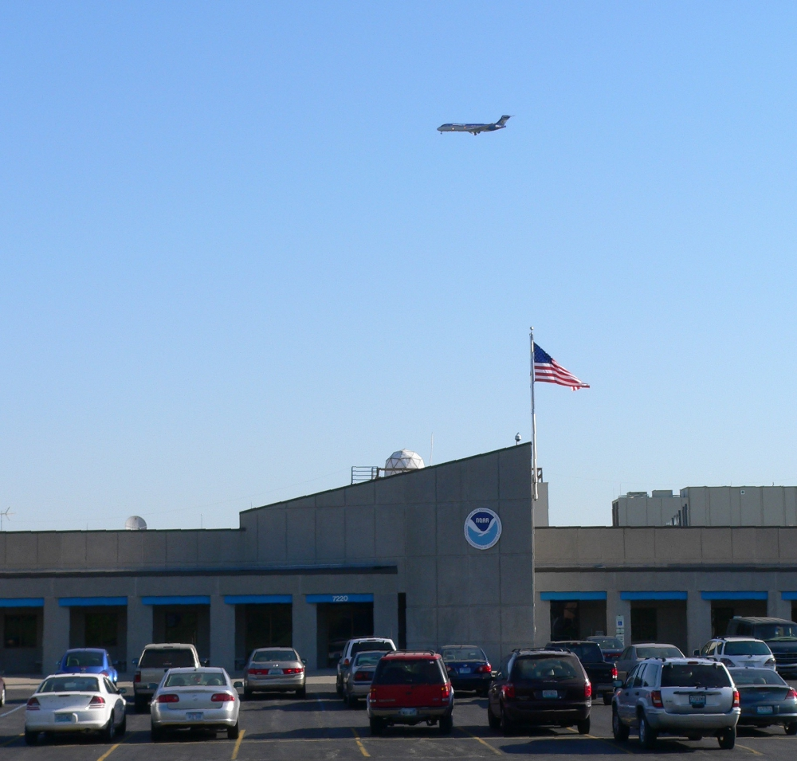
NATIONAL CENTERS GOES-R READINESS
Michael Folmer – OPC/WPC/TAFB/SAB
Andrea Schumacher - NHC
Amanda Terborg – AWC
Bill Line - SPC

Slide 2
Ground readiness

Slide 3
So much data… so many endpoints…
?
AWIPS-2
D2D
NCP
GRB
PDA
SBN
N-AWIPS

Slide 4
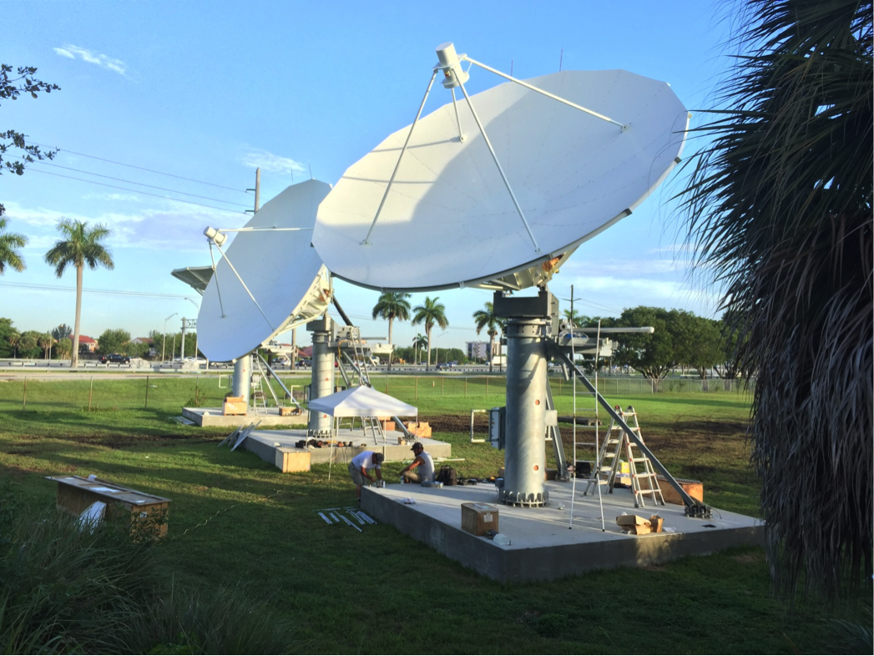
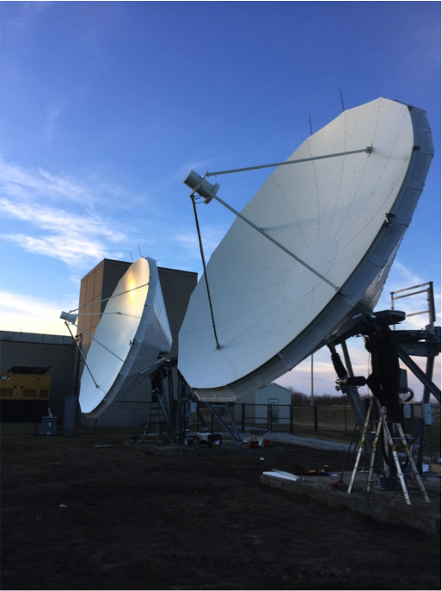
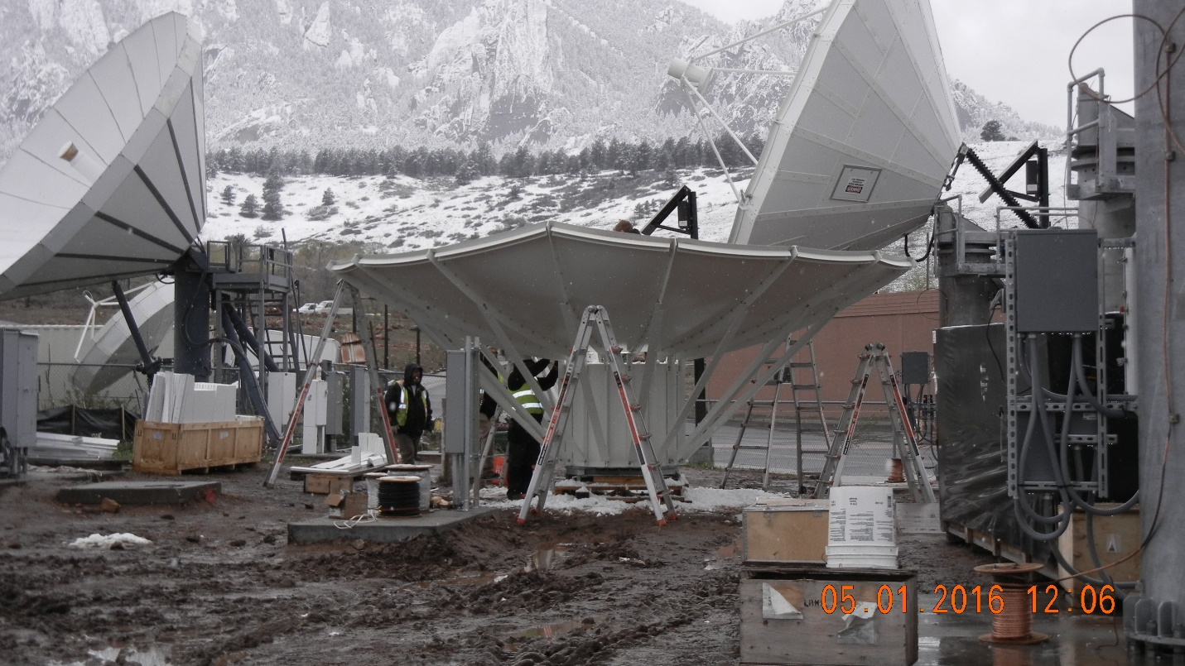
GOES-R ReBroadcast antennas
Still in progress
NCWCP – Summer 2016
Completed as of May
NHC – Summer 2015
SPC – March 2016
AWC – February 2016
SWPC – April 2016
OPC
WPC
SAB
NCO
Primary data feed for ABI data and for GLM

Slide 5
Product Distribution and ACCESS
Back up for ABI imagery and GLM
Primary for derived products
Primary for legacy polar and international (eventually)
National Center Readiness:
NHC/SPC – initial setup underway; training underway
AWC – initial setup complete; training forthcoming; participating in validation in June
NCWCP – direct connect via NCO and IDP
User Portal:

Slide 6
Satellite broadcast network (SBN)
“Cushion” data… or backup in case GRB and PDA are unavailable…
Compared to today, it would be like using GINI data in place of GVAR and ESPC data (geodist)
AWC and SPC currently pulling in simulated GOES-R data, NHC and NCWCP are still forthcoming
Secondary source of AHI, VIIRS, NUCAPS, etc.
SBN flows directly from NSOF:

Slide 7
N-AWIPS vs. AWIPS-2…
All National Centers are still operationally on N-AWIPS and will be for at least the next year
OPC is closest to the AWIPS-2 transition
Then WPC
NHC expects 1-2 years yet
SPC and AWC are sometime after that
NCP satellite project
All centers working with Monica on NCP satellite display
Plug-in rework installed with 16.2.1 n3 at most centers
McIDAS plug-in only. Netcdf question being worked…

Slide 8
N-AWIPS vs. AWIPS-2…
NCP or D2D?
NCP has its challenges, particularly with production platforms
Especially notable with complex centers and missions
Finding the most efficient route for National Center Operations
Can we advance with the new advanced systems, take advantage of new capabilities? Or do we stick with what we know?
Can we do this through NCP? D2D?
We want consistency with collaborative partners.
Proof of concept: which AWIPS tools can we use to make that collaboration work and be most efficient? PGEN? GFE or Hazard Services?
Satellite readiness is dependent on the route that is chosen. Development is beginning to move in parallel

Slide 9
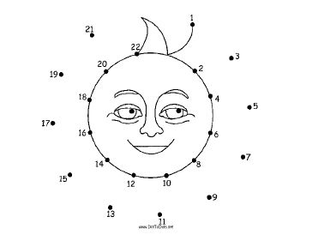
…and the in between
GRB (and GVAR) and PDA and SBN to N-AWIPS and AWIPS-2 using AREA files and netcdfs and other formats and post processing for local imagery…
It is a multi-layer infrastructure of new and legacy data
This makes building the plumbing complex and difficult
So how do we connect all the dots?
Center independent infrastructure development as currently done… or ISatSS
ISatSS – the ‘catch all’ of satellite data!
Currently running for Himawari at AWC and NHC
Also running at NCO for OPC/WPC

Slide 10
User Readiness

Slide 11
Who are the users at the National Centers?
National Center for Weather and Climate Prediction
Ocean Predication Center
Weather (Hyrdrometeorological) Prediction Center
National Weather Center
Storm Prediction Center
Aviation Weather Center
Aviation Weather Testbed
Air Traffic Control Systems Command Center
National Hurricane Center
Tropical Analysis Forecast Branch
Alaskan Aviation Weather Unit
Satellite Analysis Branch
Hurricane Specialist Unit

Slide 12
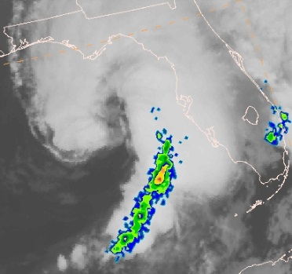
User Readiness at NHC
To date, 15 GOES-R products and 1 JPSS product have been formally demonstrated at NHC
Forecasters have been asked to evaluate products during most active part of hurricane season (Aug-Nov)
Onsite Satellite Focal Points (M. DeMaria, M. Brennan, J. Beven, Nelsie Ramos)
Satellite Liaison (remote coordination, regular visits)
Close coordination with TAFB Proving Ground
Main accomplishments
HSU/TAFB forecasters have become experts on tropical applications of some future capabilities, mention then routinely in forecast discussions (e.g., RGBs, DNB)
Forecaster comments have helped guide product improvements and Risk Reduction research (e.g., GLD-360 lightning density and use in RII)
Forecasters have helped identify new uses and refine existing uses of products (e.g., SRSO has been found to be most

Slide 13
User Readiness at NHC
We’ve found a semi-formal approach to GOES-R/JPSS User Readiness has worked well at NHC
Satellite Liaison coordinates with Satellite Focal Points, some direct forecaster interactions (when onsite)
Satellite Focal Points serve as onsite experts and advocates
Formal product training has been short, applications-focused, and administered one-on-one or in small groups
NHC forecasters are satellite data “SUPER USERS” already

Slide 14
GOES-R User Readiness at OPC, SAB, TAFB, and WPC
The 2016 GOES-R Demonstration will focus on Baseline products that haven’t been introduced to forecasters:
QPE/Rain Rate
Cloud Top Products
Atmospheric Motions Vectors
A Proving Ground satellite archive has been created on the NCEP system and is supported by NCO.
100 Tb of space and the centers have requested a 2-3 year archive of all satellite products (if possible).
Currently, archived Himawari AREA files at full resolution (1 km VIS, 2 km IR, 10 mins) takes up 5.2 Tb with a ~65% compression. This does not include RGBs, GeoColor, etc.
Himawari Training will commence this summer for all centers with emphasis on OPC and parts of WPC and SAB.

Slide 15
SPc and AWC User readiness
SPC
Different from the HWT experiment!
Specific training on convective products that would be useful for SPC operations
N-AWIPS specific and all one-on-one forecaster training
AWC
2016 Winter Experiment completed in February
N-AWIPS and AWIPS-2 D2D concepts for icing, turbulence, and ceiling and visbility
2016 Summer Experiment starting mid-August
All AWIPS-2 D2D concepts
Integrating satellite data into AWIPS-2
Ongoing longer term evaluations and proof of concept explorations
Himawari/preliminary GOES-R training starting July

Slide 16
Training for goes-R
Starts with Himawari AHI training
Two and a half day workshop for liaisons in early March, based on WFO SIFT training
Good training! SIFT is a great tool. But how do we integrate it into NC training…
National Center perspective on making a two and a half day workshop work…
AWC… to train all 44 forecasters it would take upwards of 12 weeks or 4 months
Other centers have similar concerns
Instead of reinventing the wheel, we build a more appropriate tread
Condense current H-8 agenda to a day (or whatever really fits for each NC)
Remove the more ‘weedy’ sections and use as reference materials for optional perusal
Add in applications, each center would design based on their needs
Use both SIFT and N-AWIPS
Use this training as a basis for upcoming GOES-R training

Slide 17
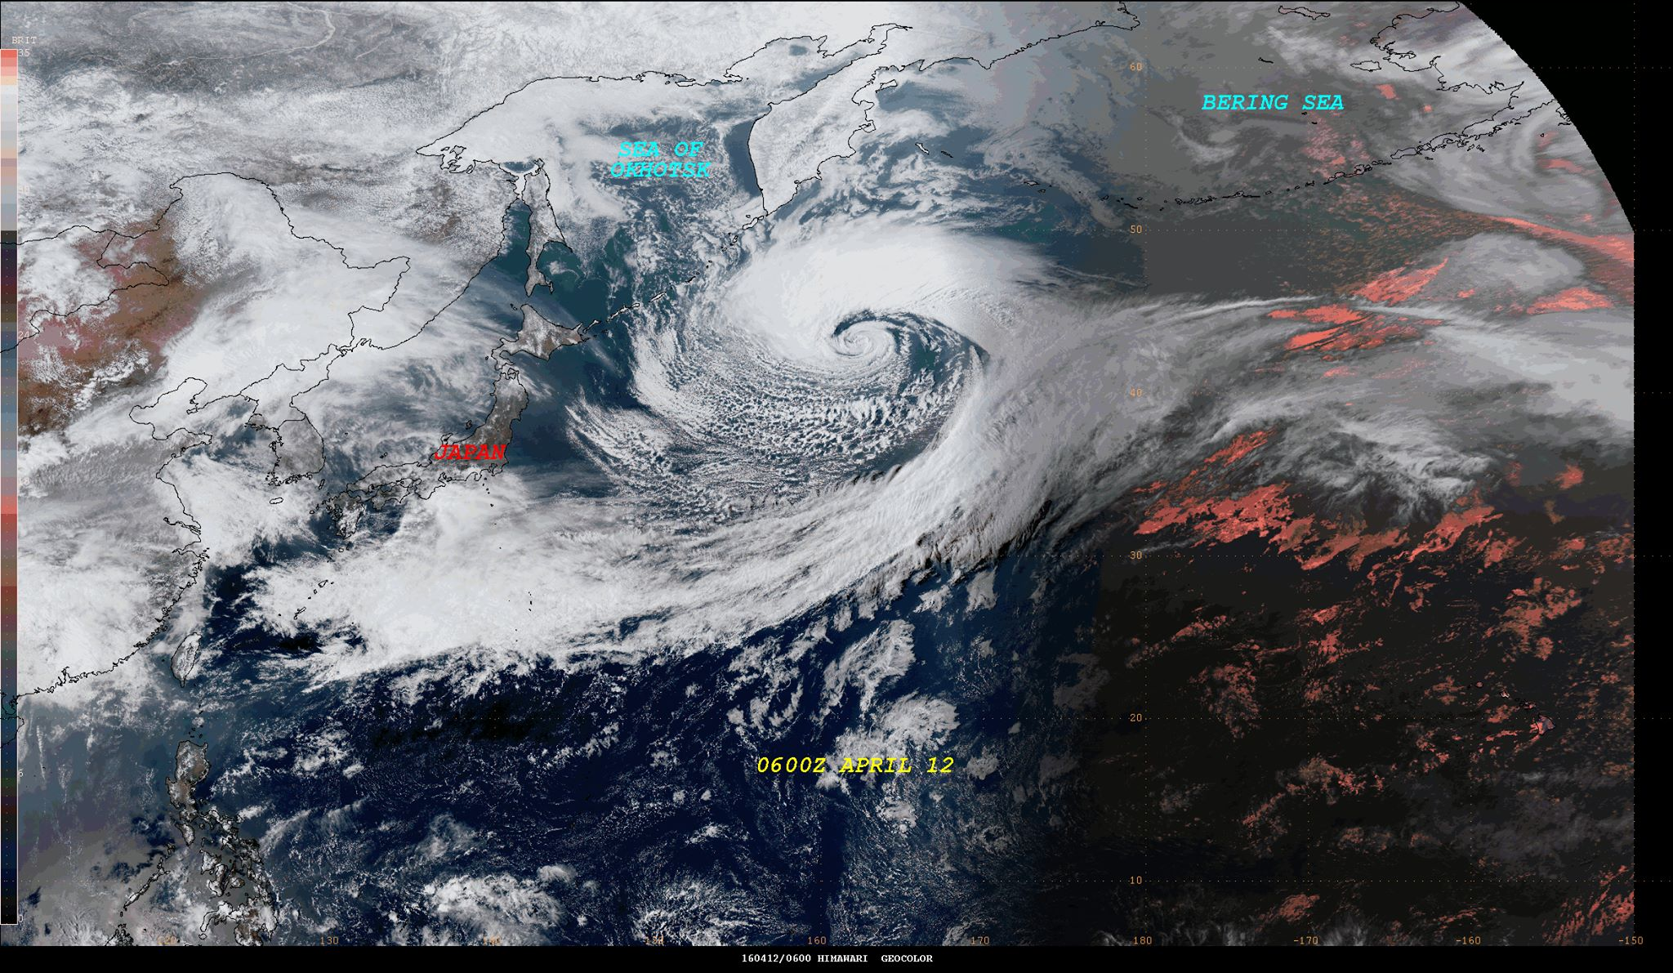
Questions?
amanda.terborg@noaa.gov
michael.folmer@noaa.gov
bill.line@noaa.gov
andrea.schumacher@noaa.gov

