Slide 1
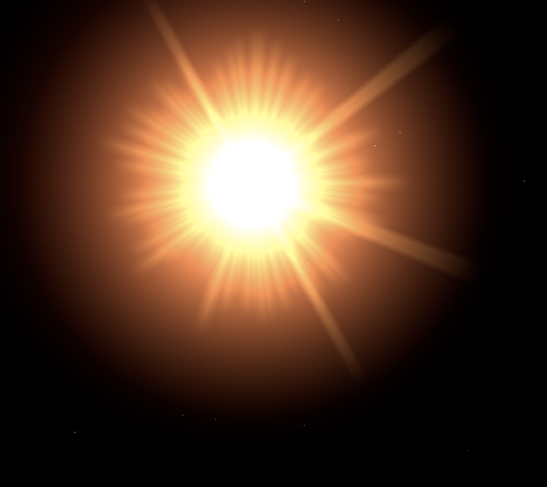
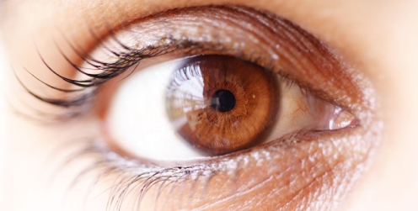
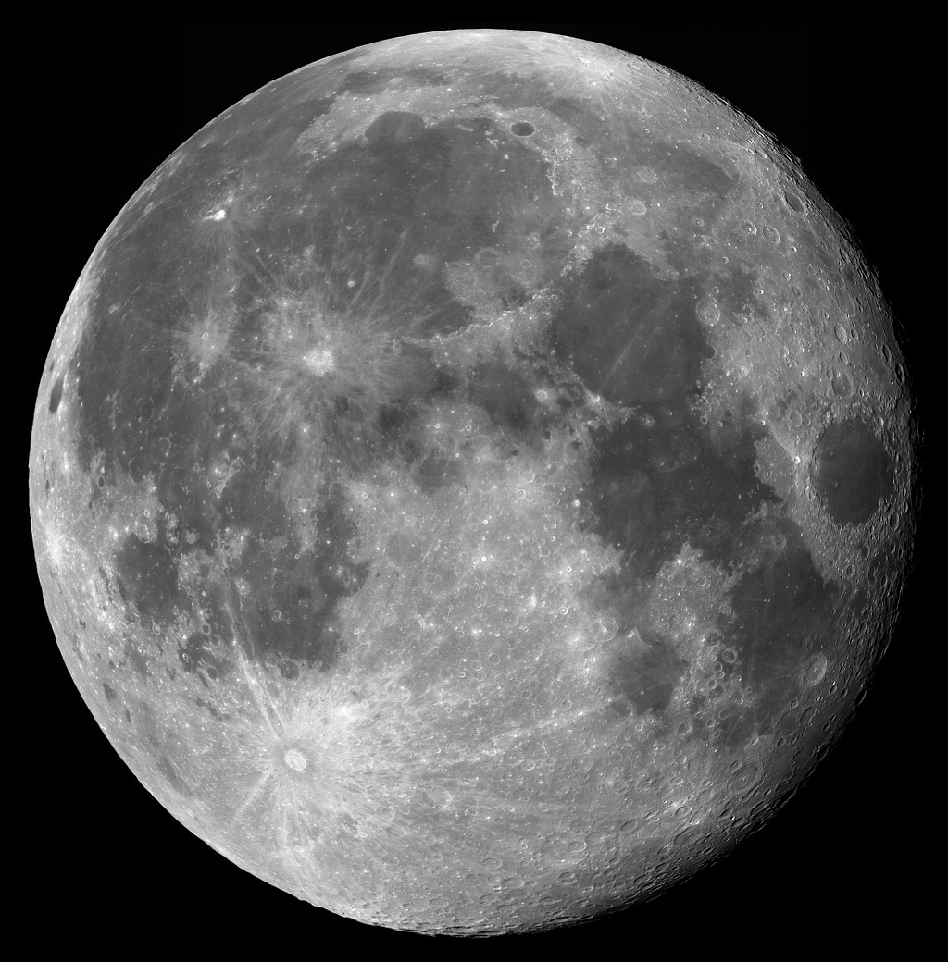
Realizing the Scientific and Operational Utilities of the VIIRS Day/Night Band—An Exercise in Dark Adaptation
Steve Miller and Curtis Seaman
Cooperative Institute for Research in the Atmosphere
Colorado State University
NOAA Satellite Science Week
Boulder, CO
26 February 2015
Notes:
Identify a science issue in the topic area and explain ongoing work to address it
List planned enhancements or improvements with GOES-R and/or JPSS over current capabilities
Include how satellite data may be fused with other datasets such as NWP
Identify any science or technological gaps that may prevent realization of the project advantages
Discuss planned user demonstrations
Use additional slides for graphics/examples, results, and/or expounding on any of the above
You will have 10-12 minutes to speak and 3-5 minutes for questions. These time constraints will be
strictly enforced, so don't try to show too many slides.

Slide 2
The Scientific Challenges
Traditionally, our ability to describe the nocturnal environment from satellite imaging radiometers has been limited to emissive bands (λ ≥ ~3.7μm).
In order to detect environmental parameters via the emissive bands, these parameters must offer some form of contrast:
Spatial contrast against the background (e.g., single band brightness temp)
Spectral contrast vis-à-vis other bands (i.e., multi-spectral emissivity differences)
Temporal contrast (requires adequate sampling interval)
Detection challenges in this regard include:
Low clouds and fog, particularly in marine environments (larger cloud particle sizes and moist lower atmosphere)
Optically thin aerosol (aeolian dust, volcanic ash)
Fine-mode aerosol (small size parameters at thermal IR)
Surface properties (snow cover, sea ice, flood plains)
The masking effect of ‘thin’ cirrus (which are optically thick in the IR)
Quantitative descriptions (e.g., retrievals clouds and aerosol optical depth) are further limited by the sensitivity range of signals in the emissive bands.
→ We are accustomed to lower expectations at night, making the most of what’s available and accepting the inevitable shortfalls of ‘being in the dark.’

Slide 3
Improvements Realized by the Day/Night Band
The Day/Night Band (DNB) on Suomi NPP’s Visible/Infrared Imaging Radiometer Suite (VIIRS) offers low-light sensitivity:
3.0 e-5 W m⁻² sr⁻¹; Noise floor at ~5.0 e-7 W m⁻² sr⁻¹
~500-900 nm spectral response
0.742 km resolution ~constant across 3000 km swath via 64 aggregation modes
Traditional detection challenges are mitigated by the inclusion of reflective contrast information (when moonlight is present).
The relative transparency of cirrus at visible wavelengths enables cloud overlap (thin over thick) detection, and reveals sea ice.
Cloud characterization is enabled by the broad-ranging sensitivity of visible reflectance to optical depth.
→ Examples to follow highlight a subset of the benefits possible from low-light measurements, with a high-latitude emphases (but applicable worldwide!)

Slide 4
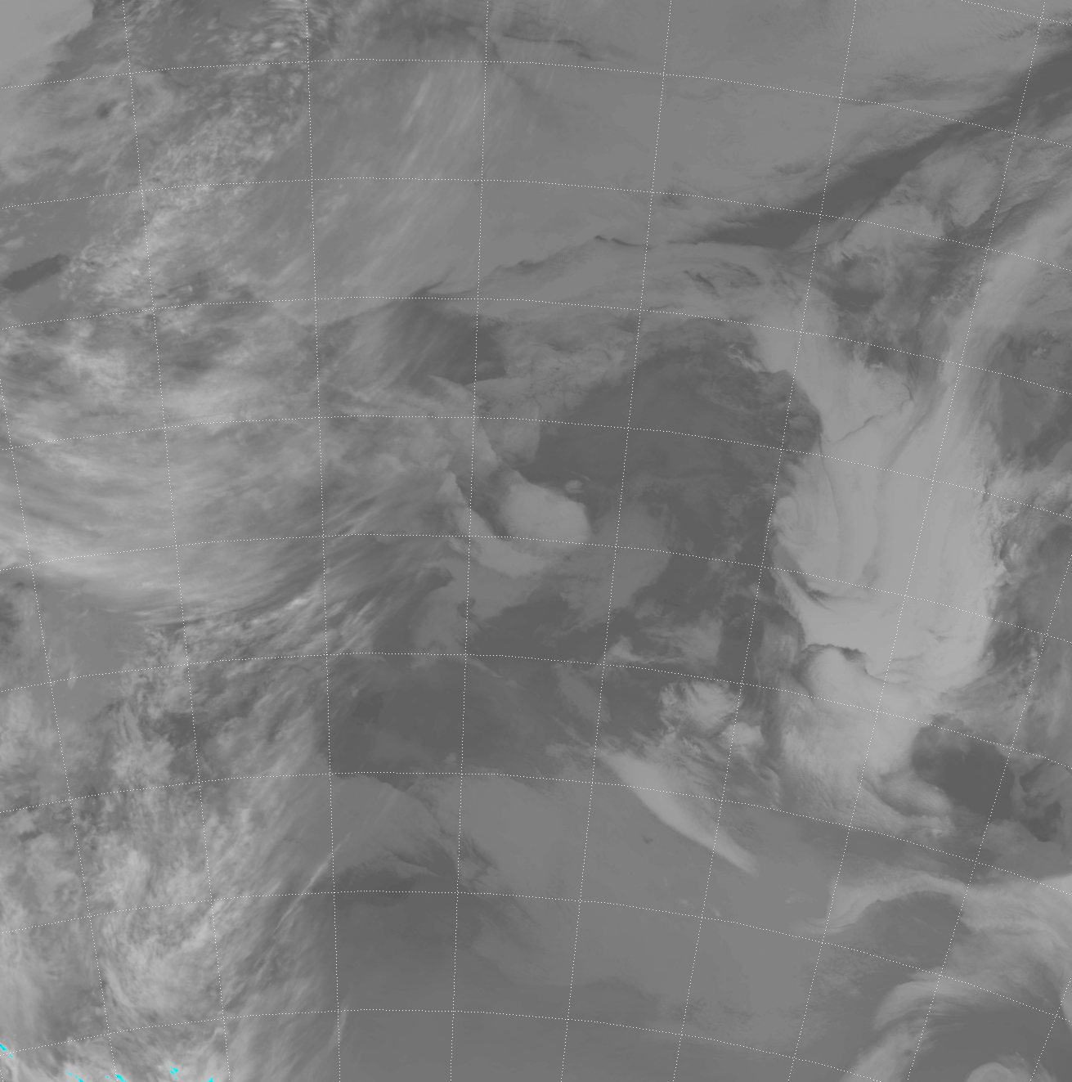
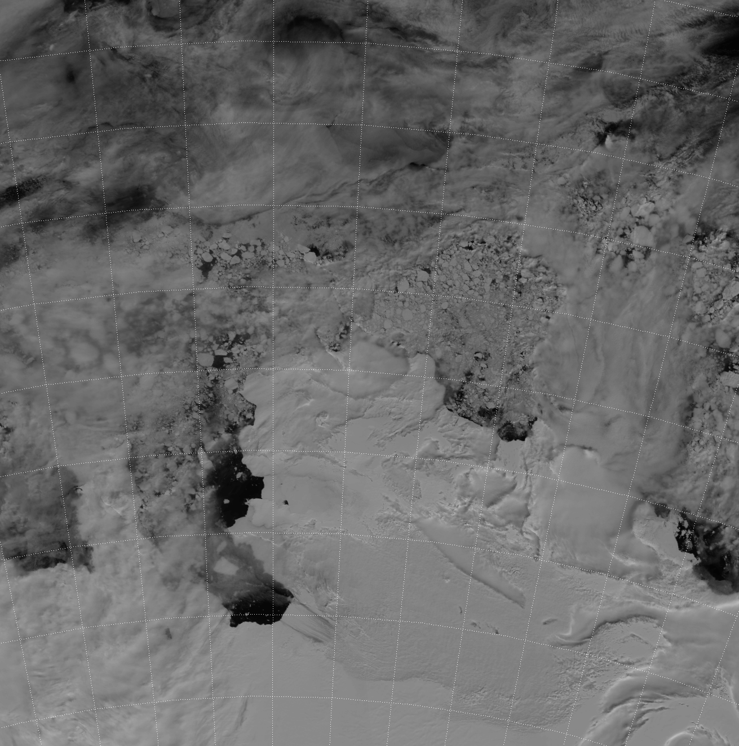
What Lies Beneath…
Strong scattering (low absorption) of cloud particles at visible wavelengths makes cirrus optically thin and hence semi-transparent
Asunción, Paraguay
Southern
Ocean
Argentina
Antarctica
DNB reveals low clouds/fog missed by infrared! …and sea ice below clouds!

Slide 5
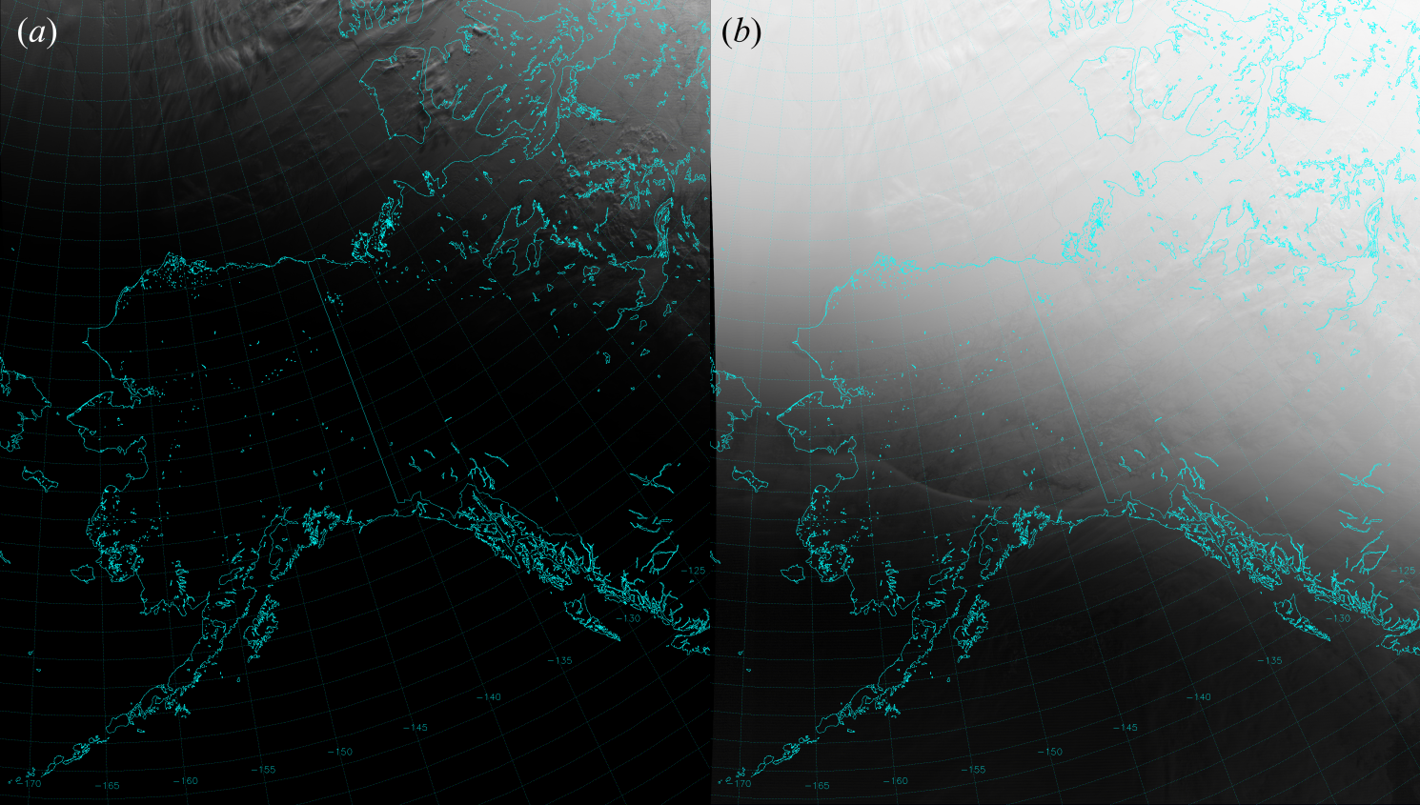
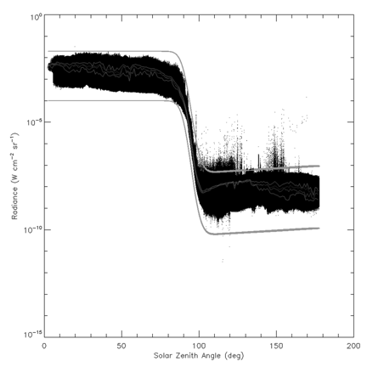
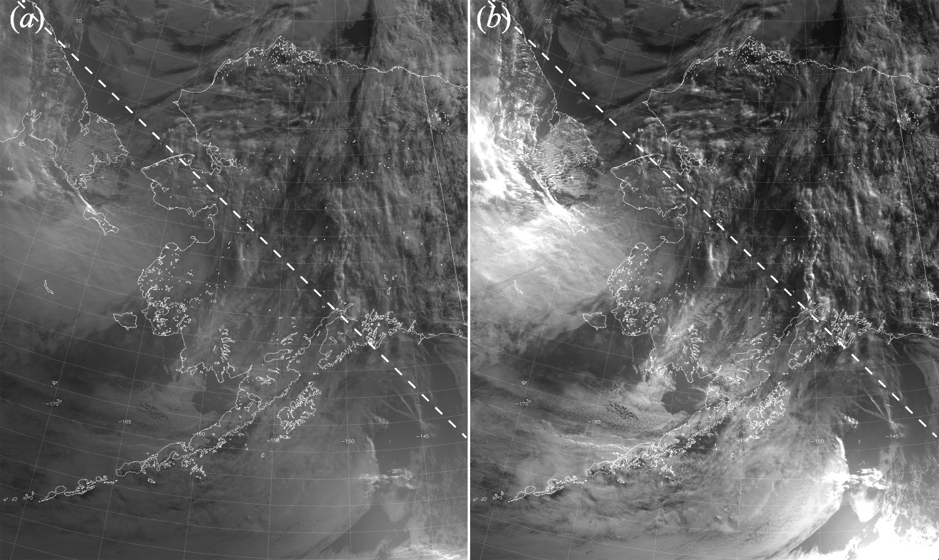
Dynamic Imagery Scaling
Linear Scaling Logarithmic
Sunset
Terminator
Alaska
Night
ERF Scaling NCC Product
Owing to the ~7 order of magnitude dynamic range from day to night, scaling in the terminator region can be tricky…
Prior to working out the kinks in the Near Constant Contrast (NCC) product, several methods were attempted…linear, log, piece log, etc.
Sunset
Terminator
Seaman et al. (2015) describe a non-linear log scaling based on the structure of the ‘error function’ (erf).
Its performance has been found to be on-par with, and in some cases better than, the quality of the NCC product.
Night

Slide 6
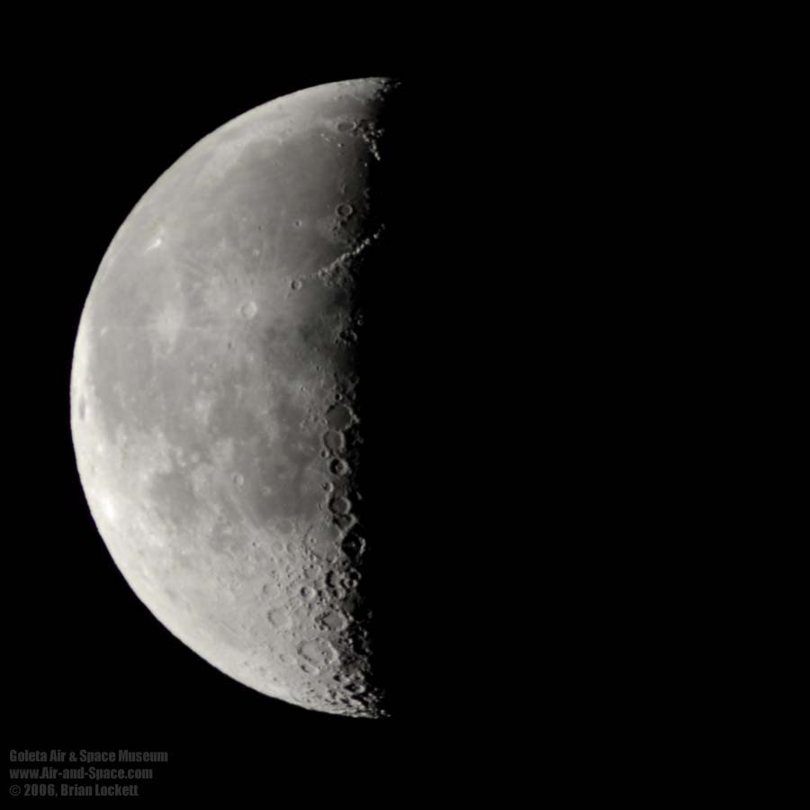
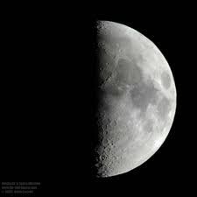
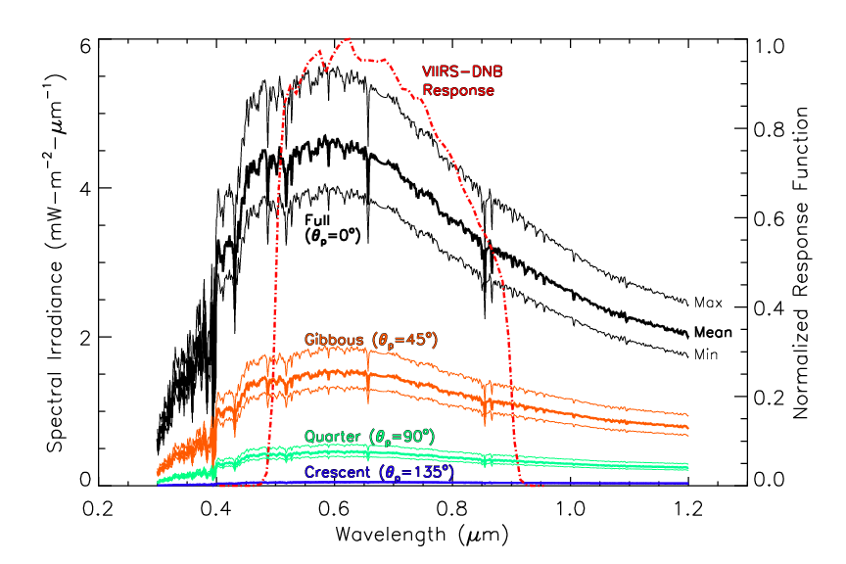
Lunar Model…
Computes lunar irradiance spectra (0.3-1.2 μm) for current date & time.
Convolve with DNB response function, φ(λ), to yield in-band irradiance (W/m²)
Model Irradiance (E) enables calculation of Lunar Reflectance (R) from the measured DNB Radiance (L) as follows:
R = π L / (cos(θ_{m}) E)
(where θ_{m} is the lunar zenith angle)
Miller and Turner (2009)
Spectra of top-of-atmosphere downwelling lunar irradiance for different lunar phases. Mean values shown in bold along with min/max ranges. DNB response function is superimposed (red-dash).

Slide 7
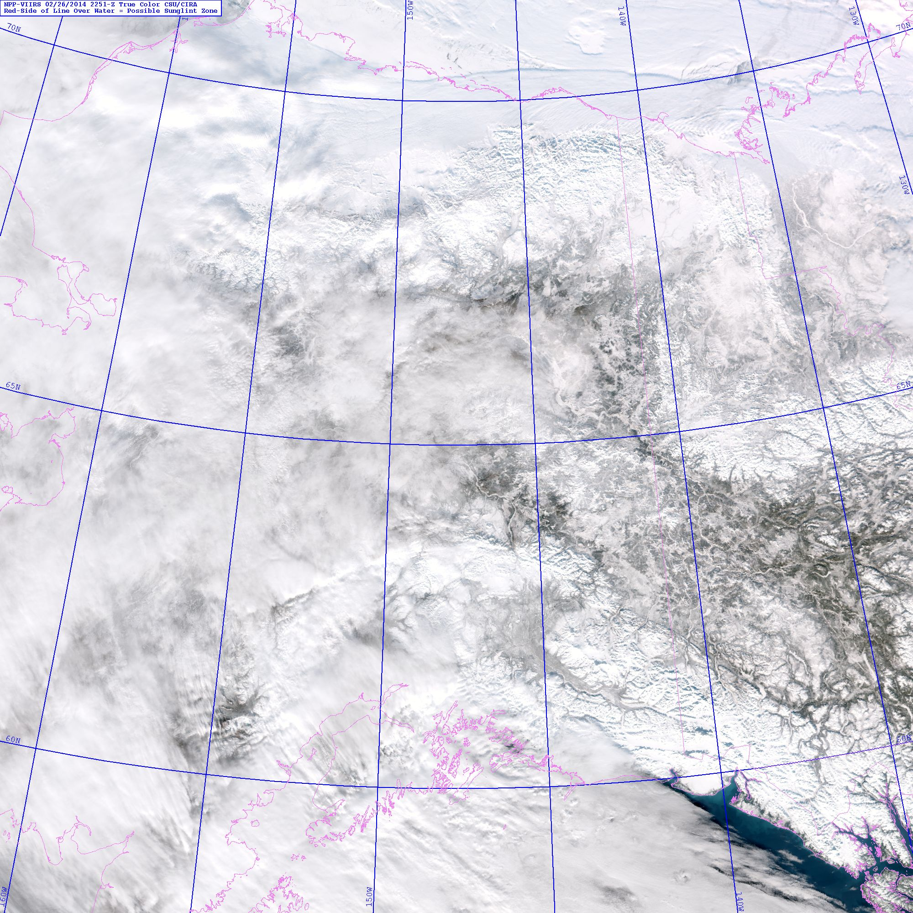
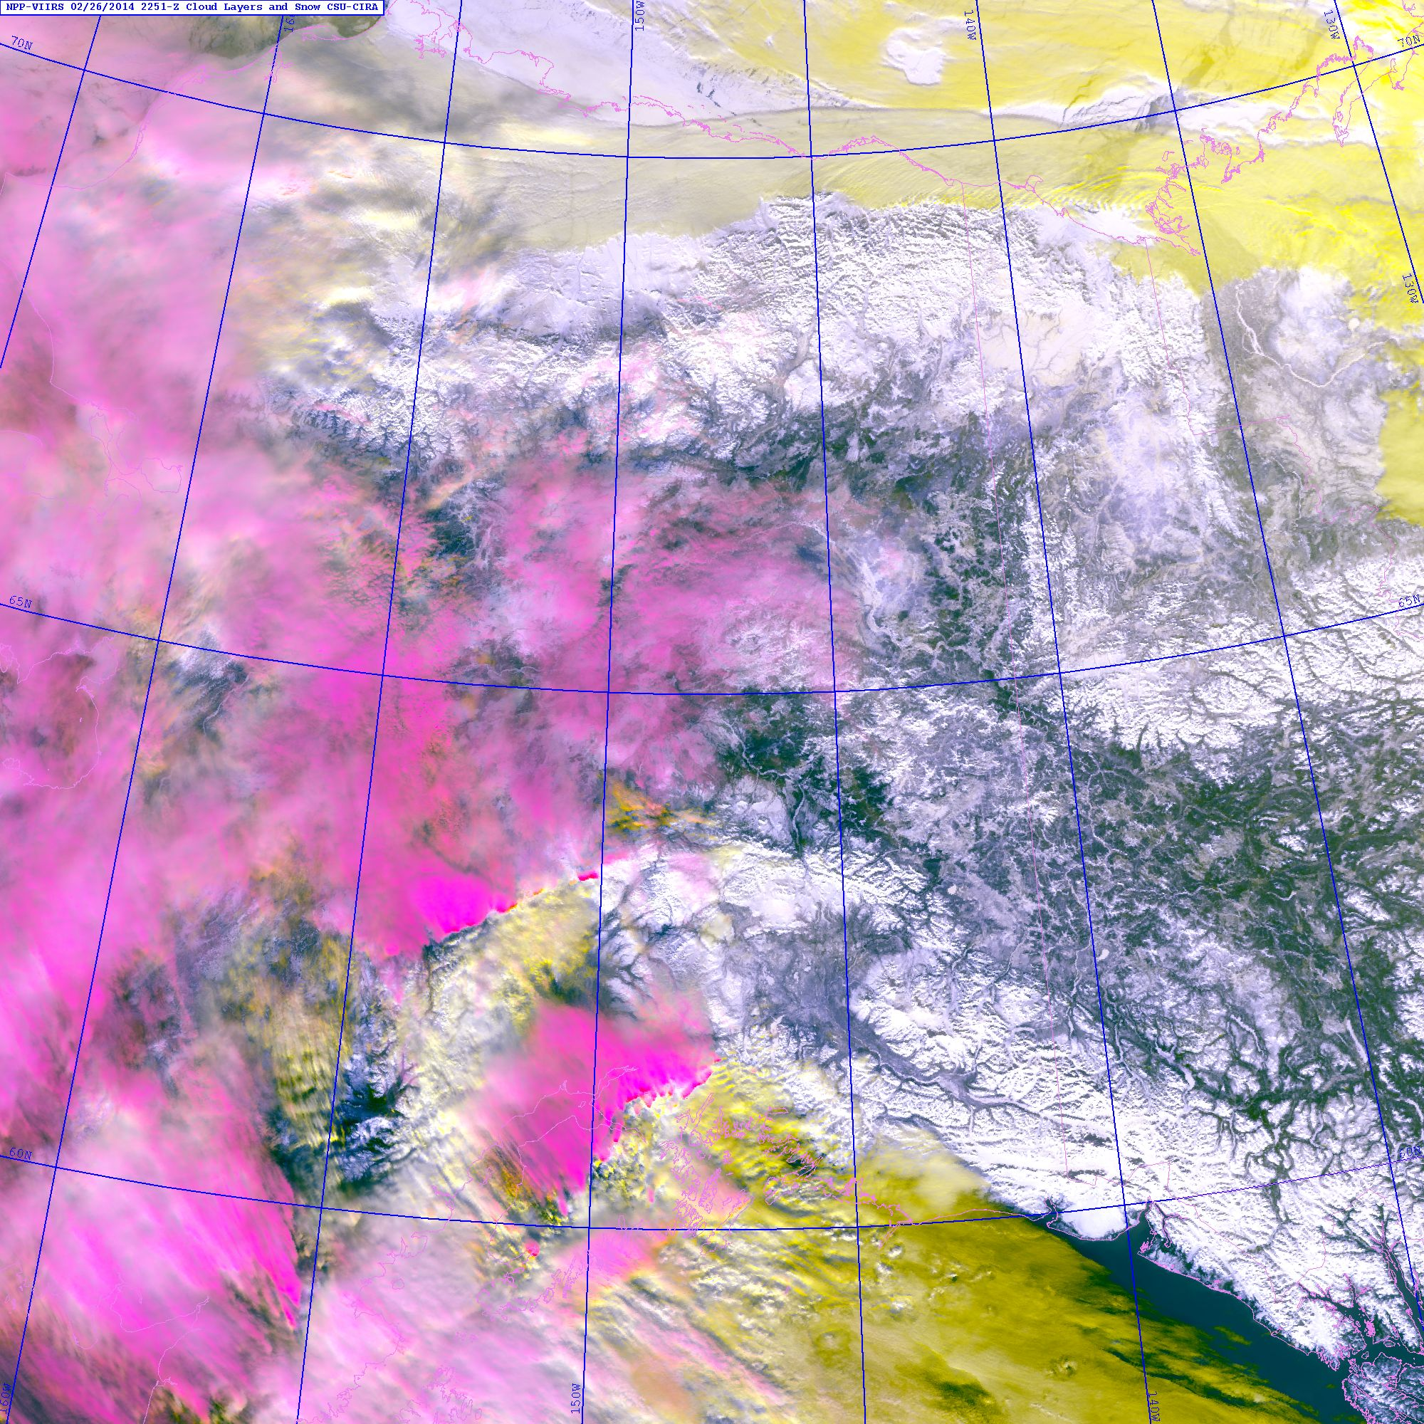
…Enabling Traditionally Daytime Applications at Night
Multi-spectral daytime techniques for distinguishing between snow fields, low/liquid clouds, mixed phase and high (ice) clouds work well during the day →
Alaska
With Day/Night Band lunar reflectance, we can attempt to replicate the performance of this algorithm at night.
Predicated on conventional emissive band techniques for cloud detection and lunar reflectance for snow/ice.
Enables survey of snow cover in regions that may have been cloud-obscured during the daytime pass.
→ Better high-resolution snow mask
Based on Miller et al (2005)

Slide 8
Example: Snow/Ice at Night Application Over Alaska Region
Aleutians
Promising, but not perfect; still working out the kinks.
Could prove useful for Ice Desk, or forecasting radiation fog if coupled with NWP information.
240 250 260 270

Slide 9
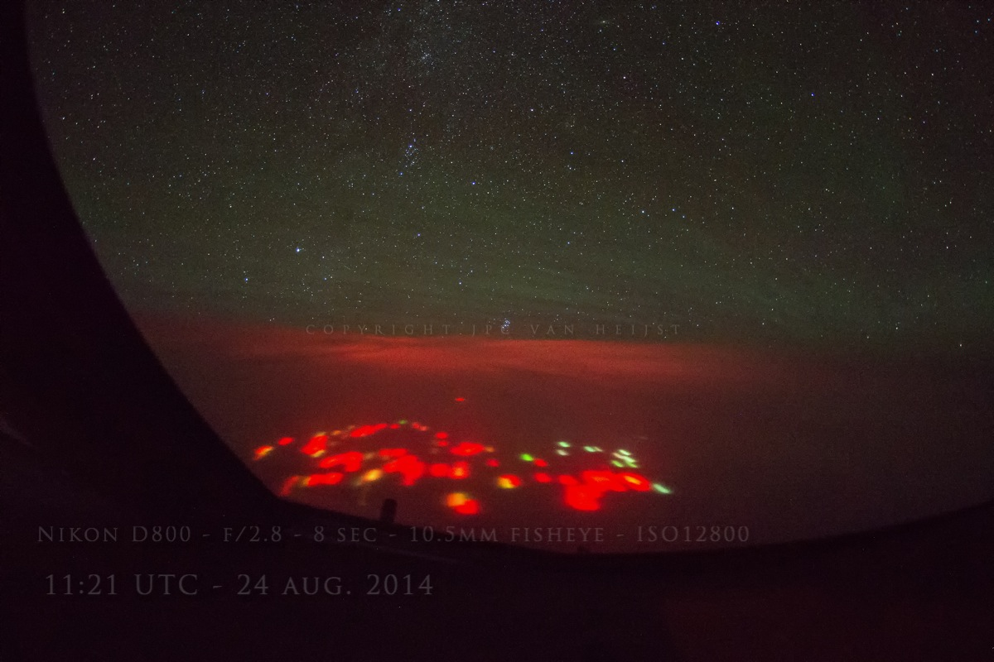
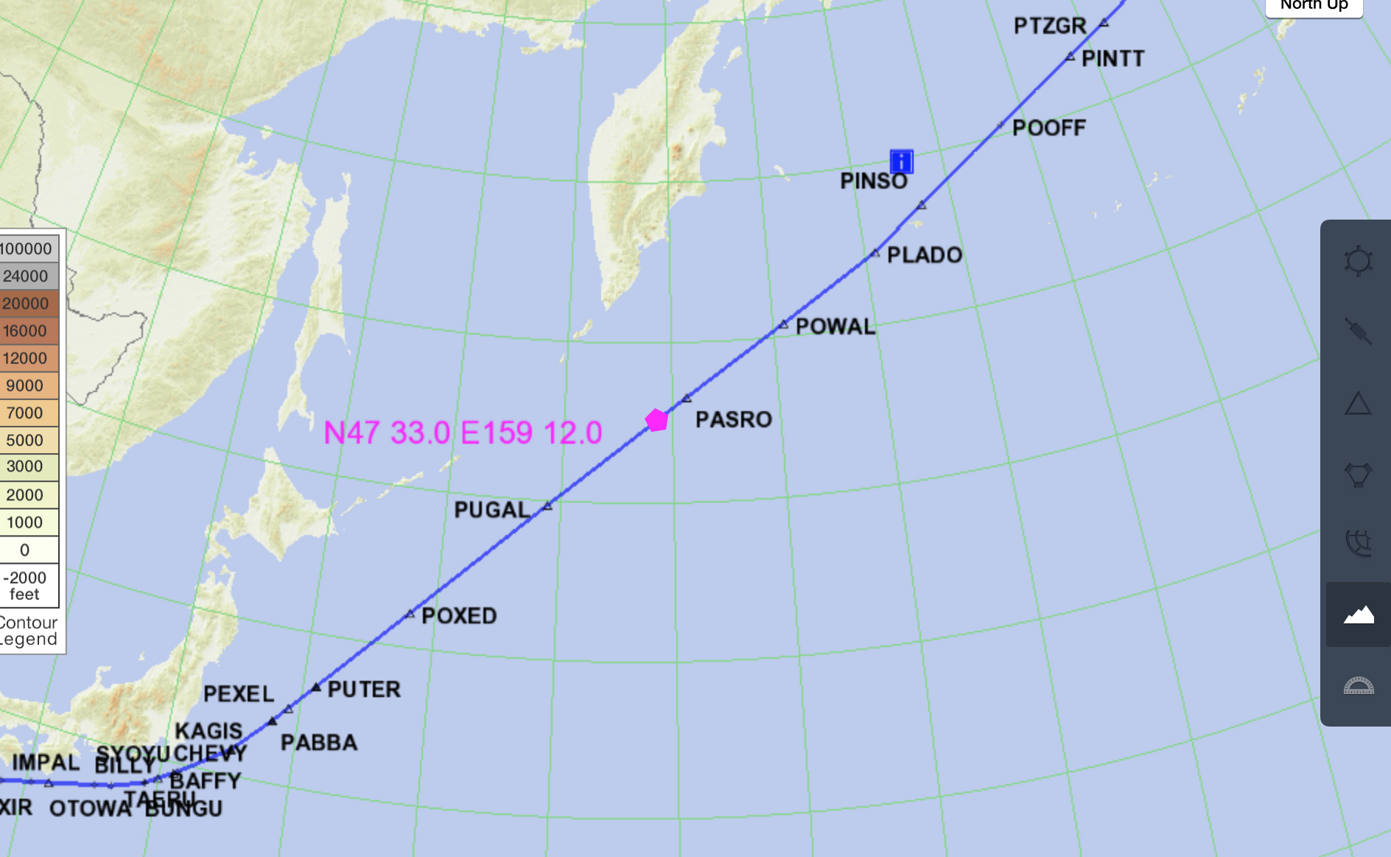
Shedding Light on Great Mysteries
Credit: JPC van Heijst
The only source of this red glow that we could think of was the explosion of a huge volcano just underneath the surface of the ocean.
Last night over the Pacific Ocean, somewhere South of the Russian peninsula Kamchatka I experienced the creepiest thing so far in my flying career…
--JPC ‘Flying Dutchman’ van Heijst (Commercial Airlines Pilot), 24 August 2014
… Rest easy, Flying Dutchman; this time it was only a fleet of ships, observed over multiple successive nights with the Day/Night Band.
Notes:
From Seaman DNB Poster:
On 24 August 2014, seasoned pilot and photographer JPC van Heijst captured this photograph (left) of “the creepiest thing so far” in his flying career – mysterious red and orange lights over a remote part of the North Pacific Ocean. The VIIRS DNB (right) saw those very same lights and, after a thorough analysis, we were able to determine they were ship lights (most likely from a military exercise). Not an underwater volcanic eruption, UFOs, or earthquake lights as some people believed. Did you notice the airglow waves visible in the photograph?
http://rammb.cira.colostate.edu/projects/npp/blog/index.php/uncategorized/investigating-mysteries-of-the-deep-dark-night/

Slide 10
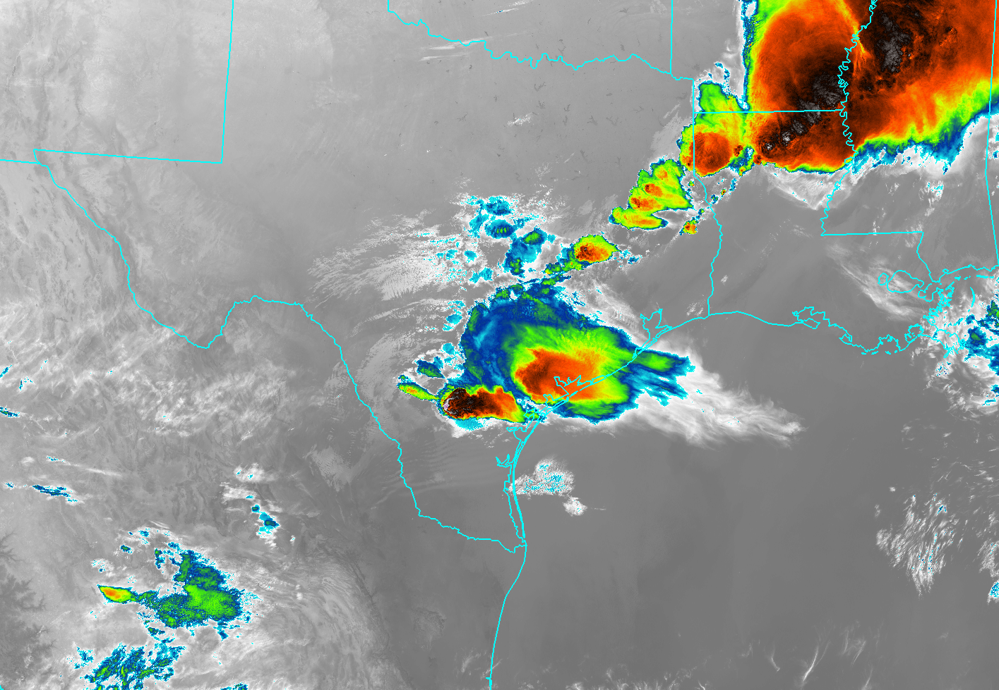
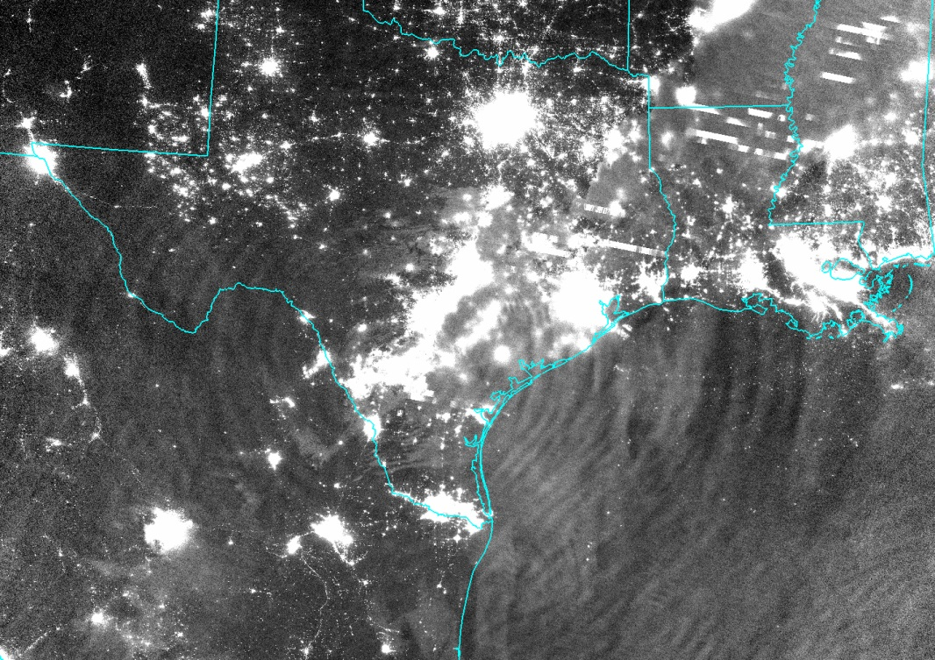
Out of Thin Air…Nightglow!
Miller et al. (2012) report on the DNB’s unanticipated capability to sense nightglow reflections/emissions.
Gulf
of Alaska
Texas
Wave breaking in upper atmosphere deposits momentum, induces drag, drives the circulation.
DNB provides the first ability to resolve gravity waves reaching the mesopause at sub-kilometer resolution.
Potential to advance global climate models at exactly the time when they are pushing their lids upward.
240 250 260 270
→ The novelty of Day/Night Band measurements presents numerous opportunities for seminal research beyond the scope of its intended mission.

Slide 11
The Operational Interfaces
Potential Synergy with NWP…
Initialization of sea ice distribution in drift models
Model verification of low cloud/fog at night, including ‘black stratus’
Combine snow field detection with NWP fields to predict radiation fog potential
Cloud water path retrievals → improved icing potential product (CIP)
Analysis of nightglow gravity waves leading to improved understanding and parameterization of momentum flux in upper atmosphere for climate modeling
Ongoing & Planned User Demonstrations…
Running ERF-Scaling on UAF/GINA machines (Tom Heinrichs & Eric Stevens), installed in CSPP (Liam Gumley and Kathy Strabala)
‘Seeing the Light’ VIIRS/DNB Blog: http://rammb.cira.colostate.edu/projects/alaska/blog/
Discussions with Amanda Terborg (NOAA/AWC) on possible correlation between convectively generated gravity waves and aircraft turbulence reports

Slide 12
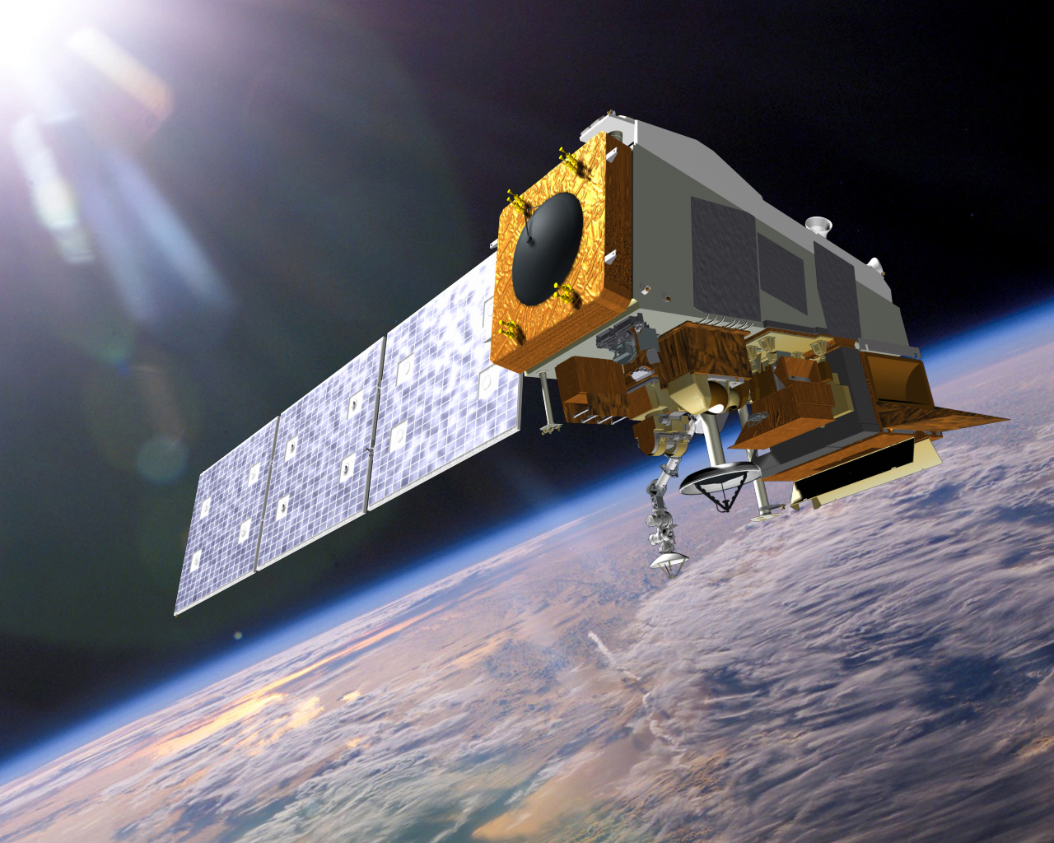
Conclusions
The VIIRS Day/Night Band has surpassed all expectations as a complement to traditional emissive bands at night.
New tools are maximizing the utility of these novel measurements for both imagery and quantitative applications.
Unexpected capabilities are presenting exciting new pathways for research and discovery!
Thanks!

