Slide 1
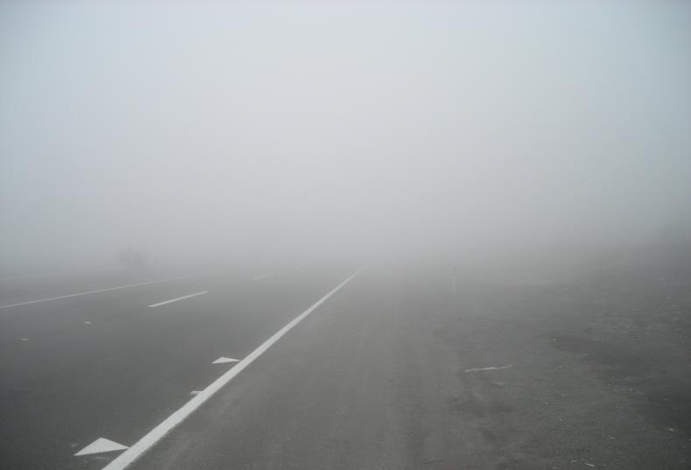
Current State of User Readiness: Fog and Low Stratus
Amanda Terborg
Andrea Schumaker
Bill Line
Chad Gravelle
Eric Stevens
Michael Folmer
Proving Ground/User Readiness
15-19 June 2015
Kansas City, MO

Slide 2
The little ‘o’
Use of the GOES-E/W proxy for NWS ‘experimental’ operations

Slide 3
Current Users
WFOs
30 offices from various regions
Alaska Region
WFO Anchorage, Fairbanks, and Juneau
Alaska Aviation Weather Unit
CWSU Anchorage
CWSUs
ZTL, ZMP, ZME, ZAB, ZLC, ZNY, ZDC, ZOB, ZHU, ZMA, ZKC, ZNC…
National Centers
Aviation Weather Center
Ocean Prediction Center
National Hurricane Center
Tropical Analysis and Forecast Branch
Storm Prediction Center

Slide 4
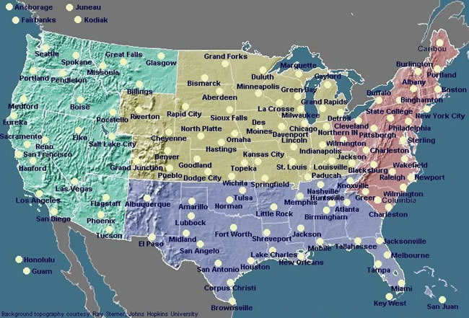
Weather Forecast Offices
WFOs formally evaluated FLS (30)
Eastern Region 8: BOX, BTV, CHS, CTP, GSP, OKX, PBZ, PHI
Central Region 10: DMX, EAX, IND, JKL, LMK, LSX, MKX, MQT, OAX, RIW
Southern Region 3: JAX, MOB, TBW
Western Region 6: EKA, HNX, LOX, MTR, PIH, SEW
Alaska Region 3: ANC, AFG, AJK
Many additional WFOs are now using these products in operations
Over 200 Area Forecast Discussion references over the last few years
WFO TBW evaluated and implemented FLS products into their environment services pilot project

Slide 5
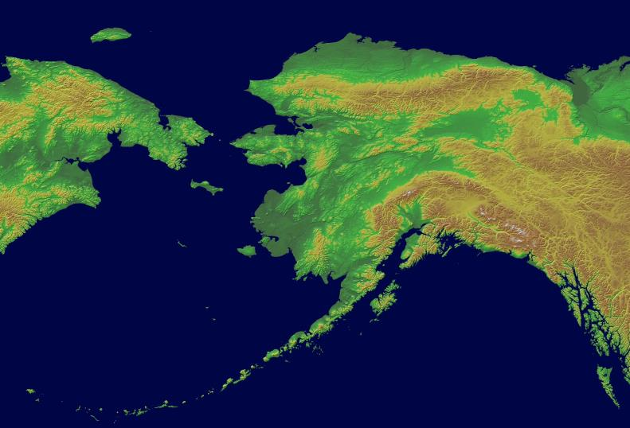
Alaska Region
In AWIPS-2 at Fairbanks, Anchorage, and Juneau
Both MODIS and GOES-W versions
Improvements
Broad areas of false positives over land in GW version
High probabilities of FLS conditions over land when it is clear
Issue fixed recently
Scale bar issue, AWIPS expecting a 0-255 scale, not 0-100
Fixed in Fairbanks
Uses
FLS is used in conjunction with other products like the Microphysics, old channel differencing, various obs, etc., to increase confidence of conditions

Slide 6
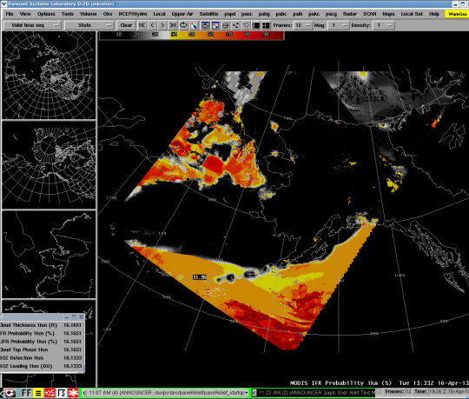
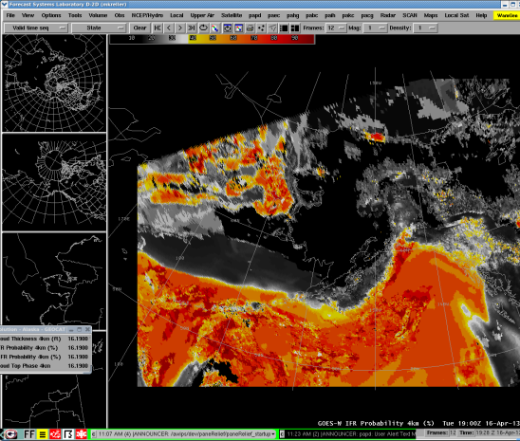
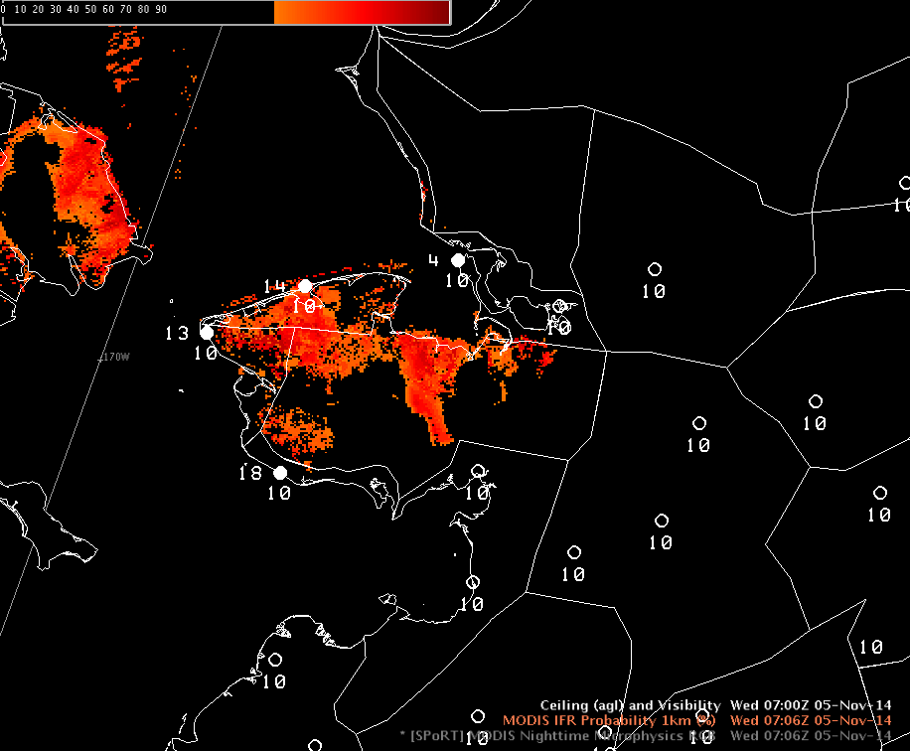
Alaska Region

Slide 7
Alaskan Aviation Weather Unit Alaska Region
Available in AWIPS-2 via WFO ANC
MODIS version
GOES-W version
Used for ceiling and visibility forecasting over Alaska
Used in conjunction with Day/Night band
Also used in conjunction with RGB Microphysics
At the 2015 OCONUS meeting it was noted that in Alaska where observations are very few (and hence there is less data for model input), there can be biases in the product at times and in certain areas

Slide 8
Alaskan Aviation Weather Unit Alaska Region
August 12th, 2014 – FLS used over Alaska, but due to model issues (i.e. lack of observations) over Alaska terrain, etc., some biases were noted.
High Bias?
Low Bias

Slide 9
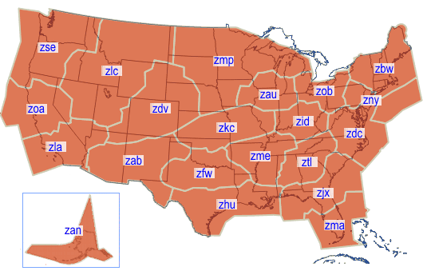
Central Weather Service Units
Anchorage CWSU
In WFO ANC AWIPS-2
Both the IFR/LIFR probs and the cloud phase are used
MODIS version
Finer detail is great
Latency not so much, even in Alaska. It’s difficult to determine fog/low stratus behavior from polar swaths
Used in conjunction with Nighttime Microphysics at times
GOES-W version
Used fairly regularly despite lower resolution at high latitudes
Examine behavior of fog

Slide 10
CWSUs
CONUS CWSUs
Availability
AWIPS2 for those co-located with a WFO
Web displays for others who are interested
Exposure during the AWC’s summer experiments
ZTL, ZMP, ZAU, ZME, ZAB, ZLC, ZNY, ZOB, ZHU, ZMA, ZKC, ZMA…
AWT Summer Experiment 2015
ZOA, ZDV, ZOB, ZDC, ZHU, ZME

Slide 11
National Centers Aviation Weather Center
Introduced in early 2012, transitioned to ops in late 2012 on N-AWIPS.
Will be pulled into AWIPS-2 D2D for the 2015 Summer Experiment ceiling and visibility desks
Heavily used by National Aviation Meteorologists for ceiling and visibility forecasting around major terminals
There have been a number of cases in which the use of the FLS has saved $$ in extra fuel costs
Also used by G-AIRMET forecasters for ceiling and visibility snapshots and occasionally by CSIG or CAWS forecasters to help identify where fog may have prevented necessary heating for convection later in the day
Use occasionally in conjunction with GeoColor imagery to further identify IFR and LIFR conditions

Slide 12
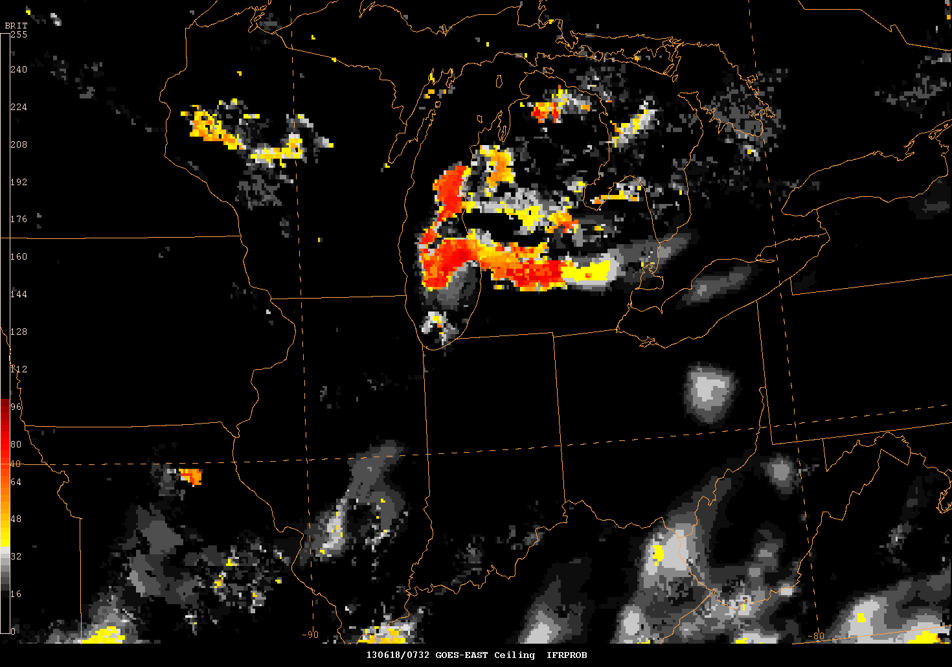
National Centers Aviation Weather Center
June 16, 2013 – ORD
GOES-R FLS showing expanding area of high IFR probabilities over Lake MI
NAM called ZAU to discuss and TAFs were updated
FAA was notified of major changes
Airport operations changes made to accommodate the IFR conditions.

Slide 13
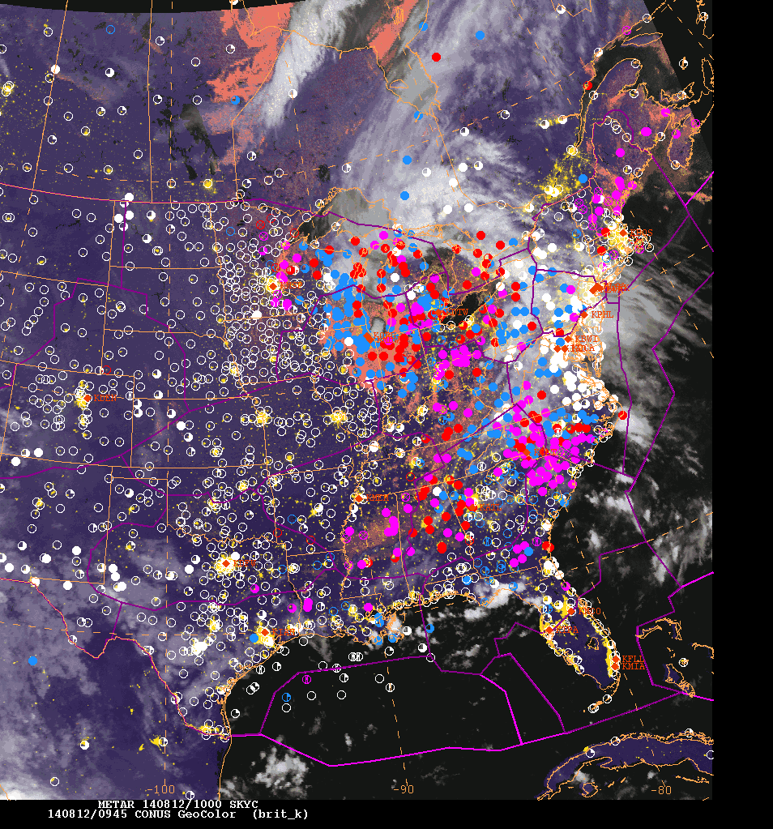
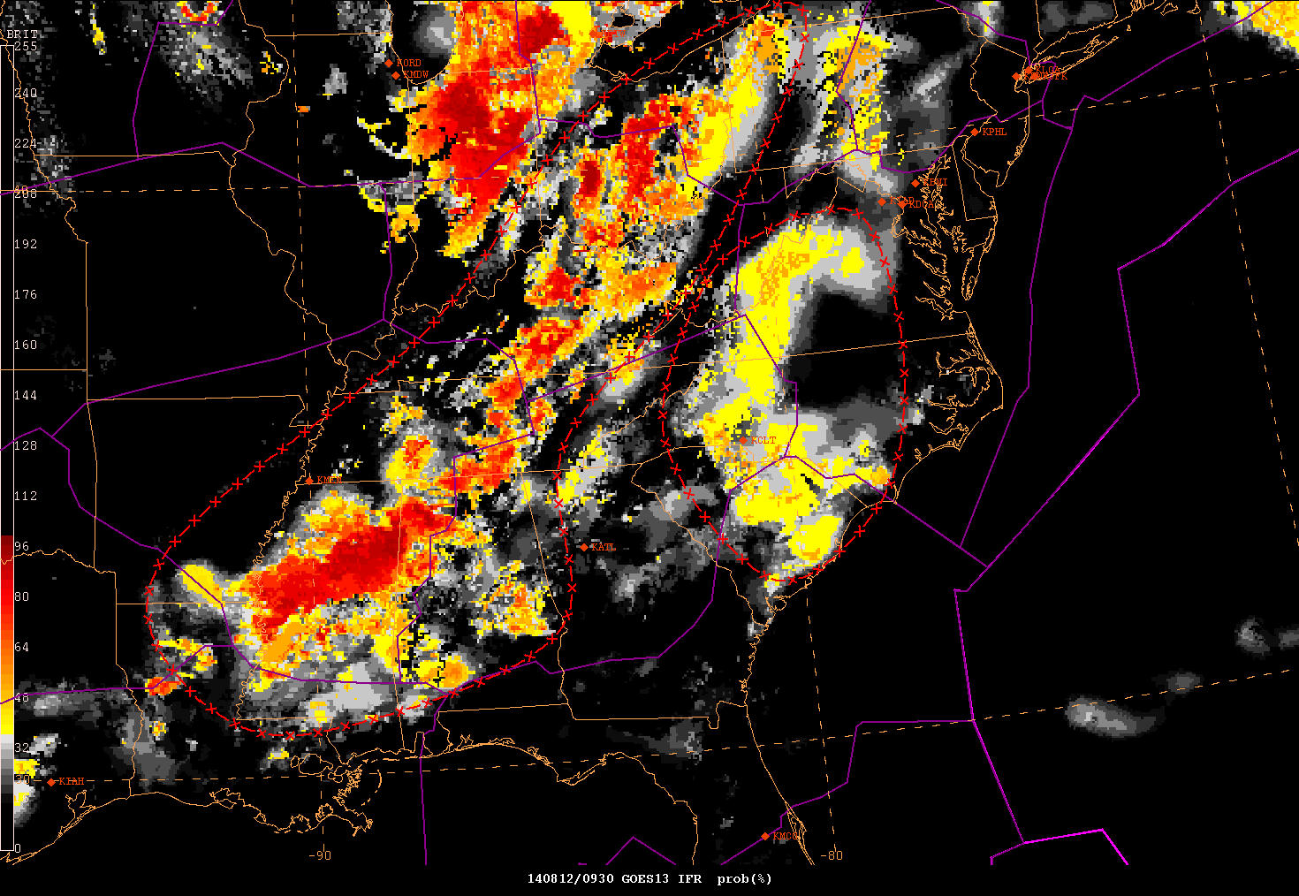
National Centers Aviation Weather Center

Slide 14
National Centers Ocean Prediction Center and Tropical Forecast Analysis Branch
The first FLS introduction occurred in late January 2015 at TAFB and early March 2015 at OPC, both in N-AWIPS
An official training module is being developed by Michael Pavolonis (NESDIS/STAR) and Corey Calvert (UW-CIMSS).
Early feedback suggests the IFR and LIFR Probability have been most popular at TAFB for identifying and confirming potential fog in the Gulf of Mexico or northeast of Florida.
OPC had an opportunity to use the product during a real-time USCG medivac mission 70 nm west of Portland, OR in coordination with the Portland WFO on 06/05/15.

Slide 15
National Centers Ocean Prediction Center
Evaluating LOW ST deck along N TX coast overlayed with surface observations to adjust GFE weather grids for text products. ~Martin Nelson

Slide 16
On the morning of 06/05/15, a call was transferred to OPC from the Portland WFO requesting a forecast for the heavy fog and low stratus located ~120 nm west of the Columbia River Bar. A ship sent a distress call to the US Coast Guard requesting a medevac, but conditions were too unsafe. Todd Shaw (OPC) answered the call and used the LIFR product along with the GeoColor imagery and ancillary data to forecast a continuation of <1 mile visibility and low ceilings. The ship had to move west away from the fog bank to within 70 nm west of the Columbia River Bar where a successful medevac occurred.
Full Story: http://www.d13.uscgnews.com/go/doc/4007/2541374/

Slide 17
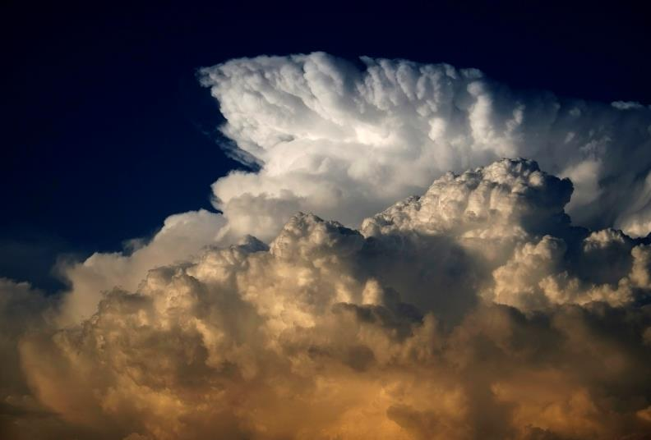
National Centers Storm Prediction Center
Not yet fully introduced, but will be in the future
Concepts…
Identifying where low clouds are, especially before sunrise
Where will differential heating boundaries set up during the day?
Cloud thickness
How long will it take clouds to dissipate?
How much heating will occur for convective activity later in the day

Slide 18
The big ‘O’
Use of the GOES-E/W proxy for official NWS operations

Slide 19
Future
Current ‘experimental operational’ status to continue until the product is implemented operationally
Supports the effort to transition the product as officially operational, i.e. the big ‘O’
Current development in the works on the MODIS/VIIRS versions of the product
Combined GEO/LEO product
Fog and Low Stratus current GOES proxy to be implemented operationally in October
Planned transition for the GOES-R product in the works but not yet approved

Slide 20
Questions
Thank you!

