Slide 1
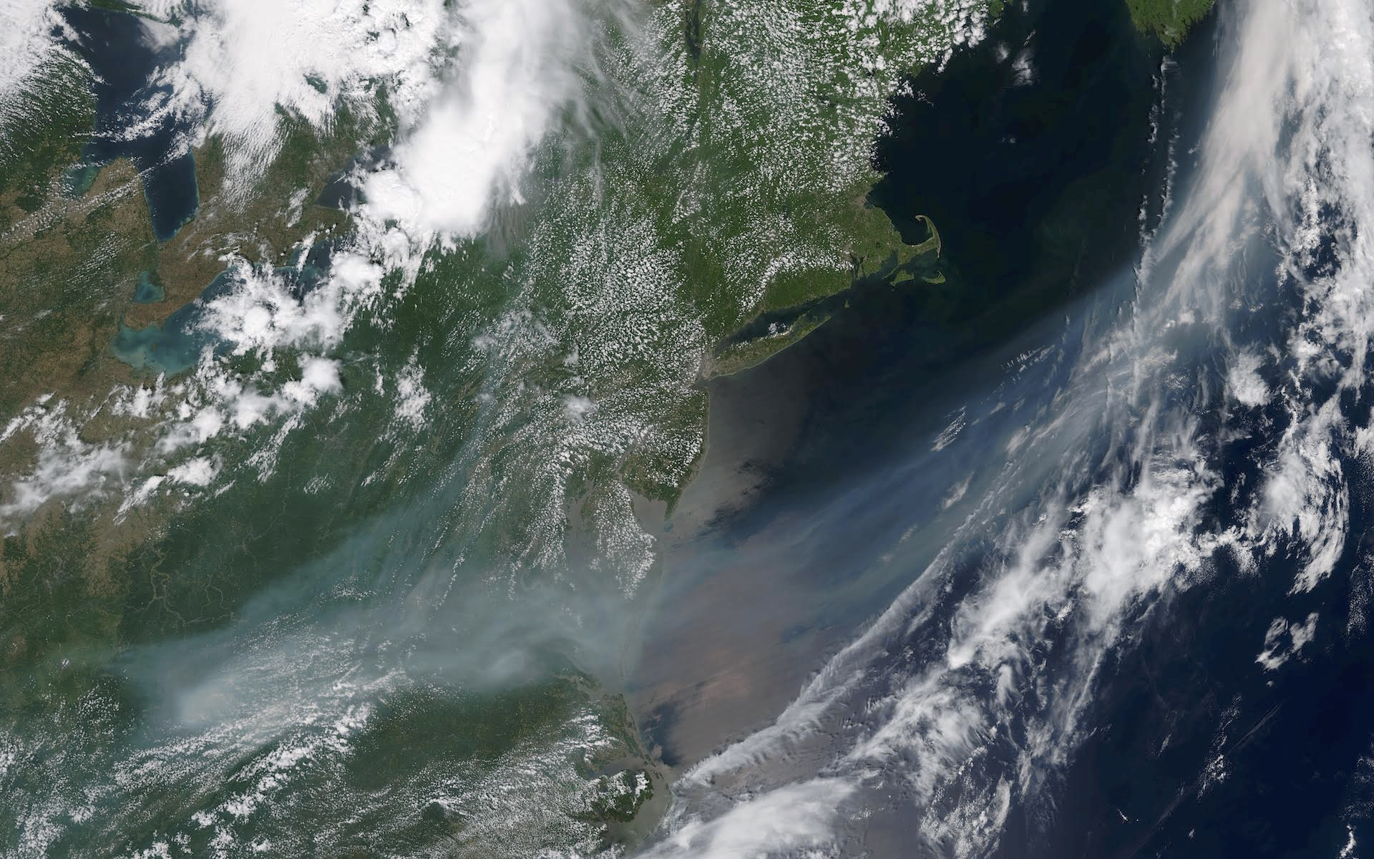
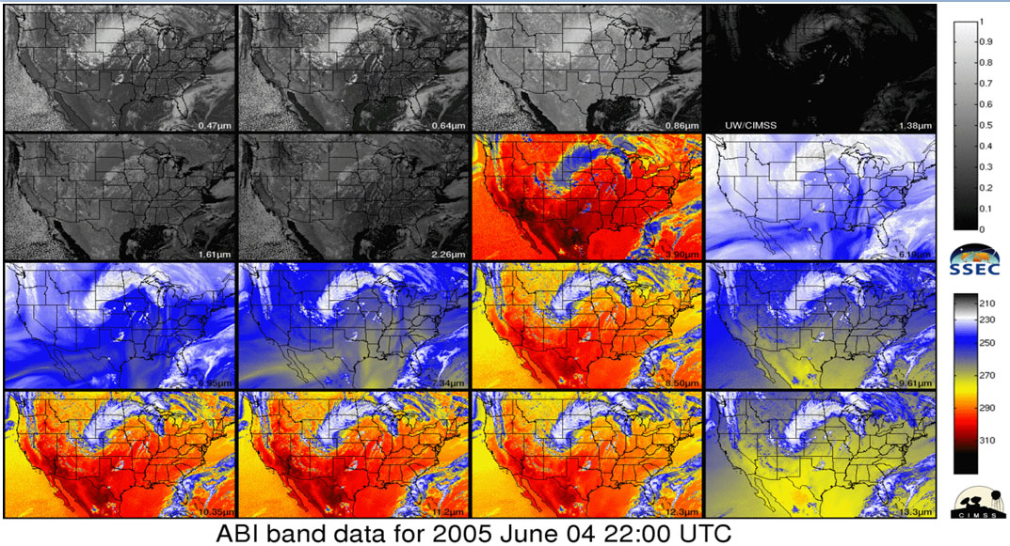
STATUS On STAT REPORT TASKS
Anthony Mostek
Chief, Forecast Decision Training Division (FDTD)
LeRoy Spayd
NOAA/National Weather Service
Office of Chief Learning Officer (OCLO)
Jim Gurka
CICS/ U.MD

Slide 2
STATUS On STAT REPORT TASKS
Contributors
Regional Scientists (NOAT)
Satellite Liaisons (Total of 11)
SOOs (STAT Team)
JPSS & GOES-R Programs
Coop Institutes: CIMSS, CIRA, CIMMS, CICS
UCAR/COMET
NASA/SPoRT

Slide 3
STAT TRACKING SPREADSHEET
Purpose:
- Monitor available resources, schedules, deliverables
- Track progress in meeting schedule deadlines for GOES-R
Satellite Foundational Course (SatFC) development.
- Provide comprehensive information on 40 mini-modules
that comprise SatFC GOES-R.

Slide 4
STAT TRACKING SPREADSHEET
Information Provided for Each Module:
-Material to be covered and training objectives;
* Objectives #1 – 105 listed in separate document;
- Run time- ranging from 5 to 30 min per module plus two 60 min simulations
- Lead office and POC for module development;
* Lead offices include: COMET, NESDIS, CIMSS, CIRA, OCLO, & SPoRT
- Existing training resources for each topic & changes needed
to existing resources;
- Training ready date and progress toward meeting deadline;

Slide 5
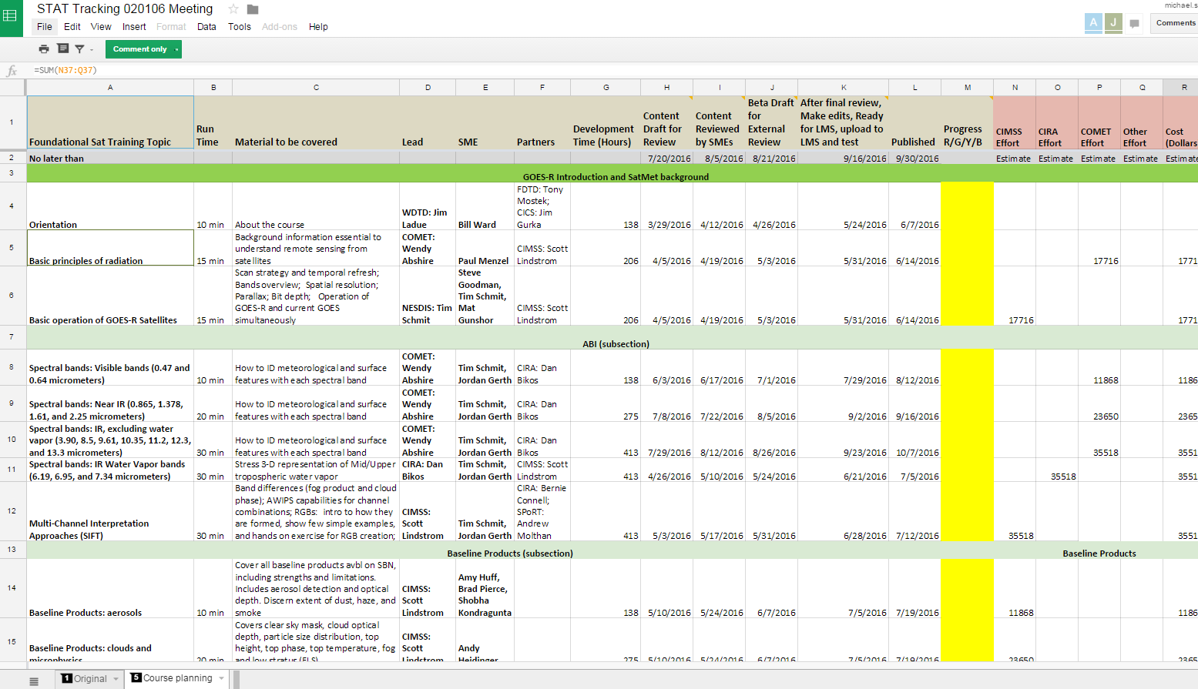
STAT Tracking Doc
Guiding the development of Sat Foundational Course - GOES-R
40 modules
Each 5-30 min
Total time 8.5 hrs.
Will be “SatFC-G” in CLC/LMS
Notes:
The Tracking Doc is guiding the main STAT activities right now.
Weekly calls ongoing

Slide 6
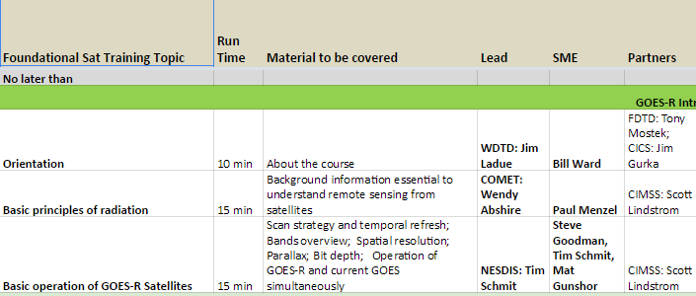
STAT Tracking Doc
1.
2.
3.
41.
Notes:
Zoom
Module, Estimated time to complete, Content, Lead, SME, Partners

Slide 7
STAT TRACKING SPREADSHEET
Latest Dates for Each Stage of Foundational Training Development:
-Content Draft for Review:
* 7/20/2016;
- Content Reviewed by Subject Matter Experts:
* 8/5/2016;
- Beta Draft for External Review:
* 8/21/2016

Slide 8
STAT TRACKING SPREADSHEET
Latest Dates for Each Stage of Training Development:
-Upload to CLC/Learning Management System & Test:
* 9/16/2016
- Publish Date:
* 9/30/2016
- NWS AA Announces SatFC via allhands email just after launch on 10/13/2016*

Slide 9
Training Development Status
- Status of each module provided as R Y G B coding:
* Red = missed deadline
* Yellow = tight schedule to meet deadline
* Green = on track to meet deadline
* Blue = training completed
- Status as of 5/5/16
* Green: 19 modules
* Yellow: 19 modules
* Red: 2 modules
* Blue: 0

Slide 10
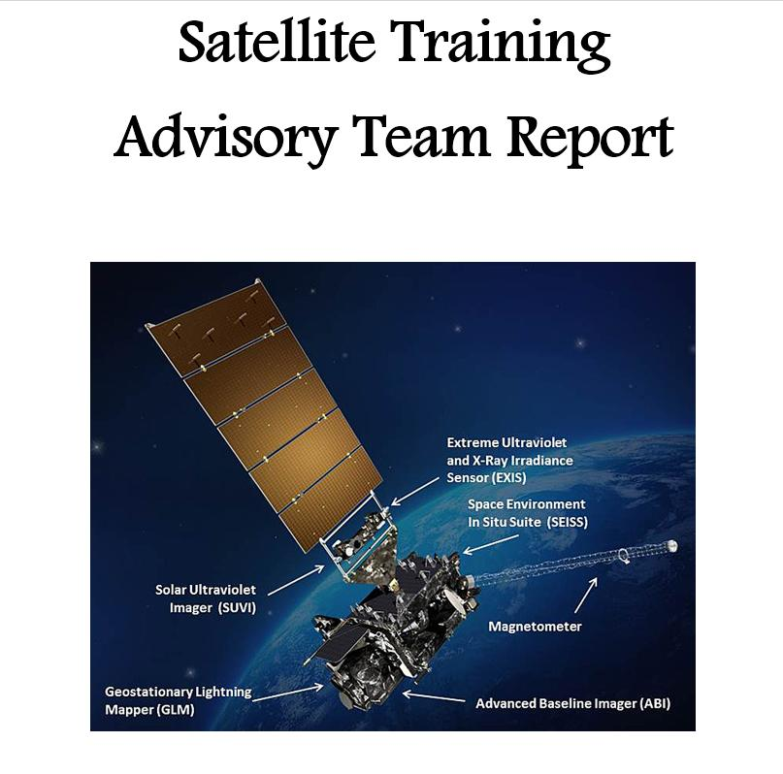
NOAA/NWS Satellite Training Plan
Learning Goals*
Understand differences between legacy GOES & GOES-R
and SNPP/JPSS satellites
Use GOES-R & JPSS for NWS forecasts and warnings
Utilize satellite-based total lightning detection sources in forecast & warning operations (GLM, VIIRS, LIS)
Understand fundamental RGB satellite techniques & Applications
* From SURT Team and STAT Reports
* STAT Came From PG/UR 2015 Actions

Slide 11
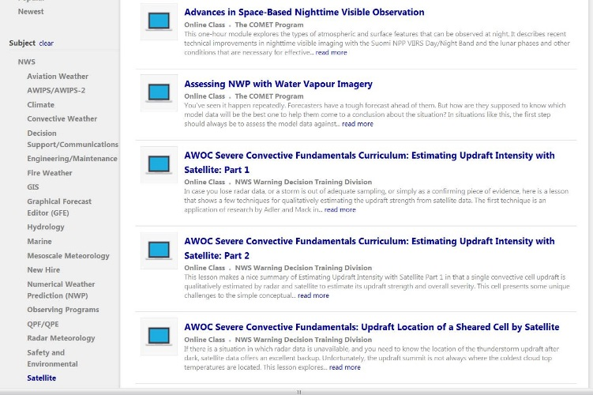
Where to Find Training?

Slide 12
Satellite Training Timeline
FY15
Oct 2016
Launch
Data?
Jan 2017 Launch 2018 & Beyond
Making it
Stick
Continuous Learning
Prerequisites
Foundation
Application
Exercise
Training Stages
Prerequisites – overall basics
Foundation – satellite specifics
Application – operational setting
Exercise – simulations, practice
Making it Stick – multi-situational, sharing
Continuous Learning – evolve and update
Notes:
Remember the Timeline? – Had March 2016 as Launch Date – still 2016!

Slide 13
Backup Slides

Slide 14
STATUS On STAT REPORT TASKS
Acronyms
OCLO = Office of Chief Learning Officer
NOAT = NWS Operational Advisory Team
STAT = Satellite Training Advisory Team
NASA/SPoRT = Short-term Prediction Research and Transition (Center)
Coop Institutes: CIMSS, CIRA, CIMMS, CICS…

Slide 15
Foundational Module List & Status
4) Course Orientation: (10 min); Green; Publish: 6/7/16
5) Basic Principles of Radiation: (15 m); Green; Pub: 6/14/16
6) Basic Ops of GOES-R: (15 m); Green; Pub: 6/14/16
-Draft under review;
8) Spectral Bands: Vis: (10 m); Yellow; Pub: 8/12/16
9) Spectral Bands: NIR: (20 m); Green; Pub: 9/16/16
10) Spectral Bands: IR (Non-WV); (30 m); Green; Pub: 9/28/16
11) Spectral Bands IR WV; (30 m); Pub; Red; Pub: 7/5/16

Slide 16
Foundational Module List & Status
12) Multi-Channel Interpretation Approaches: (30 min); Red; Publish: 7/12/16
14) Baseline Products: Aerosols: (10 m); Green; Pub: 7/19/16
15) Baseline Products: Clouds and Microphysics: (20 m); Green; Pub: 7/19/16
16) Baseline Products: Fire Characterization: (10 m); Yellow; Pub: 7/26/16
17) Baseline Products: HIE: (10 m); Yellow ; Pub: 7/26/16
18) Baseline Products: Rainfall and Precipitation: (10 m); Yellow; Pub: 7/26/16

Slide 17
Foundational Module List & Status
19) Baseline Products: Stability Indices and Legacy Profiles (10 min); Green; Pub: 8/2/16
- Draft version under review
20) Baseline Products: Derived Motion Winds: (10 m); Yellow; Pub: 8/2/16
21) Baseline Products: Volcanic Ash: (10 m); Green; Pub: 8/2/16
23) Intro to GLM: (30 m); Green; Pub: 6/21/16
24) Using GLM in AWIPS : (10 m); Yellow; Pub: 8/9/16

Slide 18
Foundational Module List & Status
26) Intro to Mesoscale/Convection: (10 min); Yellow; Pub: 8/16/16
27) Pre-convective Environment: (10 m); Yellow; Pub: 8/16/16
28) Pre-convective Cloud Features & Undular Bores: (10 m); Yellow; Pub: 8/16/16
29) Boundary Forced Convection: (10 m); Yellow; Pub: 8/16/16
30) Mountain Waves and Orographic Enhancement: (10 m); Yellow; Pub: 8/23/16
31) Fog/Low Clouds Formation and Dissipation: (10 m); Yellow; Pub: 8/23/16

Slide 19
Foundational Module List & Status
32) Meso-lows: (10 min); Yellow; Pub: 8/23/16
33) Convective Evolution: Cu-congestus/growth: (10 m); Yellow; Pub: 8/23/16
34) Convective Evolution: Discrete Storms (10 m); Yellow; Pub: 8/30/16
35) Convective Evolution: MCSs : (10 m); Yellow; Pub: 8/30/16
36) Cyclogenesis: PV Concept: (10 m); Yellow; Pub: 8/30/16
37) Cyclogenesis: Life Cycle: (20 m); Yellow; Pub: 9/6/16
38) Cyclogenesis: Trowals: (10 m); Yellow; Pub: 9/6/16

Slide 20
Foundational Module List & Status
39) Other Jet Features: (10 min); Green; Pub: 9/13/16
40) General Circulation Patterns: (10 m); Green; Pub: 9/13/16
41) Atmospheric Rivers: (10 m); Green; Pub: 9/13/16
42) Tropical to Extratropical Transition: (10 m); Green; Pub: 6/17/16
44) Impact of Satellite Observations: (15 m); Green; Pub: 8/12/16
45) Impact of GOES-R on Sat. Data Assimilation: (5 m); Green; Pub: 7/12/16

Slide 21
Foundational Module List & Status
46) Comparing NWP Simulated Sat. Imagery to Observed Sat. Imagery: (10 min); Green; Pub: 9/20/16
48) Simulation 1: Exploring ABI Bands and Synoptic Features: (60 m); Green; Pub: 9/27/16
49) Simulation 2: Mesoscale/Convection: (60 m); Green; Pub: 9/13/16

Slide 22
Satellite Training Timeline
CY16
GOESR Launch
CY17
JPSS Launch
Pre-Req
Foundational
Cont.
Learn
FY15
FY18 & Beyond
Application
Exercise
Make it
Stick
Basic Remote Sensing
Characteristics of Satellites
Pull together from COMET, VISIT, CIMSS, CIRA, SPoRT, WMO Vlab, etc.
NWS-Specific development
Initially DNB & NUCAPS
GOES-GOES-R
Use Himawari, MSG & SNPP as examples
Geo vs Polar
Strengths & Weaknesses
Forecast/ warning process
Phenomena based
GOES- R Baseline & JPSS Operational products & NWS approved RGB’s.
Service areas (severe, winter, hydro, tropical, fire, aviation, etc.)
10-15 minute modules
Techniques
Quick Guides
Simulations
Local training initiatives
“As it occurs” training
Evolve initial satellite concept of operations
Reference materials in AWIPS
Repeat…practice
Blogs
Seasonal readiness
Peer-to-peer sharing
Storm-of-the month webinars
Demonstrated performance
Continuous Learning
Operations to Research
Optimize implementations for operations
Update for evolving science
Put in IDSS and WRN context

