Slide 1
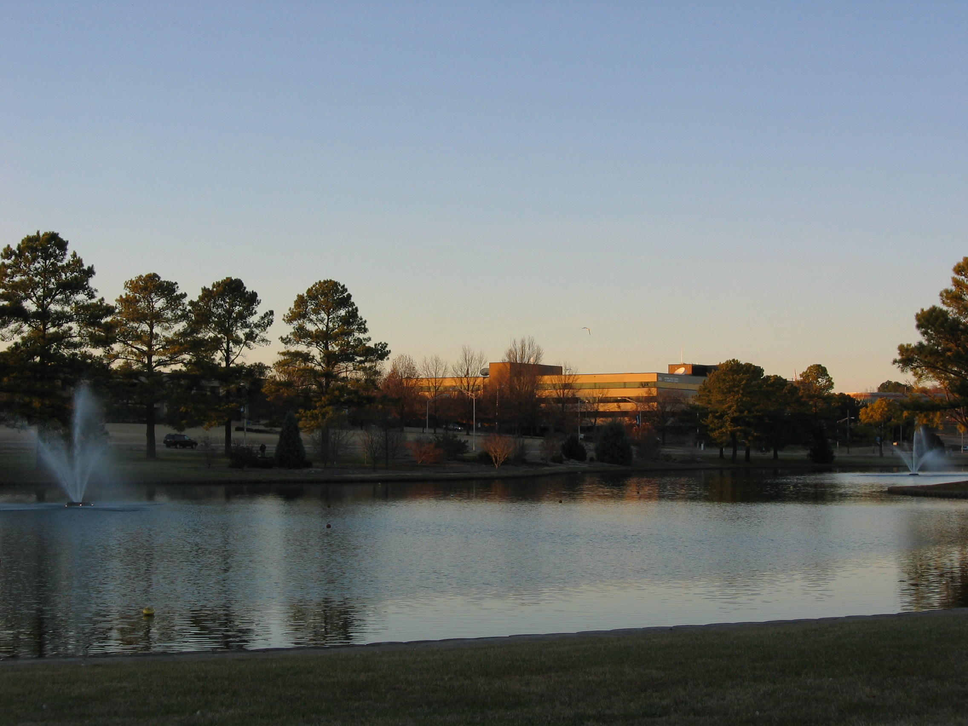
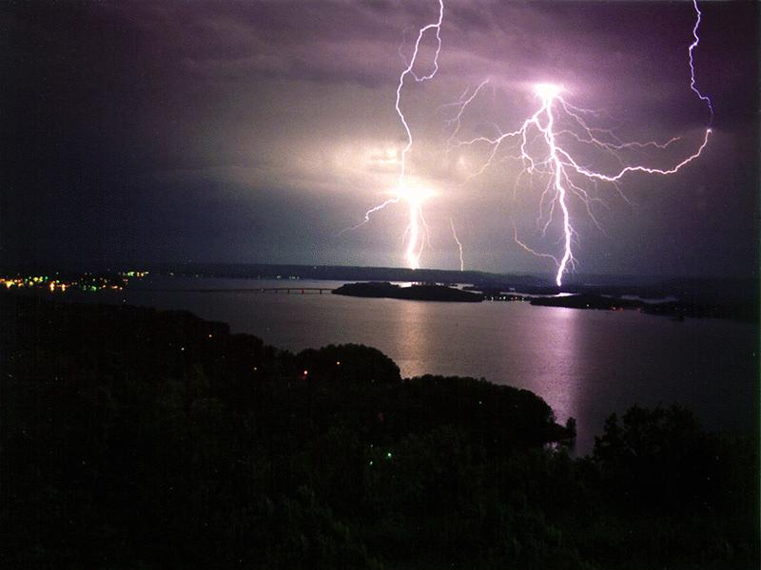
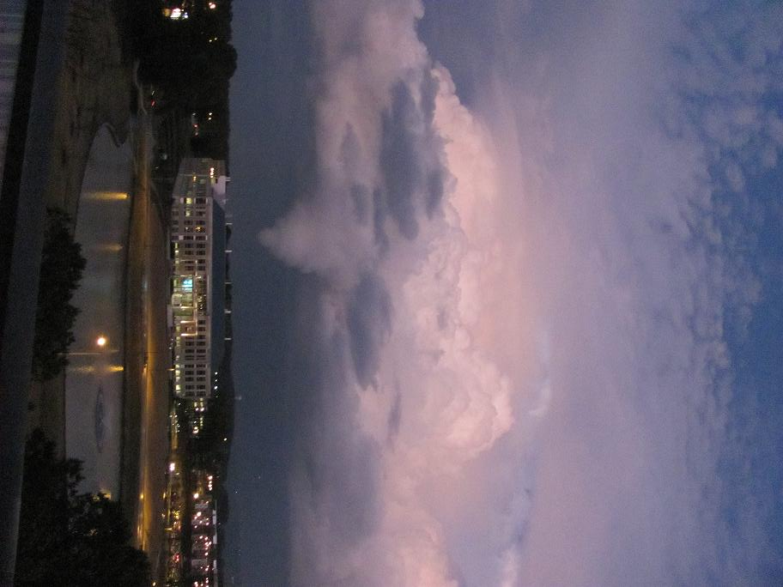
GOES-R / JPSS Proving Ground User Readiness Meeting June 2015
Kristopher White
National Weather Service - Huntsville, AL

Slide 2
Proving Ground Involvement
WFO Huntsville
Satellite Proving Ground participant - since 2003
Partnership with NASA SPoRT (located down the hall)
Advent of AWIPS II era resulted in periodic interruptions
GOES-R / JPSS RGB Products Evaluated:
MODIS imagery – since spring 2003
True Color, Snow-Cloud RGBs
Nighttime Microphysics, Dust, Airmass RGBs (since 2012)
VIIRS imagery – since 2012
Nighttime Microphysics, Dust, Airmass, Day-Night Band RGBs

Slide 3
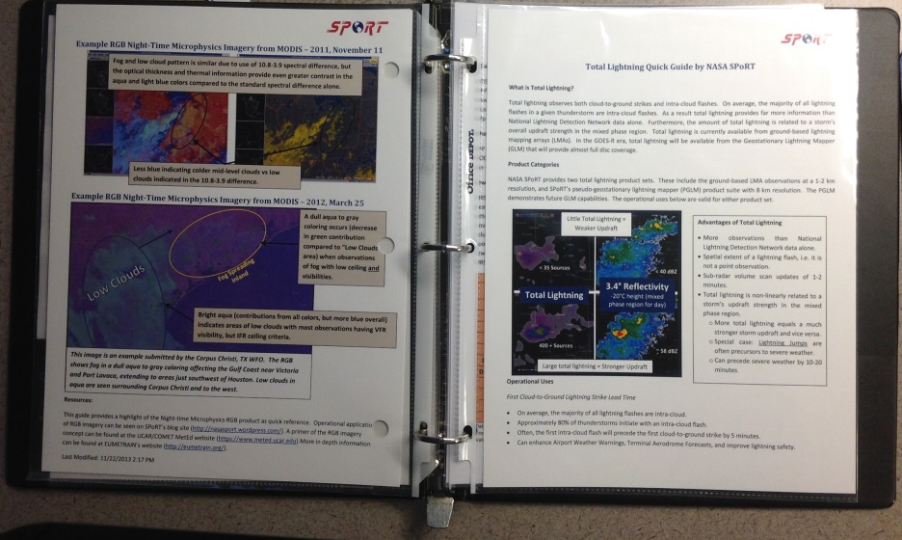
Proving Ground Training Experiences
Training Modules
NASA SPoRT and COMET
MODIS Fog Product
RGBs
Quick Guides
NASA SPoRT
Verbal Training
SPoRT Team, Applications Integration Meteorologist and SOO
AWIPS Procedures
Helps forecasters understand new products in context of familiar products

Slide 4
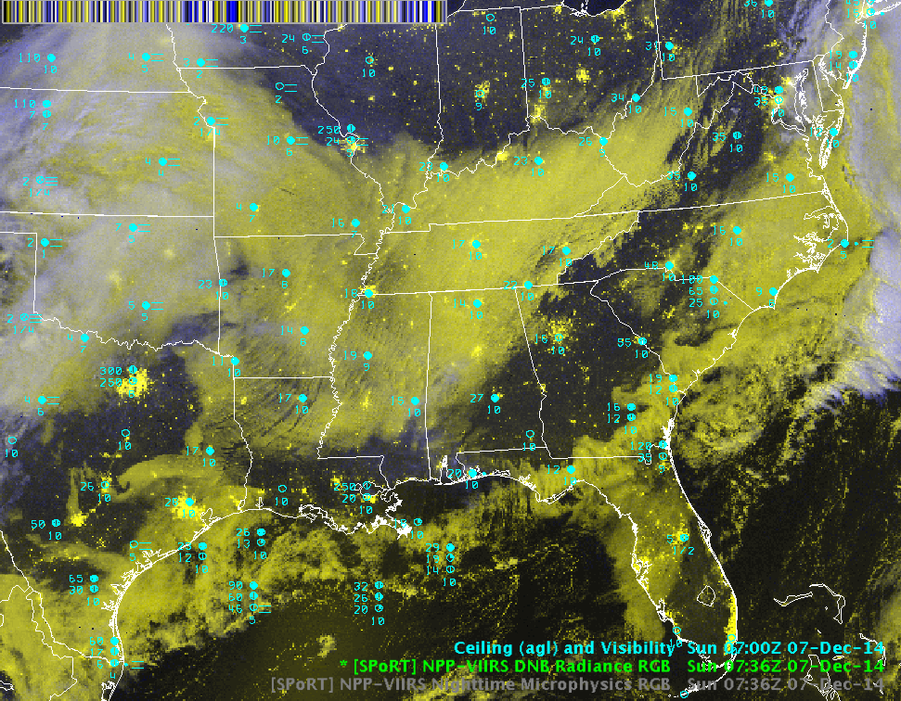
RGB Products I’ll be covering…
Nighttime Microphysics RGB
Day-Night Band RGB

Slide 5
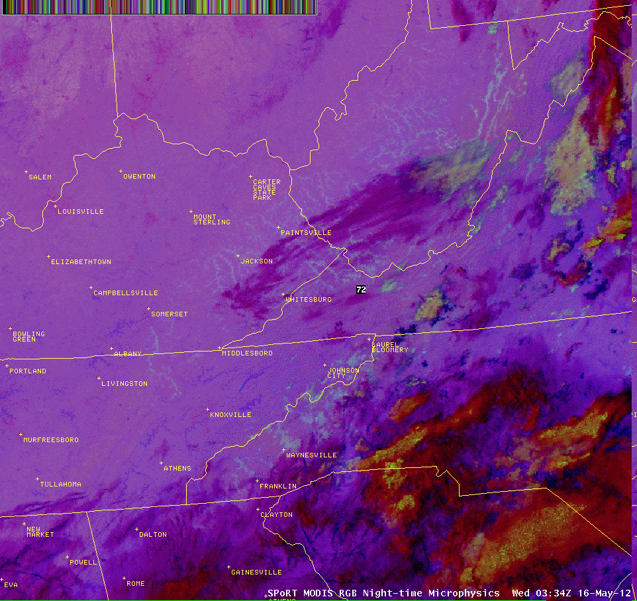
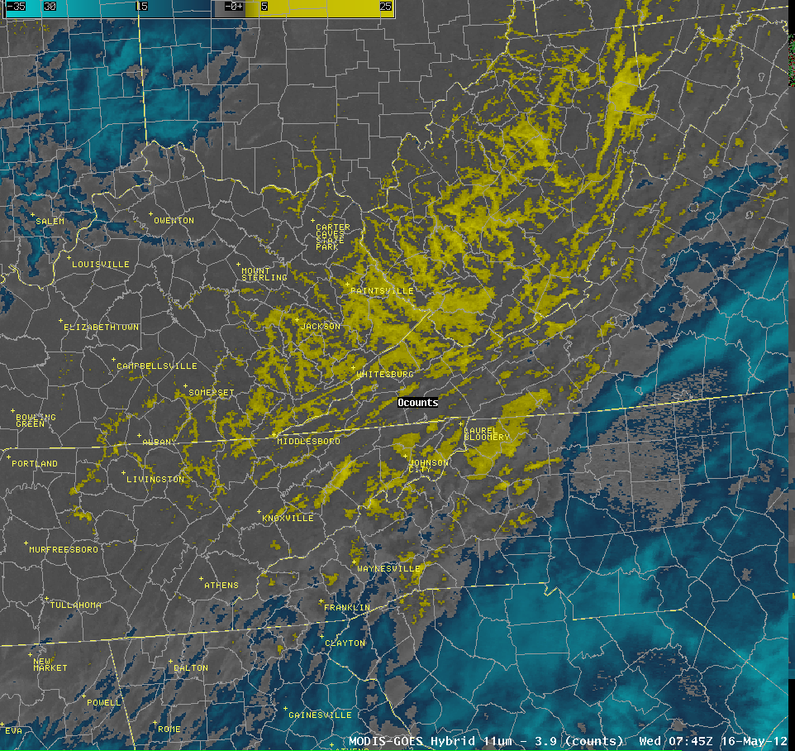
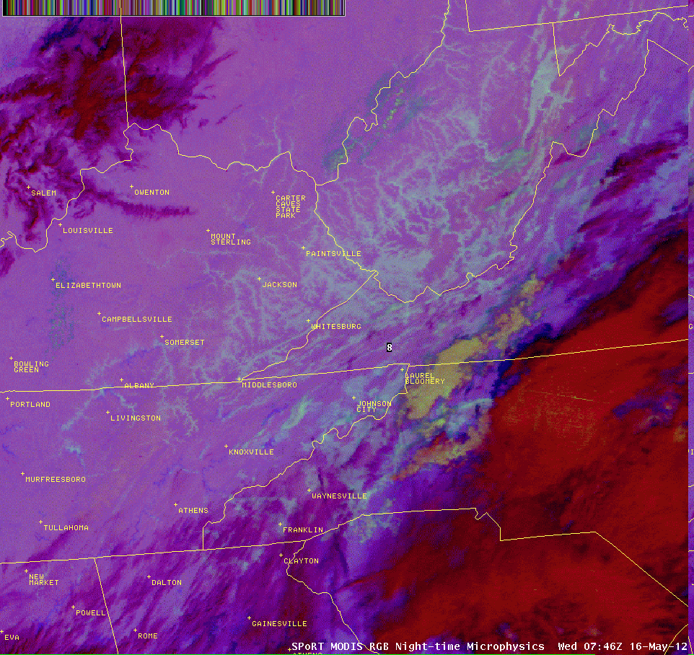
Nighttime Microphysics RGB Operational Application Fog/Low Cloud Detection and Differentiation from Mid-Clouds 16 May 2012
MODIS 11-3.9µm
MODIS Nighttime Microphysics RGB
MODIS 11-3.9µm
MODIS Nighttime Microphysics RGB

Slide 6
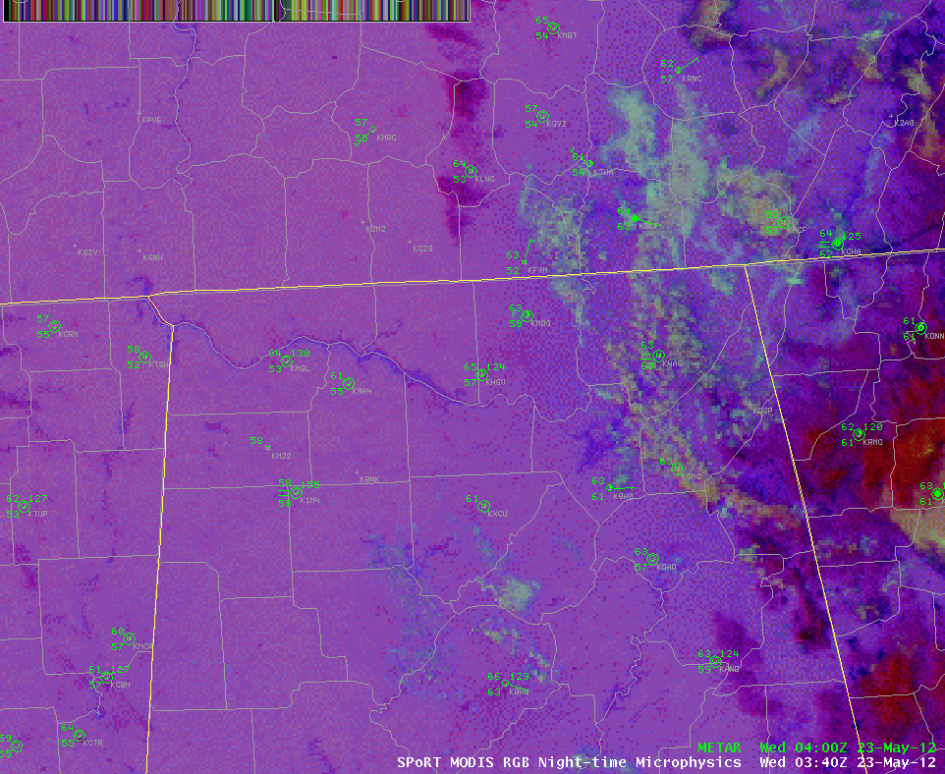
Nighttime Microphysics RGB Operational Application Fog/Low Cloud Detection and Differentiation from Mid-Clouds 23 May 2012
MODIS 11-3.9µm
MODIS Nighttime Microphysics RGB

Slide 7
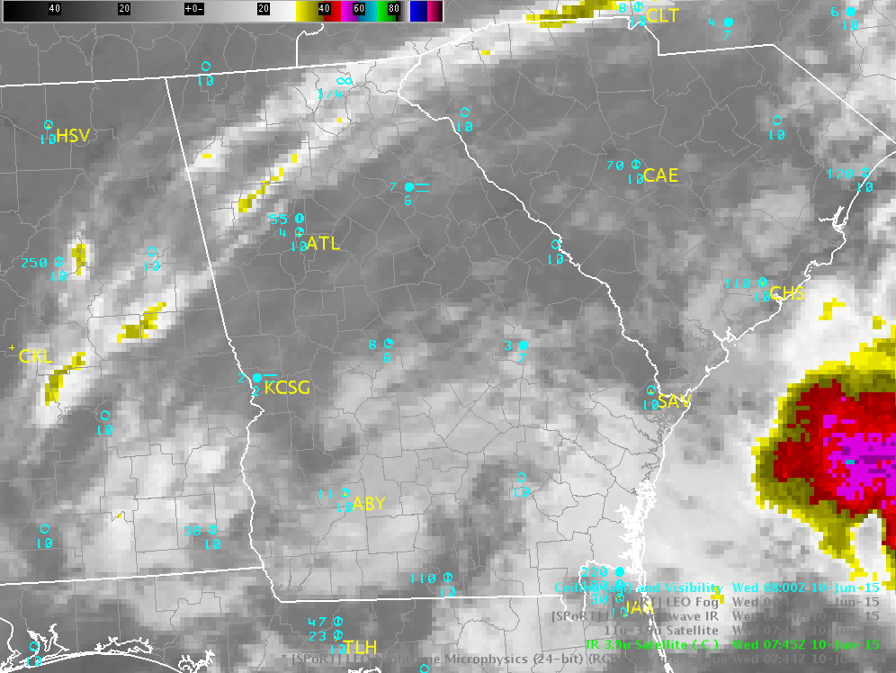
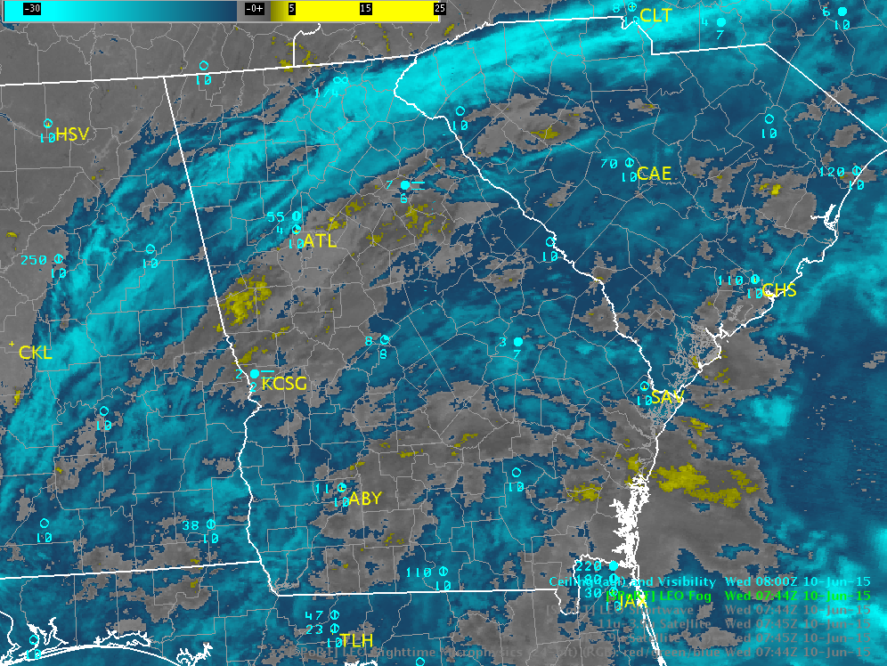
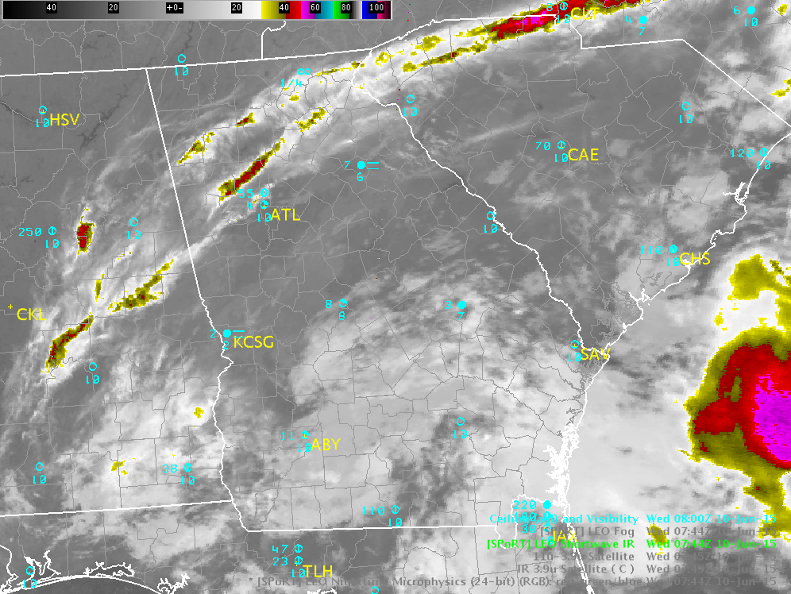
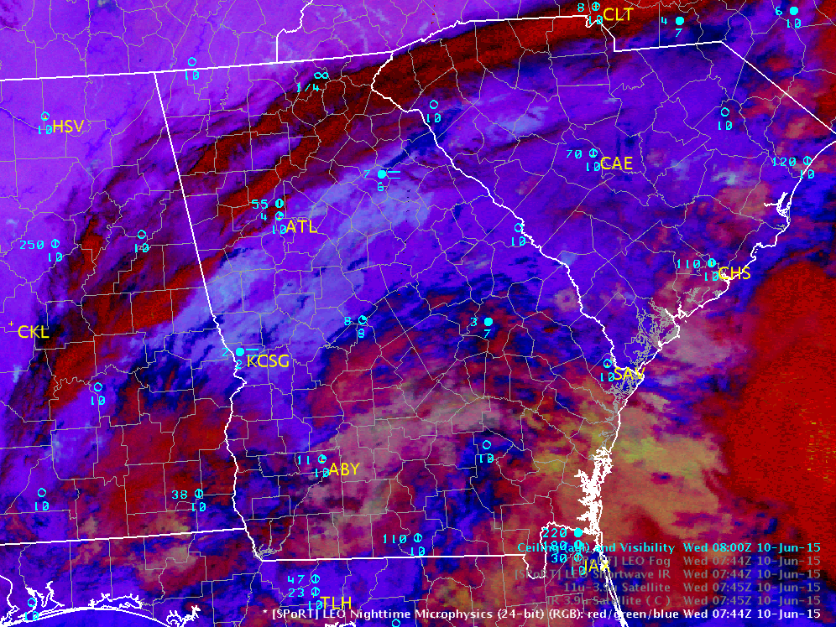
Nighttime Microphysics RGB Operational Application Fog/Low Cloud Detection and Differentiation from Mid-Clouds 10 June 2015
GOES 11-3.9µm
GOES 3.9µm
MODIS 11-3.9µm
MODIS 3.9µm
MODIS Nighttime Microphysics RGB
Even better when separate R-G-B contributions are available

Slide 8
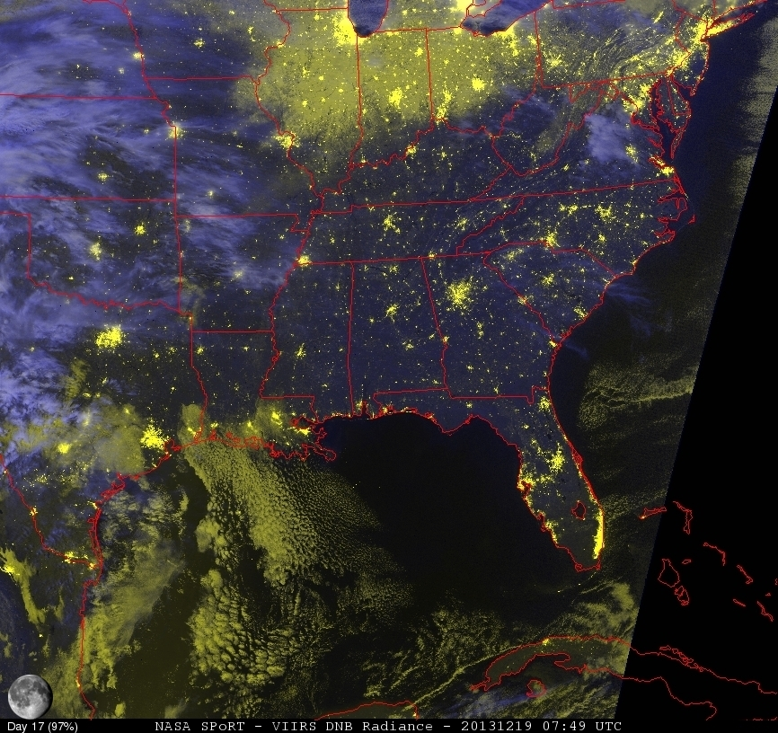
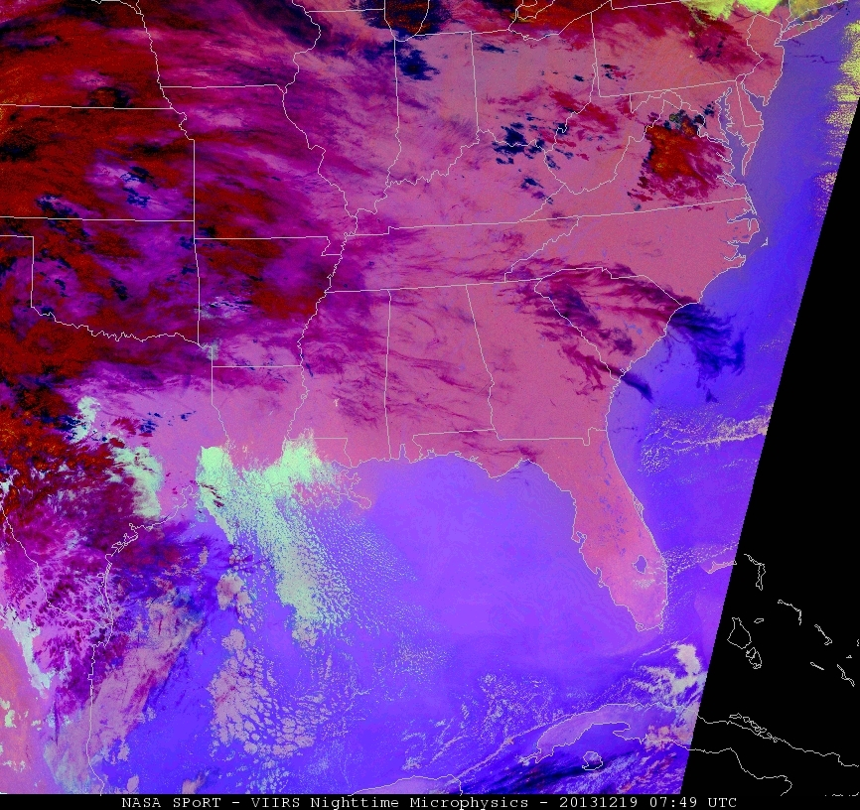
VIIRS Day-Night Band RGB Operational Applications Fog and Low Cloud Detection Through Thin Cirrus and Snow Detection 19 Dec 2013
VIIRS 10.8-3.7µm
VIIRS Nighttime Microphysics RGB
VIIRS Day-Night Band Radiance RGB

Slide 9
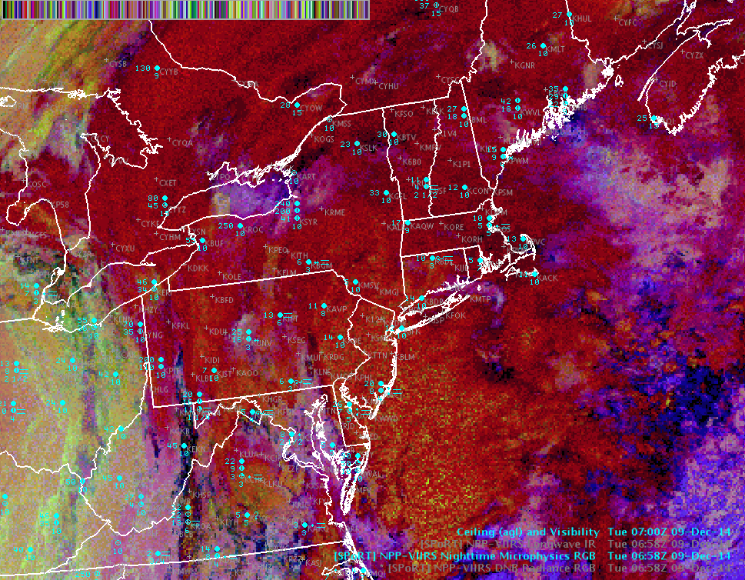
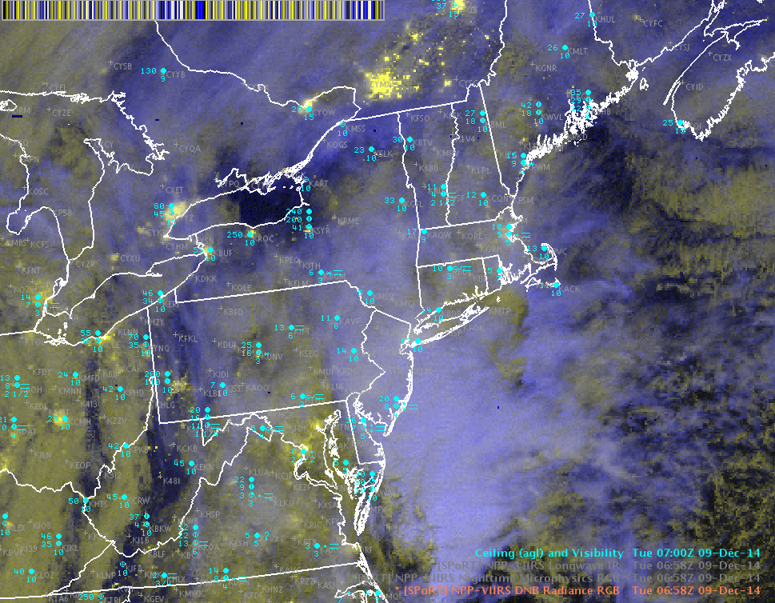
VIIRS Day-Night Band RGB Operational Applications Fog and Low Clouds Through Thin Cirrus 9 Dec 2014
GOES IR 10.8µm
VIIRS Nighttime Microphysics RGB
VIIRS Day-Night Band Radiance RGB

Slide 10
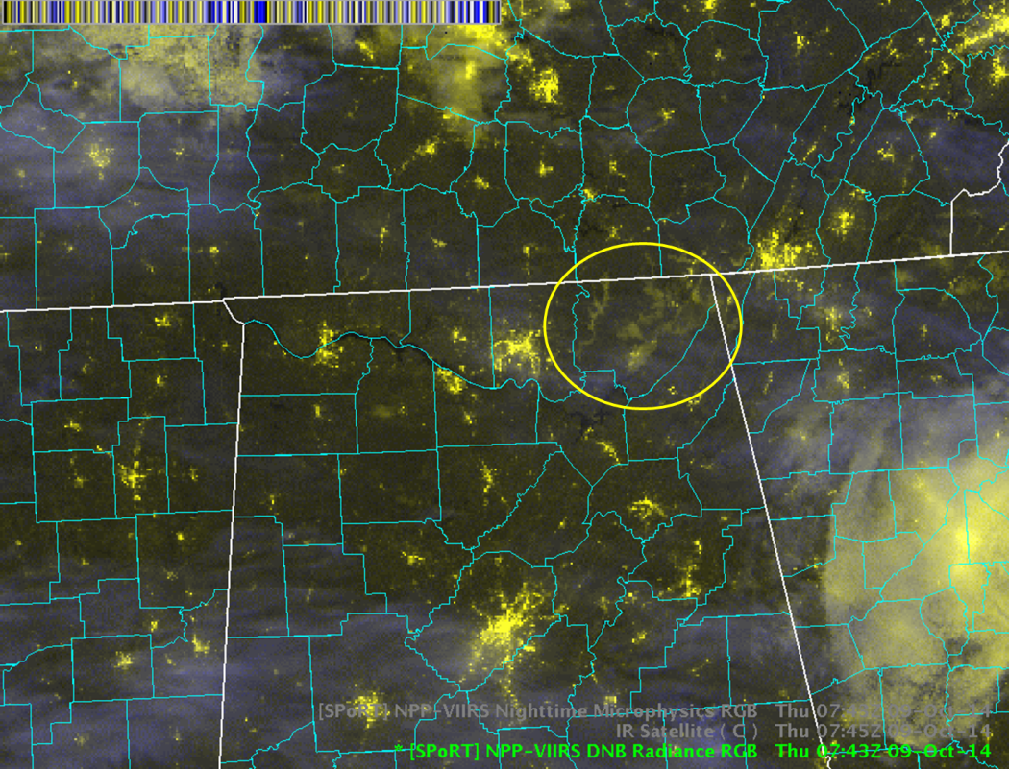
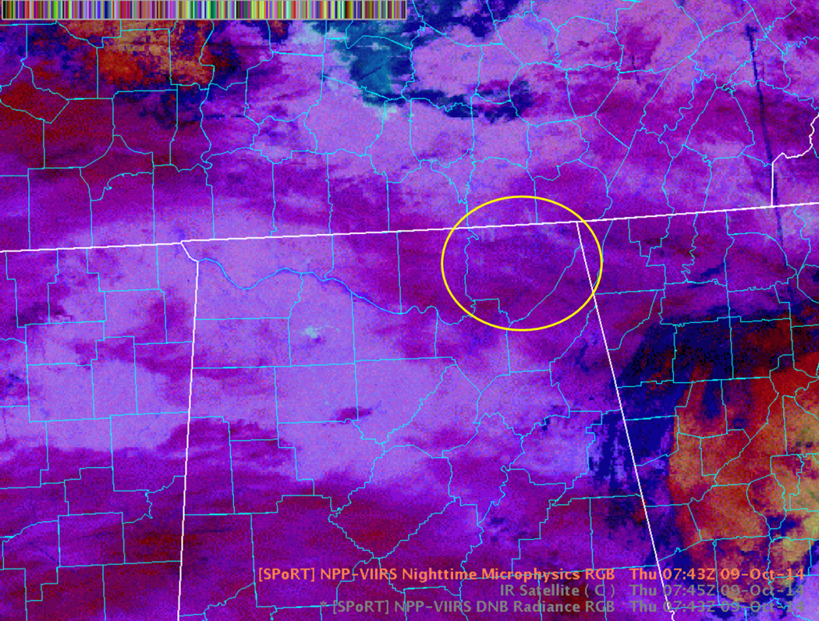
VIIRS Day-Night Band RGB Operational Applications Fog and Low Clouds Through Thin Cirrus 9 Oct 2014
GOES 11µm
VIIRS Nighttime Microphysics RGB
VIIRS Day-Night Band Radiance RGB

Slide 11
User Readiness – What the operational forecaster needs…
Future Training
Different modes of training are necessary since each can address weaknesses inherent in others (i.e., modules or paper training guides are always available, while experts may not be, but you can’t ask questions or interact with modules).
Keep modules and hard copy/digital guides relatively short and easily accessible
Examples, examples and more examples! A repository of examples would be beneficial (e.g., such as the RGB archive maintained by EUMETSAT)
Build product expertise at the local office level
Satellite Focal Points mandated through regional level?
Can provide local case studies, examples, training
Can create helpful AWIPS procedures
“Go-to” person for questions

Slide 12
User Readiness – What the operational forecaster needs…
Understand Strengths of Imagery
Nighttime Microphysics RGBs
Better at depicting differing cloud characteristics over legacy imagery
Day-Night Band RGBs
Ability to view lower clouds through thin cirrus
View features in geographical context of city/urban locations
Knowledge of channels that make up Red-Green-Blue components and the ability to view the constituent contributions in AWIPS
E.g., Nighttime Microphysics
Red (12-10.8µm): 50%
Green (10.8-3.9µm): 40%
Blue (10.8µm): 91%
Local subject-matter expert
You can do all the modules you want…forecasters will NEVER get full comprehension completely from a module. Expertise development will take time and at different rates. Local subject matter experts should be available to answer questions.
Product fusion with familiar, legacy satellite imagery

Slide 13
Questions?

