Slide 1
The GOES-R GLM Lightning Jump Algorithm
Principles and Applications toward Severe Weather Warning and Impacts-Based Decision Support
Lawrence Carey, University of Alabama in Huntsville (UAH)*
With contributions from Kristin Calhoun (OU CIMMS and NOAA NSSL), Chris Schultz (NASA MSFC and UAH), Sarah Stough (UAH), Brett Williams (UAH) and Alex Young (UAH)
* Funded by the NOAA GOES-R Risk Reduction Research (R3) Program via NOAA CICS in collaboration with NASA MSFC

Slide 2
Overview
Science Issue: Severe warning operations and impacts-based decision support require early and frequent updates of convective updraft intensity
Currently a challenge from satellite
Total lightning trends can provide
Approach: GOES-R GLM Lightning Jump Algorithm (LJA)
Conceptual model of updraft, microphysics, total lightning and LJA
Applications and fusion with radar data
Tornadic supercell
Tornadic quasi-linear convective system (QLCS)
User Demonstrations and near Future Plans
Hazardous Weather Testbed (HWT) 2014 examples
LJA in ProbSevere (NOAA CIMMS, CIMSS collaboration)
HWT 2015 and possible pathways to operations

Slide 3
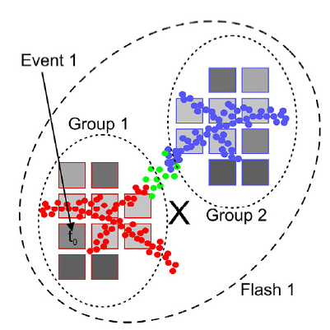
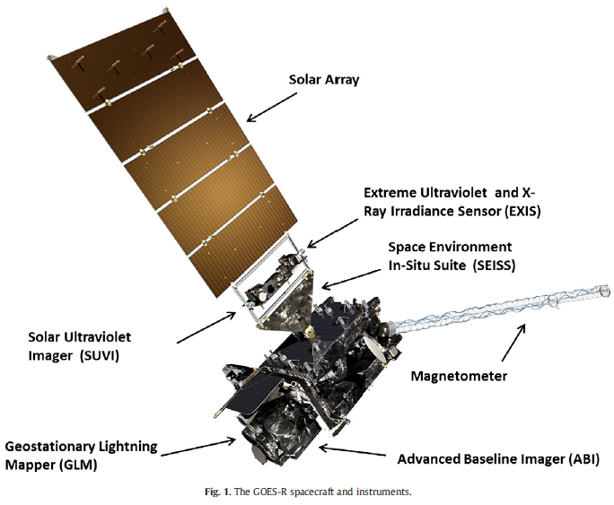
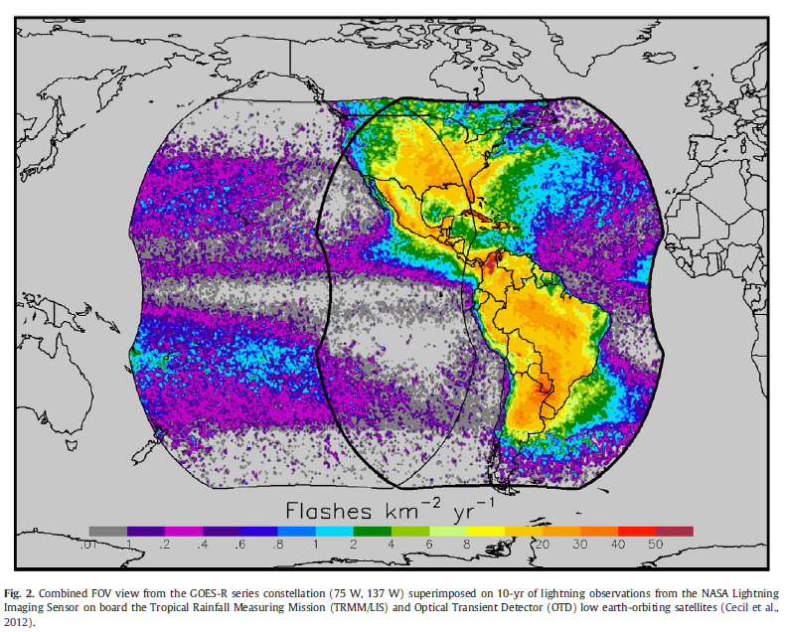
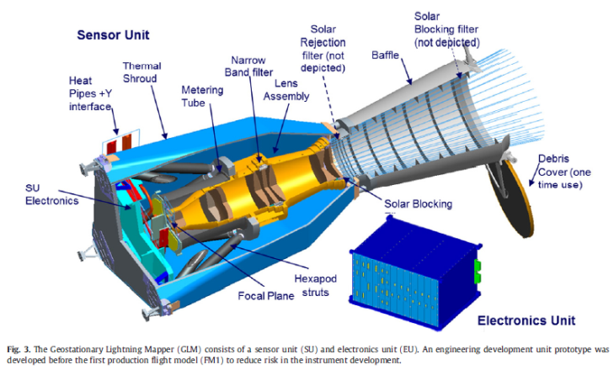
GOES-R Geostationary Lightning Mapper (GLM)
Goodman et al. (2013)
GLM
GOES-R
LMA
GOES-W
GOES-E
GLM

Slide 4
The Lightning Jump
1) The flash rate increases rapidly (t₀)
2) A peak flash rate (i.e., intensity) is reached (t₁)
3) Severe weather occurs a short time later (t₂)
(Williams et al. 1999, Schultz et al. 2009; 2011, Gatlin and Goodman 2010, Rudlosky and Fuelberg 2013, Metzger and Nuss 2013).
Figure credit : Williams et al. 1999, Atmos. Res.
Assumed physical basis: “The updraft appears to be causal to both the extraordinary intracloud lightning rates and the physical origin aloft of the severe weather at the surface” (Williams et al. 1999)
Updraft properties were not directly measured in early jump studies
Not specific which updraft properties govern the jump

Slide 5
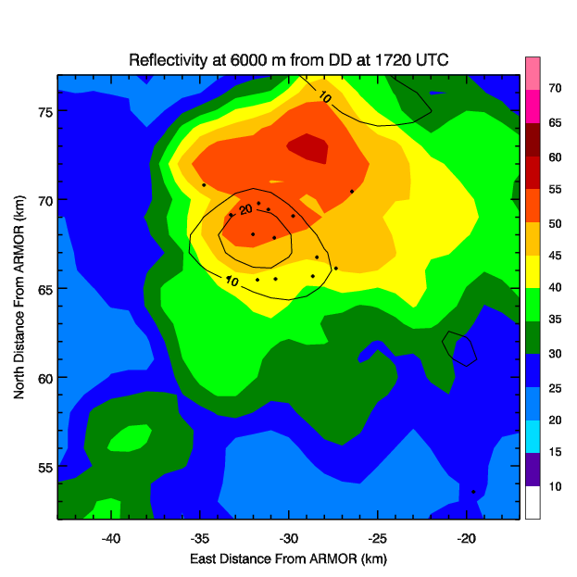
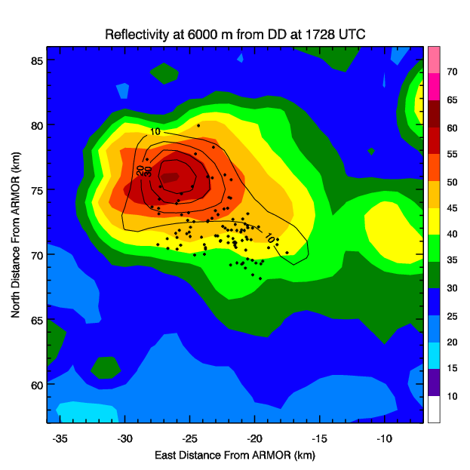
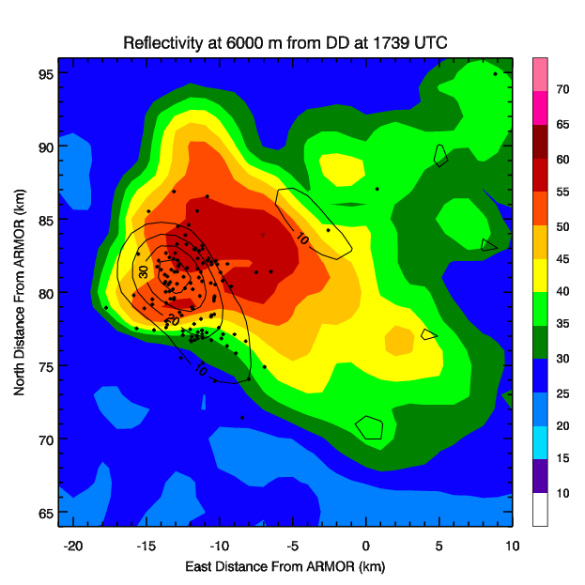
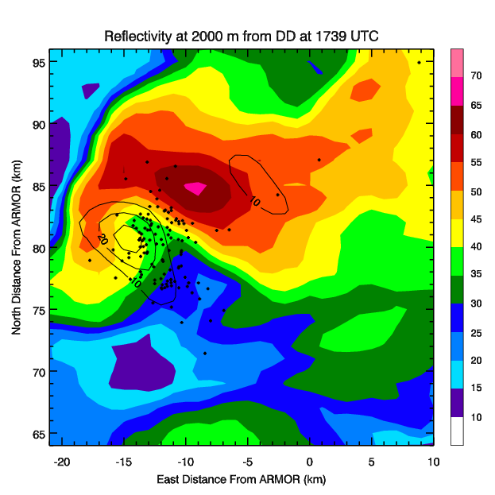
Lightning Jump Conceptual Model
Δt
Jump Time
Δt
A
B
C
C
A to B – Mixed phase updraft volume, updraft speed and graupel mass increase and a lightning jump occurs
B to C – As flash rates continue to increase, increases in intensity metrics (e.g., MESH, azimuthal shear) are observed resulting in enhanced severe weather potential.
Notes:
The A to B transition should cover the next slide, while B to C should cover Sarah’s and Themis’ work.

Slide 6
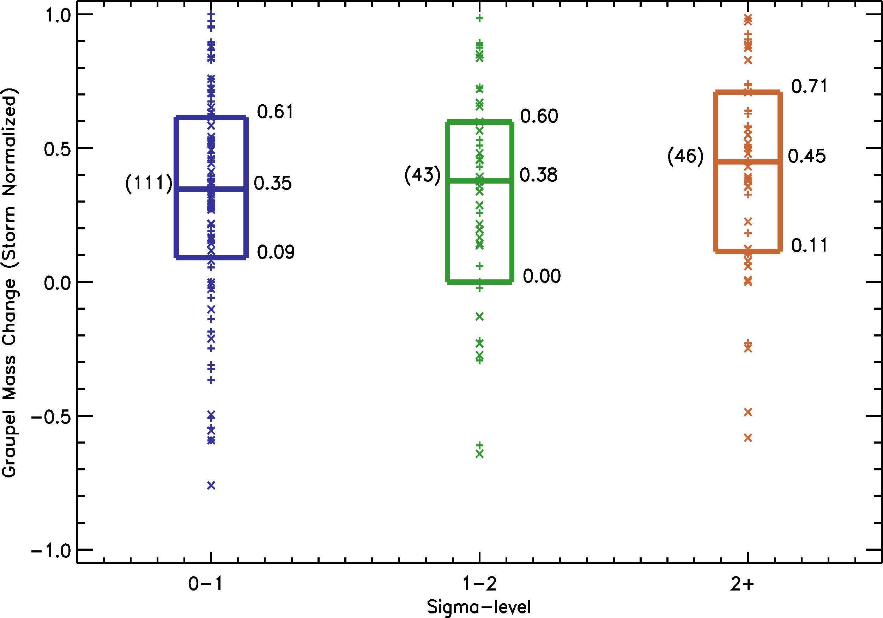
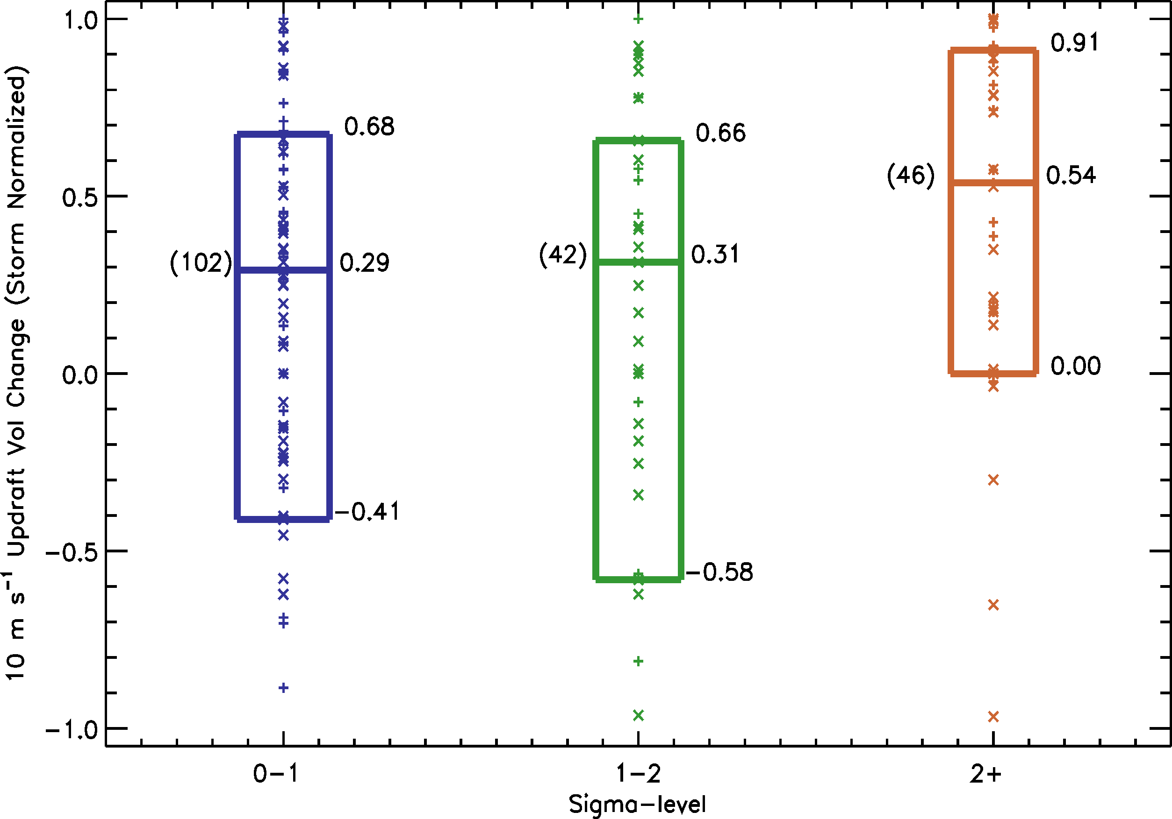
Kinematic and Microphysical Origins
During the time leading up to a lightning jump, kinematic and microphysical observations of storms display the following characteristics:
There is a substantial increase in 10 m s⁻¹ updraft volume (below) and peak updraft speed (not shown).
Mixed phase graupel mass change (%)
10 m s⁻¹ updraft volume change (%)
2) Mixed phase graupel mass also increases during this period (above).
Rank sum Testing
 | Z Score |  |  | P_Level (one tailed)
 | 0 and 1 σL | 1 and 2 σL | 0 and 2 σL | 0 and 1 σL | 1 and 2 σL | 0 and 2 σL
Norm 10 m/s vol | 0.05 | 1.60 | 1.99 | 0.48 | 0.06 | 0.03
Notes:
Tried to keep things simple. I figured if you wanted to go into more detail you could. The key point is that the difference between jumps and ordinary increases in flash rate is the peak updraft speed and more intense (10 m s and greater) updraft volume increases. I couldn’t get the 5 m s updraft volume plot to fit without making things very noisy.

Slide 7
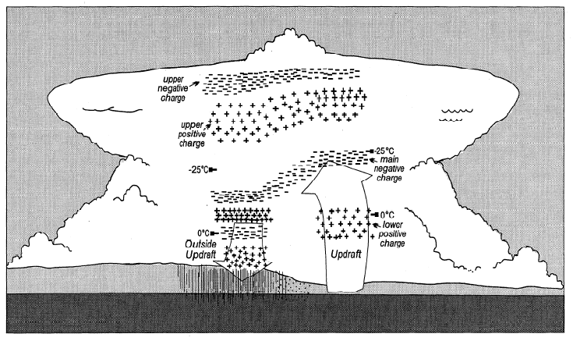
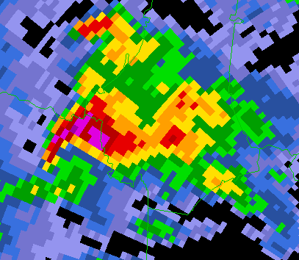
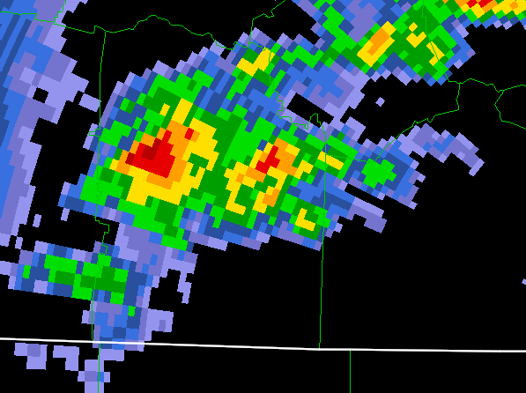
Supercell Applications: Conceptual Timeline
Given correct environment:
Moderate-to-High Shear
(ex: 0-6km shear > 15 ms⁻¹)
Moderate-to-High Instability
(ex: CAPE > 1000 J/kg)
3a: More Particle Collisions
→ Increased Lightning
2: Updraft Pulse
4: Supercell
1: Ordinary Convection
Stolzenburg et al. [1998] , Fig. 3
3b: Stretching of Vertical Vorticity
→ Mesocyclone

Slide 8
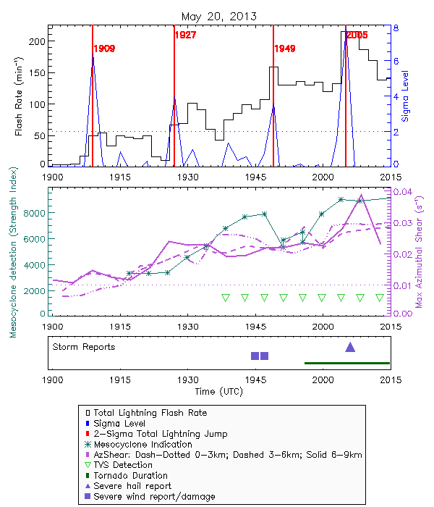
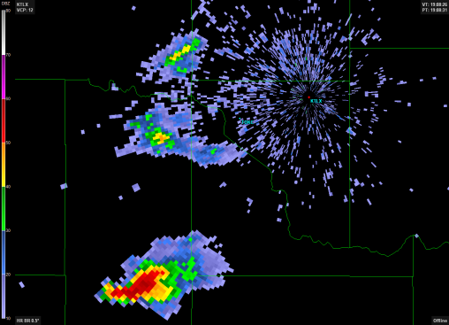
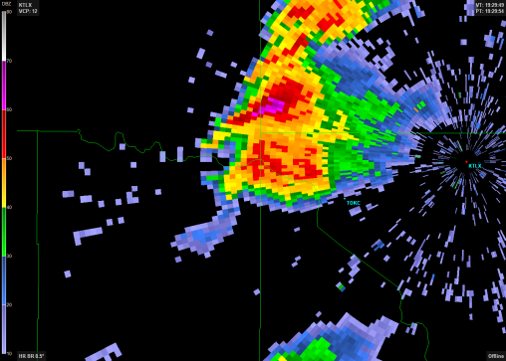
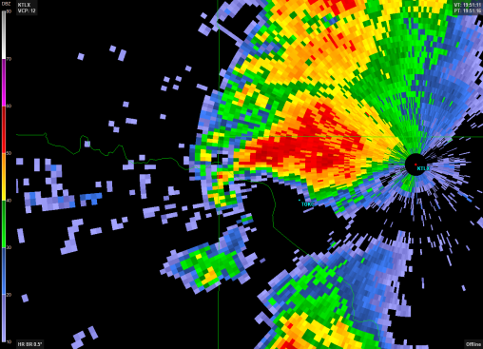
Supercell Applications of the Lightning Jump
Developing cell
First jump :
coincident with peak in mesocyclonic rotation
precedes first meso algorithm detection
1908 UTC
Supercell
Second jump:
occurs with second peak in mesocyclonic rotation
precedes severe wind reports by 18-20 minutes
1929 UTC
High flash rates along with sustained strong rotation
Third jump
precedes tornado by 7 minutes
1951 UTC
17Z OUN sounding: MLCAPE of 3120 Jkg⁻¹; 0-6 km shear of 26.8 ms⁻¹; 0-1 km SRH of 131 m²s⁻²
Notes:
Dr. Carey – This figure looks slightly different than previously presented. The older versions used storm tracking that was based on flash extent density which didn’t track the storm early enough to allow the jump algorithm the “spin up” time for the first jump (dashed line based on results using Titan tracking in old plots). I have since re-run tracking on this case using reflectivity gridded at -10*C based on the RUC/RAP models in WDSS-II, allowing earlier detection of the cell and enough time for the earliest jump to be computed.

Slide 9
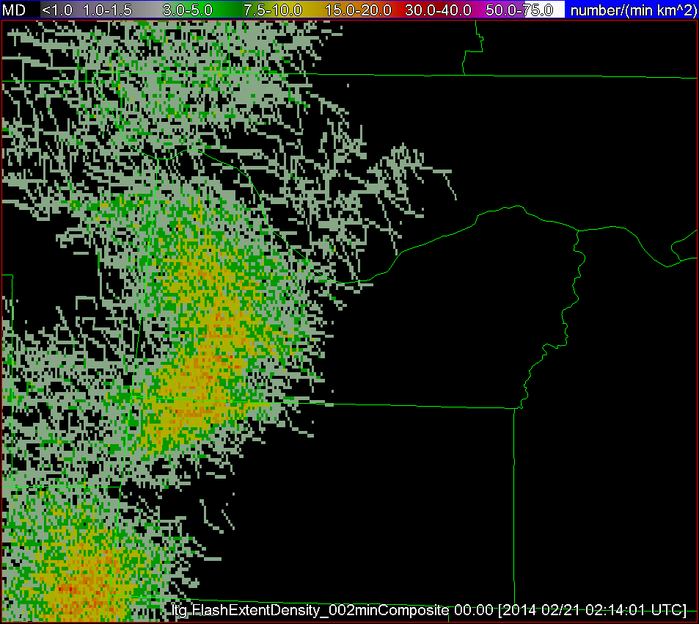
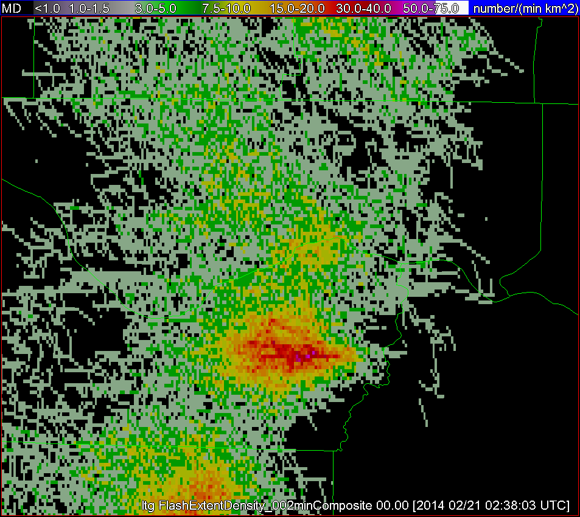
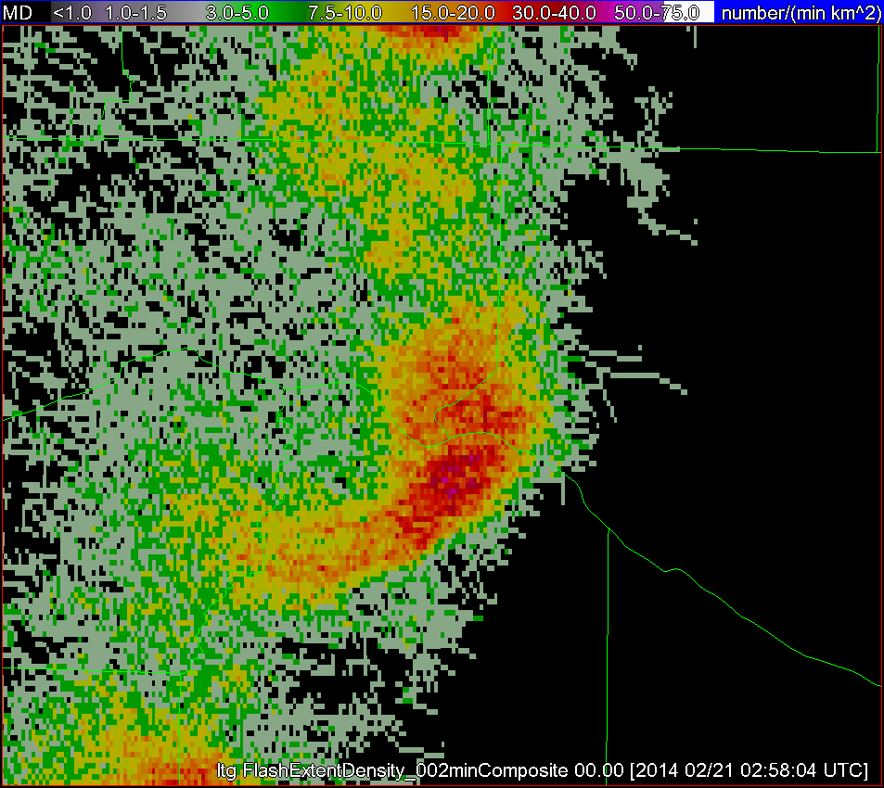
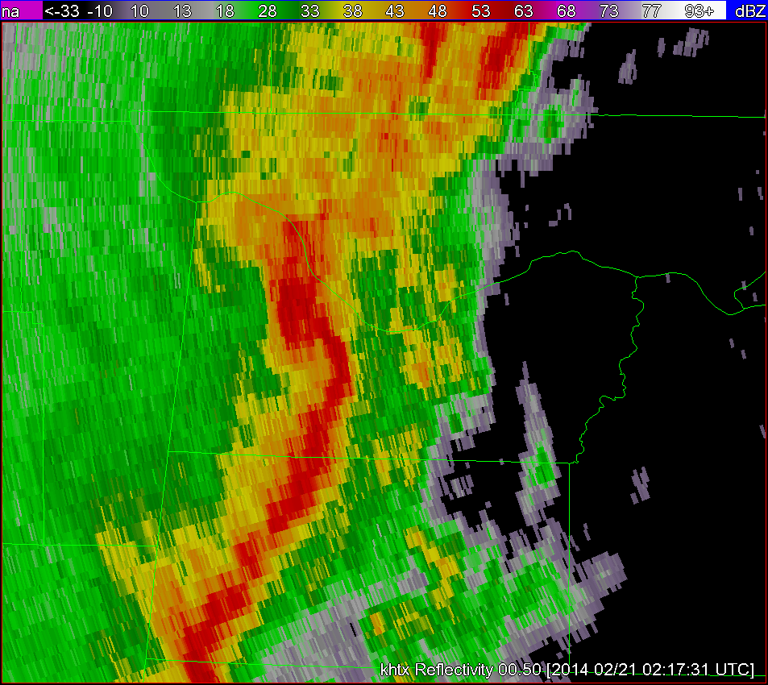
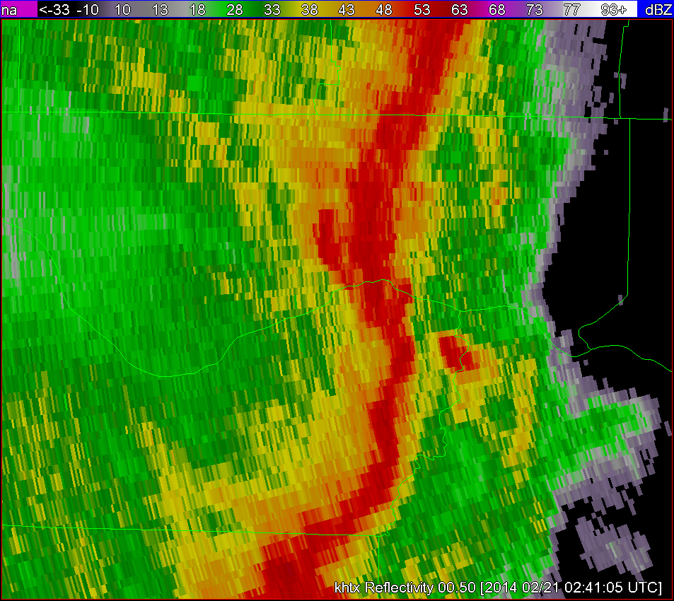
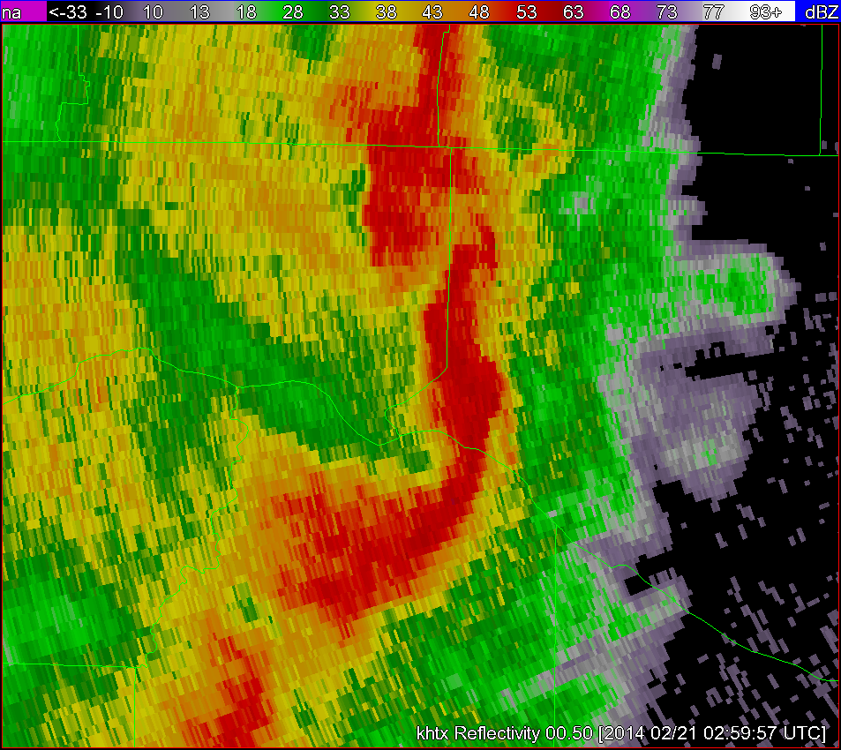
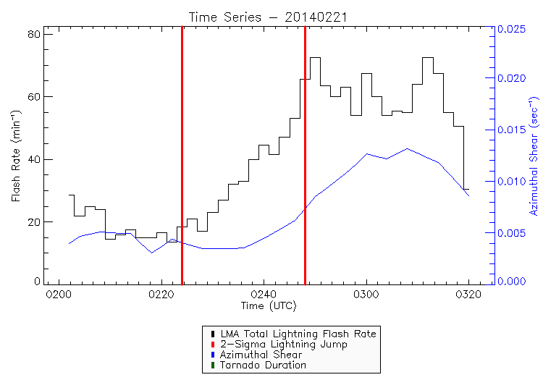
Lightning jump applications for QLCS tornadoes
Pre-jump
After jump, prior to tornado
During tornadic period
The lightning jump can potentially help identify when and what part of the QLCS is becoming more favorable for mesovortex genesis
Lightning jump is an indication that QLCS is strengthening, and precedes an increase in azimuthal shear, which signifies an increase in rotation
Jumps precede formation of hooks & appendages in reflectivity, bowing segments, and velocity couplets
Potentially providing additional lead time over traditional radar only warning methodology
If environment and radar characteristics suggest tornadic potential, the occurrence (or absence) of a lightning jump can add additional information to tip-the-scales in the warning decision process
Tornadic Region
FED - 0214 UTC
FED - 0238 UTC
FED - 0258 UTC
Tornadic Region
Bowing feature
Appendage
ZH 0.5° - 0214 UTC
ZH 0.5° - 0238 UTC
ZH 0.5° - 0258 UTC
Time Series – 20140221 – Tornadic QLCS
80
0224
0248
60
Flash Rate (min⁻¹)
Max 0-3 km Az Shear (sec⁻¹)
40
Tornadic Period – 0245 - 0309
20
0
0200
0220
0240
0300
0320
Time (UTC)

Slide 10
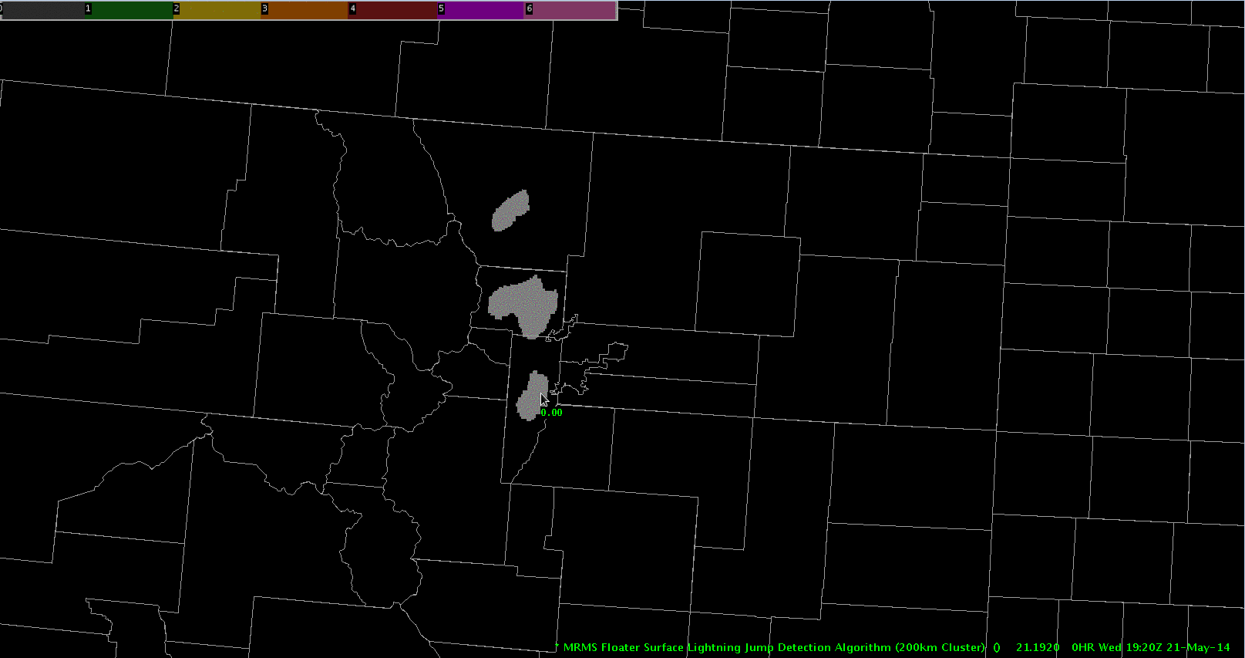
2014 EWP: Lightning Jump Algorithm
“I really think this could be one of the most valuable tools in WFO operations. Once a jump - or more precisely a series of jumps occurred - there seem to be excellent correlation to an increase in storm intensity.”
-NWS Forecaster, Post Event Survey, 2014 HWT

Slide 11
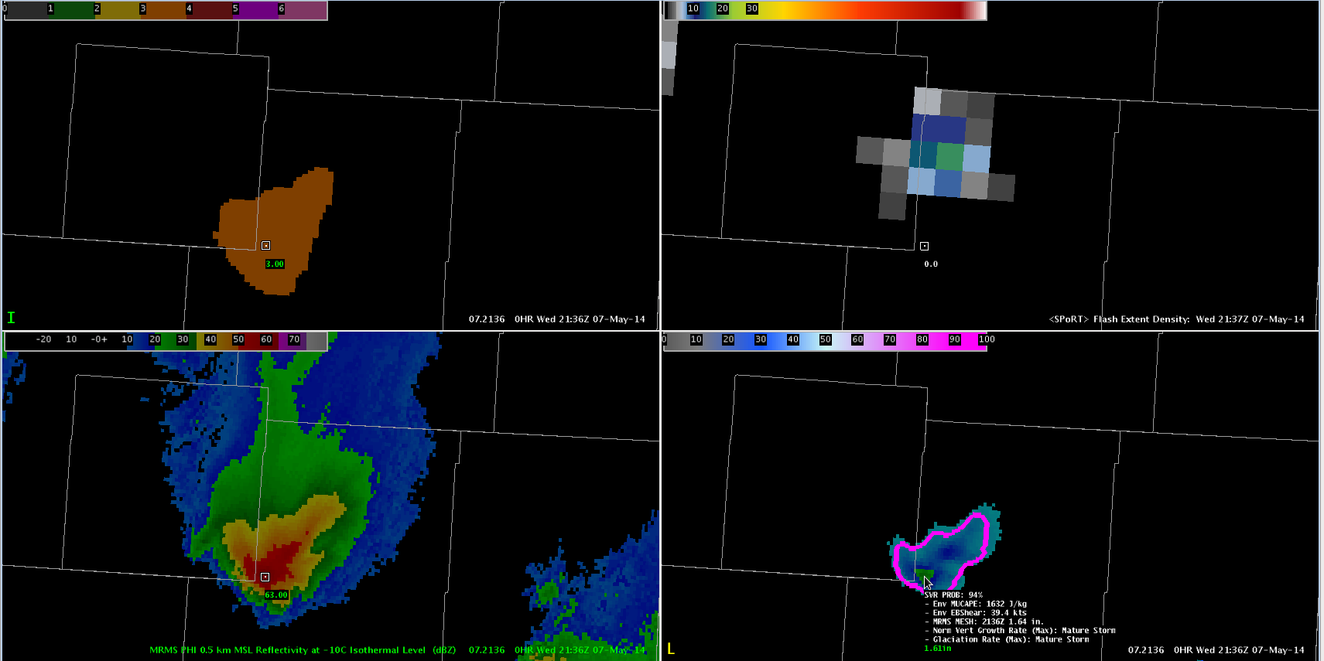
3-sigma jump
pGLM flash extent density
MRMS
Refl @-10C
MESH & ProbSevere
(LMA-based) lightning data was heavily utilized in Warning Operations:
1 min update (filled in gaps in time / distance from radars)
Jump provided view of rapid intensification in multiple storm environments
Provided extra confidence in warning decision

Slide 12
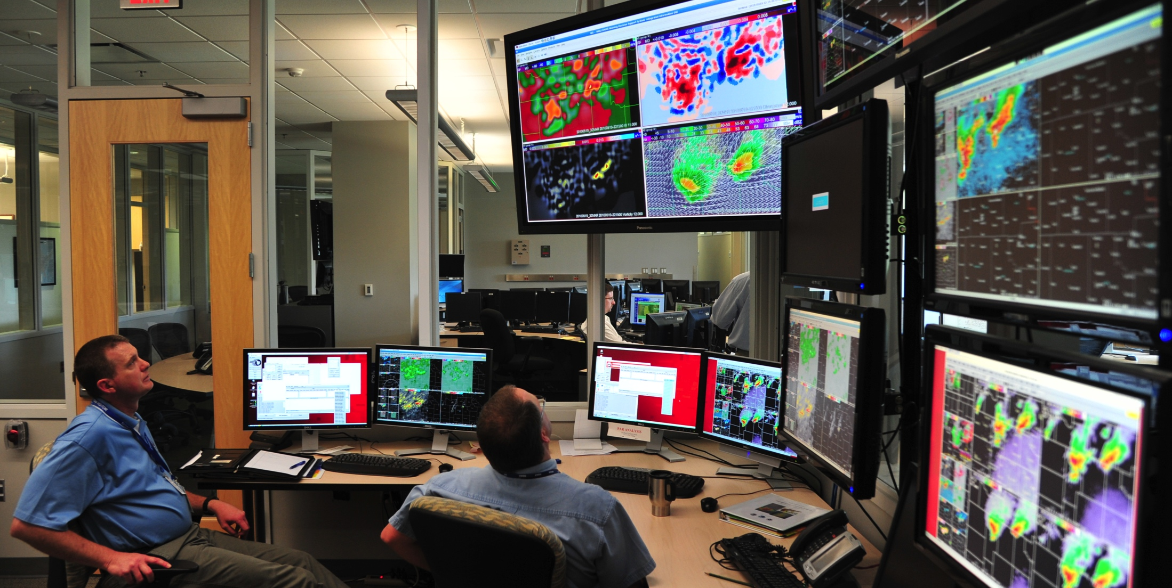
“When I saw the jump and maybe a couple scans in a row, I was confident to issue a severe thunderstorm warning….”
-NWS Forecaster, Live Blog
“This information is a high temporal resolution (1-2 minutes) and provides additional data points that can fill gaps between radar volume times.”
-NWS Forecasters (HWT blog)
“The jumps were very helpful in identifying quickly intensifying storms. … it provided valuable information that, to my knowledge, is not displayed elsewhere.”
-NWS Forecaster, Post Event Survey

Slide 13
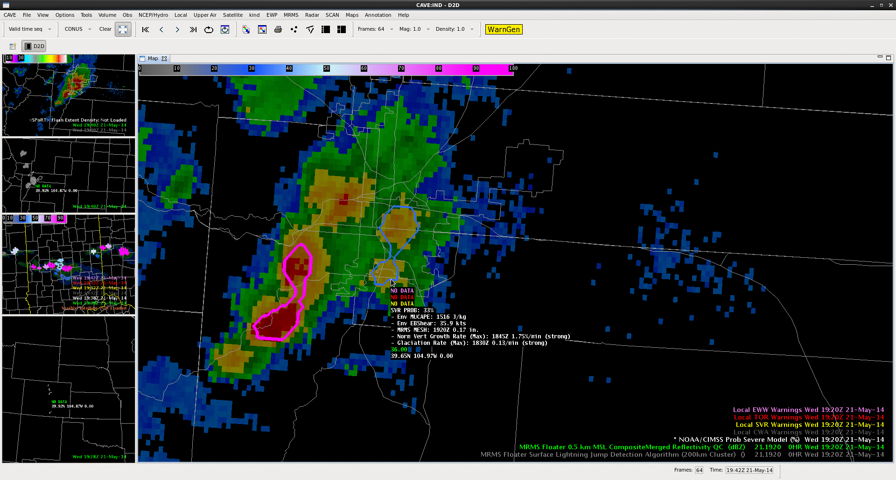
In this case, ProbSevere and LJA both displayed the rapid intensification of the updraft, and could be especially useful in identifying the first severe storm of the day, and the maintenance of the ProbSevere and additional lightning jumps continued to highlight the threat of severe weather as the storm continued eastward as the storm propagated eastward.
Future work will include the integration of the LJA into ProbSevere as an additional input to the probability calculations (NOAA CIMMS working with NOAA CIMSS)
Notes:
“The jump in ProbSevere (46% to 66% from 19:22 to 19:24 UTC) and the 2-sigma and 4-sigma jumps from the LJA (at 19:23 and 19:24 UTC, respectively) may be able to give forecasters enhanced confidence and perhaps more lead time to initial rapid development in the storm, and potential severe hazards…

Slide 14
Summary
GOES-R GLM total lightning and LJA provide early and frequent updates on updraft intensity and hence severe potential
Pre-GLM: LMA, pGLM (LMA based), ENTLN
Application of LJA in tornadic supercell and QLCS
Fusion with radar (e.g., MESH, azimuthal shear, mesocyclone, TVS)
maximum situational awareness and/or confidence to tip scale toward warning
HWT 2014 (LMA-based) Demonstration
LJA color coded “sigma jump” (i.e., jump intensity) easiest to visualize along with pGLM, MESH, MRMS, Doppler velocity etc
Positive forecaster feedback on operational utility
Future Plans
Integration of the LJA (flash rate, sigma-level) into CIMSS ProbSevere
HWT 2015: CONUS-wide demonstration of LJA using ENTLN
Possible Pathway to Operations (pending HWT 2015)
LJA could go into NWS AWIPS2 operations via multi-radar/multi-sensor processing at NCEP
in summer of 2016 following GOES-R launch

Slide 15
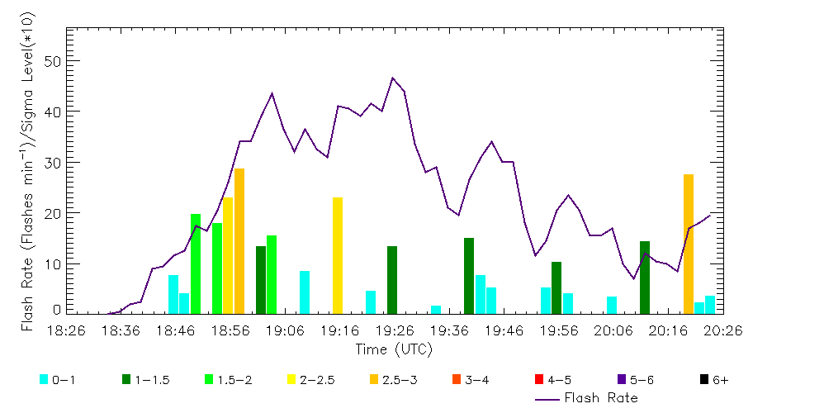
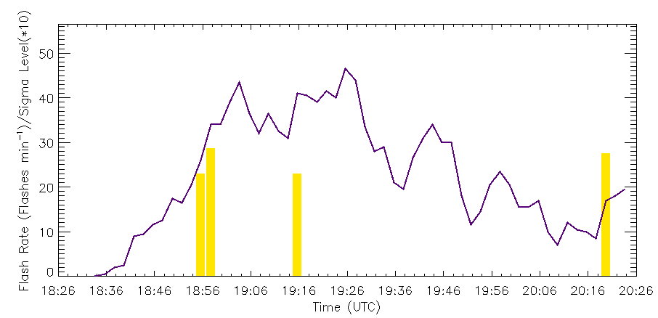
Sigma Level
The sigma level is:
Sigma level =
DFRDT_{to}/σ_{(DFRDT_t-2…t-12)}
Thus a sigma level of 2 is the same as a 2σ lightning jump from Schultz et al. 2009, 2011)
This formulation provides continuous monitoring of increases in flash rate and the magnitude of that flash rate increase relative to the recent flash rate history.
Calhoun et al. (2015); AMS 7MALD
Chronis et al. (2014); WAF
Schultz et al. 2009; 2011 definition of a lightning jump:
DFRDT_{t0}≥ 2*σ(DFRDT_t-2…t-12)
- Yes/No Answer
No information on magnitude of
the flash rate increase

