Slide 1
Utility of the GLM in an Evolving Decision Support Environment
Brian C. Carcione
National Weather Service, Huntsville, AL

Slide 2
The Lightning Jump
Much has been made of the connection between the lightning jump (LJ) and severe weather detection over the last 15 years.
LJ analysis has evolved significantly in the last 5 years, into a more scientifically rigorous, near-operational tool.
Thresholds explored by Gatlin and Goodman (2010) and Schultz et al. (2009, 2011)
A real-time LJA is under development and close to implementation—but this has not yet reached WFOs.
For now, it can be challenging to implement formal thresholds in operations while using LMAs or ENTLN.
Informal LJs are still very useful, especially in marginal situations!

Slide 3
Beyond the Lightning Jump
Increasingly, vital “decisions” are occurring outside of the traditional warning decision-making environment, as a part of “Decision Support Services” for protection of life/property.
Given the expanding emphasis in this area, it seems logical to explore the utility of total lightning.
This “decision-making” can be just as important as a warning, if not more so.

Slide 4
Why GLM/Total Lightning for DSS?
Easy, fast, and effective for assessing storm intensity trends (and potential impacts)
Easy to determine the true aerial extent of lightning
Might offer some lead time on cloud-to-ground strikes, for developing storms

Slide 5
DSS Case Studies
20-21 June 2014 – Rock The South Concert (Cullman, AL)
27 April 2013 (briefly) – Panoply Arts Festival (Huntsville, AL)

Slide 6
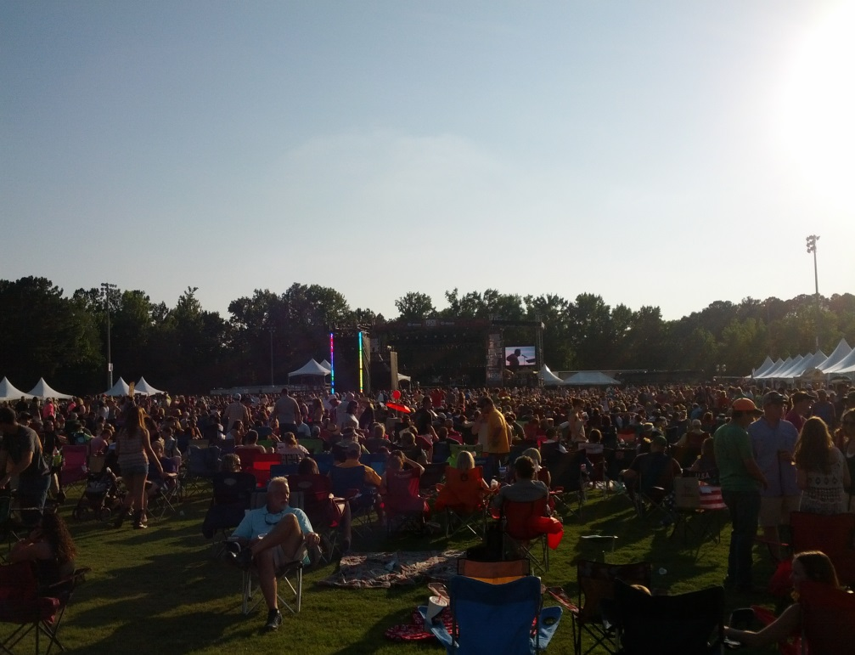
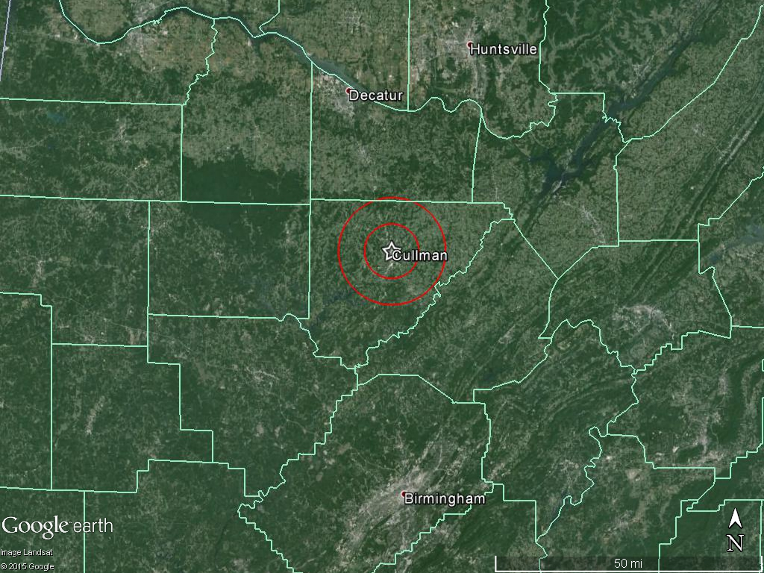
20-21 June 2014: Rock TheSouth
Outdoor concert in Cullman, AL, drawing 15-25,000 people
Substantial shelter is at least ~10 minute walk away
Past incidents at outdoor concerts loom large

Slide 7
Friday Afternoon (20 June)
Typical pulse/airmass thunderstorm environment
Already 3-4 “close calls” – storms which held together past the 10-mile range ring, but fell apart at 5 miles; EMA and concert organizers decided not to evacuate due to short-lived nature of threat
More serious threat evolves after 4 PM
On-site ER-MET with remote support from WFO
Imagery to follow is pGLM data from NASA SPoRT (higher-resolution data from the North Alabama LMA was available in real-time)

Slide 8
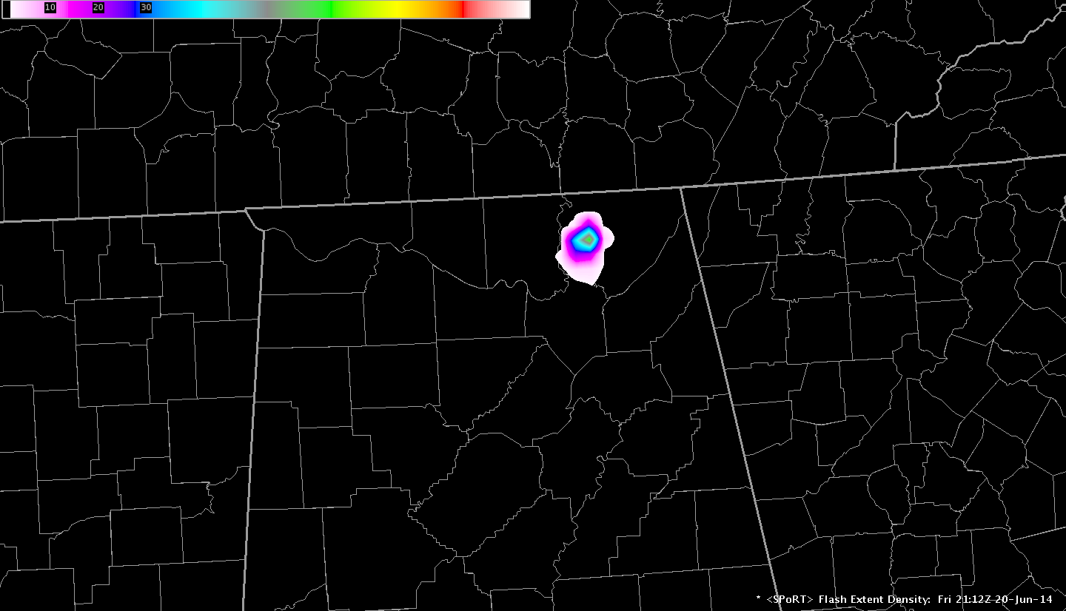
Friday (20 June) – 2112 UTC
(Star roughly covers the 5-mile range ring)

Slide 9
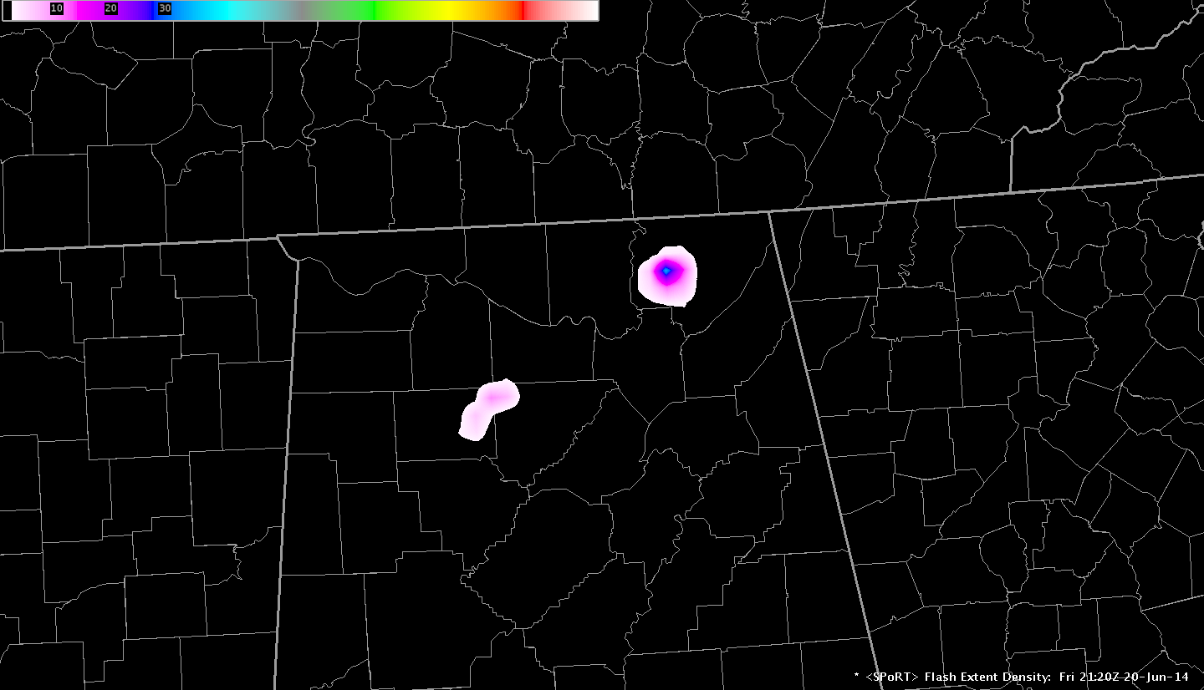
Friday (20 June) – 2120 UTC
First indication of lightning at 2120 UTC (~10 miles)

Slide 10
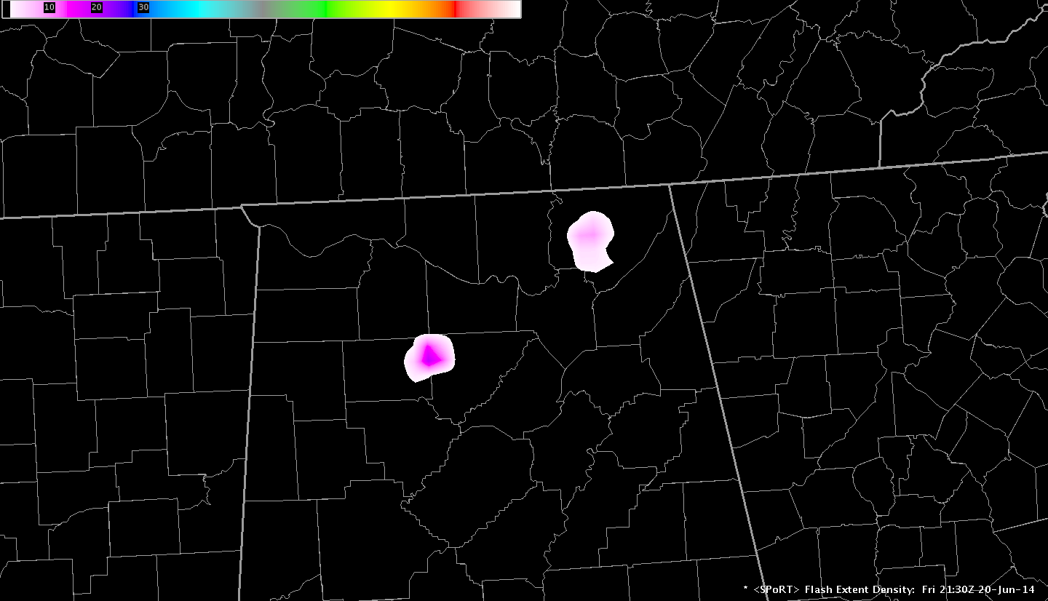
Friday (20 June) – 2130 UTC
EMA notified, concert organizers act to secure stage (show continues)

Slide 11
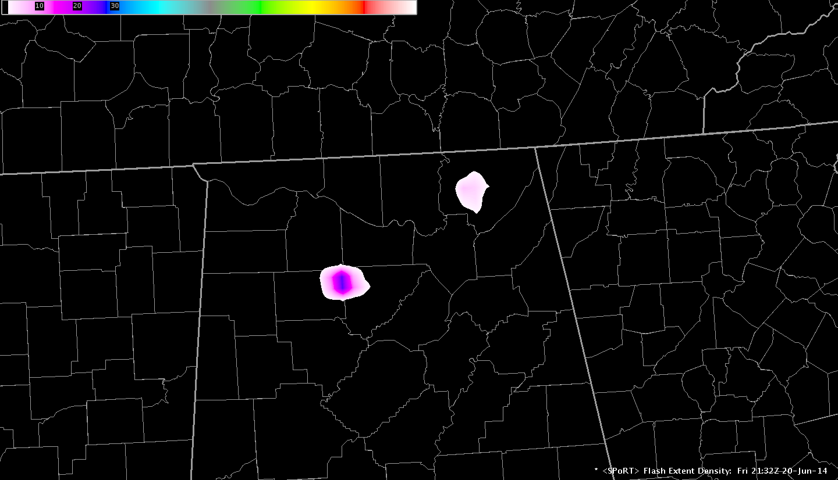
Friday (20 June) – 2132 UTC
Main updraft core remains ~10 miles out; few flashes reaching inside 5 mile ring

Slide 12
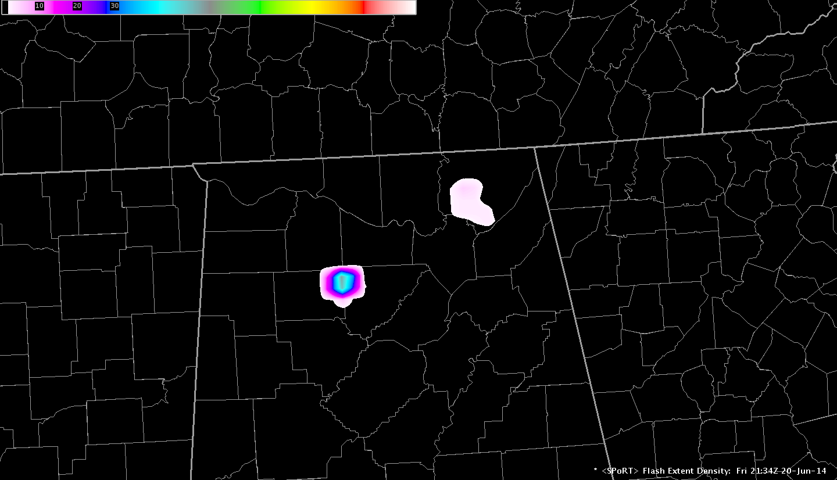
Friday (20 June) – 2134 UTC
Lightning jump? Still no definitive moves toward the site; core still outside 10 mile ring, 1-2 flashes inside 5 mile ring

Slide 13
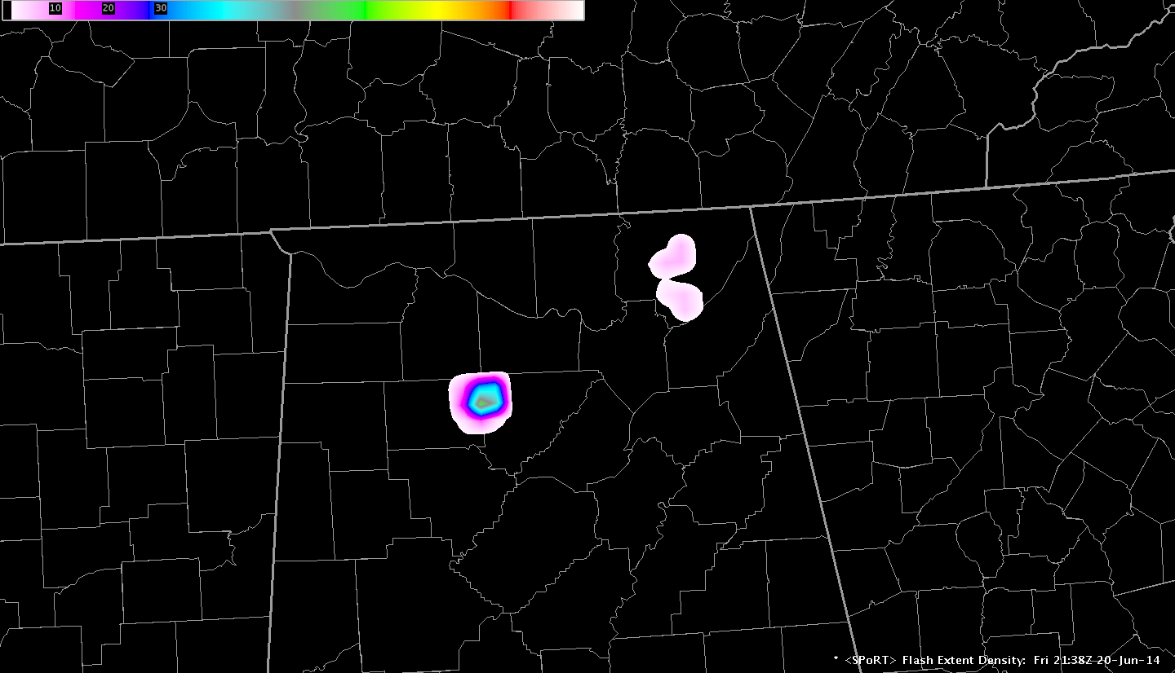
Friday (20 June) – 2138 UTC

Slide 14
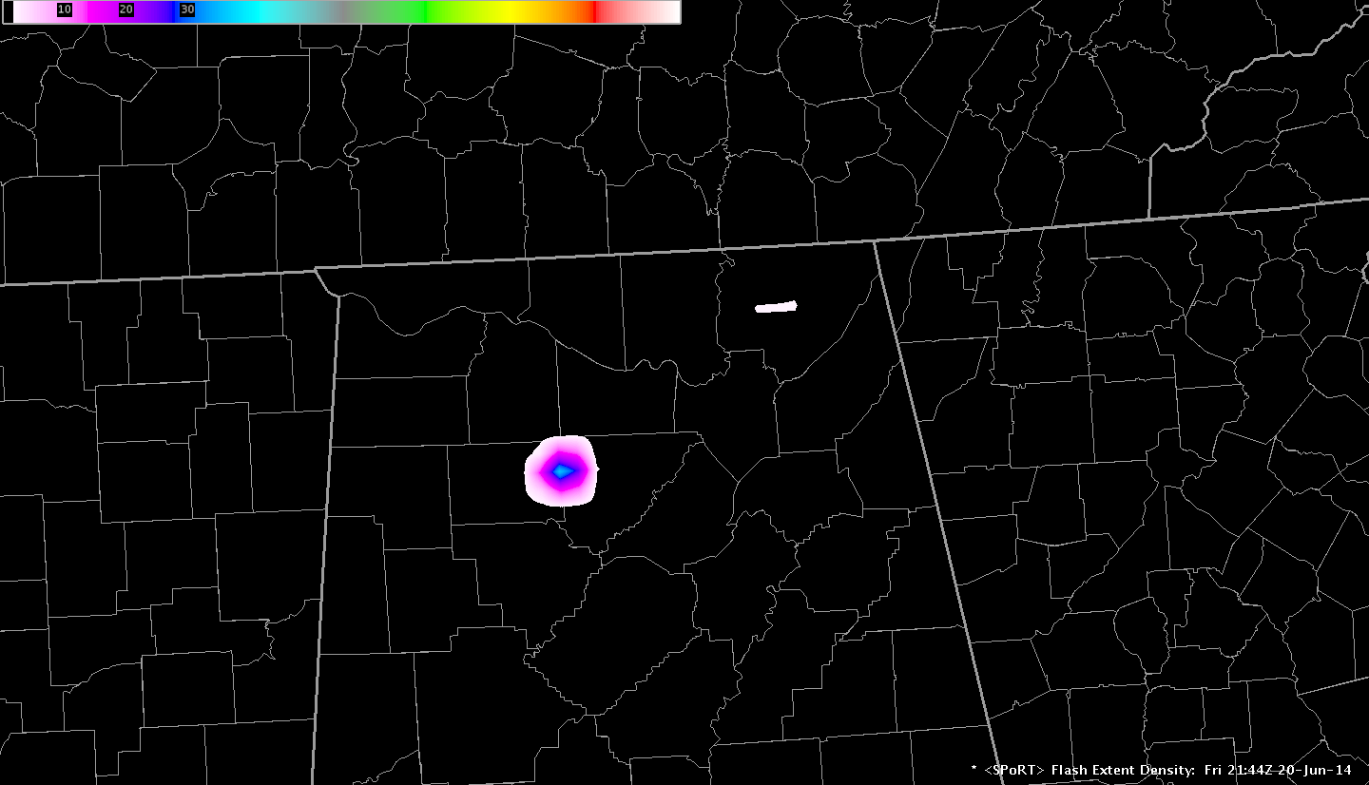
Friday (20 June) – 2144 UTC
Marked decrease; majority of flashes remain beyond 5 miles

Slide 15
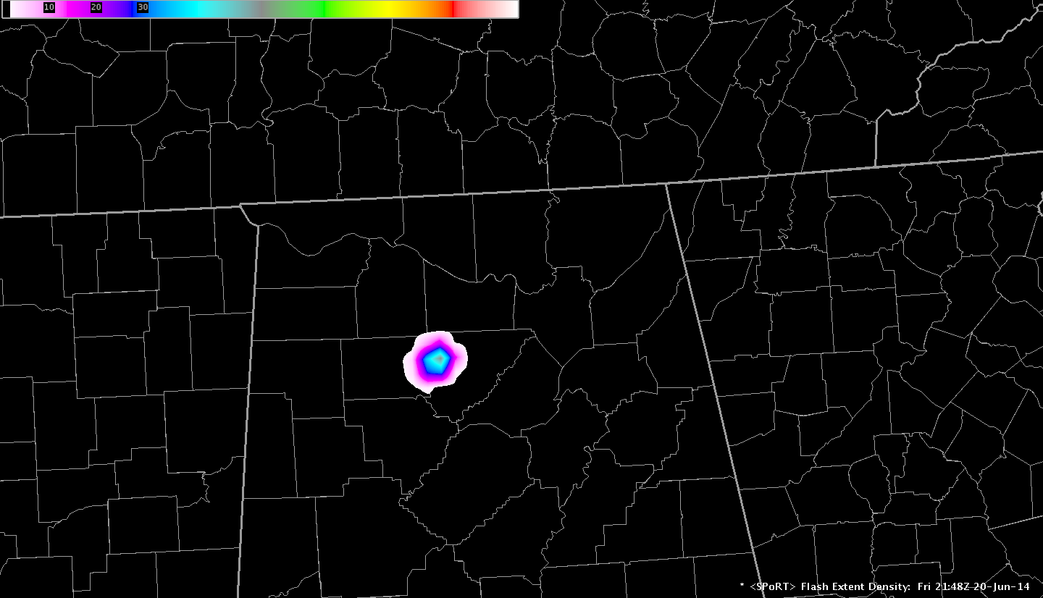
Friday (20 June) – 2148 UTC
Eastward shift; core at ~10 miles, few flashes inside 5 mile ring

Slide 16
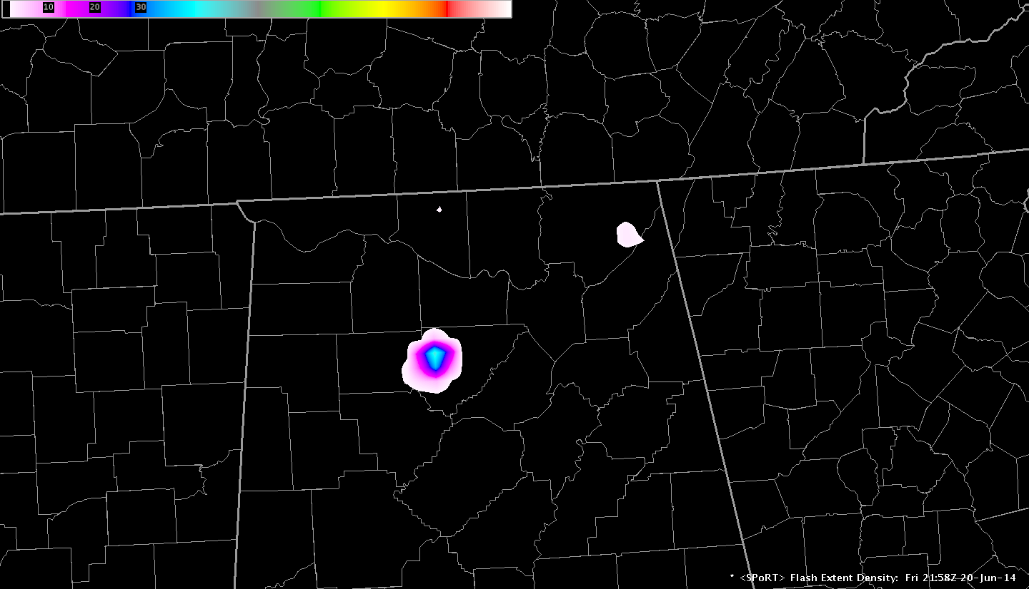
Friday (20 June) – 2158 UTC
Several flashes (one CG) inside 5 mile ring, but SW trend with core continues (and would persist for the next 10 mins).

Slide 17
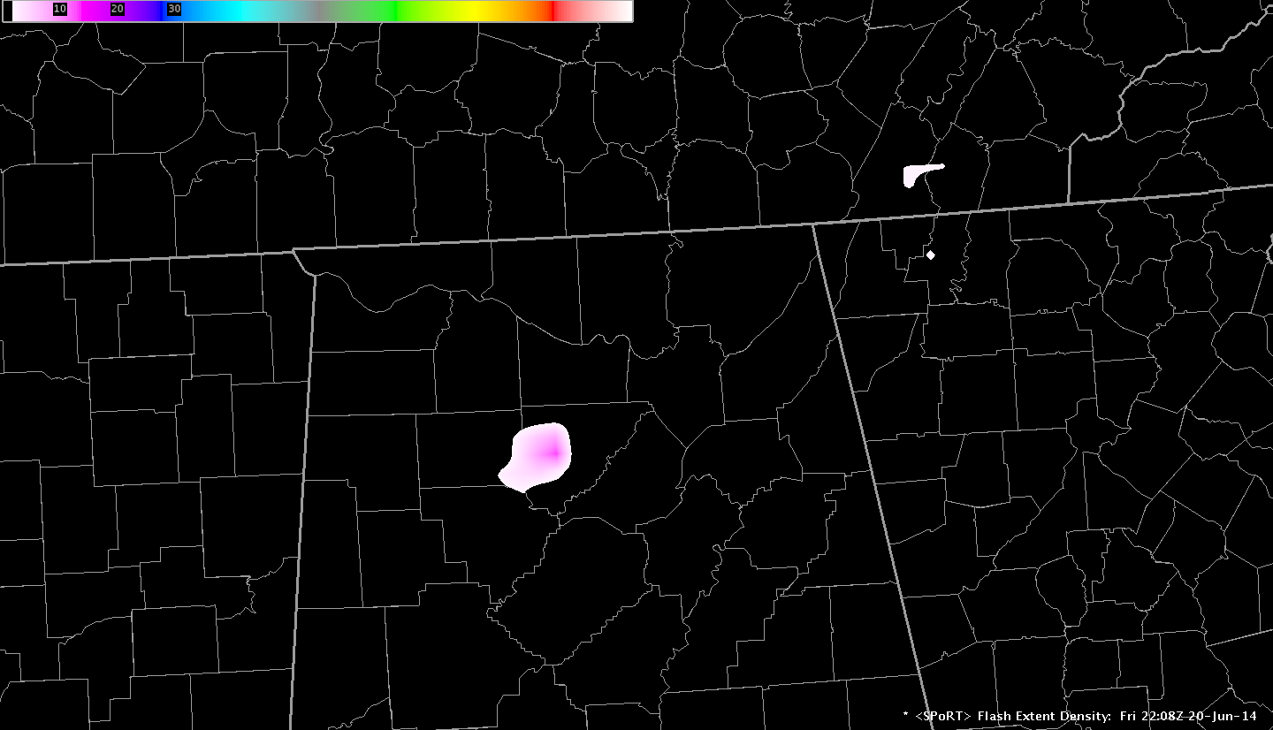
Friday (20 June) – 2208 UTC

Slide 18
Friday Afternoon: Lessons Learned
LMA/pGLM effectively illustrated the core and overall aerial extent of lightning.
It was a very close call, but ultimately the storm did not come close enough to trip the event’s operating procedures.
It was not shown here, but rapid updates (1-2 minutes) aided in EMA/organizer decision-making.
Potential challenges in using GLM for DSS:
Optical instrument will detect flashes differently
8 km spatial resolution is similar in size to the 5-10 mile radii used by some venues, so the situation could be better or worse than indicated by the GLM (as in this case). Forecasters will need to have an awareness of this when advising decision-makers.

Slide 19
Saturday Evening (21 June)
There were more air mass thunderstorms, but all were generally more than 20 miles from the concert site.
A more-organized cluster gathered over extreme northwest Alabama and moved southeast, right over Cullman and the concert.
LMA/pGLM data were more useful for assessing storm intensity (affecting potential duration) and adjustments in propagation—both of which could affect impacts to the site.
Important factor: There was no time (or PC desktop space) to perform full radar interrogation, and volume products such as VIL/DVIL arrive 3-5 minutes later than a total lightning ‘scan’.

Slide 20
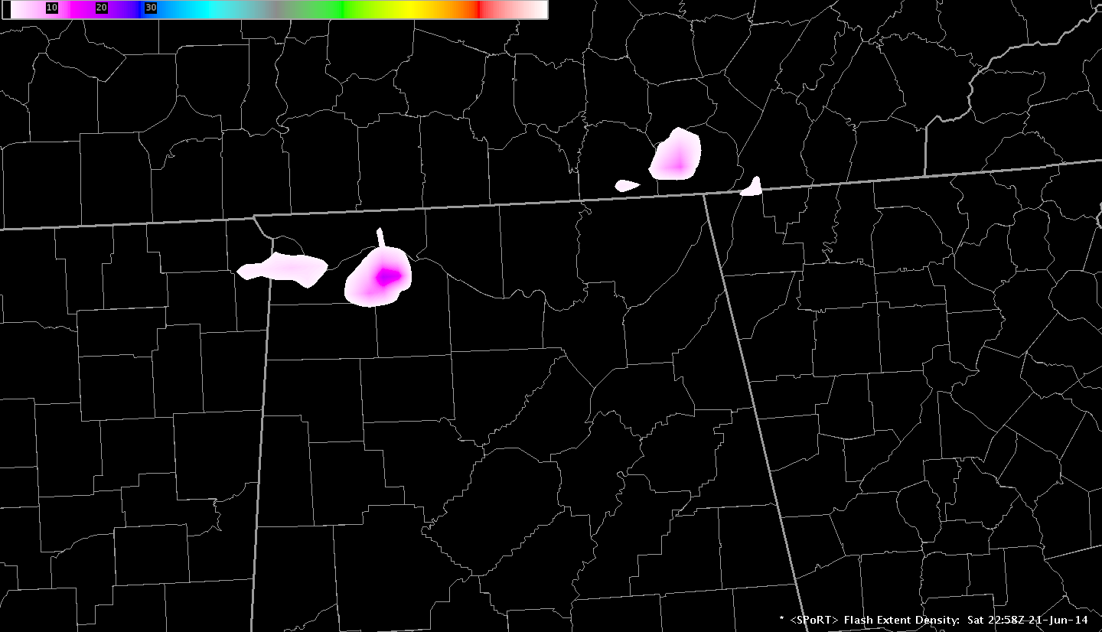
Saturday (21 June) – 2258 UTC

Slide 21
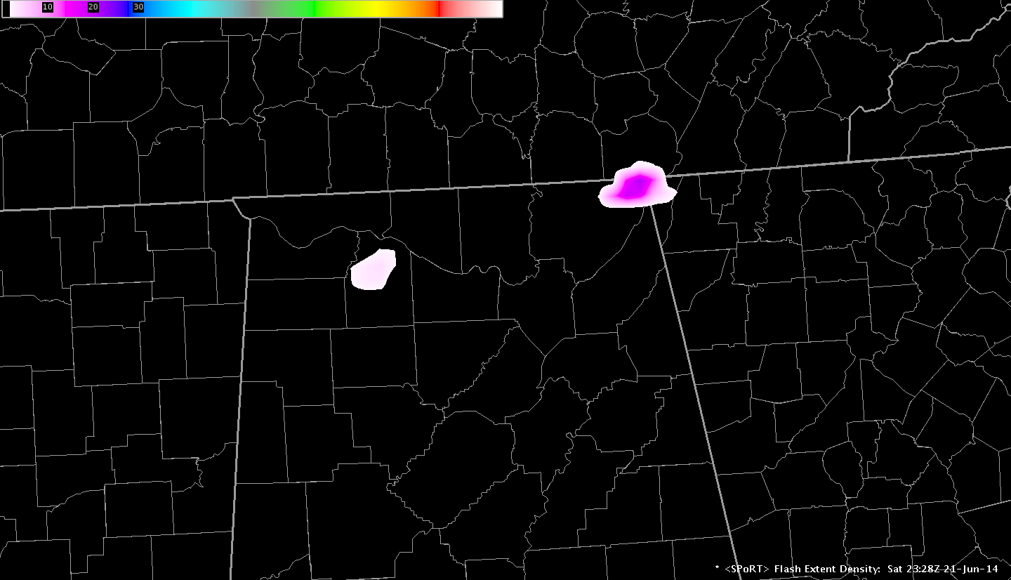
Saturday (21 June) – 2328 UTC

Slide 22
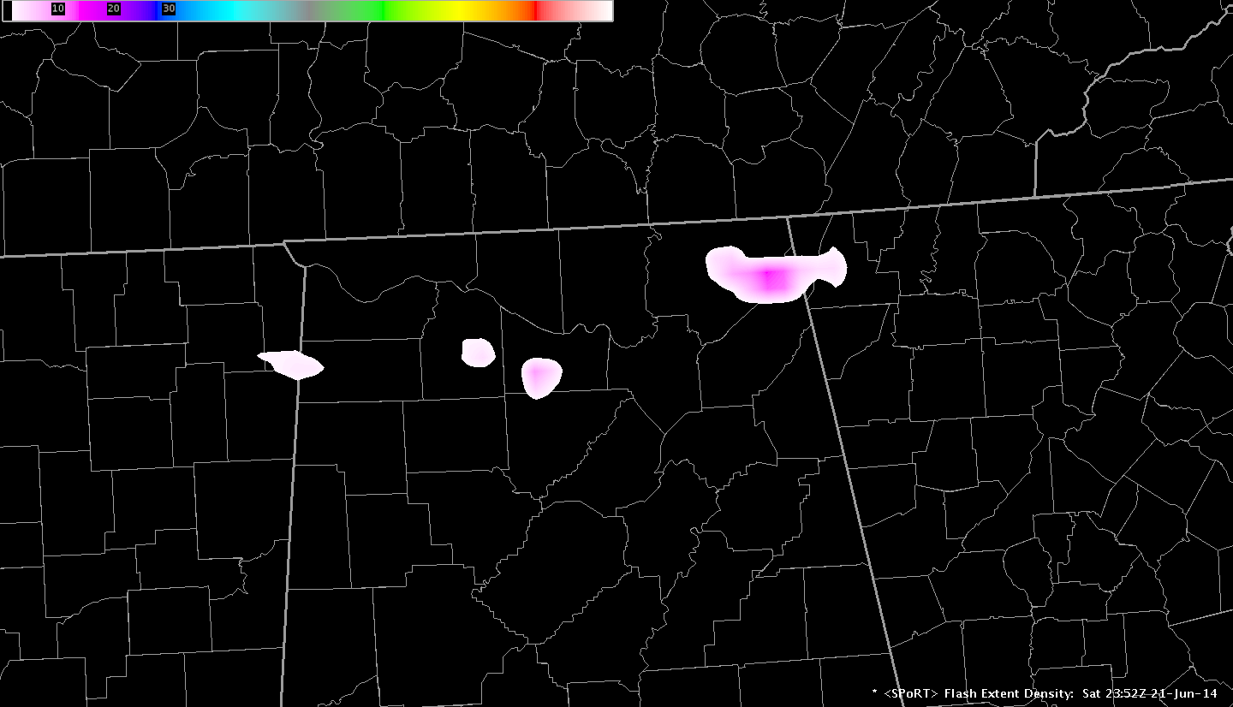
Saturday (21 June) – 2352 UTC
Initial core collapses, but new core develops to SE and continues on original track

Slide 23
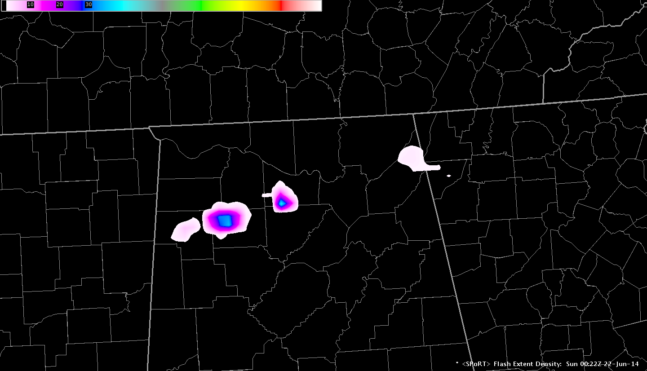
Saturday (21 June) – 0022 UTC
Strongest increase/jump occurs near the 10 mile ring while still moving SSE, indicating the need to evacuate

Slide 24
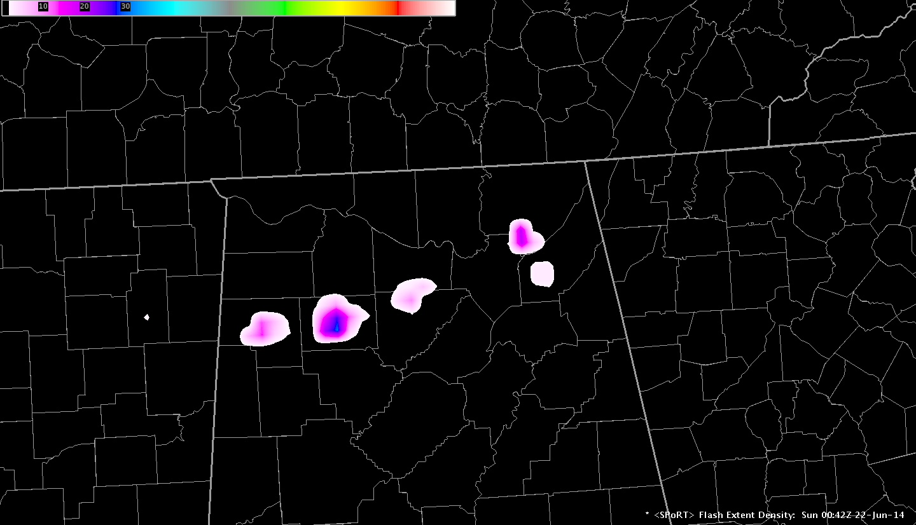
Saturday (21 June) – 0042 UTC
After jump, lightning activity rather weak—but enough to present a threat to the crowd and performers

Slide 25
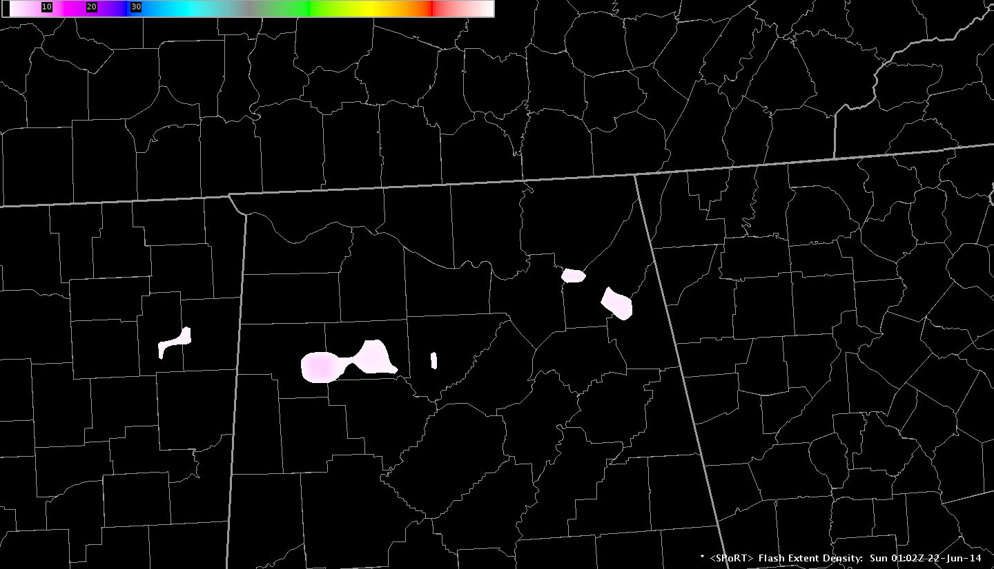
Saturday (21 June) – 0102 UTC
After jump, lightning activity rather weak—but enough to present a threat to the crowd and performers

Slide 26
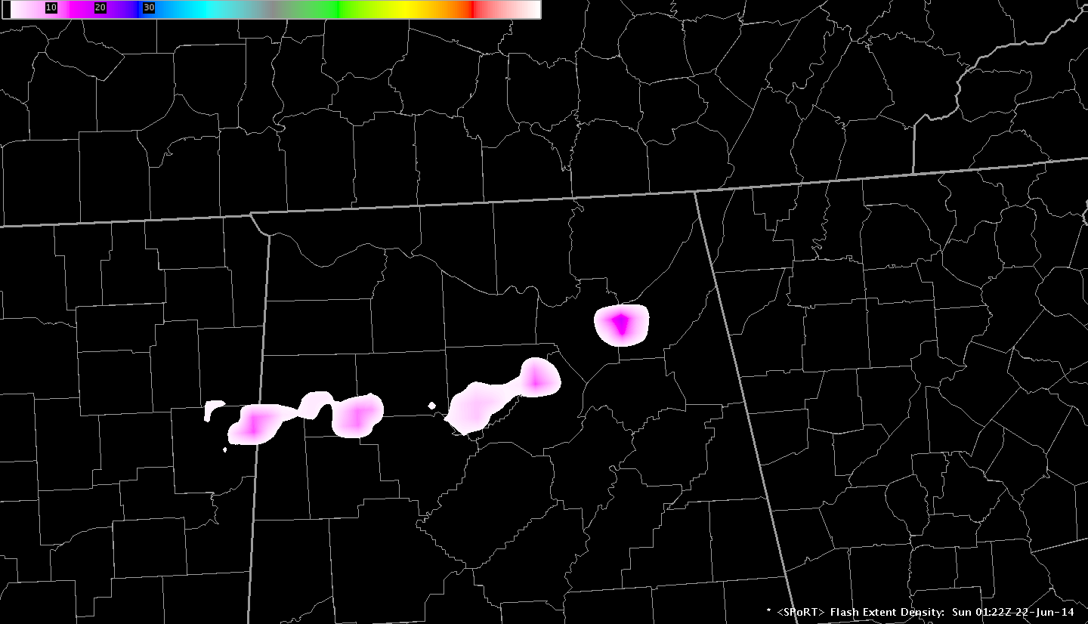
Saturday (21 June) – 0122 UTC

Slide 27
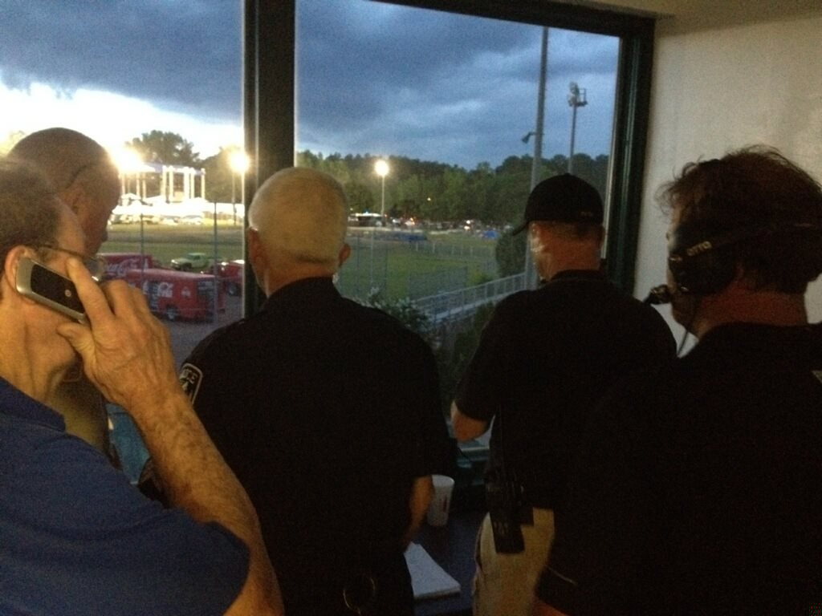
Saturday Evening: Lessons Learned
LMA/pGLM played a different role on Saturday than Friday.
Rather than just showing the aerial extent of lightning, lightning increases increased confidence that the storms would remain intact long enough to affect the concert. (Storm motion was more definitive as well.)
A decision was made to evacuate with plenty of time to spare.
Very positive response from RTS attendees, first responders, and emergency management
NWS Forecaster (hidden)
EMA Room in Incident Command Post
(from Rock The South Facebook Page)

Slide 28
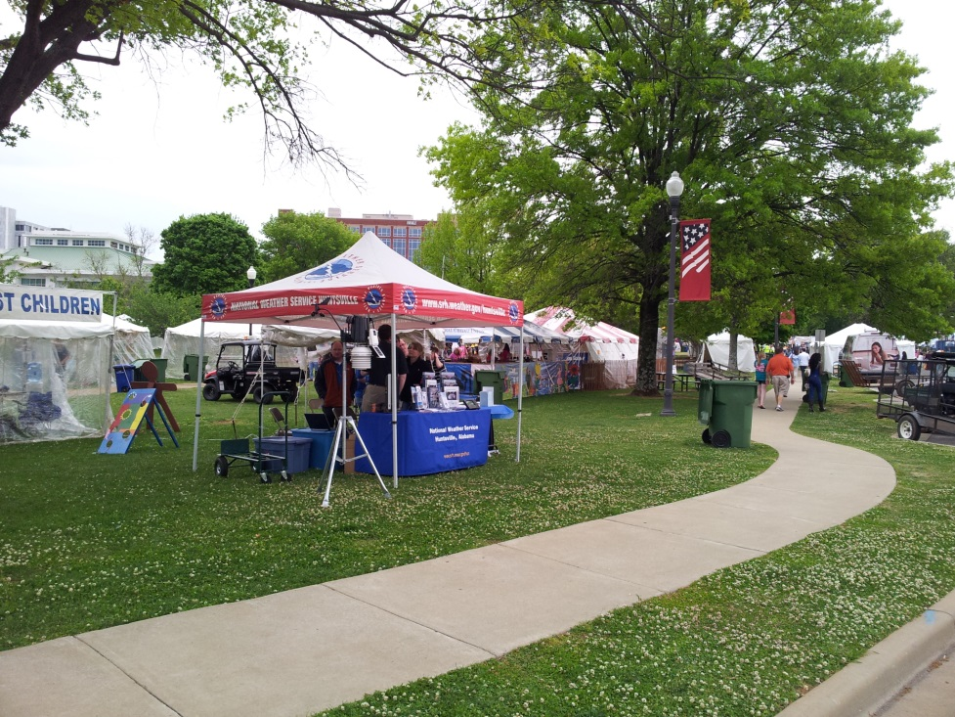
27 April 2013 – Panoply Arts Festival
Outdoor arts festival in downtown Huntsville
Storms were ~50 miles away, yet skies were still dark at the festival (anvils advecting downstream), prompting questions
NLDN indicated CGs closing in. What was happening?

Slide 29
27 April 2013 “Long Flash” Case
There were several more flashes that looked like this over the next 2-3 hours.
By getting a true sense of the spatial extent of the lightning (and its related cause), LMA data allowed forecasters to reassure emergency managers and event organizers.
5
10
20

Slide 30
Primary Takeaways
Easy, fast, and effective for assessing storm intensity trends (affecting potential duration and impacts)
Modest increases or decreases can be a meaningful signal as far as storm intensity, duration, and impacts to a vulnerable situation; DSS is less dependent on the full formal lightning jump. (Further research is needed.)
Forecasters may not have the time/ability to fully interrogate radar. Lightning is the closest and most timely available proxy.
Easy to determine the true aerial extent of lightning, particularly in situations with rapid updates (as GLM is expected to be)
Might offer some lead time on cloud-to-ground strikes, for developing storms
Lead time can be as much as 5-10 minutes (based on informal experience in Alabama). Additional research is needed here as well.

Slide 31
Thank you!
Brian Carcione, WFO Huntsville, AL
Brian.Carcione@noaa.gov
Acknowledgements:
Geoffrey Stano (NASA SPoRT) and Kris White (HUN/SPoRT)

