Slide 1

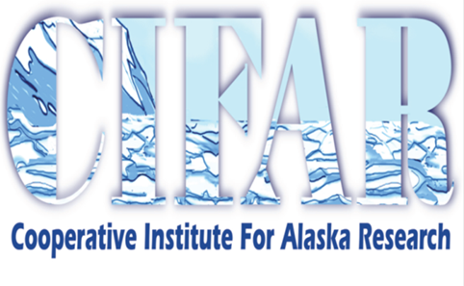


Operational Use of the
Day-Night Band in Alaska
Eric Stevens
University of Alaska Fairbanks (UAF), Geographic Information Network of Alaska (GINA)

Slide 2
Outline
The Alaskan Advantage
Operational Uses of DNB in Alaska
DNB Enhancement Issues
Closing Thoughts for Operational Users

Slide 3
The Alaskan Advantage
When forecasting weather, the situation in Alaska is often “different”
“Different” is a polite way of saying, “bad.”
  88D radar network has substantial gaps
  Upstream areas are very data-sparse
  NWP performance can fail to capture subtle, but high-impact, phenomenon like the “black stratus”
  Etc…

Slide 4
The Alaskan Advantage
However, with regard to the Day-Night Band, Alaska has two unique advantages:
  High number of polar orbiter passes thanks to high latitude
  Minimal light pollution thanks to low population
Advantage 2 can be compromised by aurora.
  Aurora in the DNB is fun to see, but is actually a hindrance to the operational forecaster because it can mask the meteorological signal below
  Aurora, unlike cities, change rapidly with time and are not a problem every pass

Slide 5
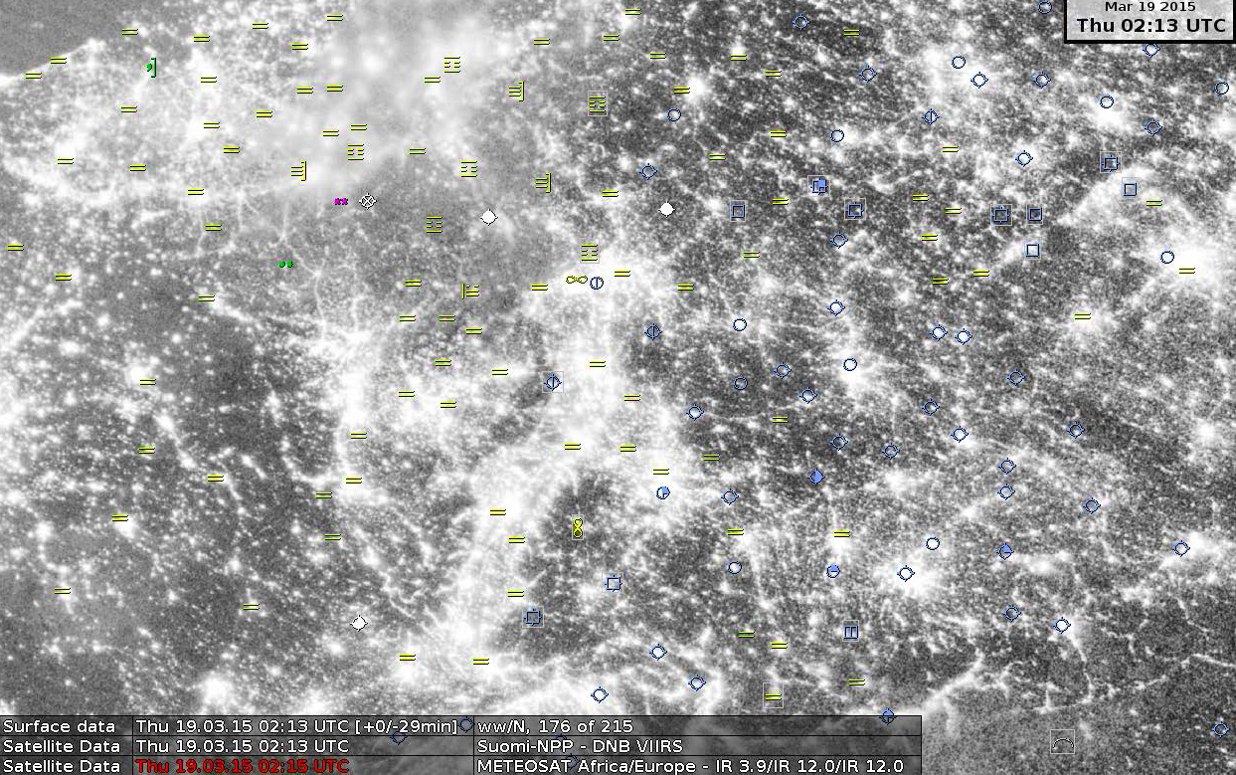
Notes:
Image courtesy of Dr. Katjia Hungershoefer, Deutscher Wetterdienst. Screen capture from DWD display system NinJo, their equivalent to NWS’ AWIPS. Forecasters say they don’t really find much use in the DNB at night because they, “already know where the cities are.”

Slide 6
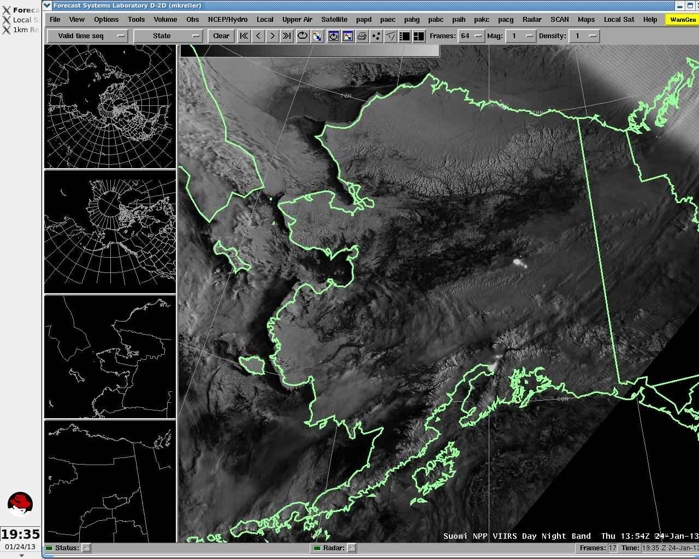
Notes:
In contrast, Alaska is the “North Korea of the USA.”

Slide 7
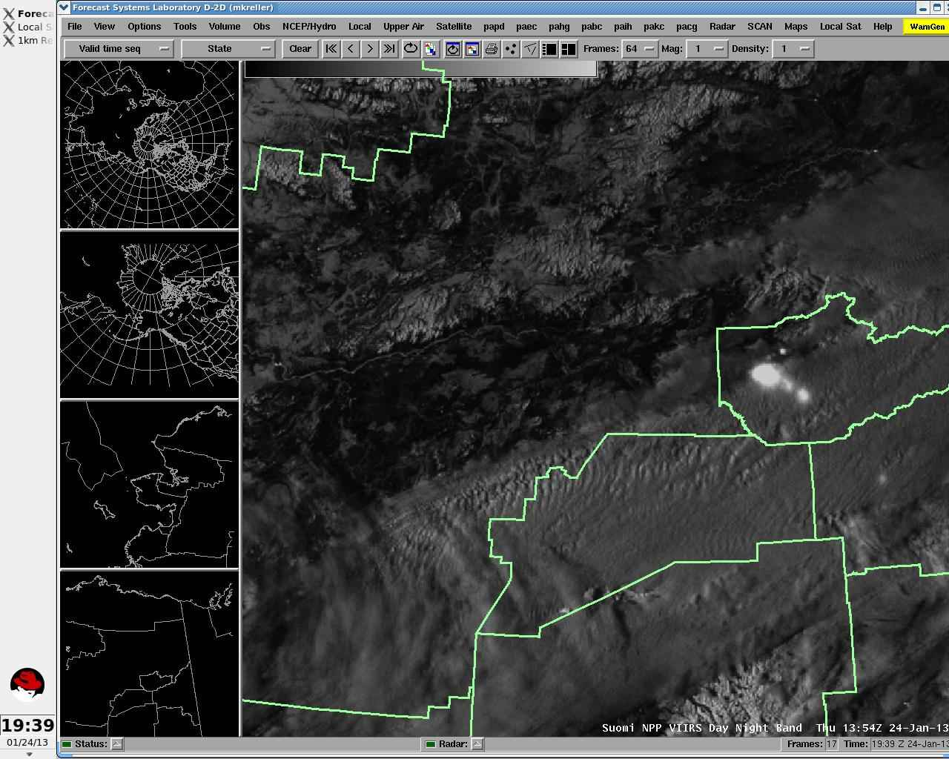

Slide 8
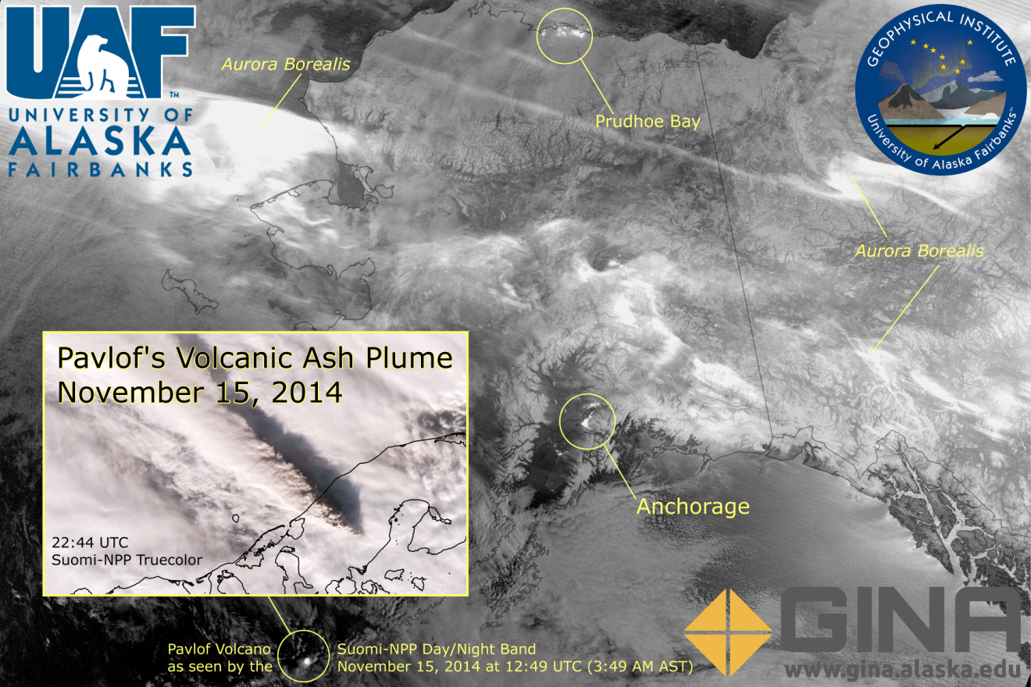

Slide 9
Operational Uses of DNB
In contrast to RGBs, the DNB has required less training and learning curve for forecasters
Forecasters treat it like visible imagery that works at night
Added advantage that one can qualitatively infer the thickness of clouds by assessing how ground signal penetrates through clouds
DNB best used in conjunction with other data sets

Slide 10
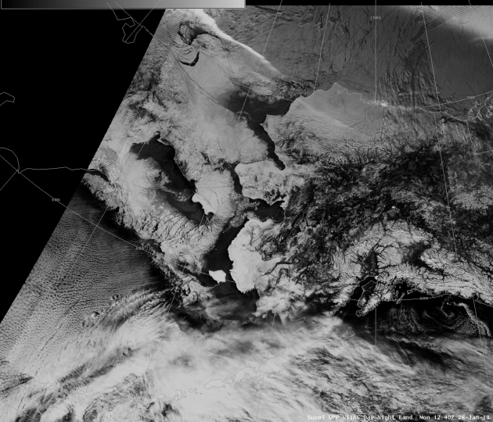
NWS Ice Program uses DNB

Slide 11
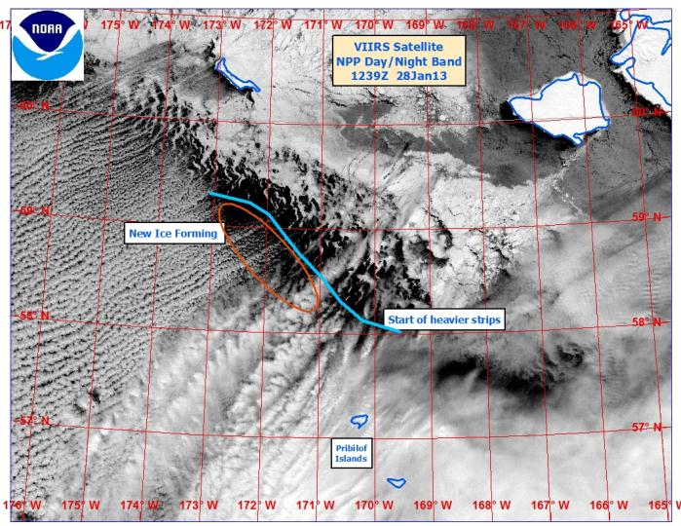
NWS Ice Program uses DNB

Slide 12
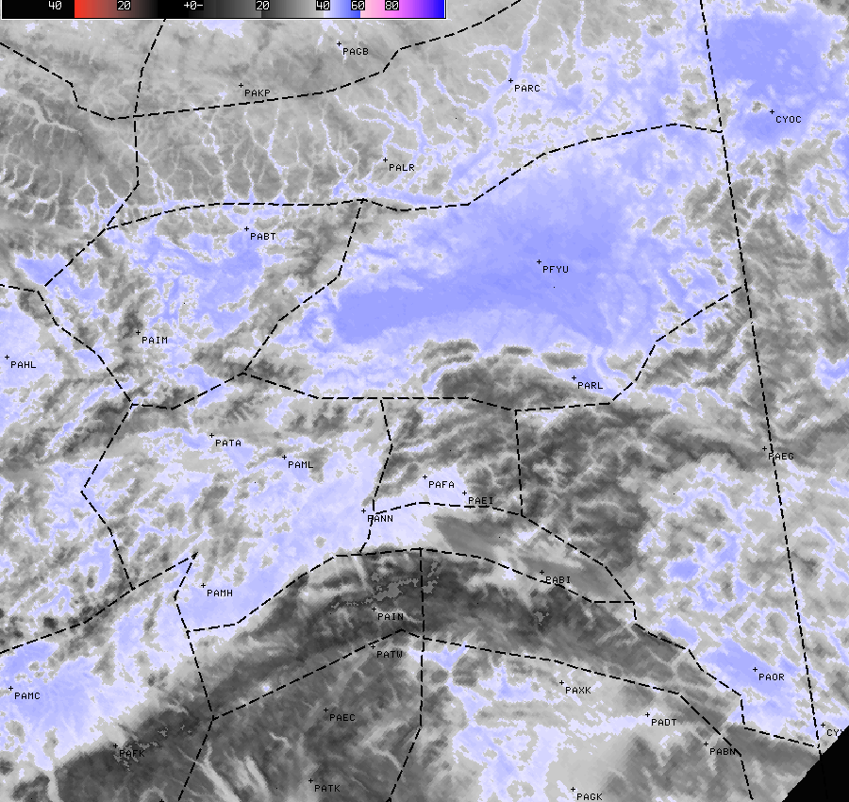
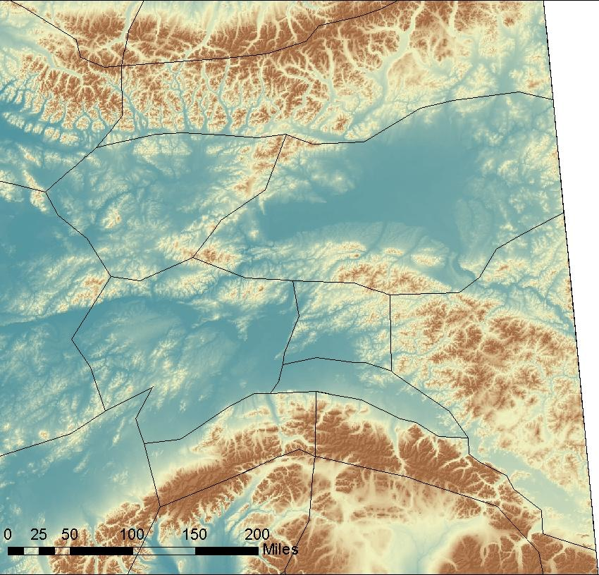
Without DNB, difficult to differentiate low clouds from wind mixing out an inversion

Slide 13
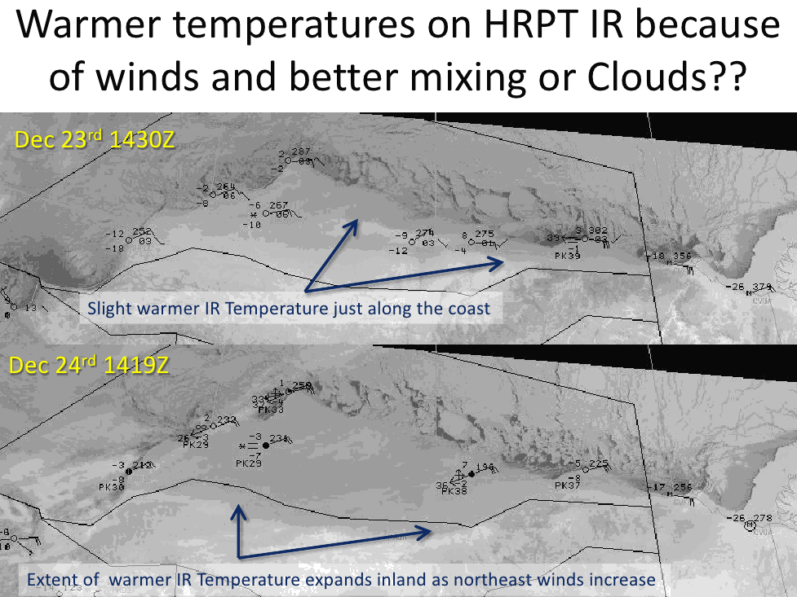

Slide 14
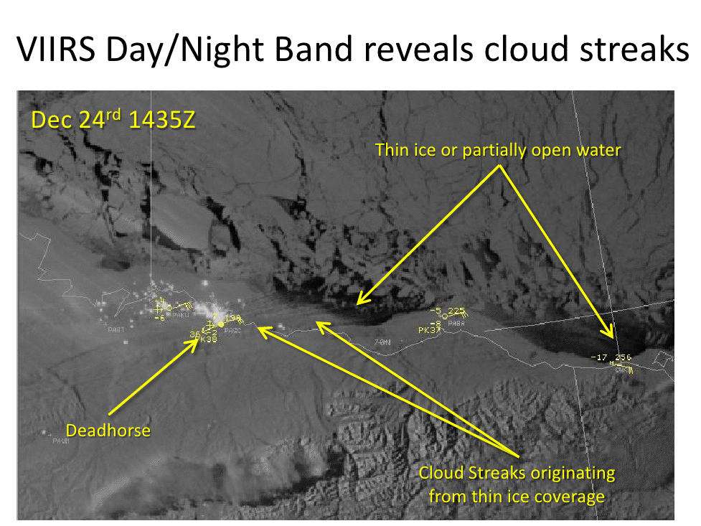

Slide 15
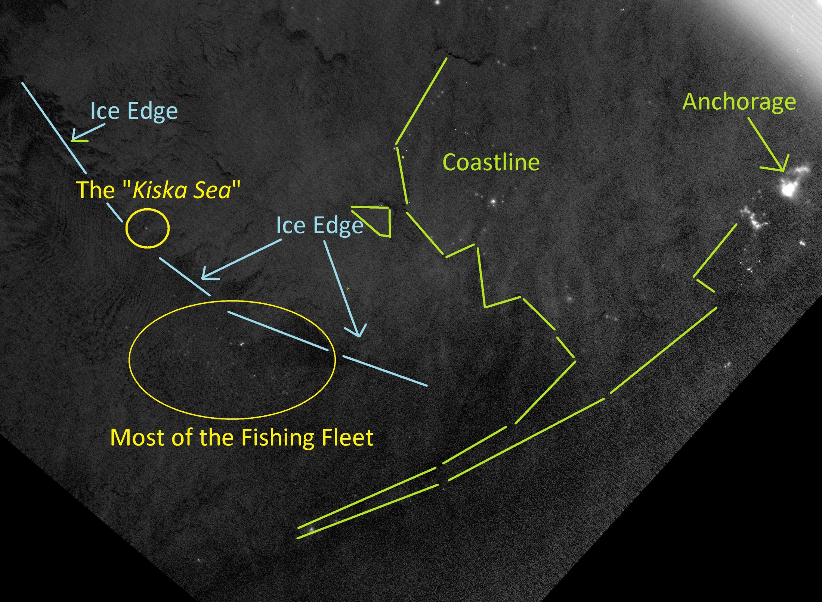
Notes:
The classic “Kiska Sea” shot. Feb 13, 2013, near period of new moon

Slide 16
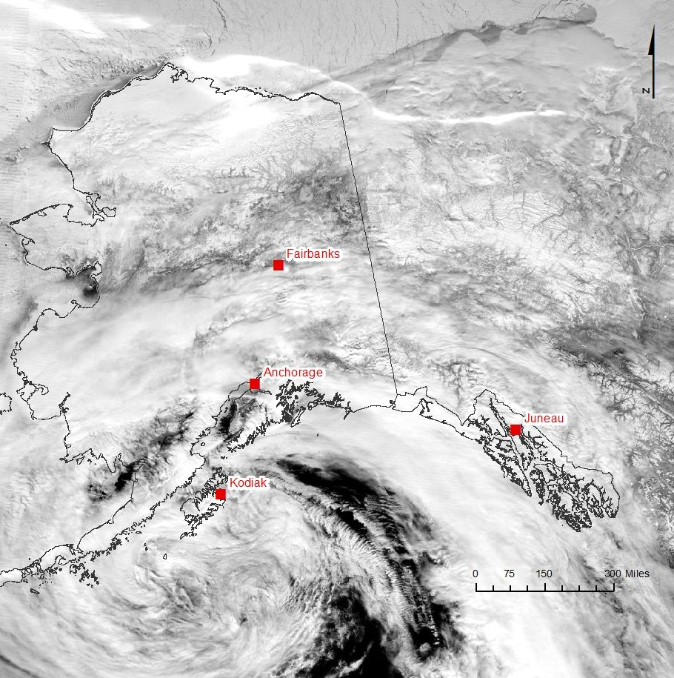
Notes:
DNB 2:41am Dec 30, 2012. Oil platform Kulluk torn from its tug by storm in Gulf of Alaska; Kulluk grounded near Kodia Island. Near time of full moon.

Slide 17
DNB Enhancement Issues
DNB enhancement can fail when the solar terminator crosses the swath
In Alaska this happens all night in the summer
  Also happens at mid-day in winter
Addressed this issue in 2013. But now it is back?!

Slide 18
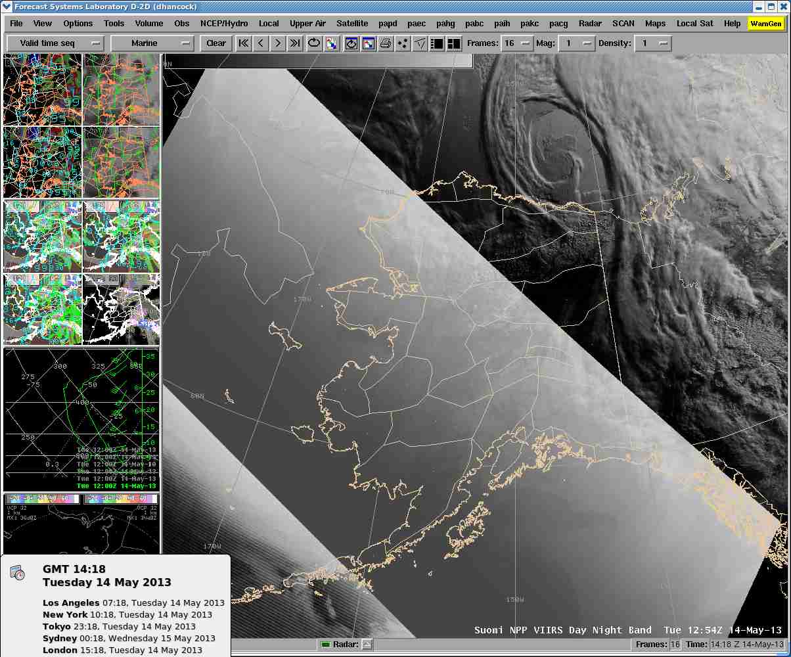

Slide 19
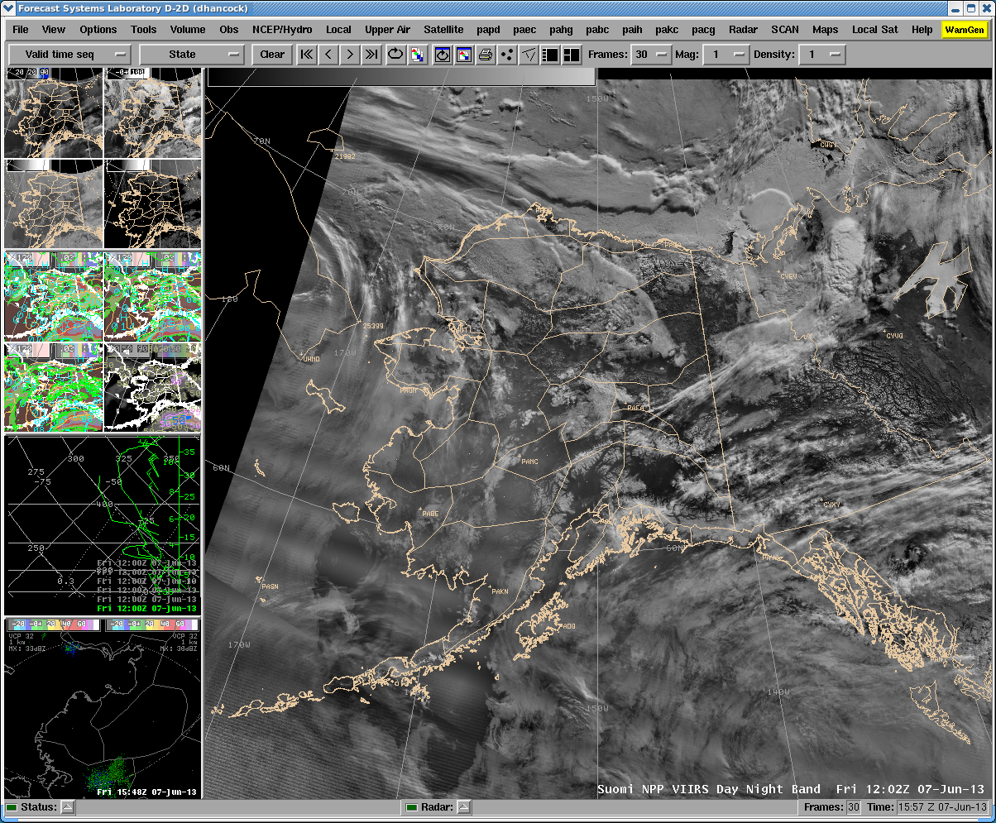

Slide 20
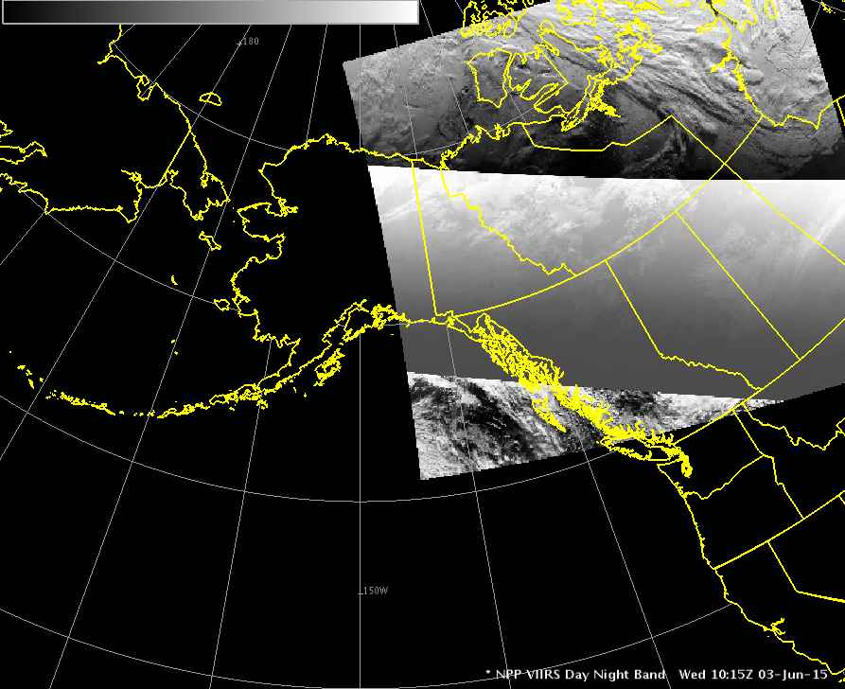

Slide 21
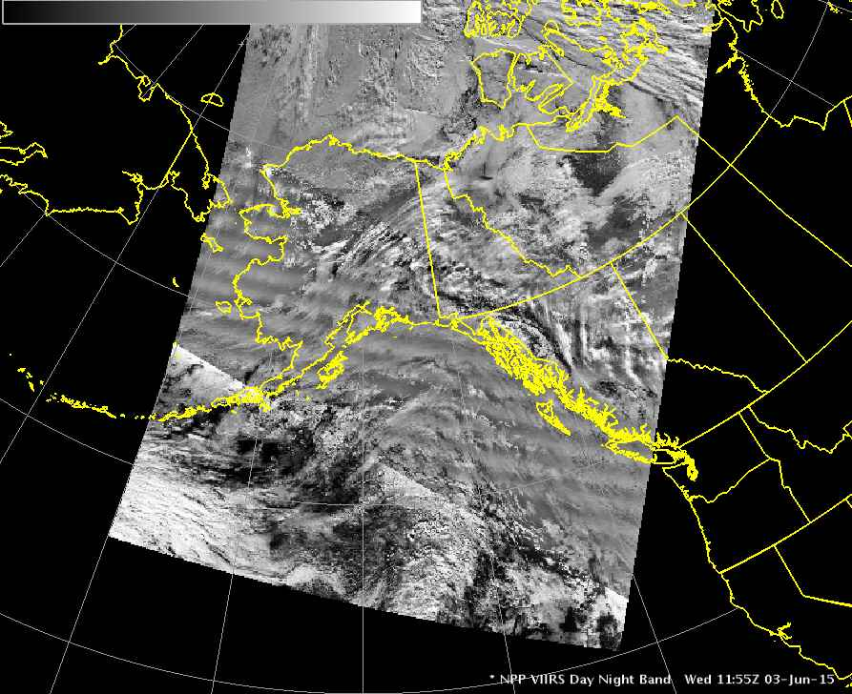

Slide 22
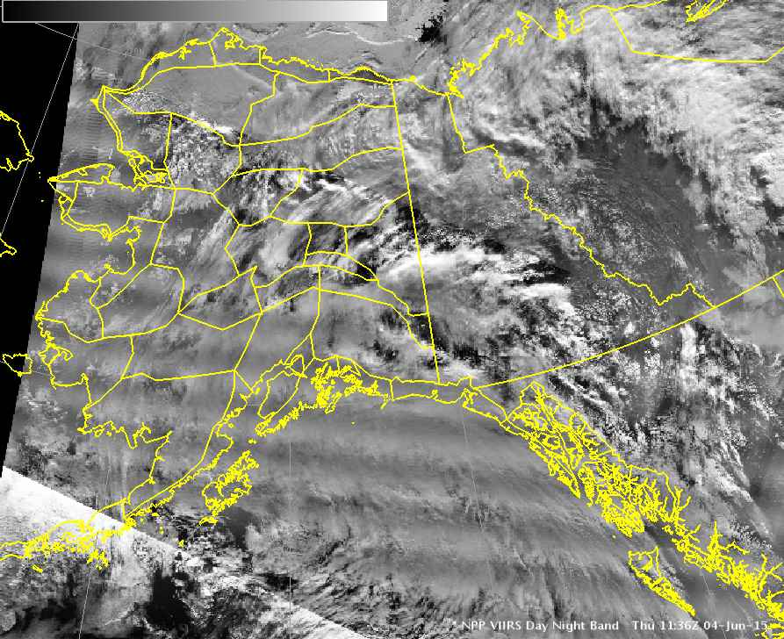

Slide 23
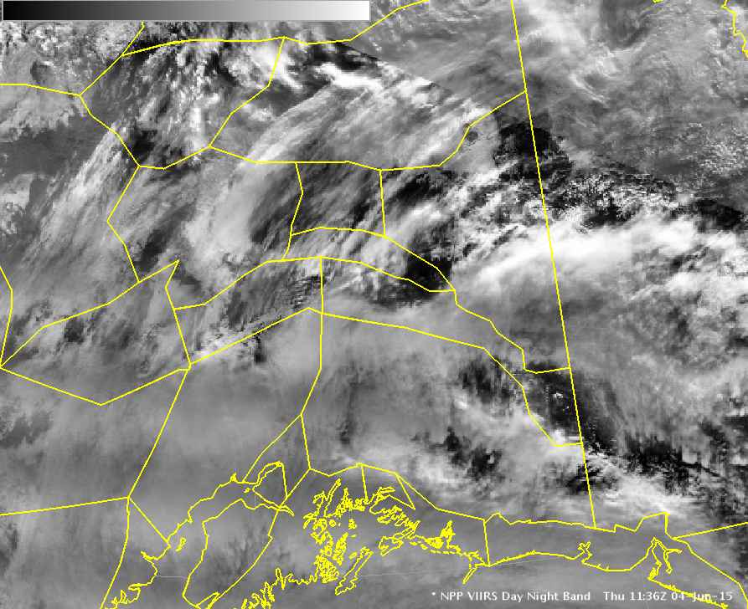

Slide 24
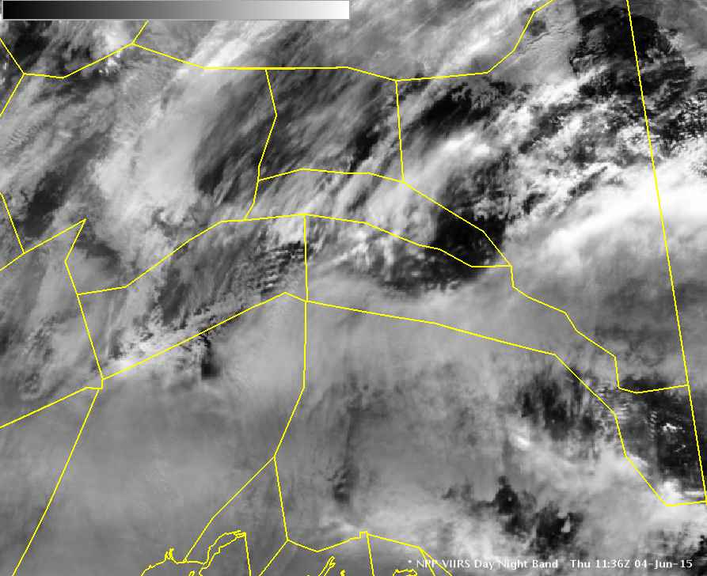

Slide 25
Closing Thoughts for Operational Users
As with all products, DNB is best used in conjunction with other data sets
DNB has already proven particularly useful in…
  Assessing thickness of clouds
  Discriminating clear and windy areas from cloudy areas over land…these areas can appear similar on IR
  Determining the extent of sea ice
  Identifying ships
  Communicating via social media; DNB is comparatively easily understood by the general public
We are still learning about the capabilities of the DNB…be open to uses not yet discovered.
If something breaks, please complain to your local ITO, SOO, satellite liaison, etc.

Slide 26

eric@gina.alaska.edu

