Slide 1
The NOAA Unique CrIS/ATMS Processing System (NUCAPS): Introduction and recent research activities.
Chris Barnet, Antonia Gambacorta, Mitch Goldberg
2015 NOAA Satellite Proving Ground / User Readiness Meeting
Thursday, June 18, 2015, 9:45 am
Notes:
15 minutes total

Slide 2
Discussion Points
Quick overview of NOAA-Unique CrIS/ATMS Processing System (NUCAPS)
NOAA Sounding Initiative Activities
  Cold Air Aloft Initiative
  CalWater 2 Campaign, Jan/Feb 2015
Future Plans

Slide 3
NOAA-Unique CrIS/ATMS Processing System (NUCAPS)
The NUCAPS science code was derived from the AIRS multi-author Science Team (AST) science code
NUCAPS was designed to be instrument independent
  Meets NOAA’s enterprise goals
The NUCAPS science code was also used for the NOAA operational Metop (IASI, AMSU, MHS, AVHRR) system.
Science code is easily configurable for these datasets
  Retrieval code can be configured to run AIRS, IASI, or CrIS
  Can be used for simulation of hypothetical instruments
  Can mix and match sensors (e.g., Aqua AIRS + NPP ATMS)

Slide 4
What makes this algorithm unique?
Designed to use all available sounding instruments.
  Only ancillary information is surface pressure from GFS forecast
  Microwave radiances used in many steps
    microwave-only physical retrieval, “cloudy” regression, “cloud cleared” regression and downstream physical T(p) and q(p) steps
  Use a comparison of 4 independent retrieval steps for quality control (QC) in addition to traditional QC (residuals, etc.).
Utilizes the high-information content of the hyper-spectral infrared – both radiances and physics.
  All channels used in constrained regression first guesses.
    Provides vertical structure
  Utilize forward model derivatives help constrain the solution.
    Physical steps use full off-diagonal covariance of (obs-calc) errors.
    Minimizes arbitrary a-priori constraints.

Slide 5
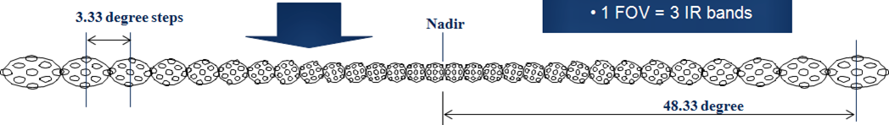
Goal of NUCAPS is to sound close to surface
We use a cluster of 9 infrared footprints and co-located microwave to eliminate the effects of clouds
  Cloud clearing sacrifices spatial resolution to see closer to surface.
  Cloud clearing works in ~70% of cases (~225,000 / 324,000 per day)
For all 3 hyperspectral infrared instruments (AIRS, IASI, and CrIS) we have 30 retrieval fields-of-regard per 2200 km swath
  Nadir retrieval field of regard is ~50 km, Edge of scan is ~70x135 km
  At this scale ~95% of all retrievals would have been impacted by clouds
FOR=1
FOR=15
FOR=16
FOR=30

Slide 6
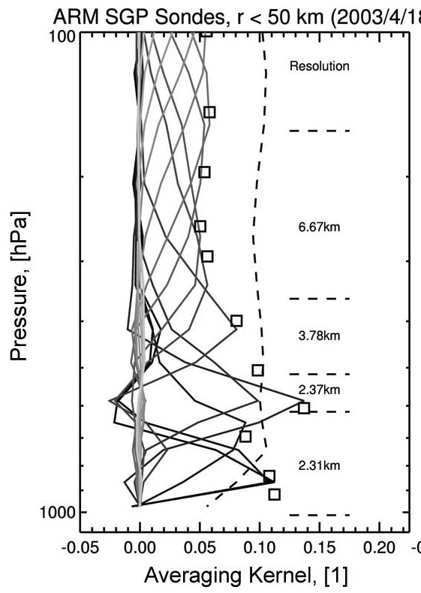
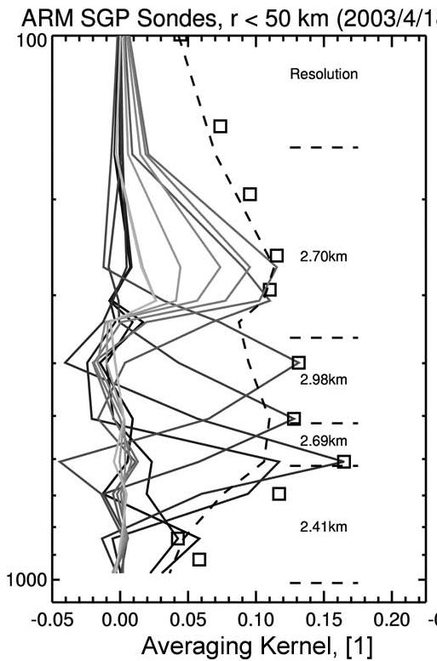
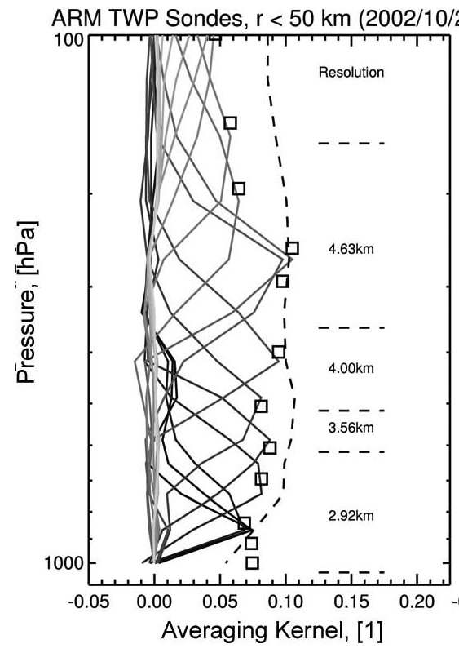
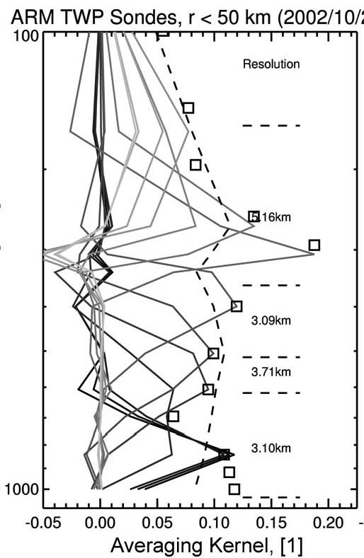
Vertical Resolution and Averaging Kernels
Temperature
Water
CONUS
(top panels)
From Maddy 2008 IEEE Tran. Geosci. Rem. Sens. v.46 p.2375-2384
Tropical
(bottom panels)
NOTE: GOES, HIRS and AMSU resolution would be ≈6-8 km by this definition
Notes:
Clearly separate information in different layers
Easily compute layered water vapor or temperature averages
Maddy, E.S. and C.D. Barnet 2008. Vertical resolution estimates in
Version 5 of AIRS operational retrievals. IEEE Trans. Geosci. Remote
Sens. v.46 p.2375-2384.

Slide 7
Summary of products from
NUCAPS (and AWIPS-II)
gas | Precision | d.o.f. | Interfering Parameters | Sensitivity
Temperature Profile, T(p), SST, LST | 1.5K/km | 6-10 | Emissivity, H₂O, O3, N2O | surface to ~1 mb
Water Profile, H₂O(p) | 15% | 4-6 | CH4, HNO3 | surface to ~300 mb
Cloud Top Pressure Cloud fraction | 25 mbar, 1.5K, 5% | 2 18 | CO2, H2O | surface to tropopause
Ozone, O₃ | 10% | 1+ | H2O, emissivity | Lower stratosphere
Carbon Monoxide, CO | 15% | ≈ 1 | H₂O, N2O | Mid-troposphere
Methane, CH₄ | 1.5% | ≈ 1 | H2O, HNO3, N2O | Mid-troposphere
Carbon Dioxide, CO₂ | 0.5% | ≈ 1 | H2O, O3, T(p) | Mid-troposphere
Sulfur Dioxide, SO₂ | ≈ 50% | < 1 | H2O, HNO3 | Volcanic flag
Nitric Acid, HNO₃ | ≈ 50% | < 1 | emissivity H2O, CH4, N2O | Upper troposphere
Nitrous Oxide, N₂O | ≈ 5% | < 1 | H2O, CO | Mid-troposphere
Notes:
O3 = Ozone, CO = Carbon Monoxide, CH4 = Methame
CO2 = Carbon Dioxide, SO2 = Sulfur Dioxide, HNO3 = Nitric Acid
N2O = Nitrous Oxide
Ammonia = NH3 = 7.5*BT(867.75)/(BT(861.25)+BT(873.5)) mg/m^2
Clarisse, L., C. Clerbaux, F. Dentener, D. Hurtmans and P.F. Coheur
2009. Global ammonia distribution derived from infrared satellite
observations. Nature Geoscience v.2 p.479-483.
IASI products: http://www.class.ngdc.noaa.gov
HNO3: -1.4 K/100% at 879, -1.17K/100% at 1325.6
N2O: -0.44H/5% at 1300, -0.726K/5% at 2220.2
CFCl3(F11): 0.08/10% at 847
CF2Cl(F12): 0.124/10% at 922
SO2: -0.2K/1000% at 1345,1371 cm-1
CCl4: -0.026K/10% at 795

Slide 8
Availability of NUCAPS
(with latency)
Apr. 18, 2014 NUCAPS operational at OSPO
  Via DDS subscription in near real time (≤ 3h)
  Via CLASS interactive webpage (~ 6h)
Sep. 2014 AWIPS-II implementation begins
  NUCAPS T(p) and H2O(p) products can be displayed as skew-T and manipulated (≤ 3h)
Feb. 24, 2015 NUCAPS operational at CSPP direct broadcast stations
  Much better latency (~30 minute)
  CSPP = Community Satellite Processing Package
  Support field campaigns and science evaluations
Soon, reprocessing of full mission CrIS+ATMS SDRs and NUCAPS at Univ. Wisconsin (JPSS funded)

Slide 9
NOAA/JPSS Application Team Initiatives for Sounding
Sounding applications team
  Primary goal is to promote new applications.
  Secondary goal is to encourage interaction between developers and users to tailor NUCAPS to applications
We currently have 5 active initiatives for sounding
  AWIPS-NUCAPS training module and improvements
    Brian Motta will discuss this
  Aviation Weather Testbed (AWT) Initiative
  Hydrometeorology Testbed (HMT) Initiative
  Hazardous Weather Testbed (HWT) Initiative
    Dan Nietfeld will discuss this
  Trace Gas initiative (ESRL/CSD, CIMSS)
    Future work (will not discuss today)

Slide 10
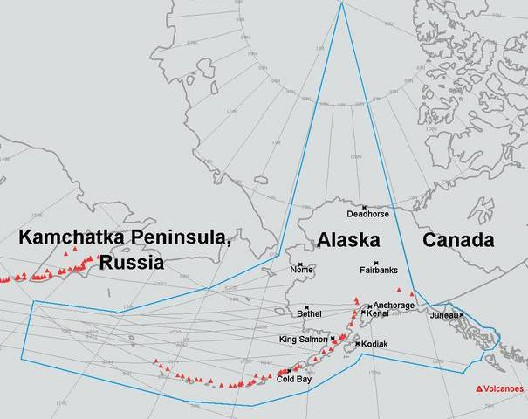
2) Aviation Weather Testbed initiative
In Alaska, forecasters must rely on analysis and model fields and limited radiosonde observations (~4/day) to determine the 3D extent of the cold air aloft
  Airline fuel begins to freeze below -65 degC, need to issue pilot advisories
  Forecasters need to know spatial and vertical location of “bubble” of cold air aloft
Anchorage Flight Information Area (FIR) encompasses 2.4 square million miles
Anchorage Airport was ranked 3rd worldwide for throughput cargo (90% of China to USA) and 1st in the USA for cargo poundage (5.9 Billion lbs)

Slide 11
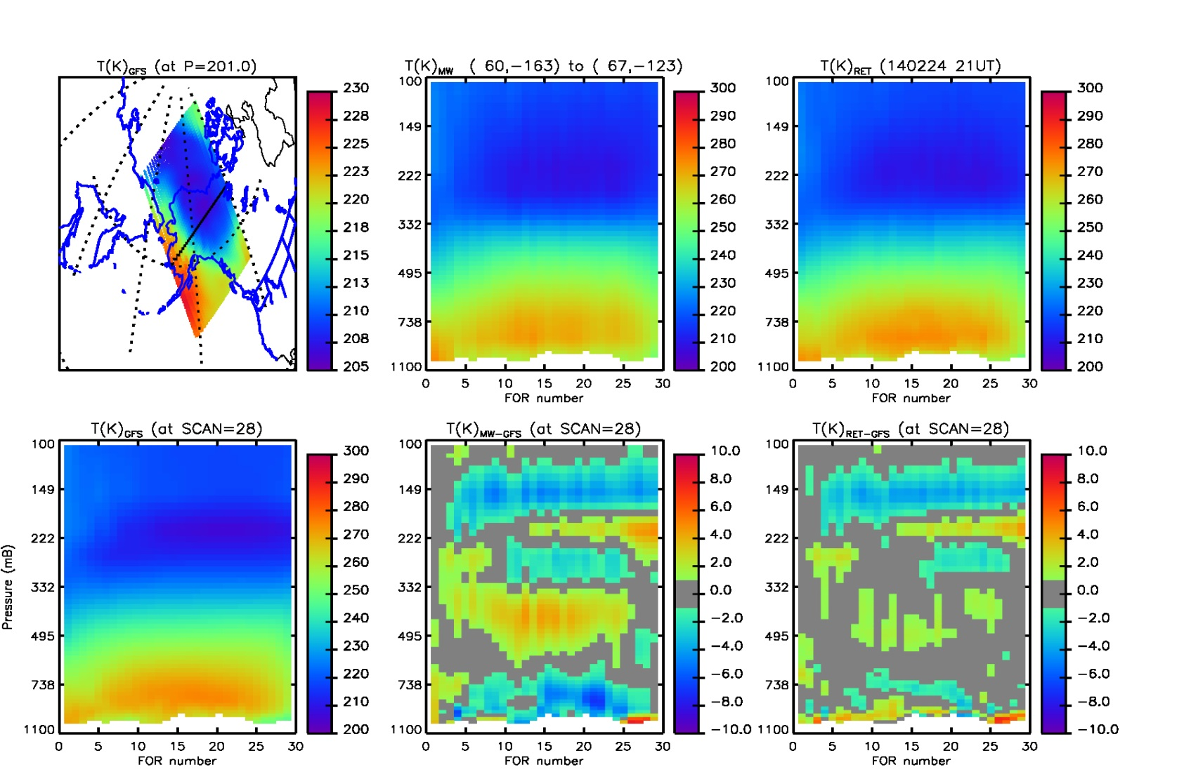
Example #1: Feb. 24, 2014 21.5 UT (NPP)
GFS
ATMS-only
CrIS+ATMS
Cross-section plots are along black line (west to east) in map
Cold Air aloft (purple color) in cross sections.
Ret-GFS (middle & right) show some structural differences
Location of Fairbanks
At FOR=14
Notes:
Sonde site (Fairbanks) is at Scan=28, FOR=14
test on 2014/02/24 24Z, Fairbanks
2014\docs\cris_atms\nucaps\results\140224_runs\140224_21_b03_dif_s0028_tmp_gfs.jpg
run b04 w/ Antonia's fixes
avn=avn_140224_2150339.bin
pl_retmat, 'b03bin','ret',[1]
y=100 p=200 s= 28,30,32
T = T(p) M = p vs FOR diff

Slide 12
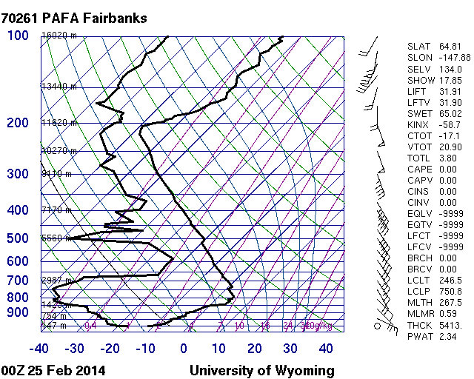
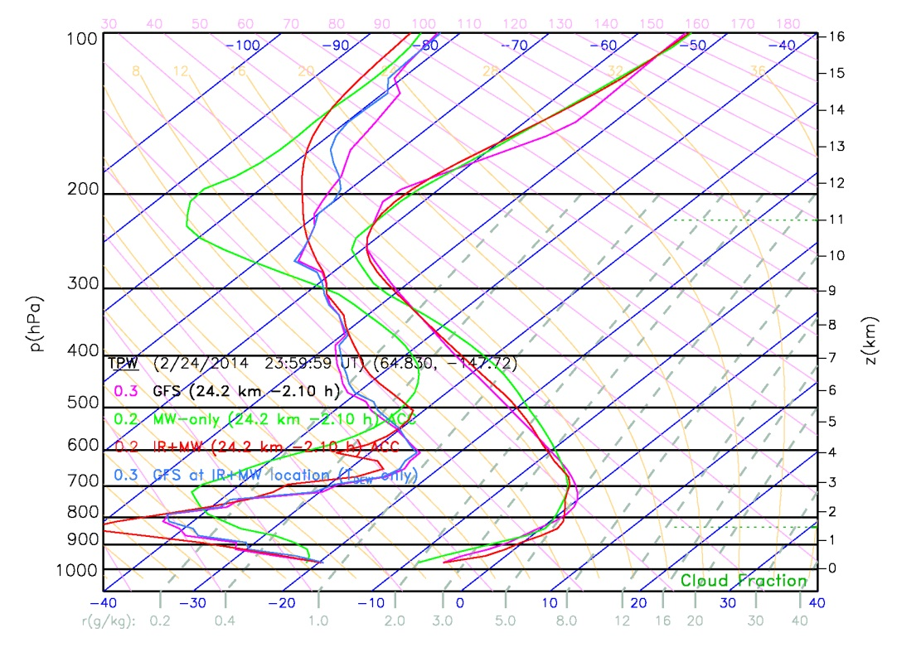
Feb. 25, 2014
(NPP 2.5h before sonde)
NUCAPS-ATMS-only (green) and NUCAPS-CrIS+ATMS (red) qnd GFS (magenta) show -60 degC at ~210mb
ATMS-only is lower than the GFS , CrIS+ATMS
RAOB vertical extent is higher and sharper than retrievals and GFS
Notes:
2014\docs\cris_atms\nucaps\results\140224_runs\140225_00p70261_skewt.jpg
2014\docs\cris_atms\nucaps\results\140224_runs\140224loc_01_b03_acc.jpg“ (21.5UT)
Feb. 24, 2014 00Z Fairbanks (64.83 -147.72)

Slide 13
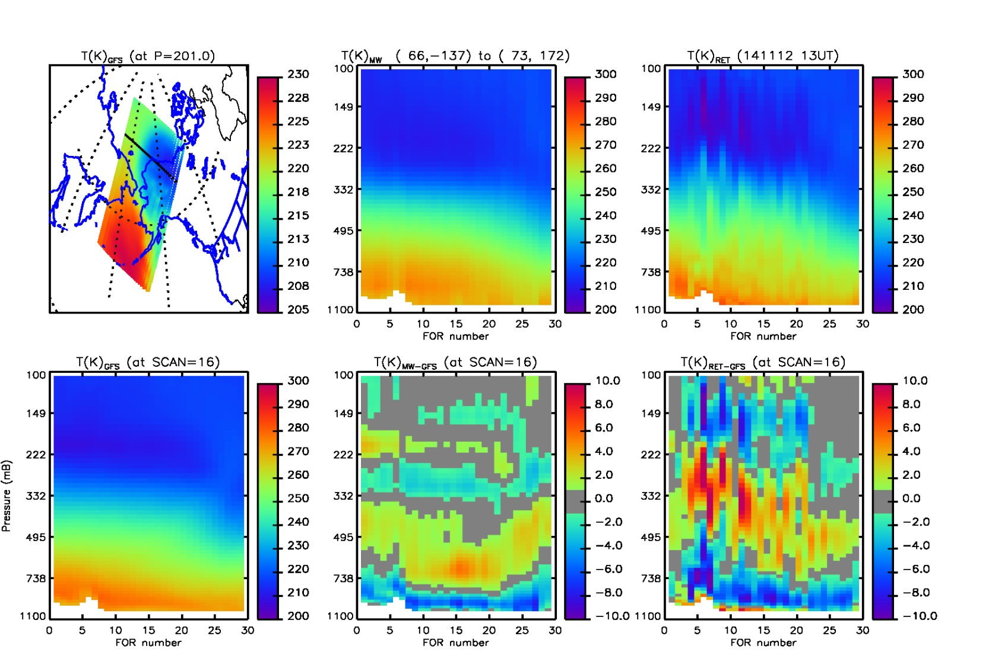
Example #2: Nov. 12, 2014 13.5 UT (NPP)
GFS
ATMS-only
CrIS+ATMS
Cross-section plots are along black line (east to west) in map
Cold Air aloft (purple color) in cross sections.
Ret-GFS (middle & right) show some structural differences
Blue means retrieval is colder than GFS
Location of Barrow at FOR=15
Notes:
sonde location (Barrow) is at SCAN 16, FOR 15
test on 2014/11/12
2014\docs\cris_atms\nucaps\results\141112_runs\141112_13_b02_dif_s0016_tmp_gfs.jpg
run b02 w/ Antonia's fixes using 13.5 UT granule
avn=avn_141112_1347219.bin
pl_retmap,'b02bin','ret_am',[2]
y=100 p=200 s=16
T = T(p) M = p vs FOR diff M = p vs FOR (to see fg)

Slide 14
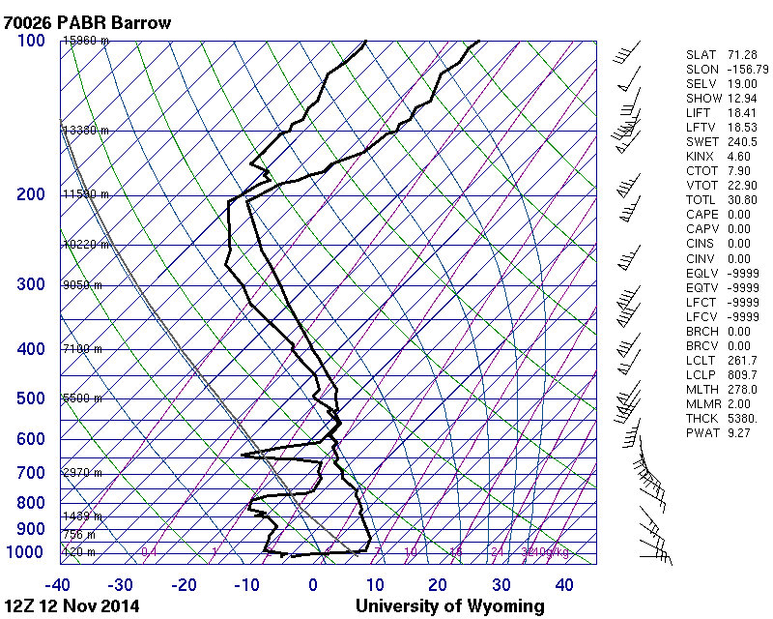
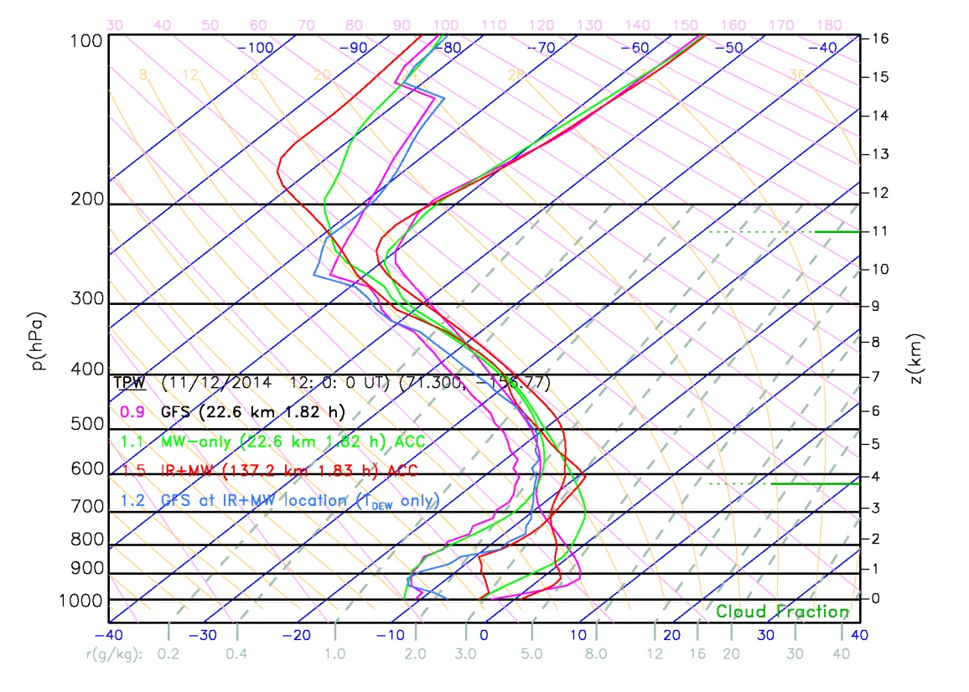
Example #2: Nov. 12, 2014
(NPP 2h after sonde)
Only NUCAPS-ATMS+CrIS (red) approaches-60 degC at ~250 mbar
NUCAPS is colder than GFS (210-250 mb) than the GFS (magenta)
RAOB vertical extent is higher and sharper than retrievals & GFS
Notes:
2014\docs\cris_atms\nucaps\results\141112_runs\141112barrow_skewt.jpg
2014\docs\cris_atms\nucaps\results\141112_runs\141112loc_02_acc.jpg
Nov. 11, 2012 12Z Barrow (71.30 -156.77)

Slide 15
Summary of Aviation Weather initiative
CrIS/ATMS easily sees the cold air aloft in our cross-sections and skew-T plots
  Product has +/- 4 K differences f/GFS
    Vertical location is different
  Goal is to work with Alaska AWT/CWSU to develop visualization of cold air aloft and evaluated Suomi-NPP soundings in this context.
GFS uses CrIS and ATMS, is it good enough?
  At 200 mbar many CrIS channels are used
  Real time NUCAPS (8, 9.5, 11 and 20, 21.5, 23 Z) adds information between the model analysis times (0, 6, 12, 18Z)

Slide 16
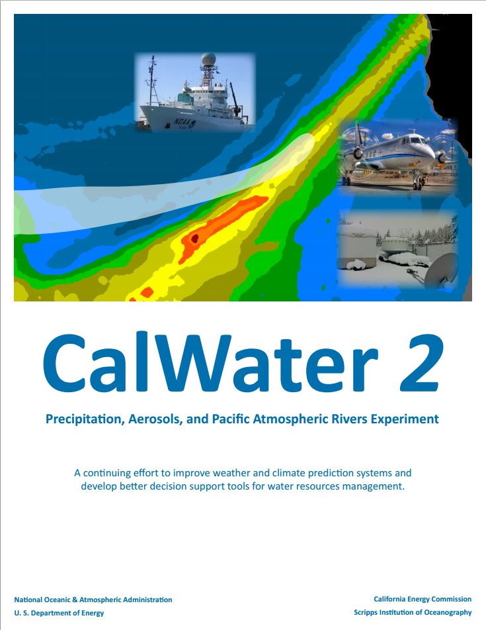
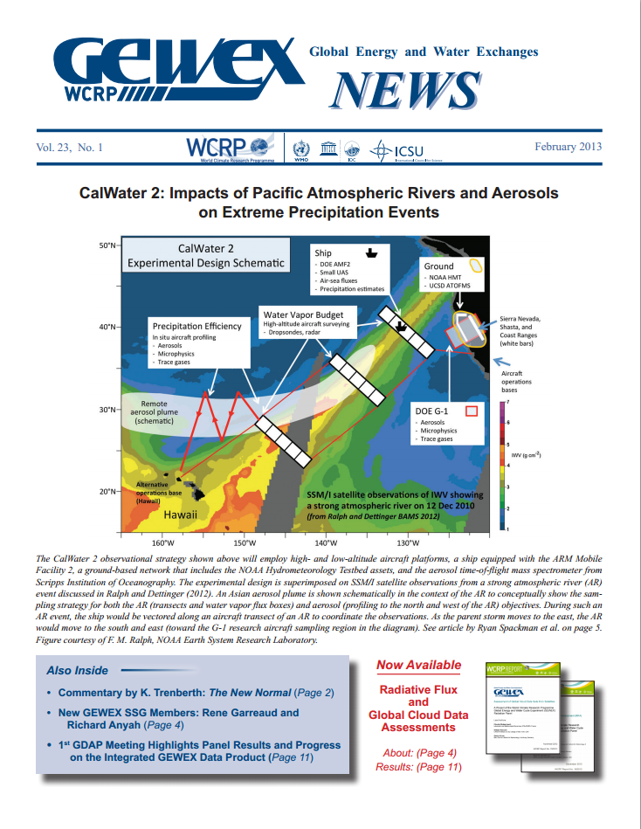
3) Hydrometeorology Testbed Initiative – CalWater-2015
  Science focus of this campaign is to improve forecasting of Atmospheric Rivers (ARs)
    CalWater 2 white paper is at http://esrl.noaa.gov/psd/calwater
    PI is Marty Ralph, Scripps
    Coordinated with DOE ACAPEX (ARM Cloud Aerosol Precipitation Experiment)
    PI is L. Ruby Leung, DOE

Slide 17
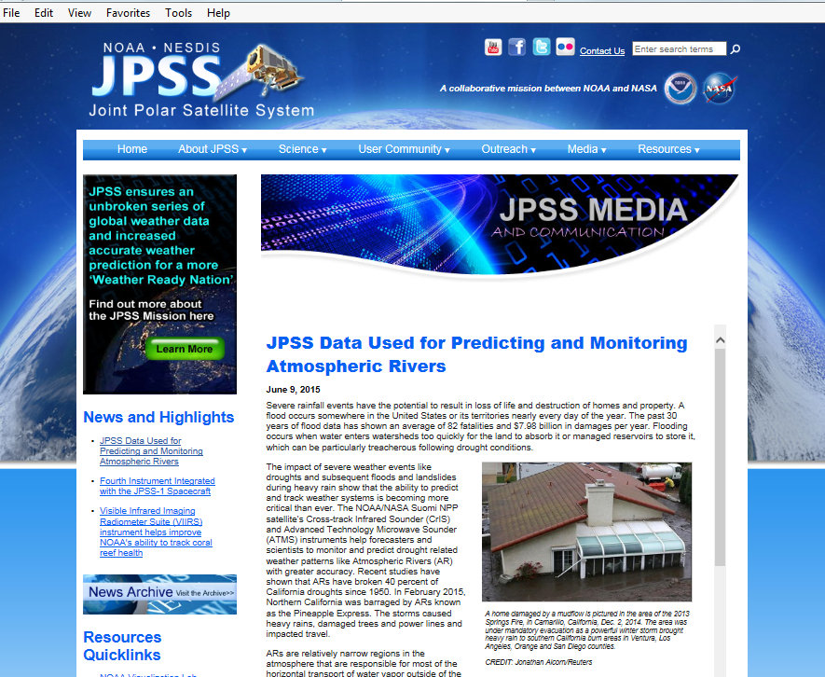
Recent JPSS focus article on NOAA JPSS webpage
http://www.jpss.noaa.gov/media.html?story=news-61

Slide 18
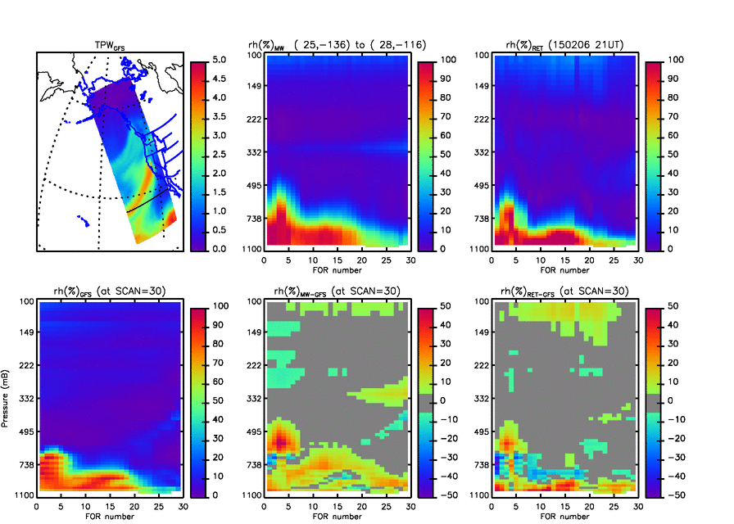
NUCAPS sees entire field campaign domain
NUCAPS Microwave RH Retrieval cross section along scanset shown as black-line in top left figure. Insensitive to non-precipitating clouds
NUCAPS Microwave + Infrared RH retrieval along same scanset. More sensitive to clouds but higher vertical resolution
NUCAPS 2200 km wide “scanset” is acquired in 8 seconds
30 retrievals with spatial resolution of ~50 km at nadir and ~70x134 km at edges of scan
  In many cases these retrievals reveal structures many hours in advance of a model analysis (i.e., CrIS/ATMS have not been ingested)
Differences shown at in lower panels could be due to retrieval errors or GFS errors
GFS TPW
Feb. 6, 2015
GFS RH cross section (along scanset indicated on top left
NUCAPS Microwave retrieval – GFS
NUCAPS Microwave + Infrared retrieval – GFS

Slide 19
CalWater-2015 / HMT Initiative
Campaign began Jan. 12
Jan. 12 to Feb. 12 we used Corvallis Oregon DB data
  Processing with NUCAPS science code
  Provided forecasters the Pacific west coast overpass (10:00 UT ≅ 2 am PST = 5 am EST) in real time
    Considered in 7 am PST flight planning meeting
  Provided 22:00 UT (14:00 PST = 5 pm EST) overpass while field campaign aircraft were in the air
Feb. 14, 2015 we used Univ. of Hawaii DB data
  Field campaign is winding down
    G-IV ferried to Hawaii
    R.H. Brown departed 2/13
    NOAA P-3 departed 2/15
  Provided forecasters the Hawaii overpass in real time (24 UT) while G-IV was in the air.

Slide 20
What JPSS program gained from CalWater 2015
Date | G-IV | P-3
1/15 | 25
1/17 | 29
1/22 | 13
1/24 | 23
1/27 |  | 22
1/31 |  | 24
2/5 | 35
2/6 | 30 | 7
2/7 |  | 9
2/8 | 32
2/9 |  | 16
2/14 | 41
2/19 | 37
2/20 | 35
2/22 | 30
2/24 | 35
total | 365 | 78
CalWater-2015 was an opportunity for NUCAPS product validation
  Over 435 dropsondes were acquired
  Test NUCAPS in extreme weather that is of national and societal interest
As algorithm developers, we need these kinds of scenes to improve the retrieval skill and tailor the quality control.
  Can test experimental versions of NUCAPS
  Gain the expertise of the entire CalWater science team to characterize the underlying science and meteorology.
  Other in-situ measurements (CO, O₃, CO₂, aerosols) will help the NPP validation,
  Demonstrate the value and shortcomings of NUCAPS in the field

Slide 21
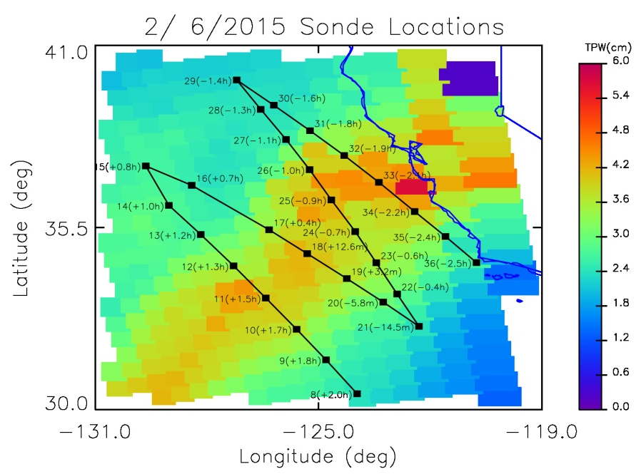
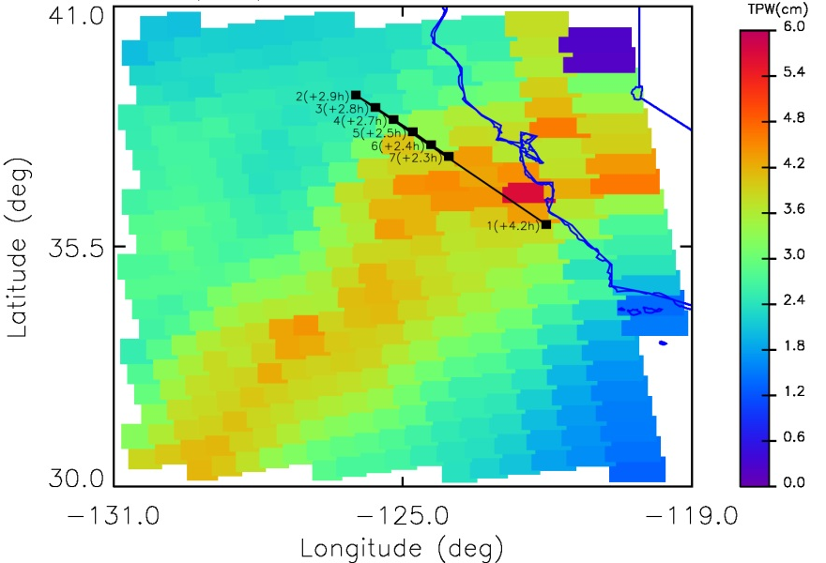
Example of Feb. 6 dropsondes
NOAA G-IV did a sawtooth pattern across the AR
  NPP Overpass occurred between sondes #19 and #20
  Capture pre-AR, AR, and post-AR regimes
  Pre-AR is relatively warm and dry
  AR is wet, cloudy, warm, and most likely raining
  Post-AR is wet and cooler
NOAA P-3 was flying at 800 mb from 3 to 4 hours after overpass
  Sampling same region as G-IV roughly 4 hours later

Slide 22
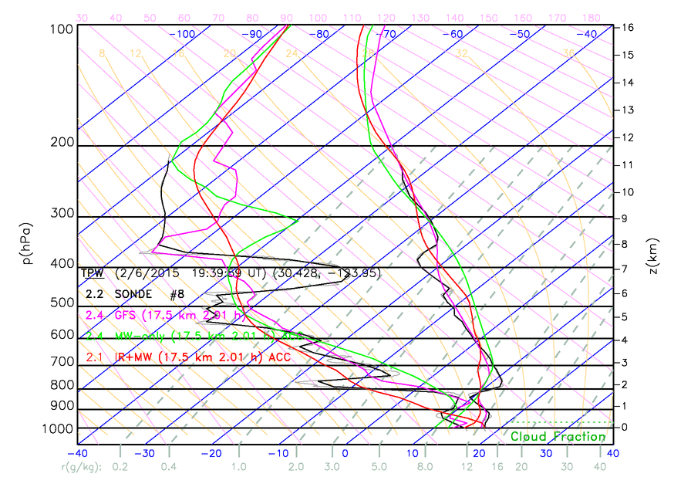
wide range of pre-AR, AR, and post-AR conditions
Pre-AR:
#8, 9, 20, 21, 22
AR:
#10, 19
Post-AR:
#13, 27,28,29,30
Notes:
Pre-AR: 8, 9, 20, 21, 22
AR: 10,19
Post-AR: 13, 27, 28, 29, 30

Slide 23
Summary of CalWater-2015
  We demonstrated the value of NUCAPS soundings in defining crucial moisture structure (position, water vapor content, amplitude) in the vicinity of sparsely sampled but high impact mesoscale events.
  Low latency (direct broadcast) access is valuable for field campaign logistical support and understanding context of in-situ data
  Synergistic validation yields a large sample of in-situ data (~150 RS-92 radiosonde and ~450 dropsondes from CalWater-2015 alone) in regimes that are traditionally difficult to validate
Ongoing and future work:
  We are using these dropsondes to improve performance (better radiance bias tuning, first guess, etc.)
    Retrieval can be re-run with proposed changes and compared to original retrieval and in-situ data before promoting to operations
  Will publish an analysis of NUCAPS capabilities in AR environments
  Plan to support other field campaigns.
Notes:
Plains Elevated Convection at Night = PECAN

Slide 24
Future Plans
The way forward
Improve AWIPS implementation
  Better training
  Automate profile modification (funded)
  Spatial and/or cross-section visualization
Metop-A & B retrievals into AWIPS-II
  Same as NUCAPS, but 4 hours earlier
  NOAA/STAR can provide file now.
  Need user request to make it happen.
Metop-A & B retrievals into CSPP DB
  In work, should be early FY16

Slide 25
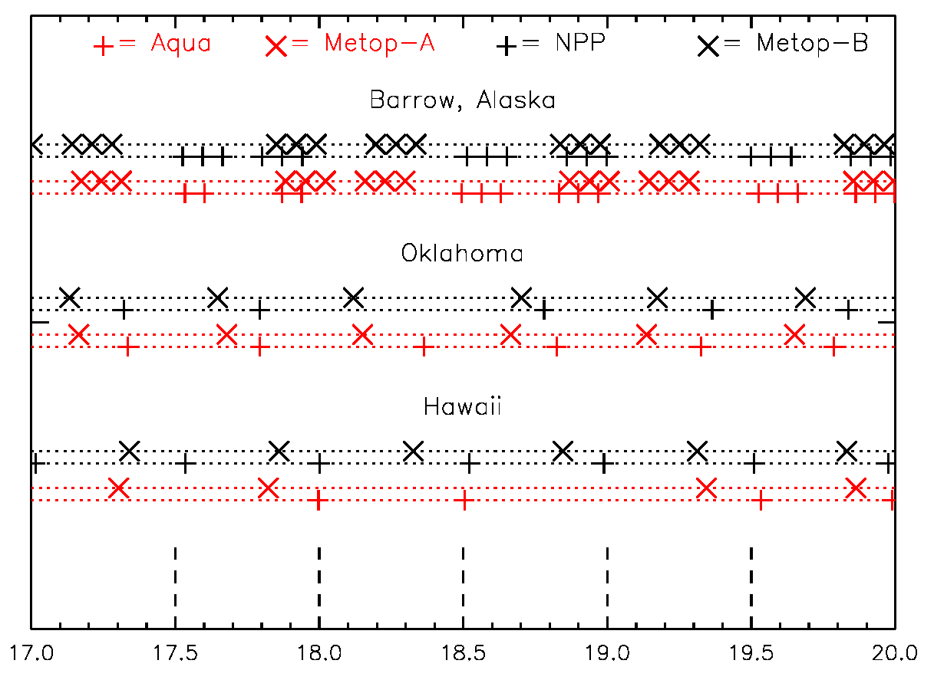
Constellation of satellites allows more observations between RAOBS
NPP/J-1 will be phased similar to Metop-A/B approx. 6 months after launch of J-1
If we included NOAA AMSU/HIRS there would be even more soundings
These are overpasses with satellite elevation > 32 deg
Day of June, 2015

Slide 26
Questions?

Slide 27
Simplified Flow Diagram of the
AIRS Science Team Algorithm
Climatological First Guess for all products
IR Physical T_{s}, ε(ν), ρ(ν)
IR Physical CO(p)
Microwave Physical for T(p), q(p), LIQ(p), ε(f)
IR Physical HNO₃(p)
IR Physical T(p)
IR Physical CH₄(p)
IR Physical q(p)
Initial Cloud Clearing, η_{j}, R_{ccr}
IR Physical CO₂(p)
MIT
IR Physical O₃(p)
Statistical Operator for Ts, ε(ν), T(p), q(p)
IR Physical N₂O(p)
Final Cloud Clearing, η_{j}, R_{ccr}
IR Physical T_{s}, ε(ν), ρ(ν)
RET
IR Physical T_{s}, ε(ν), ρ(ν)
FG
CCR
Note: Physical retrieval steps that are repeated always use same startup for that product, but it uses retrieval products and error estimates from all other retrievals.
Improved Cloud Clearing, η_{j}, R_{ccr}
IR Physical T(p)

