Slide 1
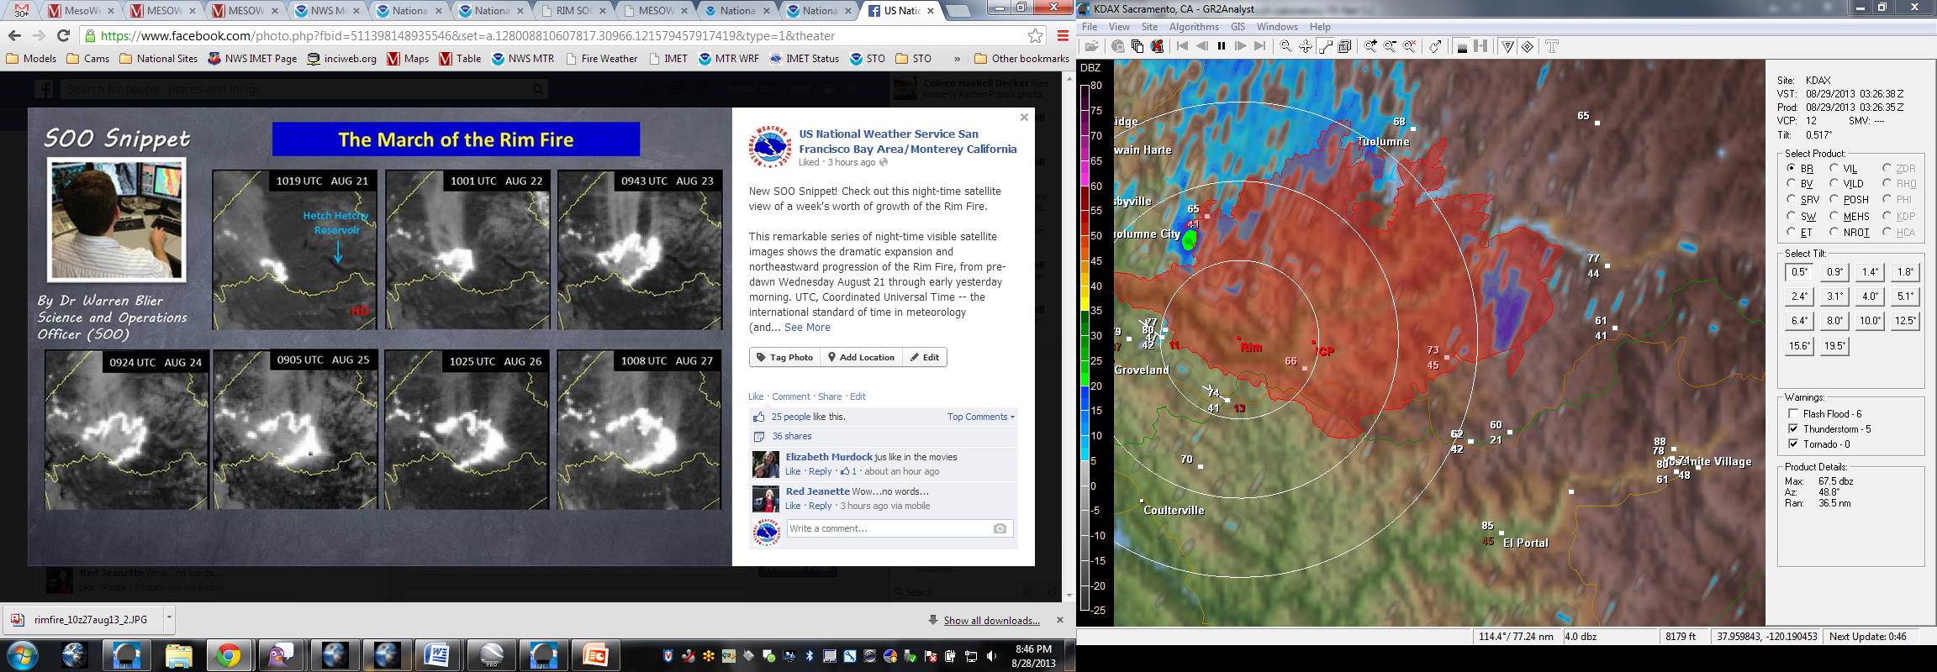
Rim Fire 2013
Using Day/Night Band
Operationally
Near Yosemite, CA

Slide 2
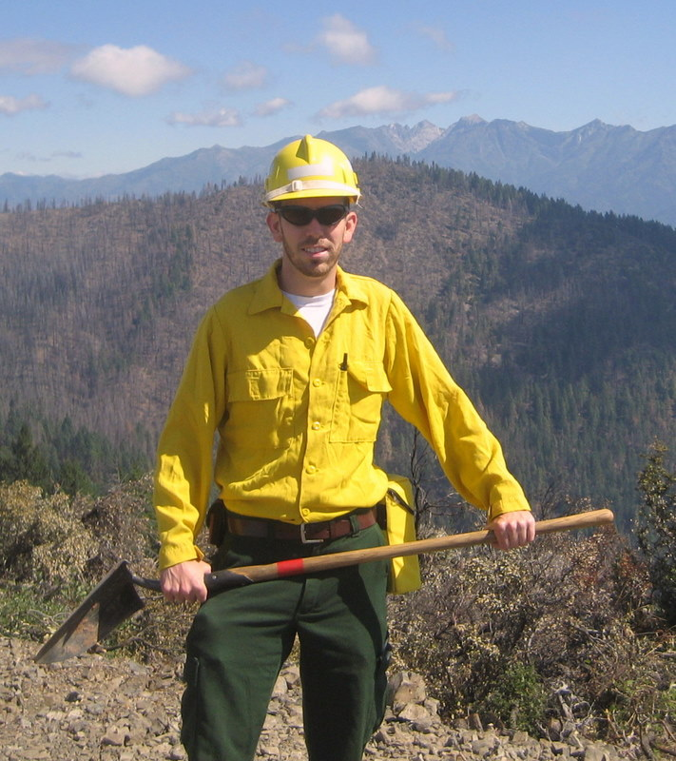
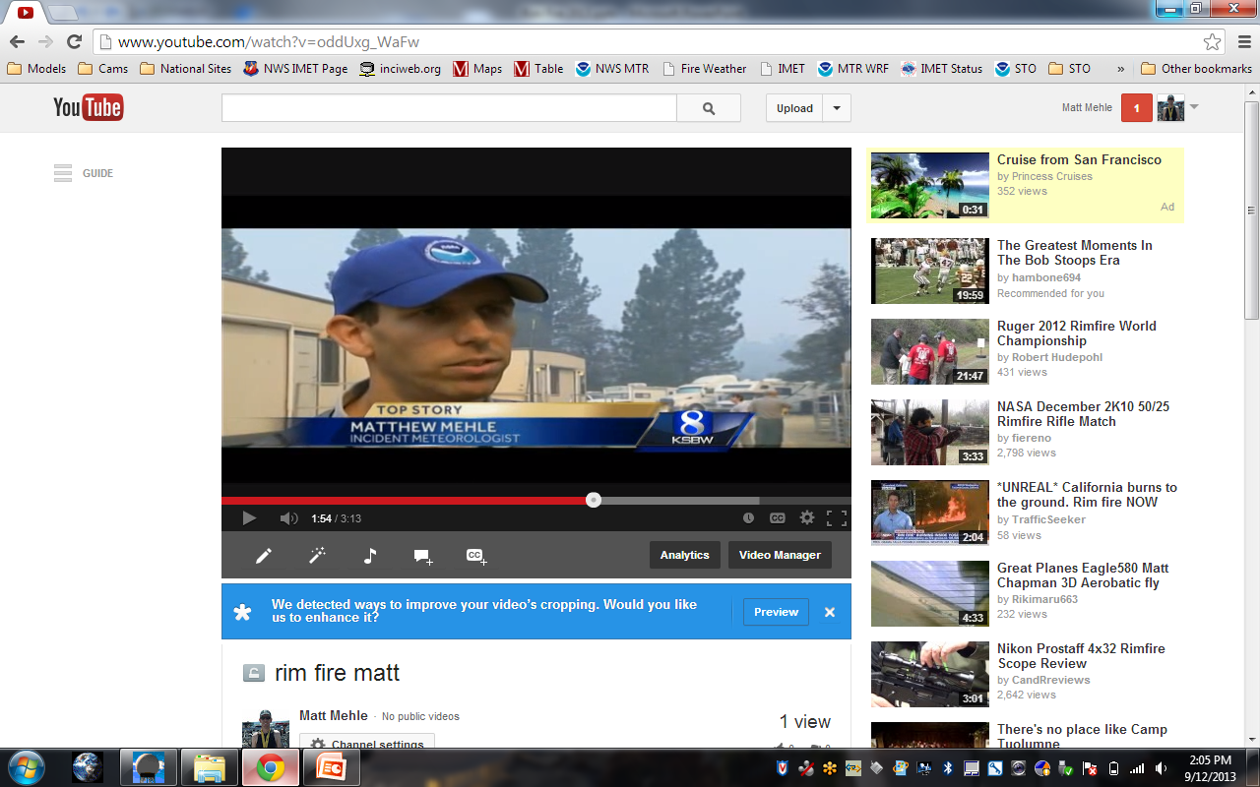
Good Afternoon…
Matt Mehle – WFO Monterey
National Weather Service - 11 years
Incident Meteorologist – 7 years

Slide 3
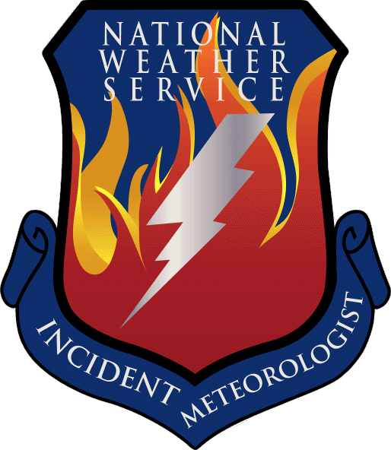
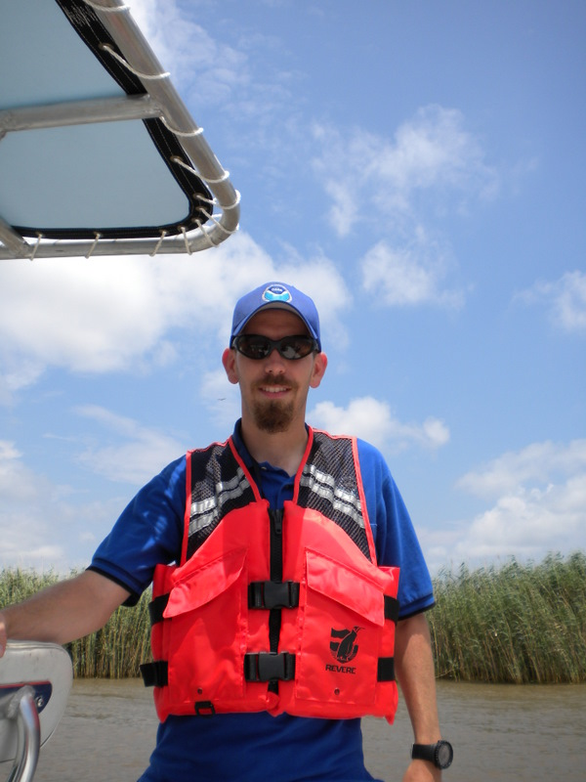
What is an IMET?
Incident Meteorologists – rapid response to an incident nearly anywhere and anytime in the United States. Established 1916.
  Respond to wildfires, oil spills, natural disasters or other “incidents”
  Safety of onsite personnel #1 priority - fire, air and rescue crews. Takes an “area” forecast and narrows it down to specific details pertaining to the incident
  ~70 IMETs nationwide, ~30 trainees
  On scene usually within 24 hours (~10 hrs avg)
BP Oil Spill
Notes:
Diverse crowd and some of you may not know what an IMET is….

Slide 4
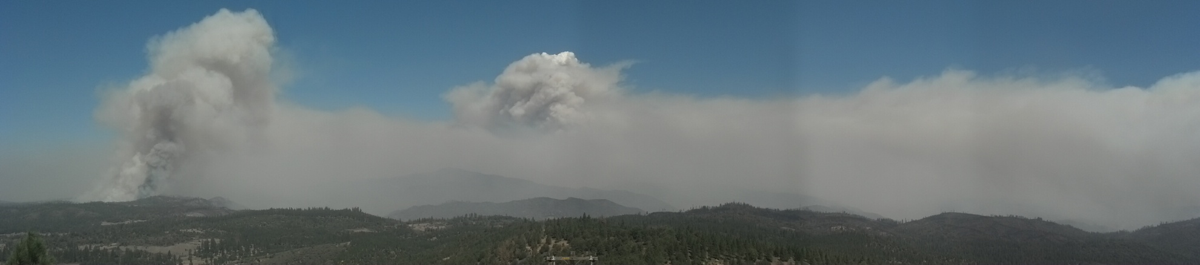
Rim Fire Stats
Acreage burned – over 255k burned
  Largest growth was 53k in one burn period
  3rd largest in California history
At its peak, over 5k personnel on the fire
  Two ICPs
Human Caused
Threatened Yosemite and Hetch Hetchy
  Water supply to San Fran and 2,000 year old trees

Slide 5
Day/Night Band – DSS Tool
How did I use VIIRS as a DSS too?
Great visualization for public/partners/media
  Easily shows growth and size
Fire Personnel
  Hot spots and most active burning
Aviation operations
  Smoke impacts on flight operations
  Smoke impacts on remote helibase/helispot

Slide 6
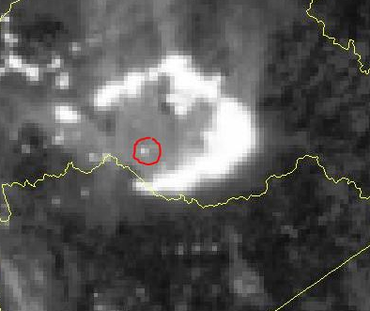
Rim Fire – Day/Night Band
ICP
Easy visualization layman on growth
Fire Camp became so large it was visible too
Another tool to show Fire personnel hotspots

Slide 7
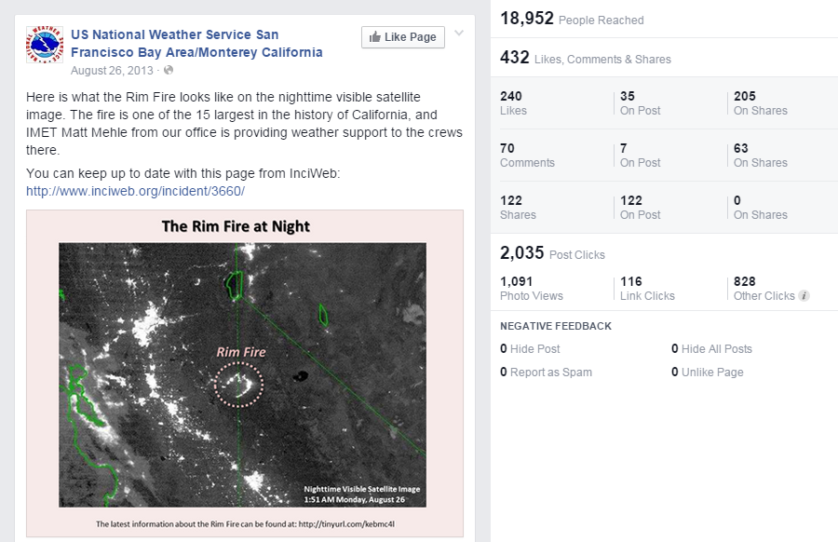
Social Media - Viral
One of our most ‘viral’ post of all time
Great way to promote/introduce the day/night band
  Participate in discussion about the VIIRS product

Slide 8
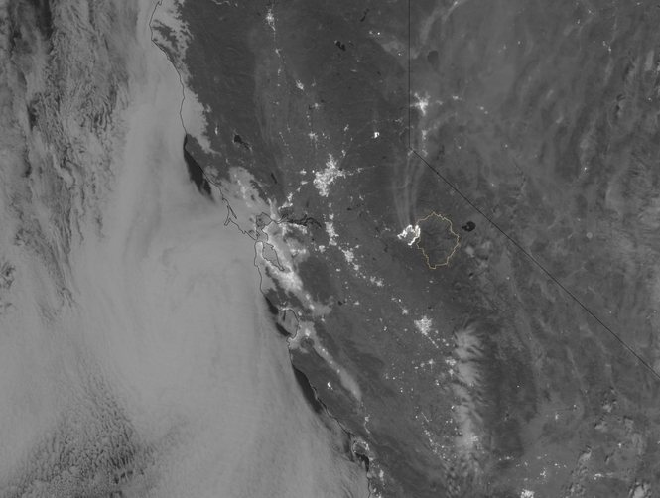
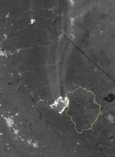
Aviation DSS
Great use of the VIIRS to track smoke. I was able to see what areas might be impacted by smoke before the daytime visible. Gave a ‘heads up’ to air ops.

Slide 9
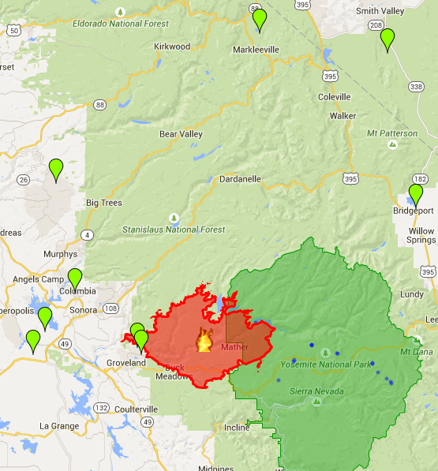

Aviation DSS
High Level Smoke
Valley Smoke
Airports *
Rim Fire
Yosemite
VIIRS Day/Night Band Image
*small airstrips not shown
Notes:
Every airport shown was not necessarily used by Air Operations. A few small airstrips were used and not shown.

Slide 10
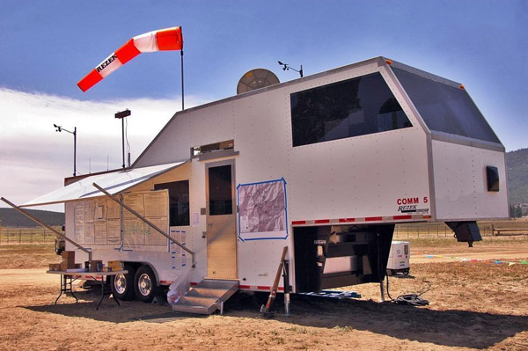
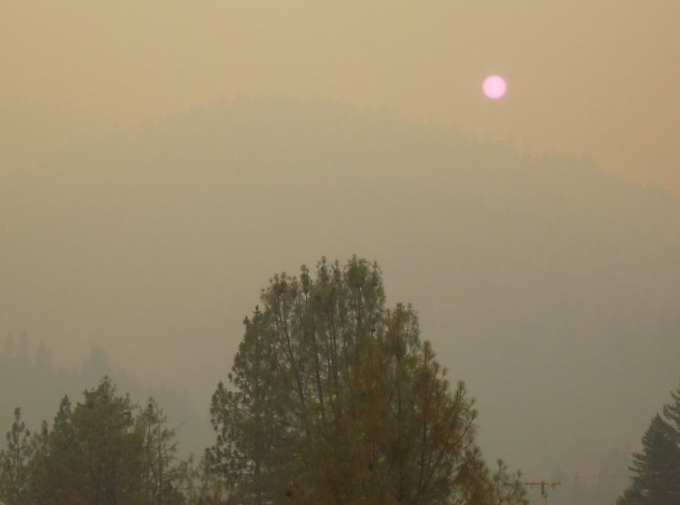
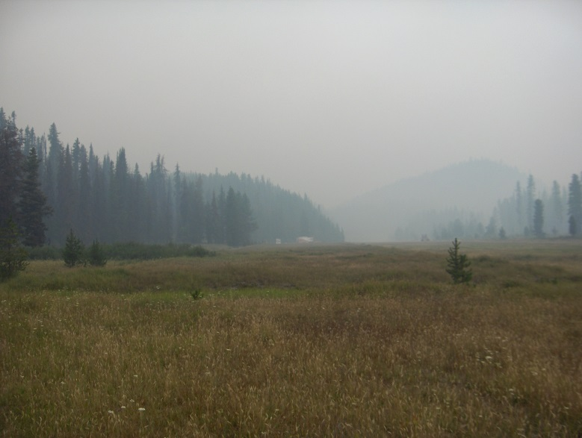
Aviation DSS
Ron Rezek
Reduced visibilities due to valley smoke
Able to inform Air Operations of potential smoke impacts before the sun has risen – huge time savings
  Potential delays for areal recon (mapping)
  Delays for transport of fire personnel/equip
  Delays on ‘bucket work’ on active fire
Inform research group from NASA AMES
  Downwind sampling of plume

Slide 11
Aviation DSS
In Summary –
VIIRS Day/Night Band invaluable for early morning Air Ops briefing
Time saver for Operations strategies and tactics
Money saver for moving air resources

Slide 12
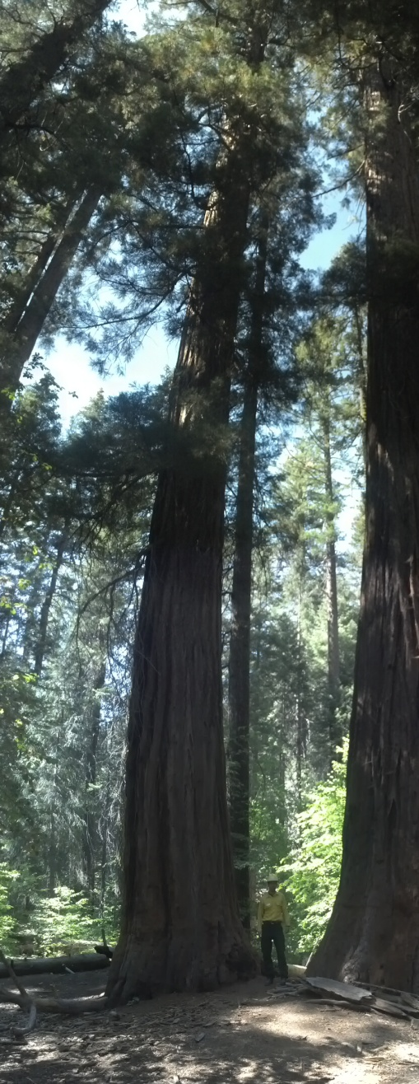
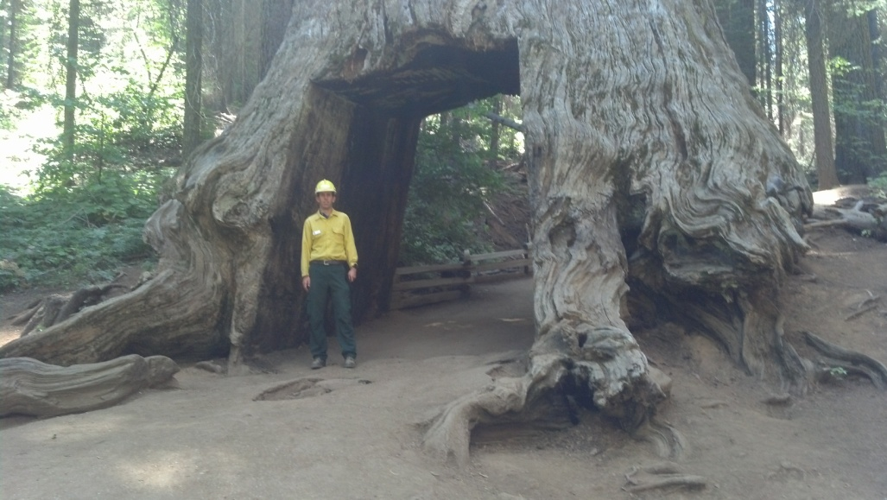
Questions?
Tuolumne Grove
Merced Grove - Giant Sequoias

