Slide 1
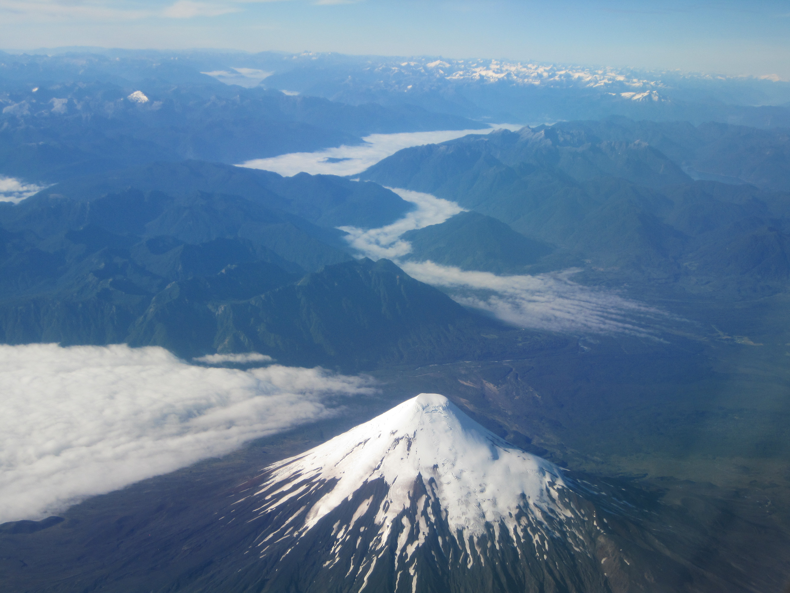
Data Fusion for Fog and Low Stratus Applications
Mike Pavolonis (NOAA/NESDIS/STAR)
Corey Calvert, Shane Hubbard, and Scott Lindstrom
(UW-CIMSS)
Notes:
-Highlight the most user relevant information.

Slide 2
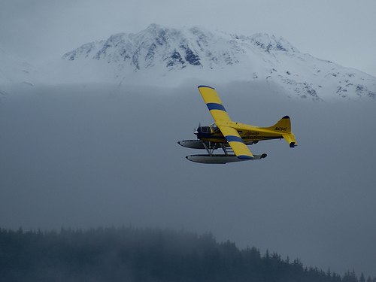
What is Fog/Low Stratus (FLS)?
FLS = Fog/low stratus
There is no widely accepted definition of fog/low stratus so the GOES-R definition of FLS was based off aviation flight rules
The primary goal of the GOES-R fog/low cloud detection algorithm is to identify IFR, or lower, conditions.
VFR - Visual flight rules
ceiling > 3000 ft and vis > 5 mi
MVFR - Marginal visual flight rules
1000 ft < ceiling < 3000 ft or 3 mi < vis < 5 mi
IFR - Instrument flight rules
500 ft < ceiling < 1000 ft or 1 mi < vis < 3 mi
LIFR - Low instrument flight rules
ceiling < 500 ft or vis < 1 mi
Notes:
Fog/low stratus impacts aviation on a regular basis so the goal of the GOES-R FLS algorithm is to identify cloudy regions that have ceilings less than 1000 ft and/or surface visibilities less than 3 miles.
These criteria correspond to Instrument Flight Rules (IFR)

Slide 3
Probability of MVFR
VFR - Visual flight rules
ceiling > 3000 ft and vis > 5 mi
MVFR - Marginal visual flight rules
1000 ft < ceiling < 3000 ft or 3 mi < vis < 5 mi
IFR - Instrument flight rules
500 ft < ceiling < 1000 ft or 1 mi < vis < 3 mi
LIFR - Low instrument flight rules
ceiling < 500 ft or vis < 1 mi
S. California

Slide 4
Probability of IFR
VFR - Visual flight rules
ceiling > 3000 ft and vis > 5 mi
MVFR - Marginal visual flight rules
1000 ft < ceiling < 3000 ft or 3 mi < vis < 5 mi
IFR - Instrument flight rules
500 ft < ceiling < 1000 ft or 1 mi < vis < 3 mi
LIFR - Low instrument flight rules
ceiling < 500 ft or vis < 1 mi
S. California

Slide 5
Probability of LIFR
VFR - Visual flight rules
ceiling > 3000 ft and vis > 5 mi
MVFR - Marginal visual flight rules
1000 ft < ceiling < 3000 ft or 3 mi < vis < 5 mi
IFR - Instrument flight rules
500 ft < ceiling < 1000 ft or 1 mi < vis < 3 mi
LIFR - Low instrument flight rules
ceiling < 500 ft or vis < 1 mi
S. California

Slide 6
FLS Thickness
Cloud Thickness Value (feet)
Number of Hours after Sunrise for Fog to Dissipate
S. California

Slide 7
Operational Transition Schedule
These products are in the process of being transitioned to NESDIS operations on an accelerated schedule (November 2015)
This operational transition only covers the current GOES satellite
A project to generate these products for GOES-R has been submitted through the SPSRB
We recommended leveraging the enterprise code delivered the current GOES system, as a transition to the Harris system would take 1-2 years longer
The GOES-R version of the products will be available from OSPO in September 2017
The products will also be available from the University of Wisconsin and CSPP-GEO to help bridge gaps

Slide 8
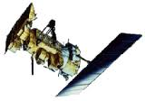
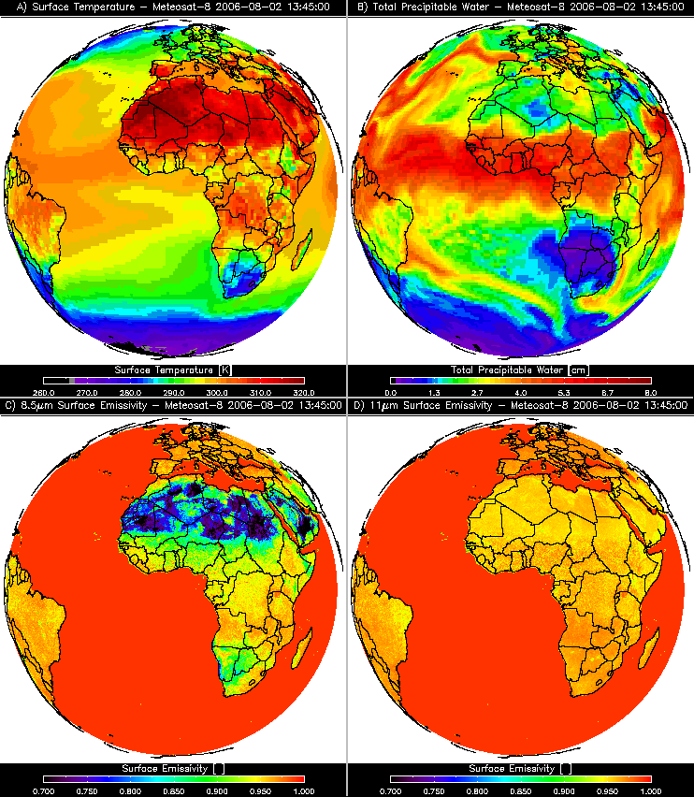
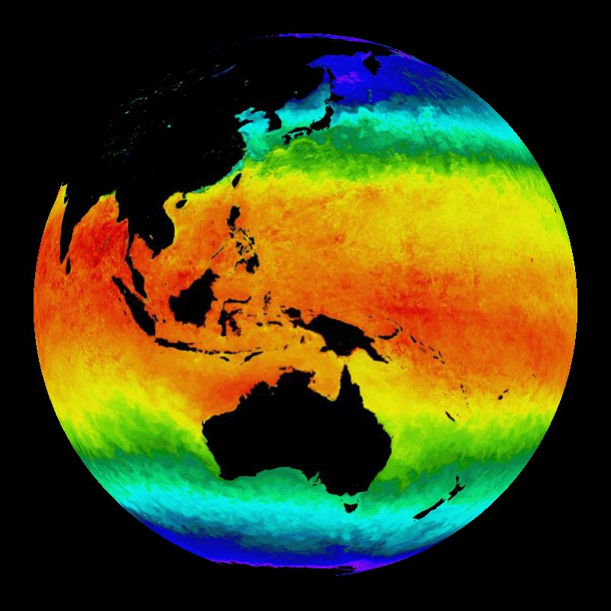
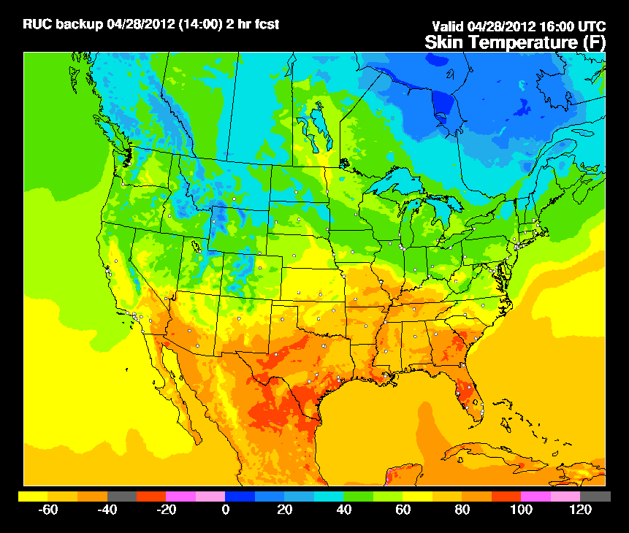
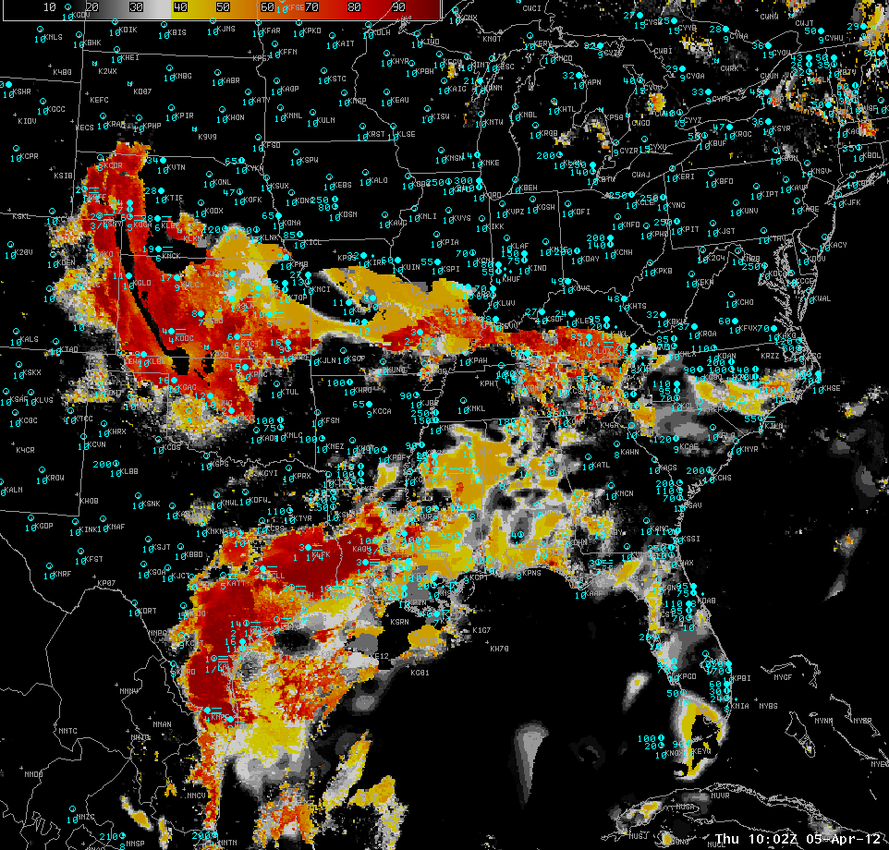
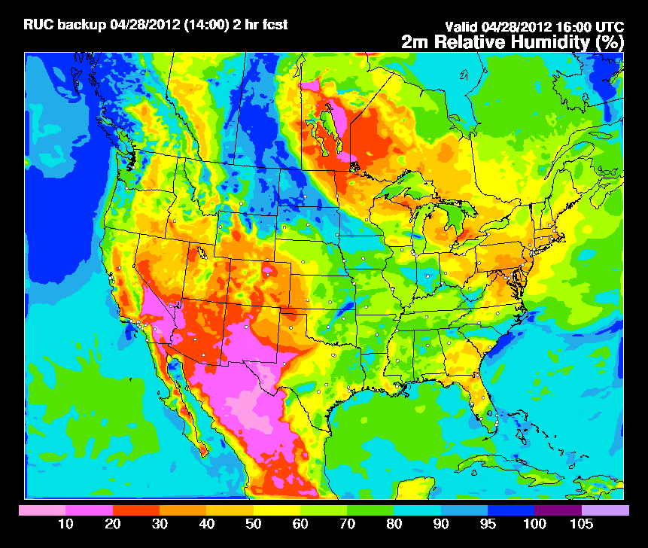
Fused Fog/Low Cloud Detection Approach
Satellite Data
Static Ancillary Data
Daily SST Data
NWP
+
+
+
-Minimum channel requirement: 0.65, 3.9, 6.7/7.3, 11, and 12/13.3 μm
-Previous image for temporal continuity (GEO only)
-Cloud Phase
-Surface Temperature
-Profiles of T and q
-RUC/RAP (2-3 hr forecast) or GFS (12 hr forecast)
-DEM
-Surface Type
-Surface Emissivity
0.25 degree OISST
Clear Sky RTM
IFR and LIFR Probability
NWP RH Profiles
Naïve Bayesian Model
Total run time: 2 - 3 minutes
-RUC/RAP (2-3 hr forecast) or GFS (12 hr forecast)
***IMPORTANT: Other sources of relevant data (e.g. sfc obs) influence results through the model fields
Notes:
8
The GOES-R IFR probability is a blended product merging satellite, NWP model, daily SST, and static ancillary data using a naïve Bayesian model (surface observations are incorporated through the model data assimilation).
The satellite predictors differ between day and night
Model temperature and moisture profiles from the 2 – 3 hour 13 km RAP forecast are used over CONUS, otherwise the GFS is used.
The fused approach allows weaknesses in the individual predictors to be mitigated. For instance, satellite measurements are not very useful for diagnosing fog/low cloud when multiple cloud layers are present and model fields tend to struggle with depicting small-scale fog events like valley fogs. The fusion process allows for confident identification of IFR conditions even when one of the individual predictors fails at highlighting the potential for IFR conditions. Once some experience is gained with the IFR probability product, it is generally easy to determine which type of predictor (satellite or model) is influencing the results the most.
Channel usage:
6.7/7.3, 11, 12/13.3 micron channels are used to determine cloud type/phase
0.65, 3.9 and 11 micron channels are used to determine which clouds are most likely to have low ceilings

Slide 9
Why is Data Fusion Absolutely Needed?
Z_{base} = Z_{top} – ΔZ

Slide 10
Why is Data Fusion Absolutely Needed?
Z_{base} = Z_{top} – ΔZ
Derived from cloud top temperature – a unique solution may not exist, especially for lower level clouds

Slide 11
Why is Data Fusion Absolutely Needed?
Z_{base} = Z_{top} – ΔZ
Derived from cloud top temperature – a unique solution may not exist, especially for lower level clouds
Function of cloud optical depth and the extinction profile
ΔZ = τ/k_{ext}

Slide 12
Why is Data Fusion Absolutely Needed?
Z_{base} = Z_{top} – ΔZ
Derived from cloud top temperature – a unique solution may not exist, especially for lower level clouds
Function of cloud optical depth and the extinction profile
ΔZ = τ/k_{ext}
Very limited sensitivity to cloud optical depth at near-IR and IR wavelengths for non-cirrus

Slide 13
Why is Data Fusion Absolutely Needed?
Z_{base} = Z_{top} – ΔZ
Derived from cloud top temperature – a unique solution may not exist, especially for lower level clouds
Function of cloud optical depth and the extinction profile
ΔZ = τ/k_{ext}
Very limited sensitivity to cloud optical depth at near-IR and IR wavelengths for non-cirrus
The extinction profile is a function of the vertically resolved size distribution – very little sensitivity, especially at night

Slide 14
Why is Data Fusion Absolutely Needed?
Z_{base} = Z_{top} – ΔZ
Derived from cloud top temperature – a unique solution may not exist, especially for lower level clouds
Function of cloud optical depth and the extinction profile
ΔZ = τ/k_{ext}
Very limited sensitivity to cloud optical depth at near-IR and IR wavelengths for non-cirrus
The extinction profile is a function of the vertically resolved size distribution – very little sensitivity, especially at night
Not to mention the influence of the surface, atmospheric gases, aerosols, and multiple cloud layers on the measurements!
Thus, satellite data should be fused with model data

Slide 15
February 28, 2012 (05:00 UTC)
IFR
MVFR/VFR
Texas

Slide 16
February 28, 2012 (05:00 UTC)
IFR
MVFR/VFR
Texas

Slide 17
February 28, 2012 (05:00 UTC)
IFR
MVFR/VFR
Texas

Slide 18
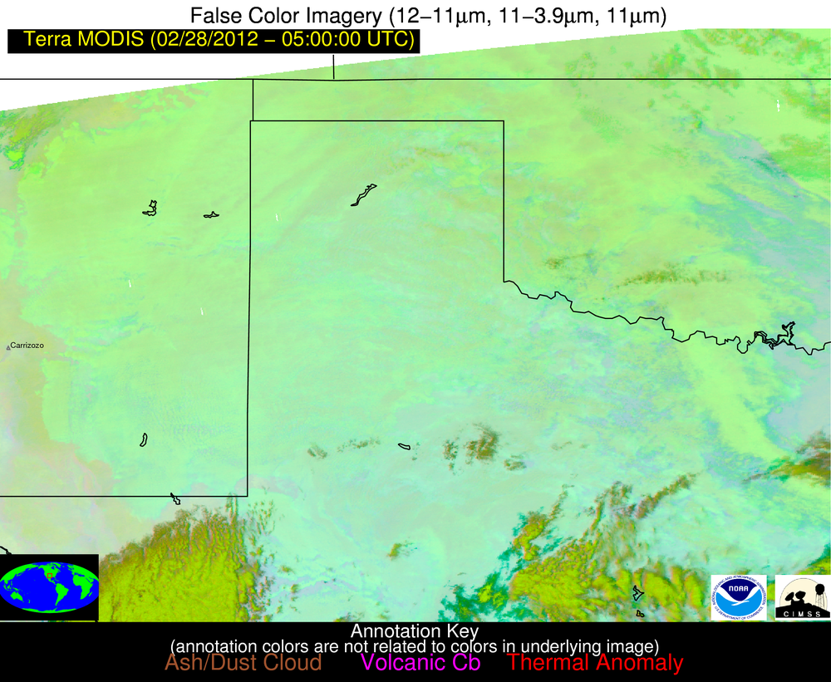

Slide 19
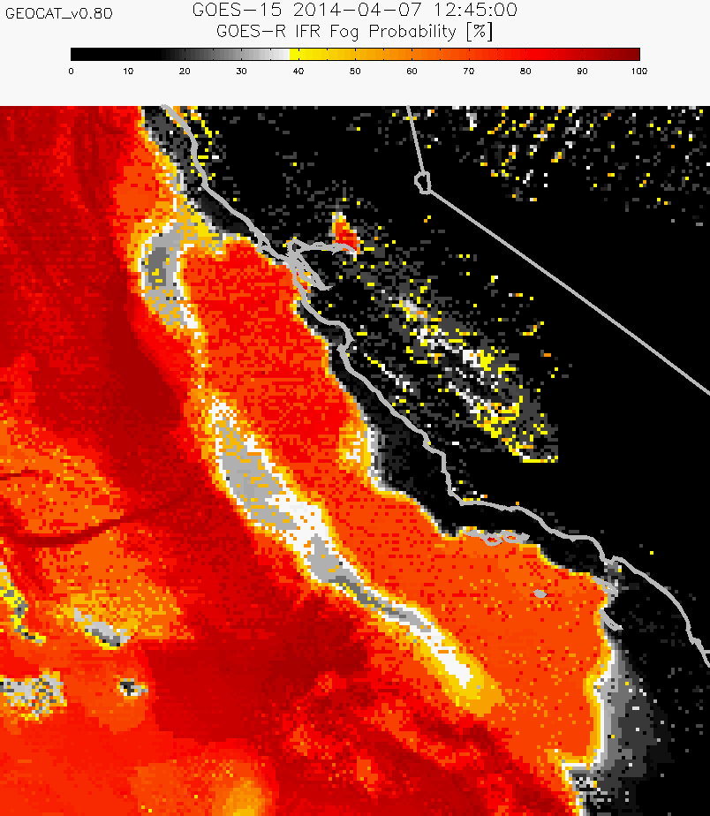
April 7, 2014
12:45 UTC
Notes:
The rest of the presentation will focus on limitations and the prospects for addressing them

Slide 20
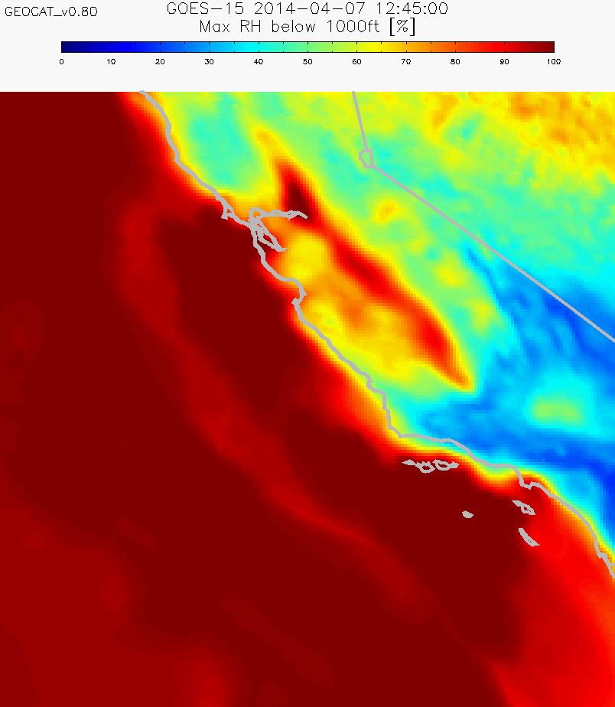
April 7, 2014
12:45 UTC

Slide 21
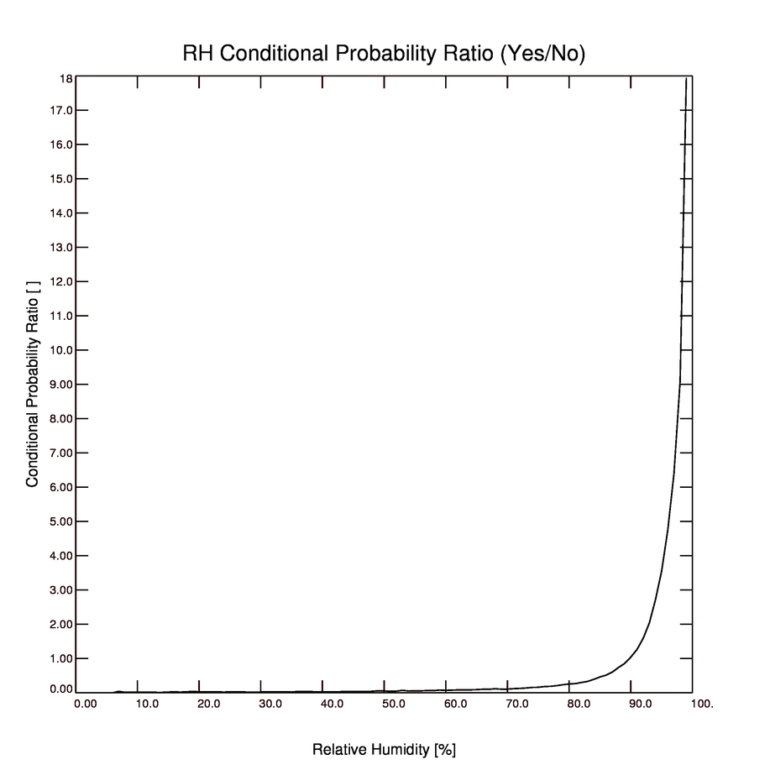
IFR conditions are more than 10 times more likely than MVFR/VFR conditions using RAP RH’s > 98% over CONUS
Ratio of frequency of occurrence of IFR to MVFR/VFR
Maximum Relative Humidity in lowest 1000 feet
Notes:
Meaning: Over CONUS it is very rare to have large RAP RH’s in the lowest 1000 feet and not have IFR conditions. In regions with sparse surface observations, this relationship may not hold

Slide 22
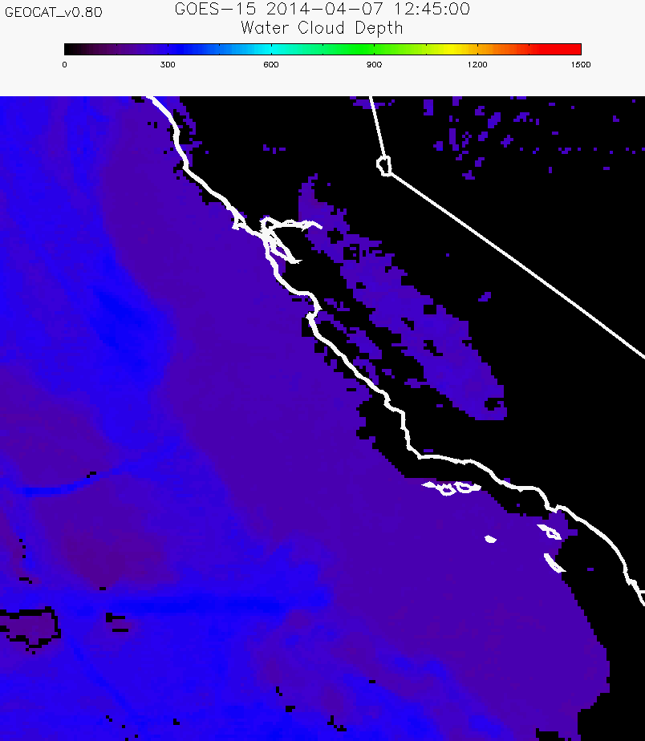
Recommendation #1: Use the FLS thickness in concert with flight rule categories

Slide 23
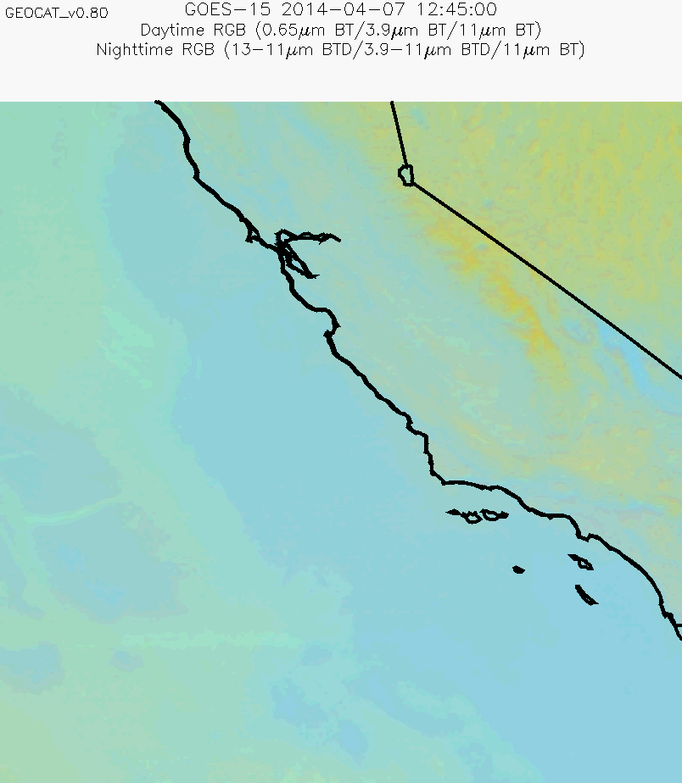
Recommendation #2: Use the imagery products in concert with flight rule categories

Slide 24
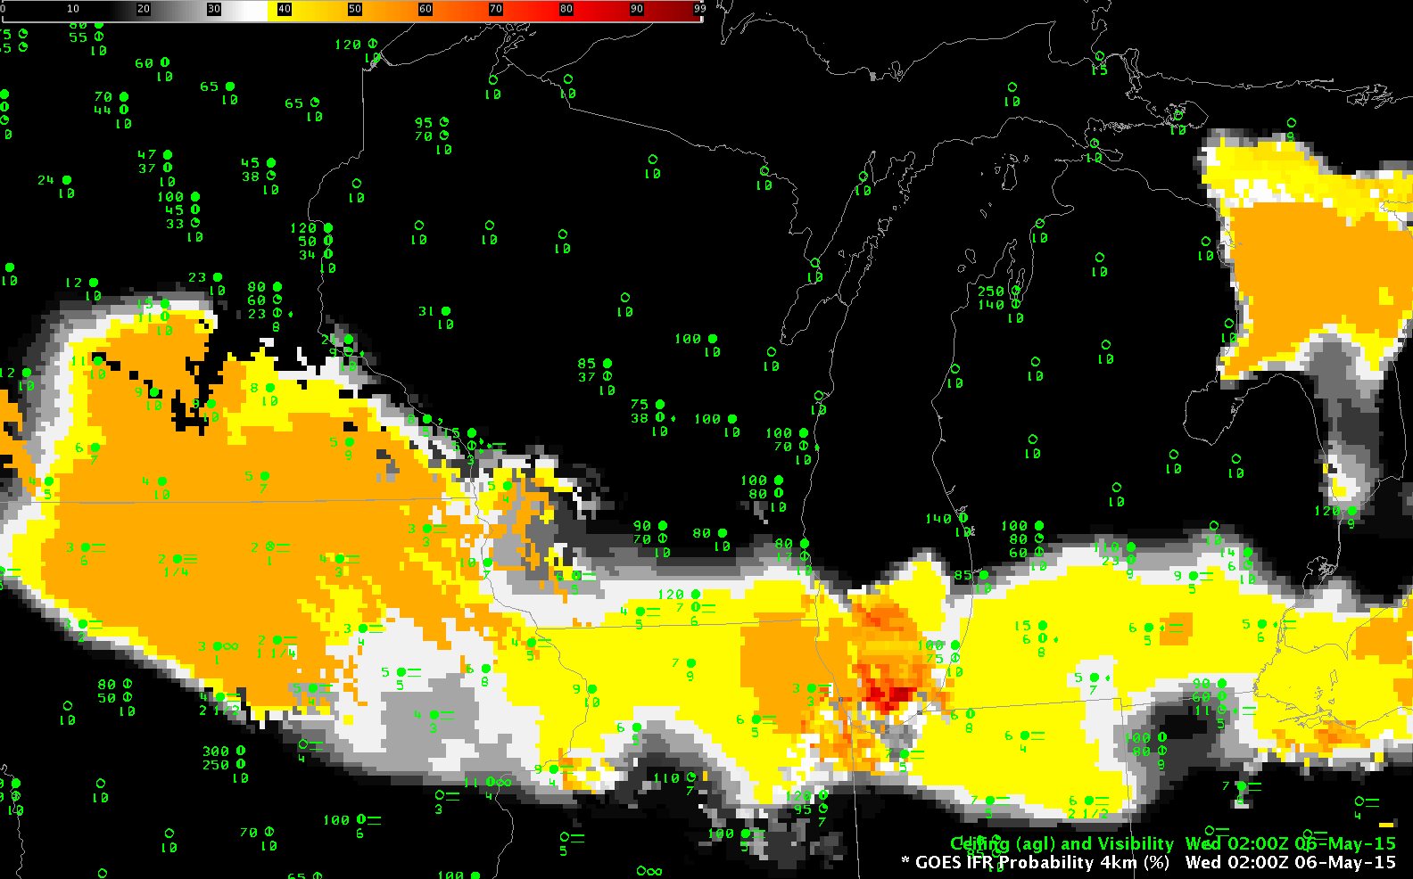
May 6, 2015
WI

Slide 25
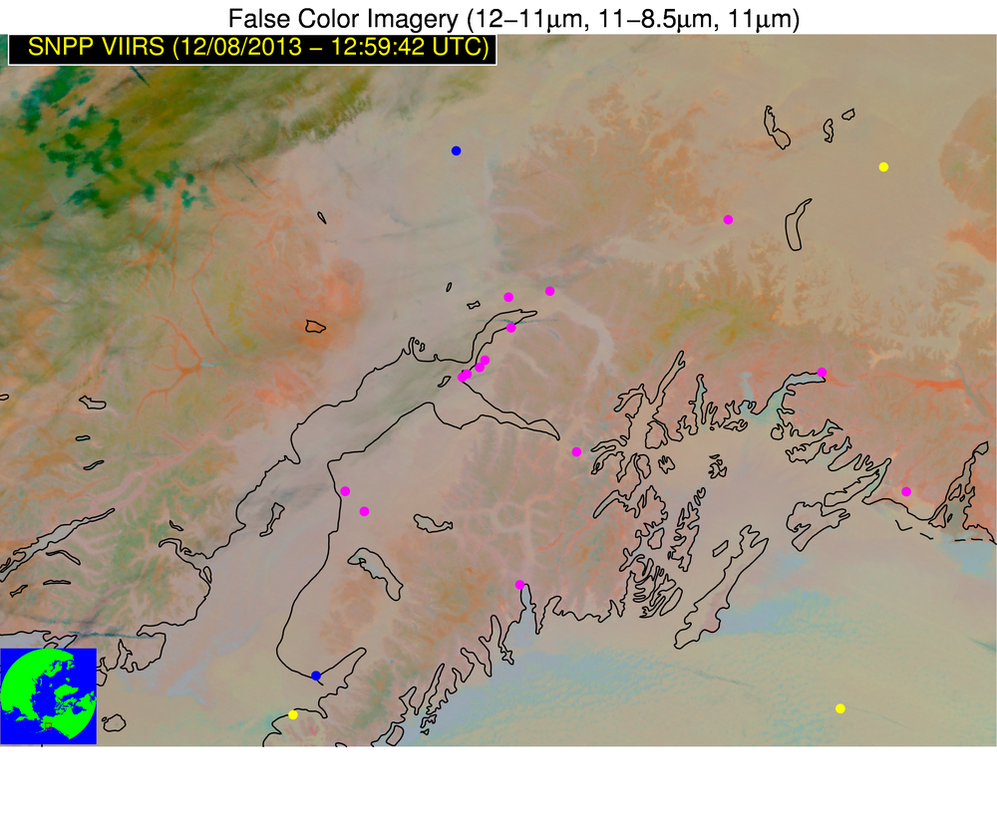
LIFR IFR MVFR VFR

Slide 26
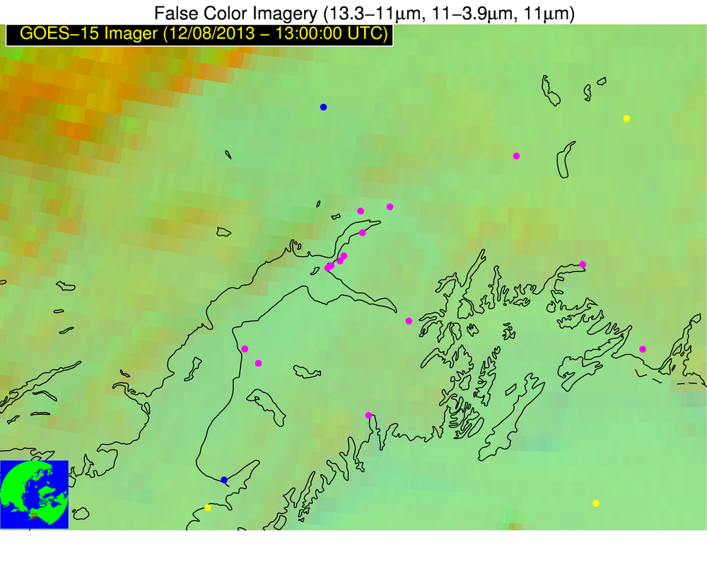
LIFR IFR MVFR VFR

Slide 27
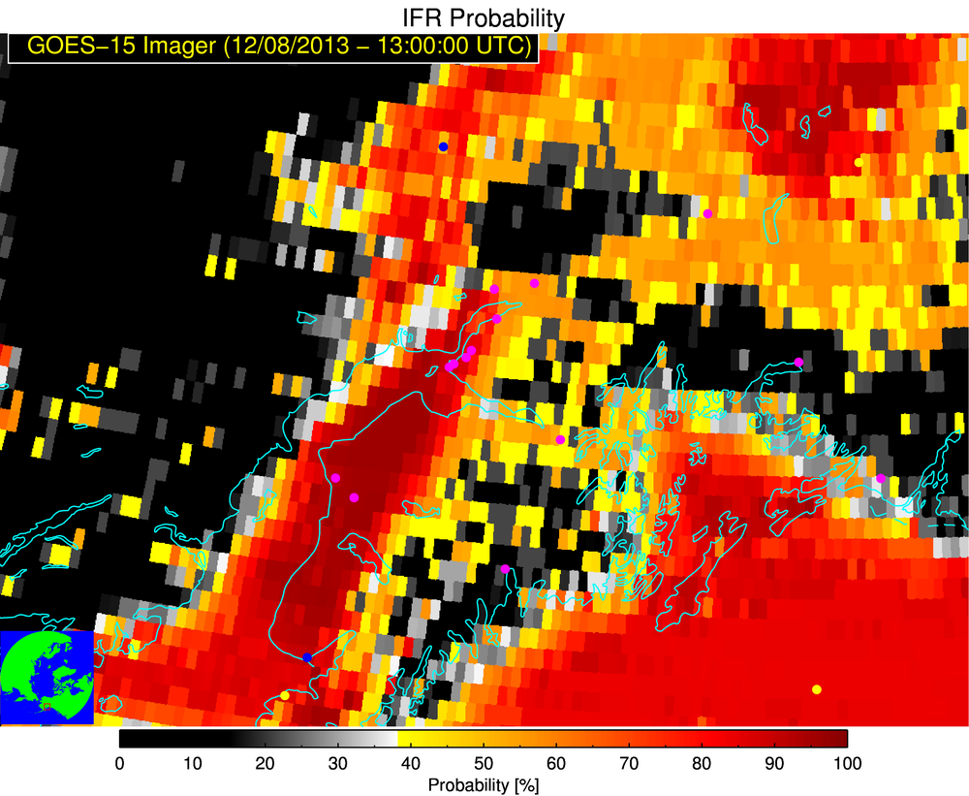

Slide 28
The low ceiling stratus is preferentially located in valleys and open areas bordered by higher terrain
Notes:
Locally fitted quadratic surface and its relationship to the spatial window

Slide 29
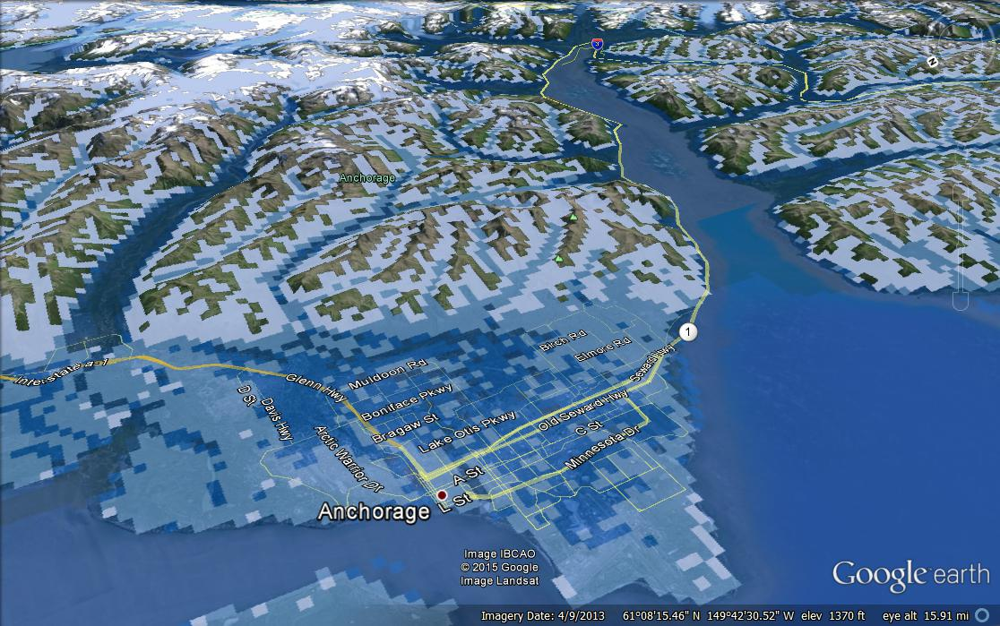

Slide 30
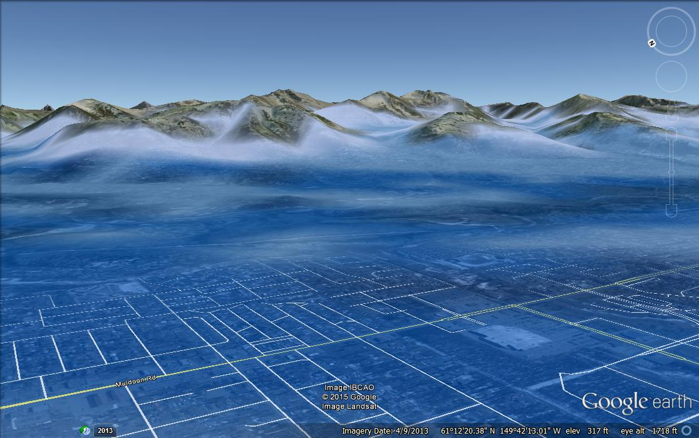

Slide 32
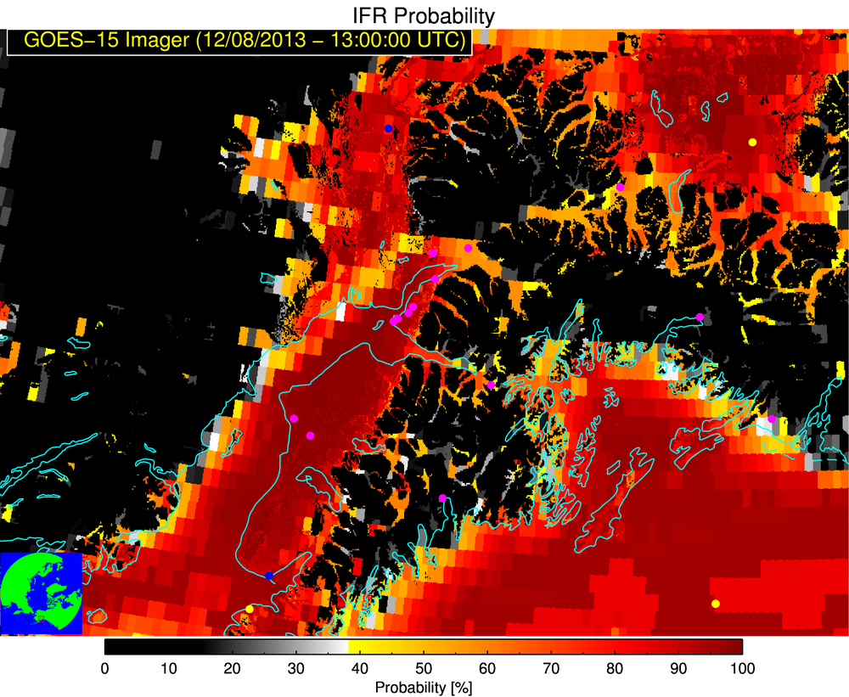

Slide 36
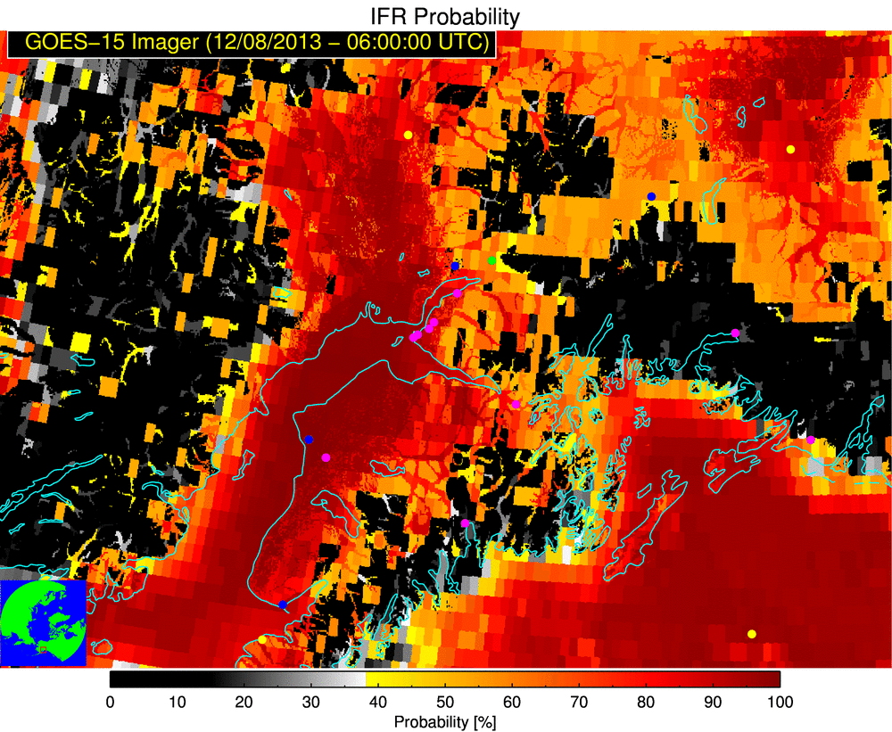

Slide 37
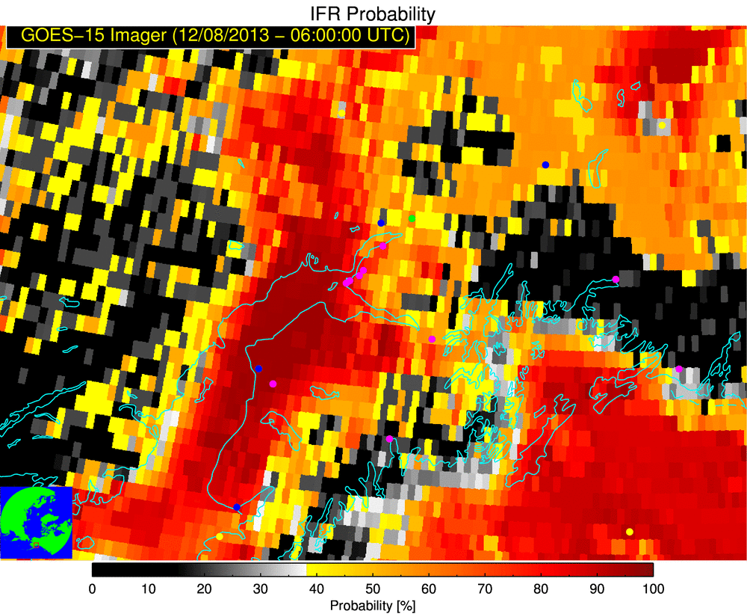
Sharpened Image
Original

Slide 38
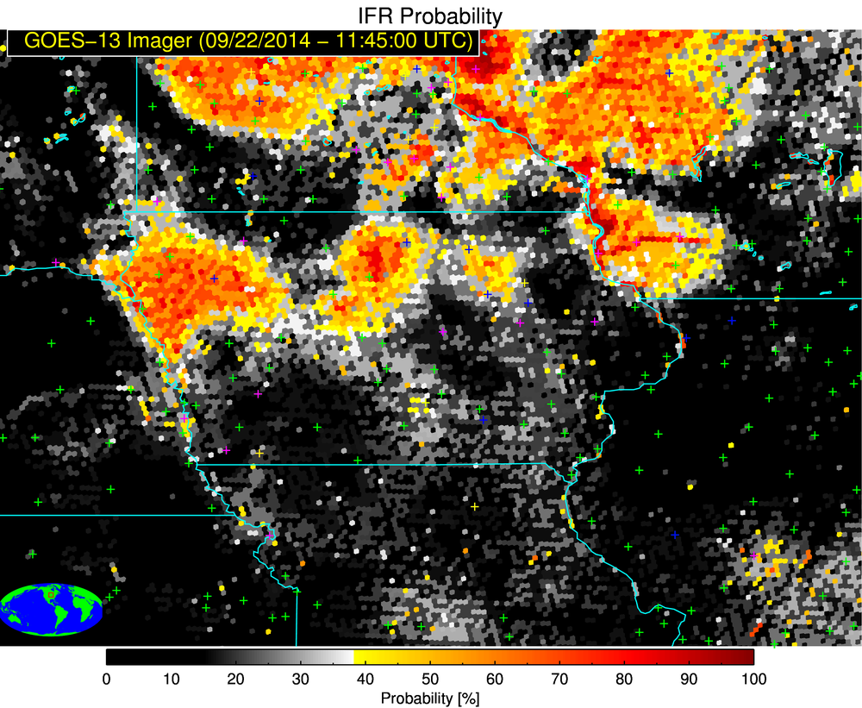
LIFR IFR MVFR VFR

Slide 39
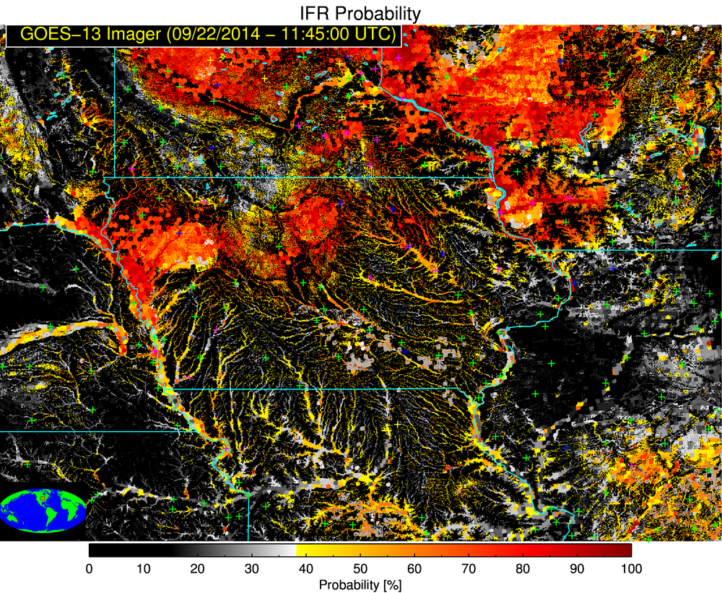
LIFR IFR MVFR VFR

Slide 40
LIFR IFR MVFR VFR

Slide 41
LIFR IFR MVFR VFR

Slide 42
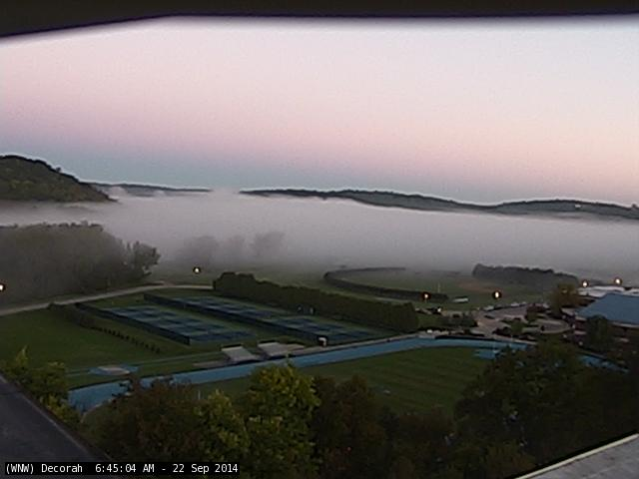
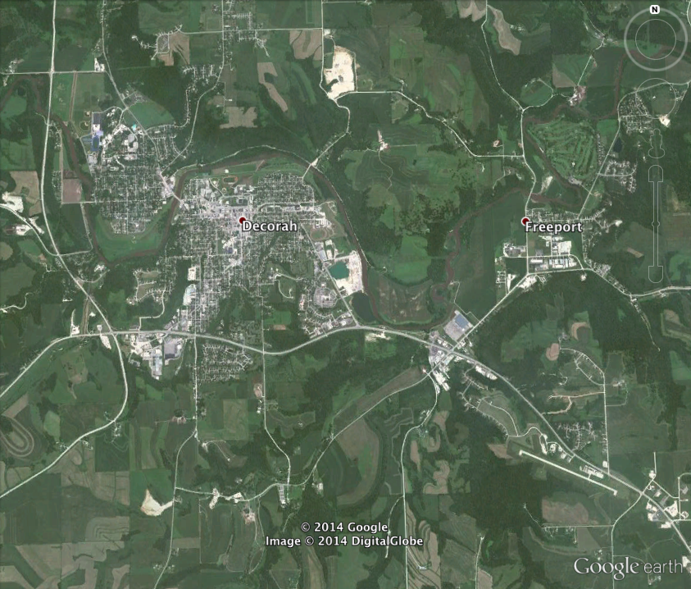
web cam location
6:45 AM LST
For small-scale fog events the location of surface station is very important
If a reporting station is not in or near a valley where fog is present then the report may be misleading
Upper Iowa
river
2.5 km
sfc report location
Notes:
Red arrow on Google earth map denotes the direction the web cam is facing

Slide 43
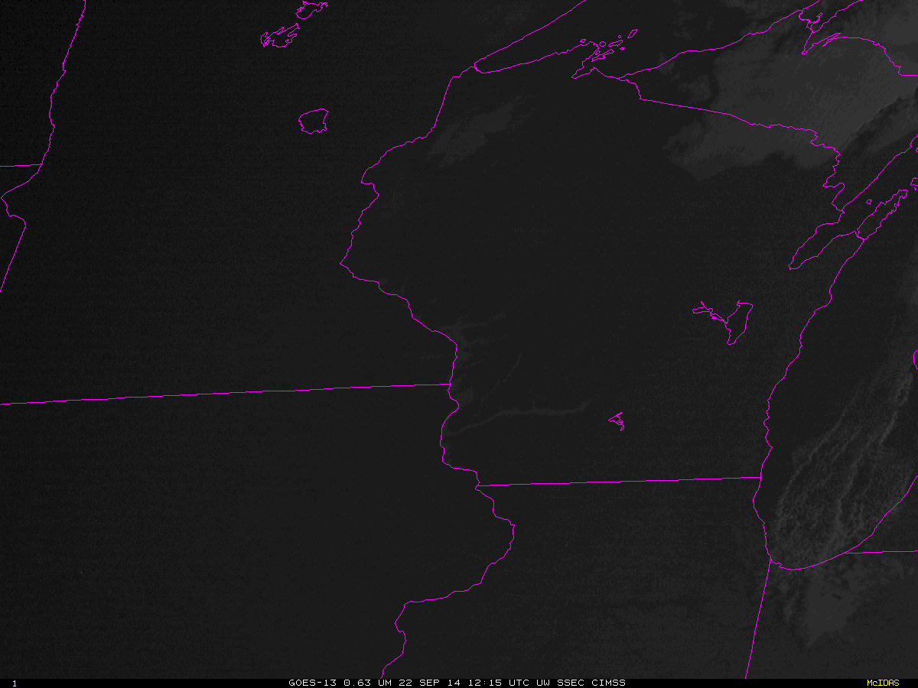

Slide 44
Fog unlikely
Areas of fog possible
Areas of fog likely
Fake example – not a real product, yet!
Notes:
Possible fusion with traffic cameras

Slide 45
Key Points
Satellite data alone (even GOES-R and JPSS) are poorly correlated with ceiling and visibility – which is why data fusion is needed
Use flight rule probabilities in tandem with FLS thickness and imagery of choice to help mitigate the impact of the RAP overestimating the RH (we are also exploring methods to directly address this problem)
In the GOES-R era we hope to be able to decrease day/night discontinuities
Readiness concern: Very few Southern Region PG evaluations
Future applications: 1). Use of DEM’s to downscale the FLS products is extremely promising, 2). Automated alerting capability, 3). An empirical model to forecast the development and dissipation of FLS conditions (directly addresses TAF and other forecasting problems) (akin to ProbSevere)

Slide 46
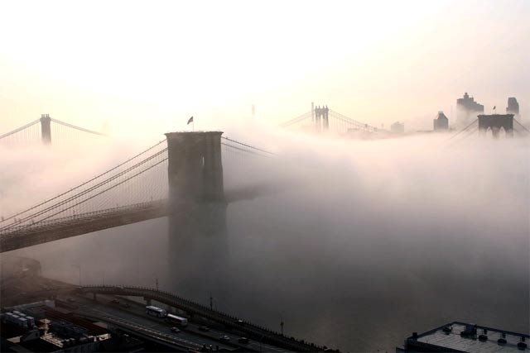
Product Info and Training Material
Product Training Module
http://cimss.ssec.wisc.edu/goes_r/proving-ground/SPC/SPC.html
GOES-R Radiation Fog Dissipation Relationship PDF
http://cimss.ssec.wisc.edu/~ccalvert/goesr_fls_training/FLS_dissipation
GOES-R Fog/Low Cloud Detection Fact Sheet
http://www.goes-r.gov/education/docs/Factsheet_Fog-Low%20Cloud_05-02-11.pdf
UW-CIMSS GEOCAT Realtime Cloud Product Website
http://cimss.ssec.wisc.edu/geocat/
GOES-R FLS Detection and Thickness ATBD
http://cimss.ssec.wisc.edu/~mpav/goesr/GOESR_ABI_100pct_ATBD_Aviation_Fog_v2.0_revised12Sept2011_MS2004.doc
UW-CIMSS “Fog Blog”
http://fusedfog.ssec.wisc.edu

Slide 47
http://fusedfog.ssec.wisc.edu
Notes:
-We are now at the point where if we discontinued the distribution of these products, many forecasters would be upset. That is perhaps the ultimate measure of success.

Slide 48
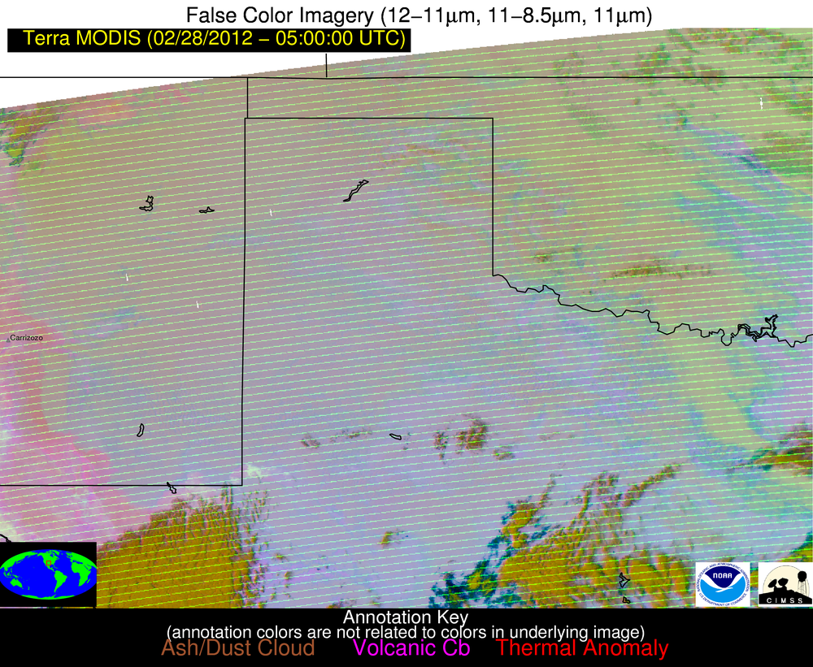

Slide 49
GOES-R FLS Validation Over Alaska
The FLS products were validated using surface observations of ceiling and visibility
The plot below shows the Critical Success Index (CSI) of the daytime/nighttime GOES-R IFR probabilities along with the nighttime BTD product as a function of the threshold used to differentiate between FLS and non-FLS clouds
The maximum CSI for the nighttime BTD product was calculated at 0.306
The maximum CSI for the daytime/nighttime IFR probabilities were calculated at 0.426/0.450 respectively, significantly higher than the traditional BTD product
Notes:
Validation was performed using 1 day from each month comprising roughly 1100 GOES-E scenes
The CSI was calculated as a function of the probability threshold used to separate IFR from non-IFR conditions over the full range of probability values (0-100%)
Similarly, the CSI was calculated for the traditional 3.9-11 um BTD as a function of the BTD threshold used to separate IFR from non-IFR conditions over a large range of thresholds
The maximum CSI for the GOES-R IFR probability product is nearly twice as large as the maximum CSI for the traditional BTD product
CSI = (hits)/(hits + false alarms + misses), is sensitive to the climatology of the event

Slide 50
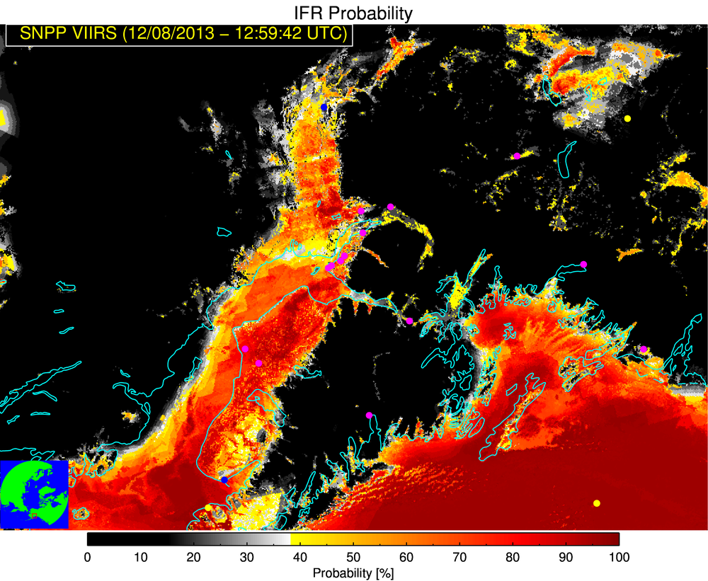
Physically based image sharpening
Compute the correlation between the fraction of the satellite pixel that is in a valley and the IFR probability
If sufficiently correlated, use “valleyness” metric and LEO data (if available) to determine which parts of the satellite pixel most likely have IFR conditions and re-compute the IFR probability with larger a priori probability

Slide 52
Naïve Bayes Probabilistic Model
The naïve Bayes’ model returns a conditional probability that an “event” will occur given a set of measureable features defined by the equation below
The “naïve” aspect comes from the assumption that the measureable features are independent of each other
where
is the climatological probability an “event” occurs regardless of the measured features
is the climatological probability an “event” does not occur regardless of the measured features
Is the conditional probability that an “event” is observed given a measured feature
Is the conditional probability that an “event” is not observed given a measured feature
Notes:
For the GOES-R FLS product an “event” is defined by a surface observation reporting IFR conditions
The “measured features” are the set of model and satellite predictors we chose for the algorithm collocated with the surface observations

Slide 53
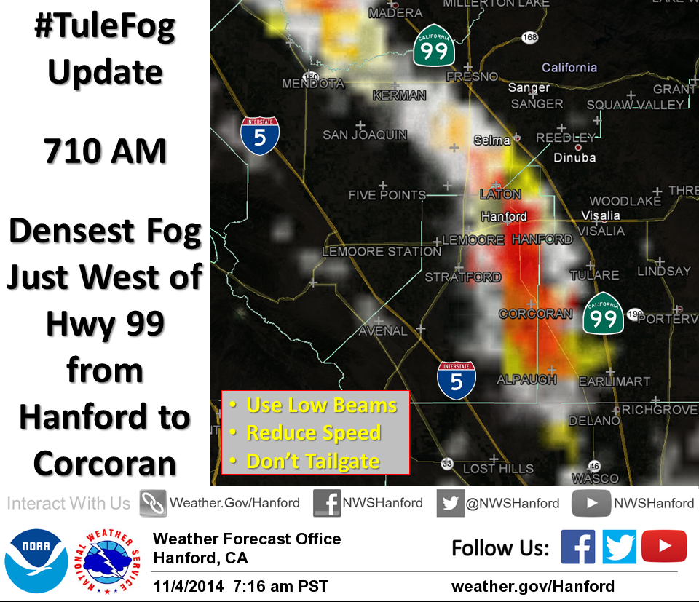

Slide 54
Using GOES-R Probabilities of IFR Visibilities & Ceiling for Decision Support at the FAA Air Traffic Control System Command Center – Michael Eckert (NAM)

Slide 55
FLS Products in GFE Gridded Aviation Forecast Program at WFO Greenville-Spartanburg
The IFR and MVFR probabilities are now used to adjust the grids from which Terminal Area Forecasts (TAFs) are created

Slide 56
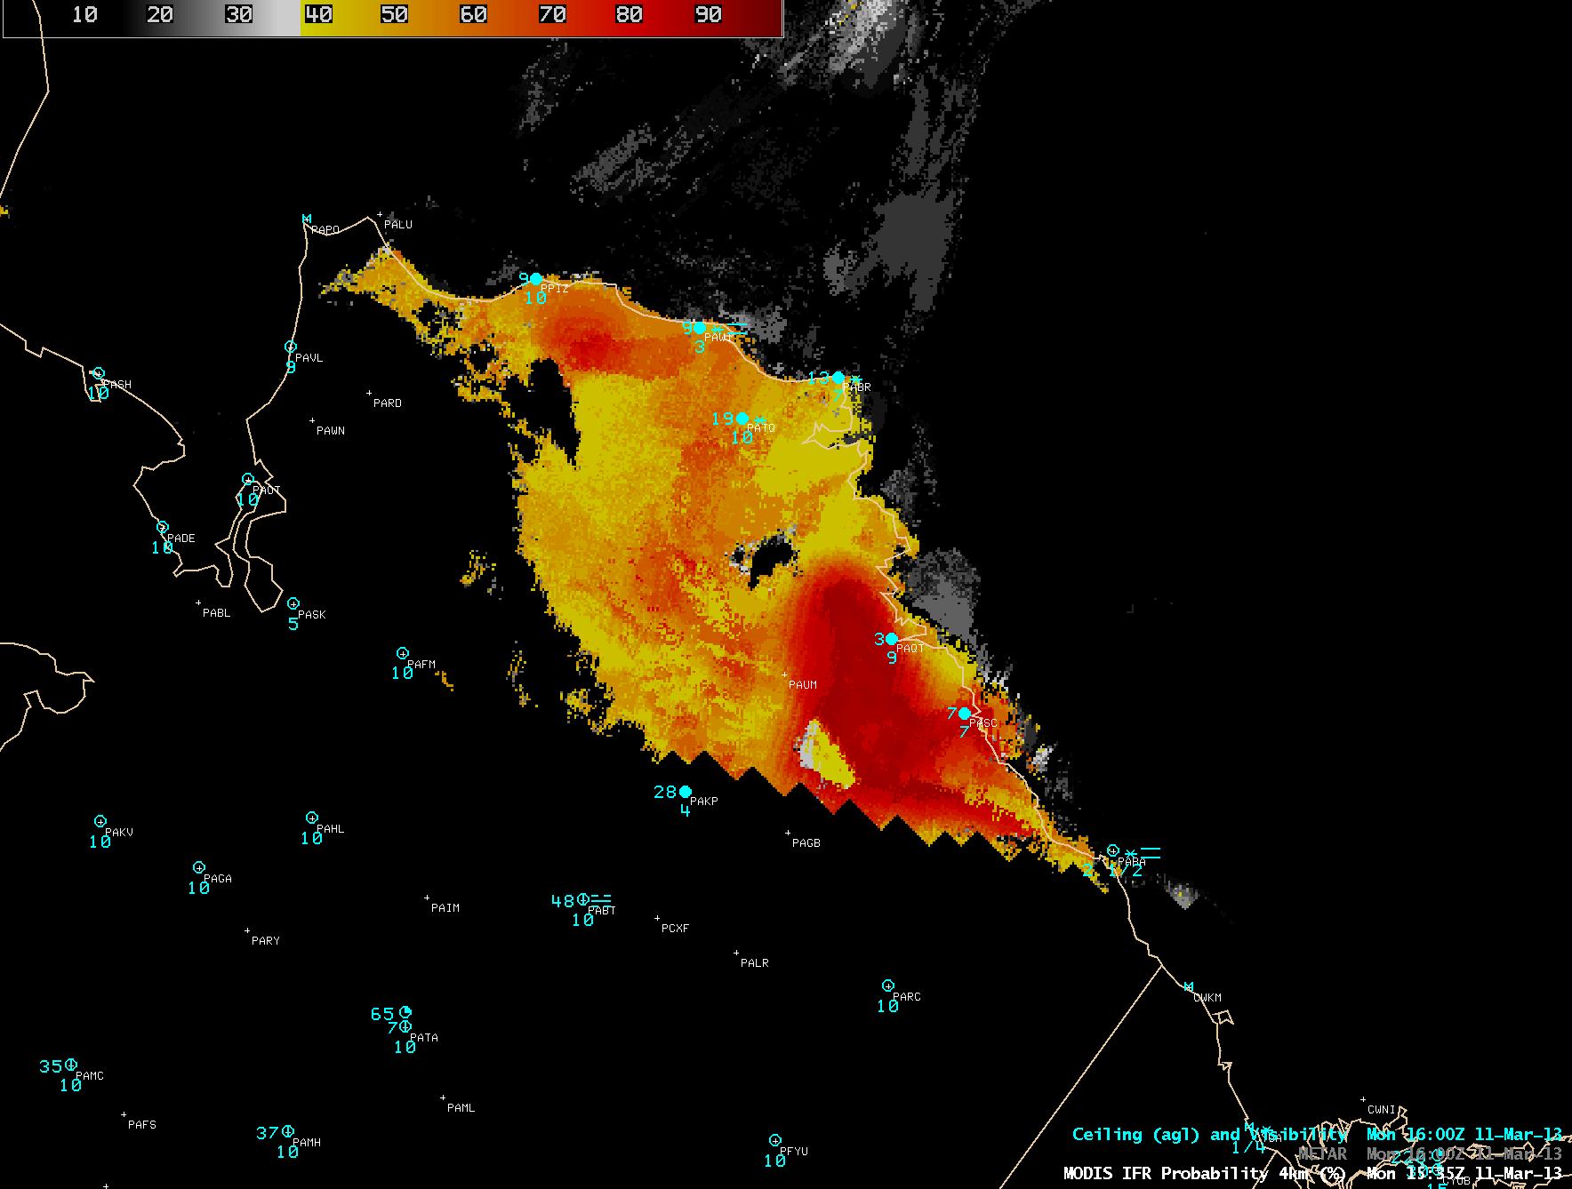
FLS on North Slope

Slide 57
