Slide 1
Feedback Requested!

Slide 2
Context of this session
“Great plan!”
My needs:
What can be done better?
What did I overlook?
Notes:
2
The context of this session:
The words “It is a great plan!” are very nice to hear, but doesn’t help me any further.
By lack of critical mass at home I hope to hear from you, experts in education and training:
what can be done better?
What did I overlook in this plan?
Like to use you as a mirror to make my plans better!

Slide 3
Background

Slide 4
Train the Trainer, Sibiu, 2010
Notes:
4
Sometimes you get information from which you think: You are absolutely right but how the hell am I going to implement that in my organisation ……
Fresh into to the field of education and training I was confronted with this Context of learning schema of Ian Bell during the WMO train the trainer in Sibiu

Slide 5
Develop the program from the top down
Are the goals met?
Goals
Support
Evaluate all aspects of the training
Job Tasks
Competencies
Training Needs
Notes:
The message was: Develop the training program for your institute from the top down and evaluate all aspects of training against the goals. Than you training program will last.
Creating training needs from competencies is not the most difficult things. WMO has done a wonderful job with writing competencies for especially forecasters down during the past few years….. and to be honest those helped me at awful lot during the past couple of years.
The main problem was THE BIT in the red circle ….. It was already starting with a lack of a clear company strategy.

Slide 6
Reorganisation KNMI
New management
Learning and development was back on the agenda
Learning and development was centralised at the HRM department
There was a plan to make a HR strategy
Notes:
6
Then we had a large external forced reorganisation. During this reorganisation some important things happened:
We have got a new top AND middle management and the KNMI structure was changed.
We got education and training back on the agenda and we were asked to created a plan how the education and training should be organised in the new organisation.
During this process we managed to get the message across that learning and development is important if your want to be a leading knowledge institute in Meteorology, Climatology and seismology.
So we asked for:
1) To create a learning and development strategy for KNMI
2) To appoint the roles and responsibilities on learning and development too
3) To fix an annual learning and development budget
4) And to ensure a strong learning environment
And our new top management asked “Is this all?” Let’s start!
I was moved to the HRM department and started to work with my HR colleagues on a HR strategy in which learning and development was integrated.
Institute we wanted to be..
We created a plan where we

Slide 7
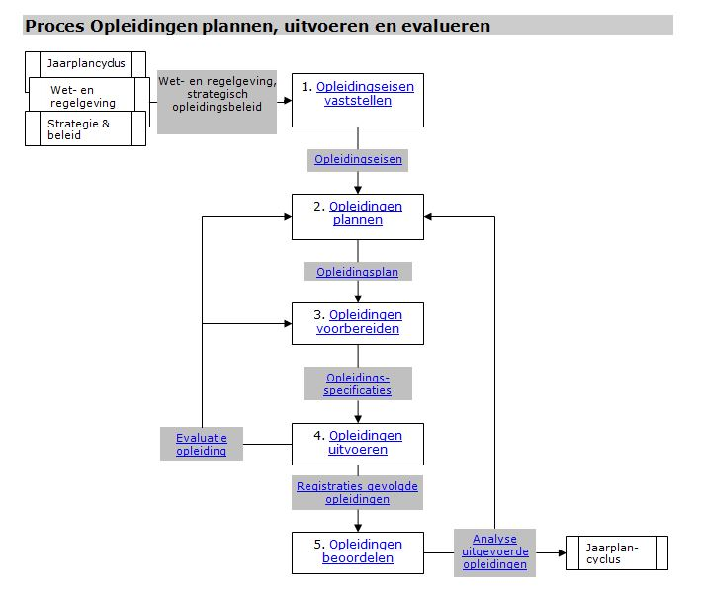
Situation Right Now: Contrast
Notes:
7
The situation we have until right now:
KNMI has:
1) Some departments have no learning and development plan and no money
2) Some departments have no learning and development plan and uses the learning and development money they have to give presents in the form of a training course to their employees
3) At the same time the forecasting department has a process in place for the to plan, execute and evaluate education and training plans for their observers and forecasters.
Probably very recognizable for you too.

Slide 8
The Plan
Notes:
So the new plan which we wanted to use to solve these learning and development problems.
we started to integrate from scratch since this spring…..

Slide 9
HR strategy v.s. KNMI training and education
Notes:
9
This is what it looks like!

Slide 10
Goals
Support
Job Tasks
Competencies
Notes:
10
Show part of Ian’s schedule we were missing and make the relation to the HR plan
I think with adding learning and development to the HR strategy we have solved the gap we had (click and show KNMI HR strategy part).
Explain HR strategy step by step

Slide 11
Notes:
11
In the plan is descripted what to do:
Educate/refresh the staff
Hire new staff
Mobility of staff
Or innovation projects to upgrade the quality
The main question for al these 4 opportunities for the organisation the central question is “What should the staff/organisation do differently/better to achieve the organizational goals?
And can be our training related changes we need to have develop a education and training plan.

Slide 12
Notes:
12
This is what we call our house of learning and development! The idea of it was introduced to us by Mieke Posthumus (NSCU) and it is based on a corporate university model.
So we are also going to adapt our process to come to develop and execute the learning an development plan….. Please walk with me through the schedule.
Roof: trainings issues come in
Windows: training solutions are converted to training needs and given a priority. Think I will use a TPD for that.
Basement: good management of the learning and development process. Think of budget distribution and execution of the education plan.
In the end of the total HR process appointments will be made between the manager and the employee. Among those appointments will be also the appointments on learning and development. Also will the evaluation will be done of the learning process

Slide 13
HR strategy v.s. KNMI training and education
Notes:
13
In the end all aspects of learning will be evaluated against expected change and whether this change supports the goals of the organisation. And than the process will start all over again.

Slide 14
And now hope (!) that it is going to work
Notes:
We started to integrate this plan from scratch since this spring…..we are learning on the job and at the moment the mangers are busy with the strategic staffing plan.
Hopefully at the beginning of November we will have the fleet show. I expect we need the whole of next year before we have experienced the whole house of learning.

Slide 15
Possible Risks!
Notes:
The possible risk I see so far.

Slide 16
Way of financing the plan
Difference in planning cycles
The windows in the house of learning focus on the wrong things
Notes:
16
Way of financing:
2% of the payroll is a lot of money if your are not used to spend money to education and training.
Next to that this budget is only reserved for learning and development efforts. The costs of managing the house of learning are not included.
The first part of the HR cycle is going slower than it should go, because we are learning on the job. Than means that the full cycle can’t be handled in one year this year. The managers don’t understand the new planning process yet and find it scary the the learning and development money is now situated in one big pot and want to have is on their own department. We hope that they are willing to share it again as soon we get up to the MT special of dividing the budget.
Difference in cycles:
HR cycle is 3 years with a little update in between
The education cycle is a yearly cycle and possibly more often when the demands of having to service new customers occur.
A lot of changes in the HR cycles are for the longer term and are not done within one year so training related issues be keep coming from that side. It is getting a new customer wanting a totally for KNMI people new product I am worrying about. How do I reserve money to be able to handle urgent last minutes requests too? Many companies I know do the planning for learning and development once a year, every request that comes in later won’t be handled or new periodization is needed. This is a bit rigid in my eyes. How do other companies do that?
The windows of the house of learning focus on the wrong things
* Think we are going to use a kind of training development plan as used during the last WMO train the trainer to make the training needs and prioritization of each request for training clear. During the last TtT I saw what can go wrong with a training development plan. So I have added a learning and development specialist to every window in the house of learning to ask the right questions but we haven’t got them in the house right now.

Slide 17
Who has experience and is willing to give advice?
Notes:
Who has experience with these kind of processes and is willing to give advice or share ideas?

Slide 18
What is the best way to help our managers in the budgeting process? Examples?
What do I miss in these plans?
Notes:
18
1) Does for instance anyone has experience with for instance managing the distribution of the money by the MT members. What is the best way to help our MT members to do it?
2) What do I miss in these plans?

Slide 19
I hope for some discussion!

