Slide 1
Quality assurance approaches
Philip Merritt, Met Office, UK

Slide 2
Aims
To understand the different approaches we have to quality assurance when assessing competence

Slide 3
Objectives
By the end of this session you should be able to:
Identify the right people to be involved with quality assurance processes
Know different ways evidence can be standardised

Slide 4
Why is it important?
If there is no formal approach to consistency then there may be differing levels to what assessors are looking for or what happens over time
Your hired
Your fired

Slide 5
Why is it important?
Therefore we need to find a way that ensures consistency between assessments
This means consistency in different forms
over time
locations
people
Any pre-existing documentation setting out what is expected from the standards will help in defining required levels and expectations

Slide 6
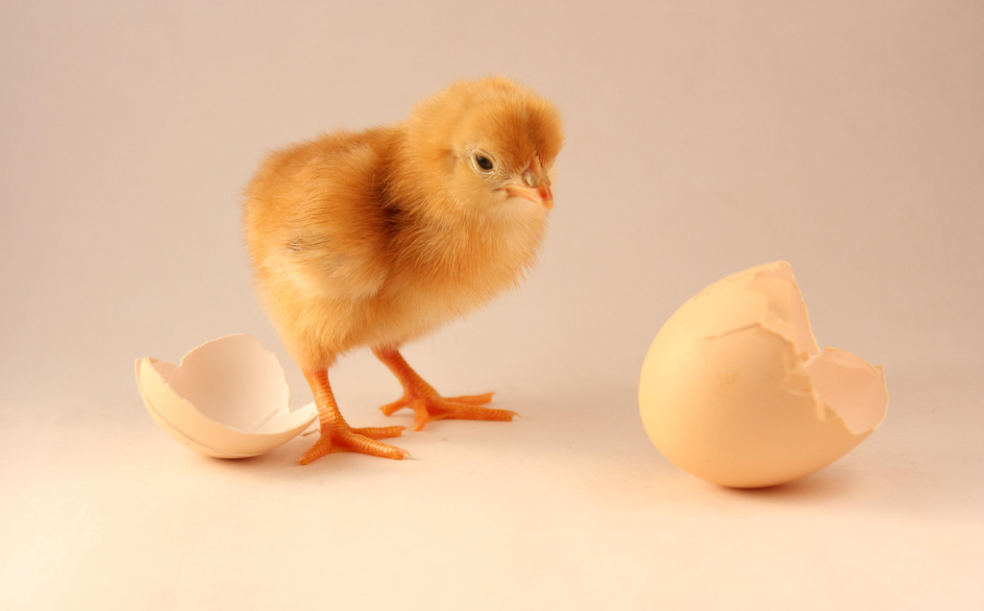
What came first......

Slide 7
Who are our subject matter experts?
Those with suitable qualifications in this subject
Those with suitable experience in this subject
A range of people across the subject
Constantly review this

Slide 8
Who are our assessors?
In many ways similar to the subject matter experts
Can be those in certain job roles – team leaders, trainers, managers
Need to have currency in the subject
Need to have the expertise but also skilled in areas like feedback

Slide 9
How can we standardise assessments?
Standardisation meetings
If several people are assessing within your organisation then have occasional meetings
The assessors look at pieces of evidence and blind mark them
Try to get agreement over what is deemed as sufficient evidence
See if the assessments could have been completed in a more thorough way or in a different style

Slide 10
How can we standardise assessments?
Internal Verification
Identify someone who is the lead assessor or internal verifier
This person (or persons for larger organisations) can then check consistency
They can organise and lead standardisation meetings
They can check a sample of work of other assessors to ensure standards

Slide 11
Improving the process
The standardised material should be formally documented as part of QMS
Continuing standardisation and internal verification should help to ensure these have been implemented
If not, then more formal action should take place to help raise standards and deliver best practice
Always reflect on are we doing this in the most efficient and practical way

Slide 12
So hopefully....
If we follow these processes we will see this
Your hired
Your hired

