Slide 1
Assessment FOR Learning
Larisa Timofeeva
PhD, Ass. Prof., Hydrological Faculty
Russian State Hydrometeorological University, Saint Petersburg
CALMet XI, Seoul
7-11 September, 2015

Slide 2
Assessment
A way of measuring what individuals have learnt as a result of a learning activity – for example,
by testing a learner’s knowledge, skill or behaviour – or of determining current knowledge or competency.
The assessment should be based upon the objectives of the learning situation or job requirements.
Guidelines for Trainers in Meteorological, Hydrological and Climate Services, Glossary (WMO, 2013)

Slide 3
Students can survive (with difficulty) poor teaching,
but they can't escape the effects of poor assessment.
Boud, 1995

Slide 4
1.38

Slide 5
If educational measurement
doesn’t lead
to better education for students,
then we shouldn’t be doing it
J. Popham, 2000
Learning
for
Assessment
of

Slide 6
Formativе assessment
Gathering information during training to provide feedback to both learners and trainers about progress and to identify any alterations that might be required.
Guidelines …, Glossary (WMO, 2013)

Slide 7
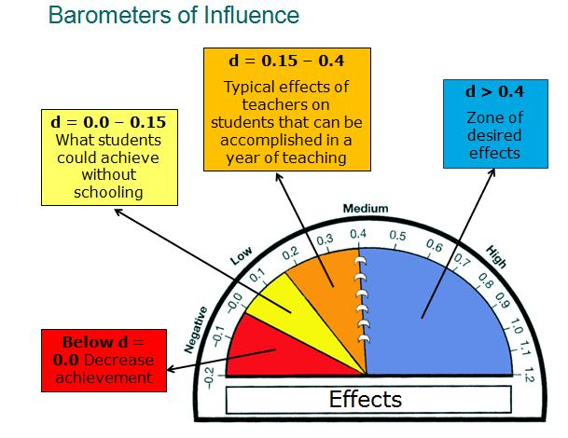
John Hattie, 2009
Average effect size = 0.4

Slide 8
Feedback needs to provide information specifically relating to the task or process of learning that fills a gap between what is understood and what is aimed to be understood
Sadler, 1989
Effect size = 1.13

Slide 9
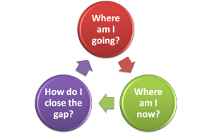
Sadler (1989)

Slide 11
Feedback …
Is not evaluation, but information about how we are doing in our efforts to reach a goal
Is goal-referenced. Must be so tangible that anyone who has a goal can learn from it
Must be user-friendly: consistent, concrete, specific, useful.
Too much feedback is counterproductive
Must be "timely“, occur while there is still time to act on it
Needs a safe environment, where mistakes can be made
In classroom mostly comes from peers, and much of it is wrong
Is most powerful when it is from the student to the teacher
Adapted from Educational Leadership/September 2012
Vol. 70, Issue 1, pp. 10-16, 96

Slide 12
Peer Assessment
Peer assessment requires students to provide either feedback or grades (or both) to their peers on a product or a performance, based on the criteria of excellence for that product
Falchikov, 2007
Effect size =
0.5

Slide 13
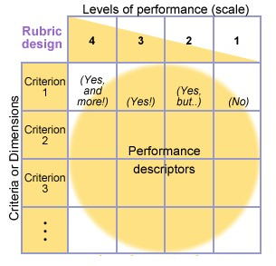
Each rubric has at least
2 criteria
2 levels of performance
A rubric might not have descriptors

Slide 14
Peer Assessment
students |  | academics
challenges | benefits | challenges | benefits
 | transfer of learning and reflection | How to start? | effective way to monitor students progress
 | can enhance the students learning experience |  | can reduce the lecturer assessment workload
 | better learning from seeing other students’ successes and weaknesses |  | more feedback, not only given by the lecturer
 | eliminates the mystery of the assessment process

Slide 15
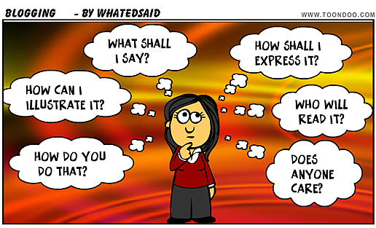

Slide 16
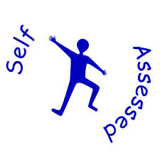
Assessment can contribute
to improving
students’ learning and
teachers’ teaching
Newton, 2007

Slide 17
Resources
Australian Institute for Teaching and School Leadership
www.aitsl.edu.au
www.coursera.org
Judy Halbert and Linda Kaser
Co-directors, Centre for Innovative Educational Leadership
Vancouver Island University, British Columbia, Canada
Assoc. Prof. Gavin T L Brown
The University of Auckland, New Zealand

Slide 18
Thank you!
Welcome to Saint Petersburg

