Slide 1
Learning through gaming
Anna Ghelli, ECMWF
(anna.ghelli@ecmwf.int)
Louise Arnal, ECMWF
(louise.arnal@ecmwf.int)

Slide 2
Notes:
The history of Monopoly can be traced back to 1903,^{[1][4]} when American anti-monopolist Elizabeth (Lizzie) J. Magie Phillips, created a game through which she hoped to be able to explain the single tax theory of Henry George. It was intended as an educational tool to illustrate the negative aspects of concentrating land in private monopolies.
The object of the game is to own as much land (property) and be the richest person

Slide 3
Key points …..
Meet learners where they are
Learner’s engagement is at the core of learning
Games offer an atmosphere where risk taking is safe and encouraged

Slide 4
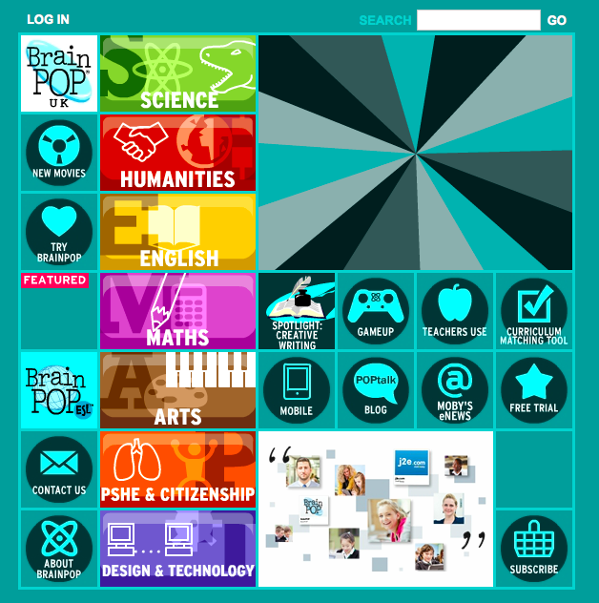
BrainPoP survey
57% respondents say that games make it easier to learn
49% respondents say that the use of games increased their learning
44% respondents say that the use of games helps to become better thinkers and problem solvers
“learning games simply make
school more fun!”
Notes:
BrainPoP sponsored a survey in 2013 on use of technology and game-based learning
Since 2003, Project Tomorrow SpeakUp survey has captured more than 3.4 million perspectives on the use of technology for learning (results above are for 2013 and are for secondary school students)
Much literature on using games for adult learning. Games are appreciated and more teachers/trainers try to incorporate them in their programmes. It is not true that games make adults feel childish. They created a safe environment, good dynamics and willingness to participate more in the learning activities --→ especially if there is a price for the winners!!!!
BrainPOP was founded in 1999 by Avraham Kadar, M.D., an immunologist and pediatrician, as a creative way to explain difficult concepts to his young patients. Today, we're used in more than 20 percent of U.S. schools, and are growing internationally:

Slide 5
Learning through playing
Learn critical skills: teamwork, creativity, solution finding
Develop a variety of connections with the content
Form positive memories of learning
Grab students’ attention, creating a context for engaging practices
Notes:
Problem solving: The problem solver’s approach to fixing something that is broken is likely to take the error or behavior that is being observed and start to research it using a tool like Google, or any other search engine. 7/10 times this will yield results for the most common of issues. The challenge is in the other 30% of issues that will take the problem solver down the rabbit hole and cause them not to surface for days on end while every avenue is explored for the cause of the problem. In the end, they will probably find the cause of the issue and resolve it, but the cost can be days, or weeks of work.
Solution finding: The solution finder’s approach to a problem will begin the same way the Problem Solver’s approach will. The difference comes in the more difficult cases. Rather than stick to the pure “This has to work so I am going to work with it until it does” approach, the Solution Finder will look for other ways to get the requirements satisfied that may or may not be using the original approach.

Slide 6
….. Last year
Kuna – Parrish (Eumetcal workshop 2014)
Notes:
Learning activities are planned interactions between learner and the instructor/content/or other learners that intend to facilitate learning. They ask learners to go beyond just memorizing or understanding, but to also engage in analytical thinking, decision making, creative thinking, problem solving, evaluation, or practical tasks that require some combination of these. These forms of learning activities develop deeper knowledge and knowledge that can be more easily applied to tasks.

Slide 7
Playing games at ECMWF…..
What will the temperature in Moscow be? ENS or HRES: which will score better?
Make your decision using probability
Should I open the flood gate?
Manage your reservoir with probability forecasts
When and how big will the peak of river discharge be?
How much are you willing to pay for having forecast information?......

Slide 8
… recapping: the box and whiskers plots!
77, 79, 80, 86, 87, 87, 94, 99
Max → 99
Q75 → (87 + 94)/2 = 90.5
Median → (86 + 87)/2 = 86.5
Q25 → (79 + 80)/2 = 79.5
Min → 77

Slide 9
Today’s game
How much are you willing to pay for having forecast information?

Slide 10
Debrief…….
Team work:
Was it easy to come to a “common decision”?
Under pressure:
How did you handle the time constraints?
Communicating importance of ENS
Do you feel you have used the information you had in the best way?

Slide 11
Some statistics ……
Event risk and skills of forecast
Notes:
Value of forecast is controlled by the perceived event risk
Importance of knowing skills of forecasts
People do not follow the forecasts because of the higher level of initial risk (river levels are getting higher) -→ see bars for case 3 and 4
People need info on the skills of the forecasts before using them. See case 5 where a large number of people in group 3 did not use the forecast (ie protected against floods) because they had realised that their forecasts were biased.

Slide 12
… and more statistics
Perceived usefulness
Notes:
90% bid for more forecasts) ←- this will give us an idea on the perceived usefulness of ens

Slide 13
Thank you!

