Slide 1
Enhancing Learner Retention
Brad Snyder
Meteorological Service of Canada
Notes:
Motivation: to underline the importance of Learner Retention
Most of the material here is from the book Make it Stick and Art Kohn who offered this…

Slide 2
http://blogs.koreanclass101.com/blog/2013/08/31/korean-word-of-the-day-satisfied-adjective/
Notes:
…back in your office, while you bask in the glory of your success, something is happening in the brains of your students.
The neural networks that your training inspired are beginning to dissolve, …your employees are quietly forgetting almost everything you presented.
Art Kohn (2014)

Slide 3
Forgetting
Chris Madden
Notes:
Your brain actually needs to forget the unimportant things
But we need to find ways to interrupt the act of forgetting – to remember the important stuff

Slide 4
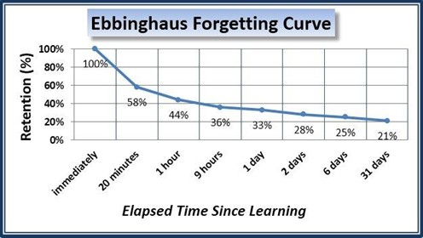
Notes:
The work of Ebbinghaus is well known in education
(but in the 130 years since his findings, have we succeeded in mitigating the forgetting curve)?
You devote days in preparing a course and in just ONE day, students can forget almost 70% of the material!

Slide 5
Notes:
According to Kohn, “Training organizations spend 60 billion dollars a year on training programs knowing full well that most of that knowledge will quickly disappear”
How much do you spend on training each year?
MSC spends over $60,000 a year to send forecasters to the Winter Weather Course at COMET

Slide 6
Return on Investment
MANAGER
TRAINER
www.illustrationsource.com
Notes:
The Tree of Learning costs money to grow…
Trainers want to nurture successful learning outcomes
Meanwhile managers are often forced with trimming the budget…. There’s an increasing demand on return on their investment

Slide 7
Notes:
Most of you are familiar with the 4 levels of the Kirkpatrick Model.
to see impact on job performance and behavioural changes, we must first create a successful learning environment

Slide 8
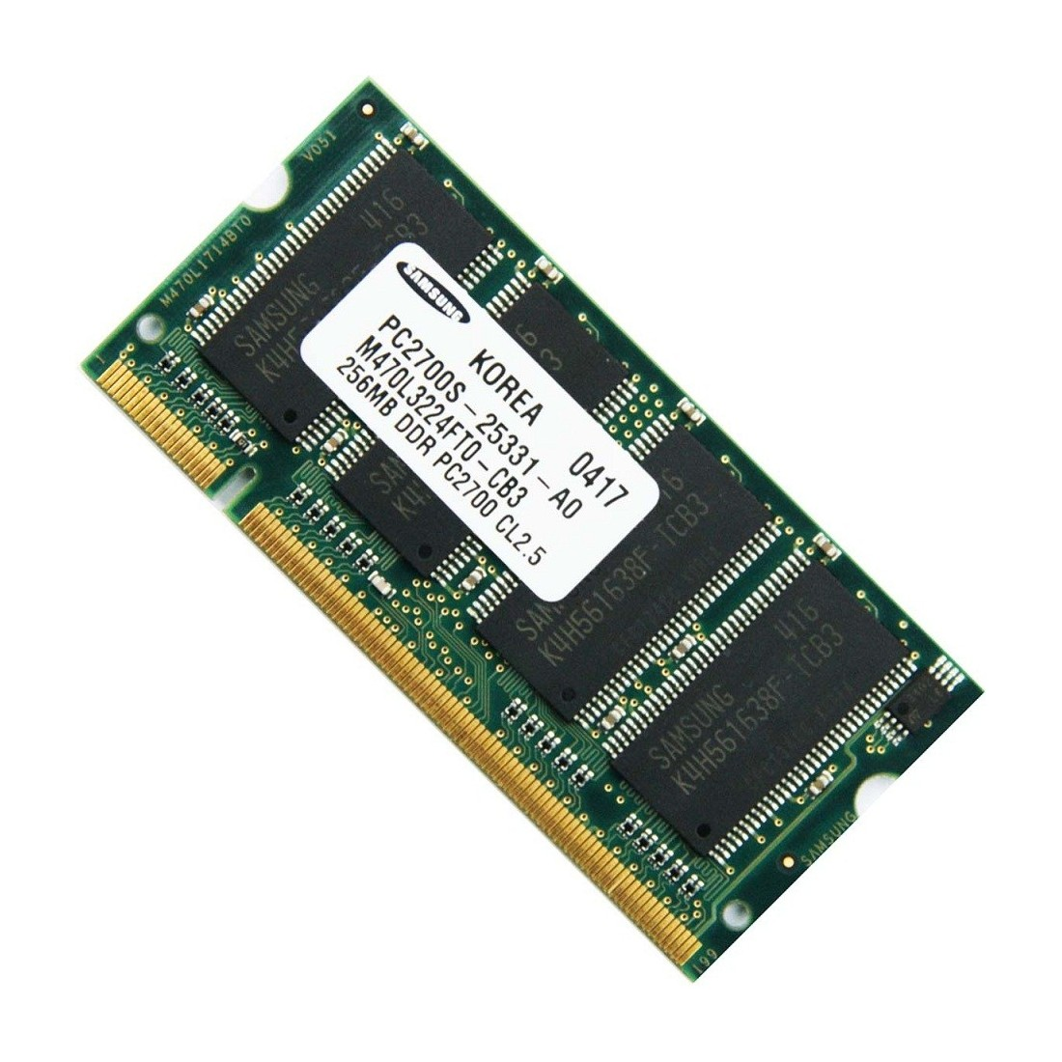
Learning
Notes:
learning is a 3 step process
Encoding into short term memory
Consolidation – moving things from short term to long term memory
Retrieval – strengthening the learning
We want to enhance consolidation and retrieval

Slide 9
Pathways to a memory
Notes:
Imagine that your brain is like a forest…your memory is there somewhere.
The more times you make a path to a memory, the better the path is and the easier it is to find next time
- Mary Pat Wenderoth, UW

Slide 10
http://www.hubsbookhub.com/the-reading-rabble-blog/2ttem5up80htcj7m6jpr6k61jqtojs
Notes:
So, we want to strengthen
Consolidation
Retrieval
The next few slides will introduce some strategies that we can adopt to help maximise the return on our training investment

Slide 11
Retrieval Strategies
Notes:
Strategies where the learner is forced to retrieve information are going to improve learner retention
Some of these include -
Quizzes & Self-testing
Reflection
Spacing out practice and Interleaving with other related material

Slide 12
The Testing Effect
Roediger and Karpicke, 2006
Notes:
Two groups – Group 1 studied the material twice; Group 2, studied once and took a recall test.
After 5 mins, Group 1 recalled more.
After one week, the results reversed…

Slide 13
The Testing Effect
Recall improved
for those
tested
Notes:
Two groups – Group 1 studied the material twice; Group 2, studied once and took a recall test.
After 5 mins, Group 1 recalled more.
After one week, the results reversed…
Incorporating testing resulted in enhanced learner retention

Slide 14
Reflection
How does what I read last month connect with what I’ve just learned?
http://blogs.ubc.ca/ransonetec530b/files/2012/07/woman-thinking.jpg
Notes:
Reflection – Reinforces the pathways through the forest
Studies have also shown that the physical act of writing one’s thoughts down, further improves retention

Slide 15
Spacing out practice
Pre-course
Post-course
http://i.huffpost.com/gen/2008614/images/o-EMPTY-CLASSROOM-facebook.jpg
Notes:
Distributed study episodes over time leads to better long term retention than does cramming
Pre-course practice
pre-course reading
Flipped classroom

Slide 16
Spacing out practice
Pre-course
Post-course
Notes:
Distributed study episodes over time leads to better long term retention than does cramming
Post-course practice
quizzes (booster questions)
reflection (webinars) serve to make stronger connections

Slide 17
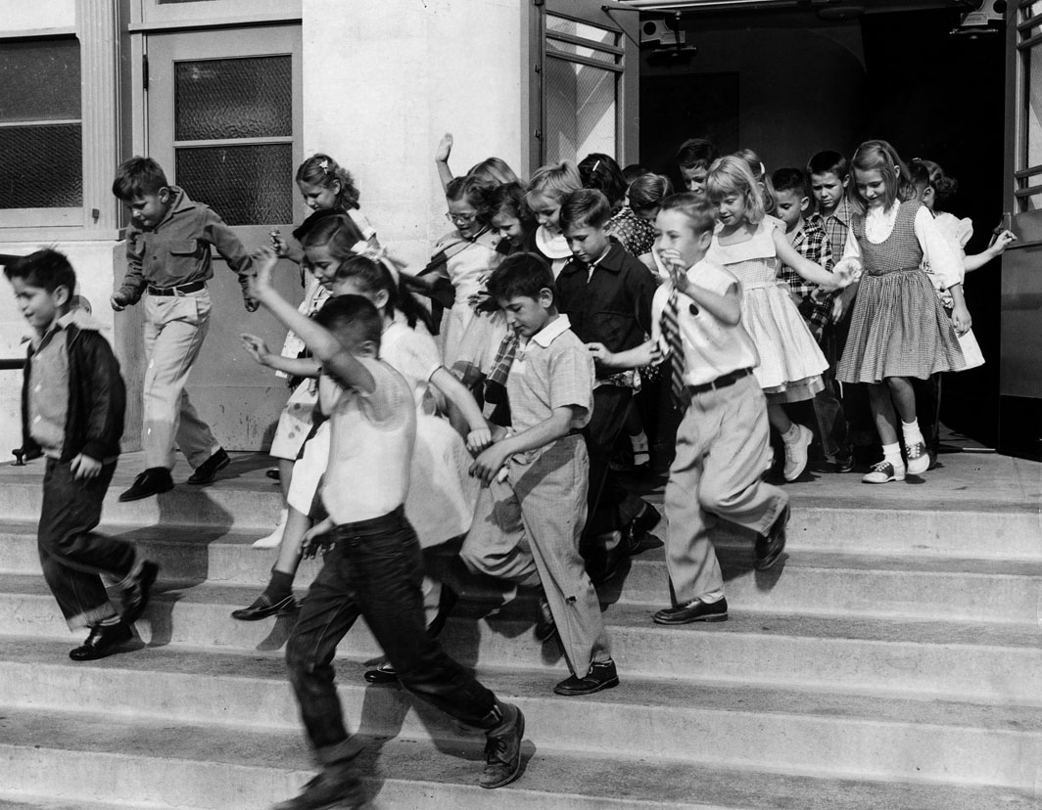
…What you do after training is more important
than what you do during training
Kohn, 2014
http://jpg1.lapl.org/pics43/00041180.jpg
Notes:
If your goal is to produce long-term retention, and if your goal is to produce behavior change, then what you do after training is more important than what you do during training.”
-Reconsolidation of memory traces
-Interrupting forgetting

Slide 18
You can get a good deal from rehearsal,
If it has the proper dispersal.
Cramming will not do the trick
If you want it to stick
So, don’t forget your testing
And managers will keep on investing
Modified from Ulrich Neisser

Slide 19
In conclusion
Notes:
Fiscal pressures demand more efficiency and accountability on trainers and learners
Let’s optimise what students learn
Let’s invest wisely in learning

Slide 20
What can you do ‘now’ to help enhance learner retention?
?
Notes:
Pre-course reading or flip classroom
Times for reflection during class
Quizzes and feedback
Interleaving topics
Post-course reflection, booster questions…

Slide 21
Make it Stick – The Science of Successful Learning. Brown, P.C. et al 2014.
Art Kohn
http://www.learningsolutionsmag.com/articles/1379/brain-science-the-forgetting-curvethe-dirty-secret-of-corporate-training
http://www.learningsolutionsmag.com/articles/1400/brain-science-overcoming-the-forgetting-curve
Other examples of Ignite presentations
http://igniteshow.com/

