Slide 1
Booster Questions and Learning Retention
Tsvet Ross-Lazarov
COMET Instructional Designer

Slide 2
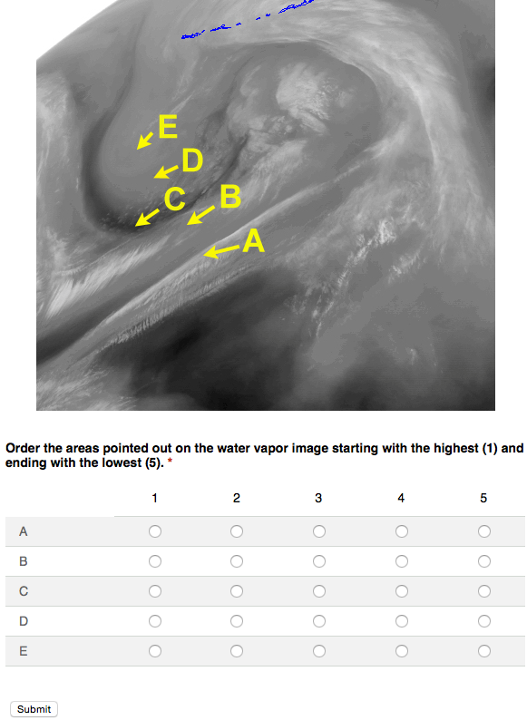
What are they?
Questions sent after training
Increasing learning retention
How many of you remember the number of the hotel room you are staying in now?

Slide 3
Forgetting is Easy, Remembering is Hard
Interrupt the process of forgetting!

Slide 4
Which do you think is better for learning? Select the best answer.
To study a subject for six hours in a single day
To study a subject for two hours each day for three days
To study a subject and answer questions each day
5%
9%
86%
22 of 24

Slide 5
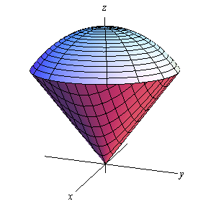
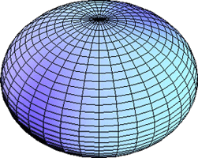
Which strategy will produce a more lasting ability to compute the volume of various objects? Select the best answer.
Computing the volume of one object in four problems and then switching to the next object for four problems and so on.
Computing the volume for each object in a randomized problem set.
84%
16%
25 of 26

Slide 6
Effortful Processing
Short-term difficulty, long-term retention
Short-term ease, little long-term retention
 | Short-term | Long-term
Problem in sets of 4 | 89% | 20%
Random problems | 60% | 63%

Slide 7
Illusion of Mastery
Feels easy and productive
Feels difficult but results in retention

Slide 8
Both groups studied a text. Group A re-read the text, group B took a test. Which group retained more a week later? Select the best answer.
Group A
Group B
17%
83%
23 of 26

Slide 9
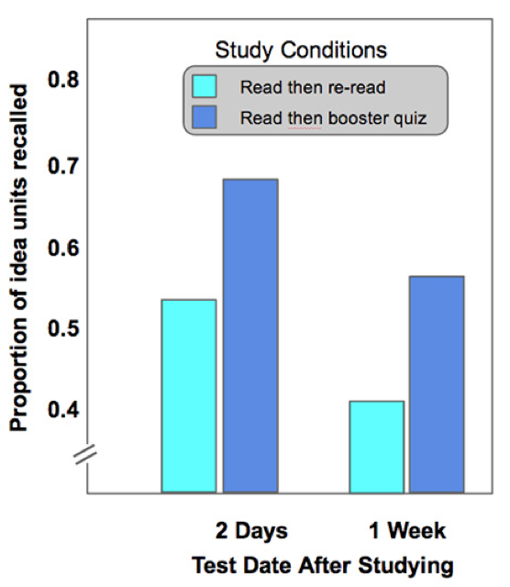
Re-reading vs Testing

Slide 10
Students listened to the same lecture that mentioned 60 different objects. Group A did not receive a test, Group B received one test, Group C received 3 tests in the days after the lecture. How did their ability to remember the 60 objects differ when they were tested a week later? Select the best answer.
Group A remembered 28%; Group B 39%, Group C 53%
Group A remembered 39%; Group B 53%, Group C 28%
Group A remembered 53%; Group B 39%, Group C 28%
83%
8%
8%
24 of 26

Slide 11
Testing Effect

Slide 12
Assess after instruction
Quizzes are a learning tool
Avoids illusion of mastery
Boost recall

Slide 13
Booster Questions
To Learn
Booster Questions
Space retrieval
Vary our practice
Test ourselves
Space questions
Vary the questions
Send questions

Slide 14
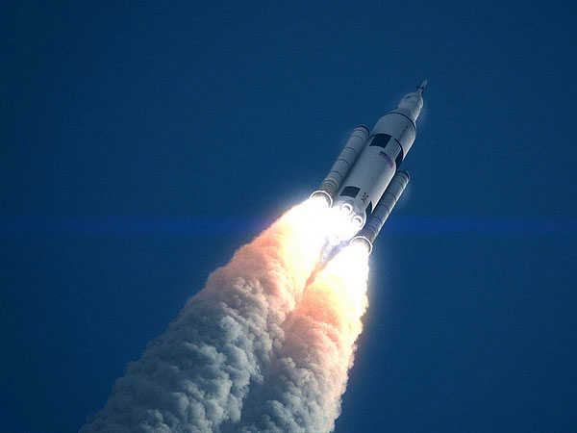
Booster Questions
Space - send questions:
2 days
2 weeks
2 months
Vary by sending:
Recall questions
Application questions
How they have used it
Send them via the web, mail or by phone

Slide 15
A colleague delivered a 40 minute training course about how to interpret probabilistic model guidance. The course contained a 30 minute lecture in which he showed how to correctly interpret the guidance; and 10 minutes of questions from forecasters. One month after the course, your colleague found that learners had forgotten most of the information and did not use the guidance correctly. He wants to offer another course. Which adult learning principles will you recommend to guide his work on the new course? Select all that apply.
Design for individual learning styles
Reflect on learning experience
Implement a problem-centered approach
Include periodic memorization activities
Space and vary the course practice
Assess learners after training
Include problems of immediate relevance
5%
10%
23%
10%
18%
19%
14%
23 of 26

Slide 16
After 2 weeks
You are designing a training program to help forecasters give effective aviation weather briefings. In two or three sentences, describe how you would use the spaced practice principle.

Slide 17
After 2 months
How have you used water vapour analysis in your work? If you haven’t yet, how do you see yourself using it?

Slide 18
Write Booster Questions
First question after 2 days
Handout

Slide 19
After 2 Days
A colleague delivered a weather briefing to the mayor of a city about to be affected by a tropical cyclone. The colleague carefully explained the scientific information about the cyclone but the mayor was unhappy with the briefing. What four briefing elements will you recommend to your colleague in order to deliver a good weather briefing? Select all that apply.
What is the expected weather?
Why will it occur?
When will it get here?
What impacts will it have?
When will it be over?

Slide 20
Write Booster Questions
Next question after 2 weeks
Handout

Slide 21
After 2 Weeks
A forecaster asked you to help them offer better briefings. She covered the four main elements in a clear and concise way. While delivering the briefing she looked at her feet often and rarely at the audience. What will you recommend that she do differently?

Slide 22
Write Booster Questions
Next question after 2 months
Handout

Slide 23
After 2 Months
How have you used the strategies for delivering clear and concise briefings in your work? If you haven’t yet, how do you see yourself using them?

Slide 24
Booster Questions for this Session
Would you like to receive booster questions for this session?

Slide 25
References
Brown, Peter C. (2014). Make It Stick. Harvard University Press. Kindle Edition.
Roediger, H., Karpicke, J., Rohrer, D. (2006). The Power of Testing Memory. Association for Psychological Science, 1, n. 3, 181-210.
Roediger III, Henry L.; Agarwal, Pooja K.; Kang, Sean H. K.; Marsh, Elizabeth J., Davies, Graham M. (Ed); Wright, Daniel B. (Ed), (2010). Benefits of testing memory: Best practices and boundary conditions. Current issues in applied memory research. Current issues in memory., (pp. 13-49). New York, NY, US: Psychology Press, xiii, 262 pp.
Kohn, A. (2014). Overcoming the Forgetting Curve. Learning Solutions Magazine.

