Slide 1
An Update on Meted
Tsvetomir Ross-Lazarov
Bruce Muller
September 2015
UCAR/COMET

Slide 2
https://youtu.be/OX_1MasrAhU
Notes:
It’s our birthday!

Slide 3
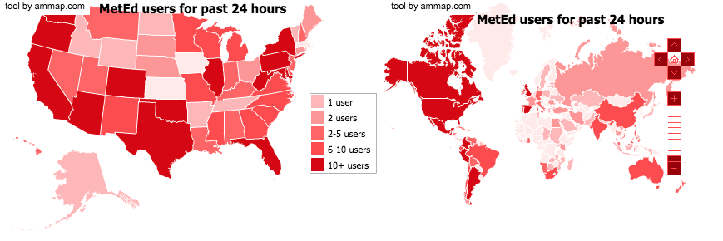
Usage is still growing...
Module sessions in July: 26,002
Quizzes passed in July: 7612
Avg. time spent in a module (mins): 53
Online education served in July (hrs): 23,002
Total served since January 2007 (hrs): 2,011,526
Notes:
Over 400,000 registered users since January 2007: ⅓ international, ⅓, higher education, the rest a mix
4000-6000 new every month
Average module session times are consistently staying over 50 minutes!

Slide 4
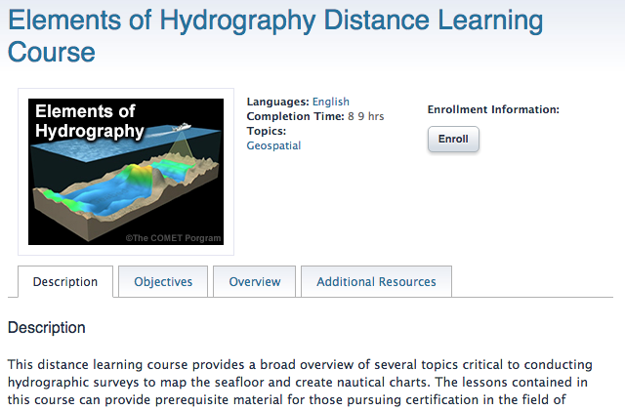
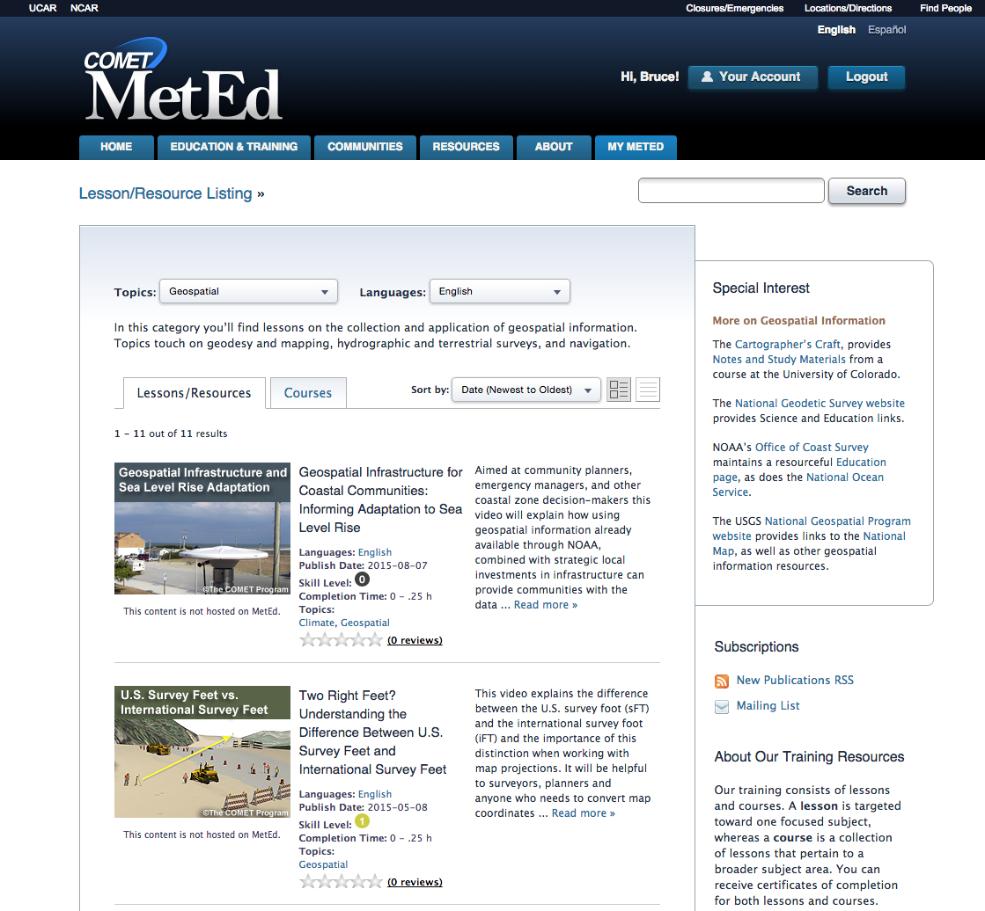
New topic area...
Notes:
Geospatial added as a new topic area

Slide 5
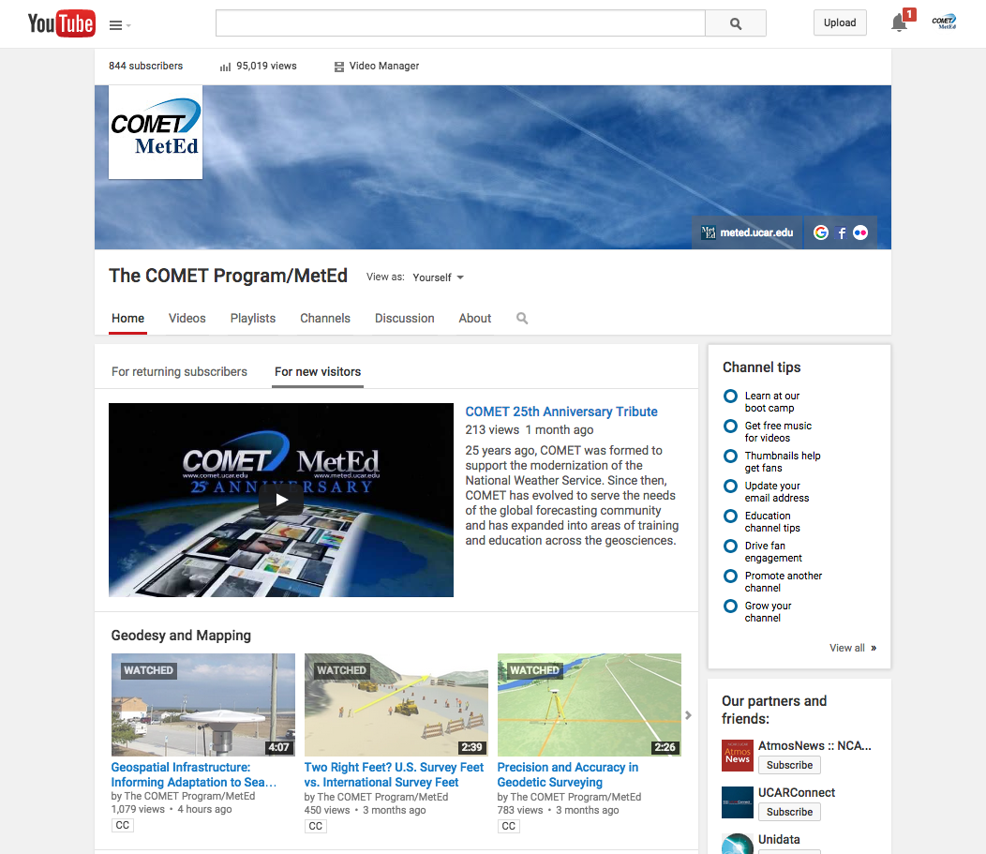
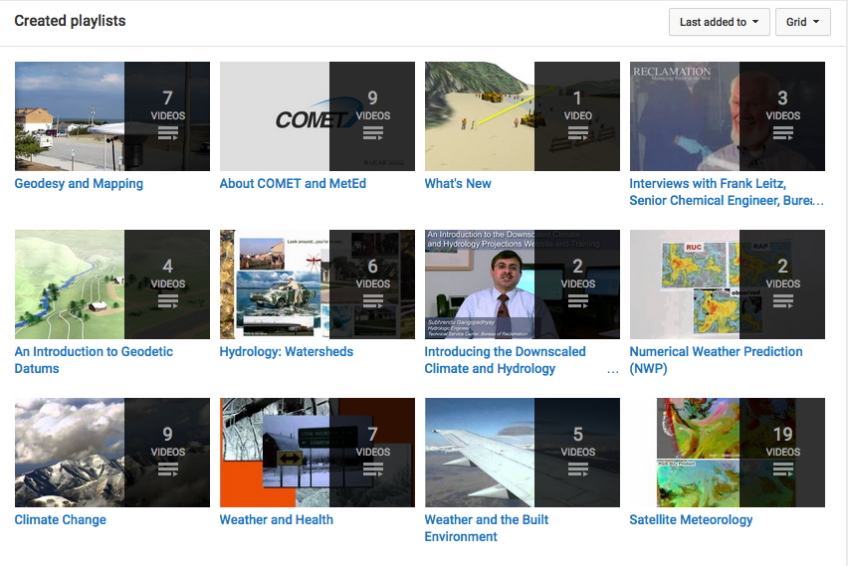
YouTube as a platform
Notes:
We’re creating more short-form video and using YouTube as a platform for delivery

Slide 6
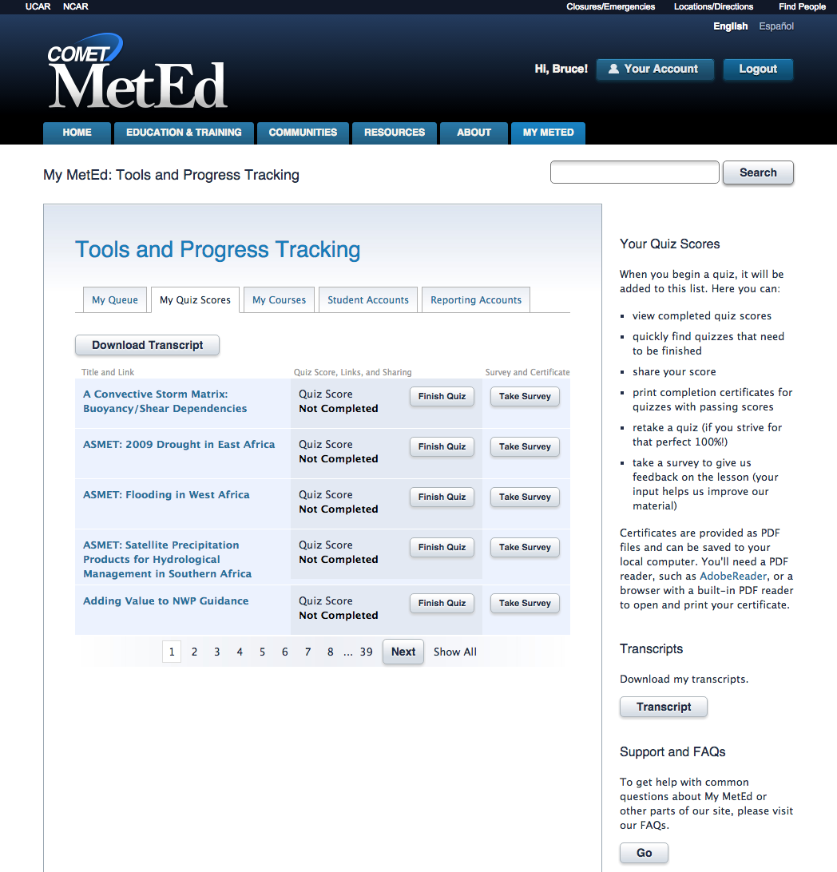
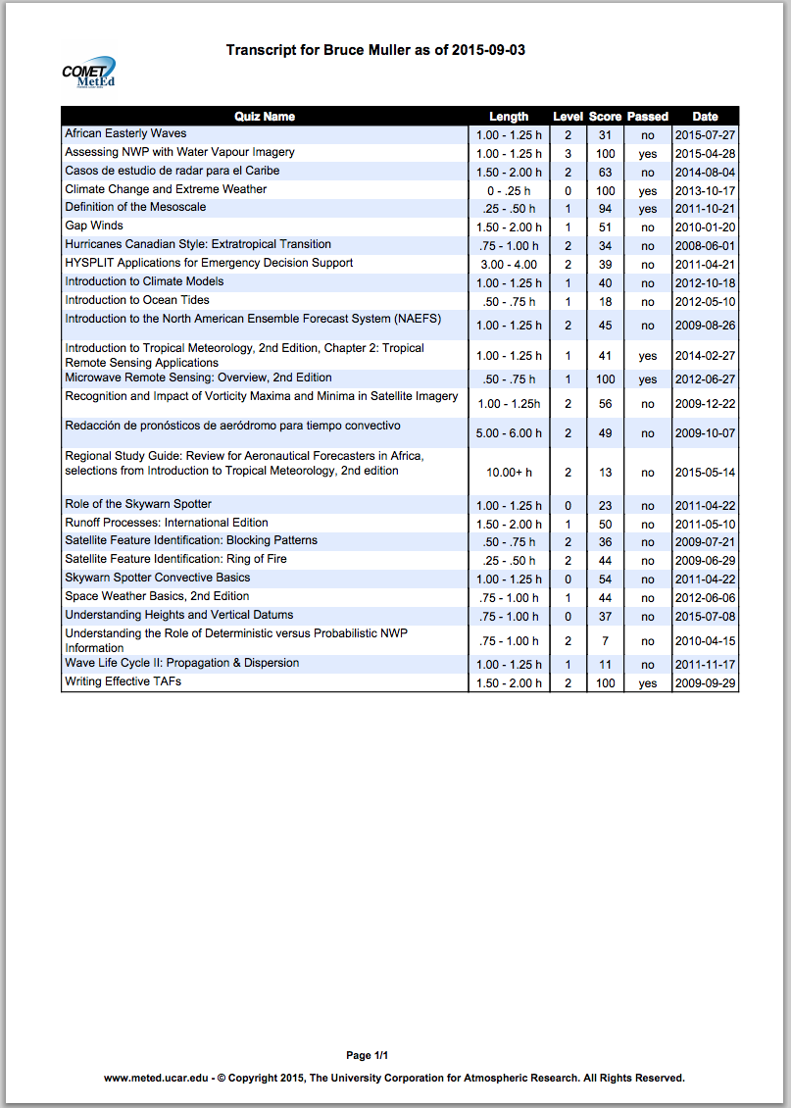
Improved transcripts (and more to come…)
Notes:
New pdf version of quiz transcripts.
Working on refinements to the reporting tools via WMO/Caribbean Institute for Meteorology and Hydrology funding (late November 2015)

Slide 7
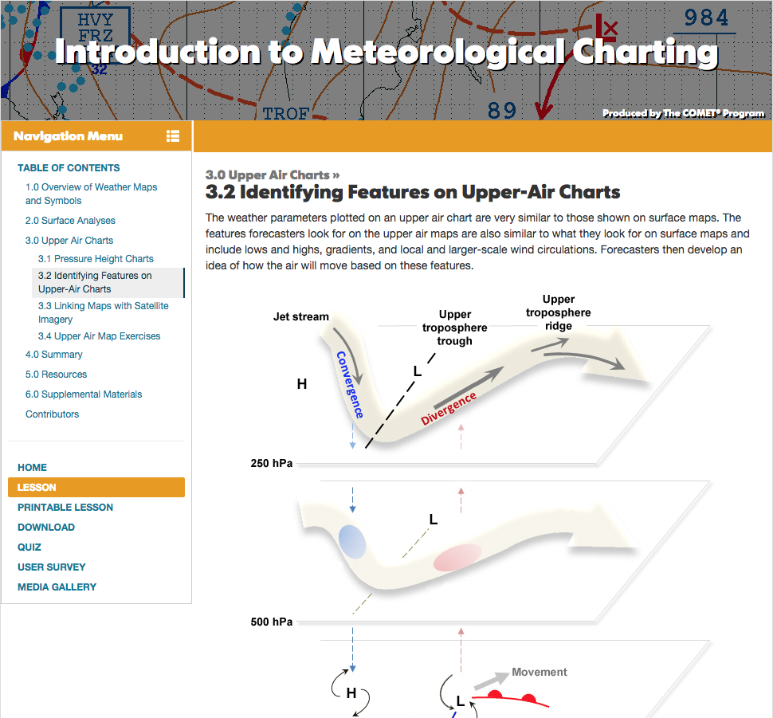
Improved lesson layout
Responsive design for better tablet and mobile use
Improved interaction design and layout
HTML5-based scripting:
mp4, mp3, WebGL, canvas, etc.
Improved printability of print version
http://www.meted.ucar.edu/intromet/charting/index.htm

Slide 8
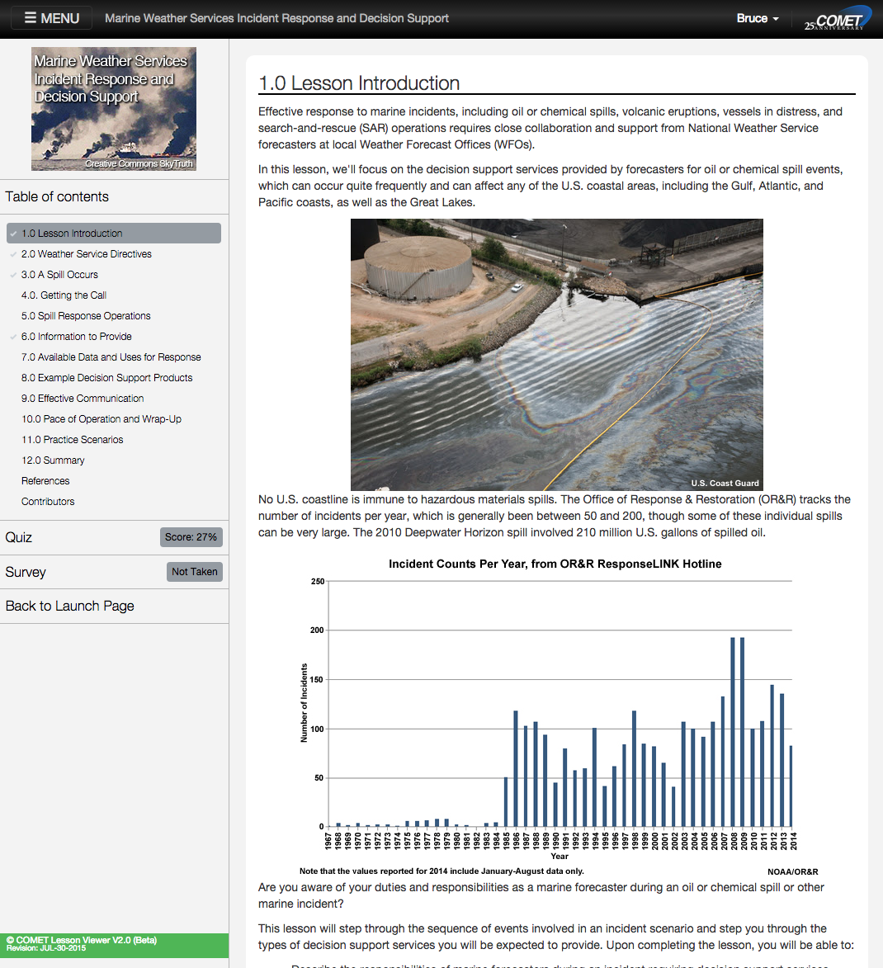
Coming soon: LessonViewer and updated Quiz and Survey interface
Improved usability
Responsive design:
Mobile friendly(ier)
Session tracking and bookmarking:
Pick up where you left off on any device or browser
Integrated quiz and survey
Quick access to account settings
A framework for adding more functionality and a possible move towards iOS/Android apps

Slide 9
We appreciate all of your support and feedback!
Come and see more at one of the Poster and Demo sessions!

