Slide 1
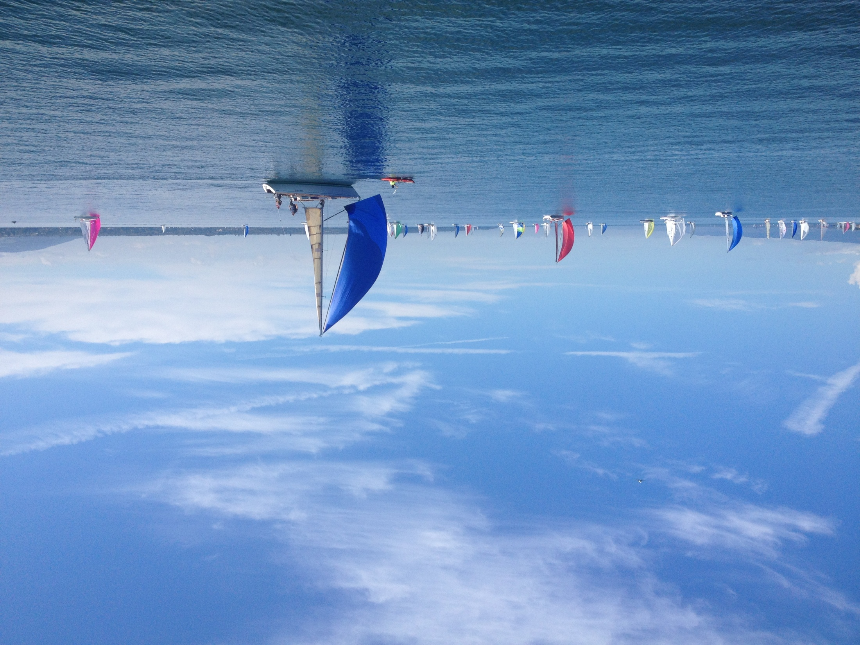
Assessment as Learning Activity
Patrick Parrish (WMO) & Maja Kuna-Parrish (EUMETSAT)
Socrative: https://b.socrative.com/
Room Code: H9MPCL4U
CALMet XI – Seoul 2015

