Slide 1

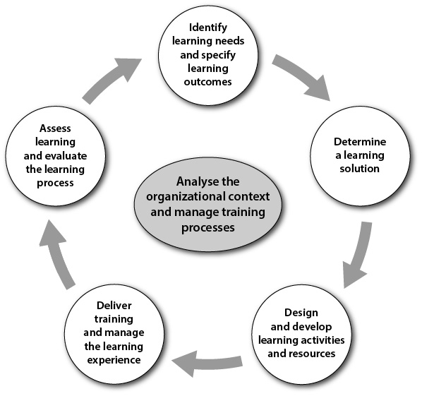
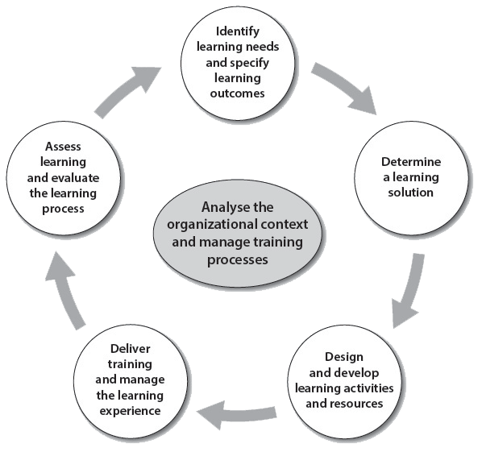

What do competency frameworks mean for trainers?
Patrick Parrish, WMO ETR
for CALMet 2015

Slide 2
Why develop competency frameworks?
Promotes consistent standards of service
Guides resource allocation
Helps training address true job needs
for participants, this increases relevance, motivation, retention
WMO Congress Cg-XVI recommended that all technical commissions make the definition of competency standards a high priority

Slide 3
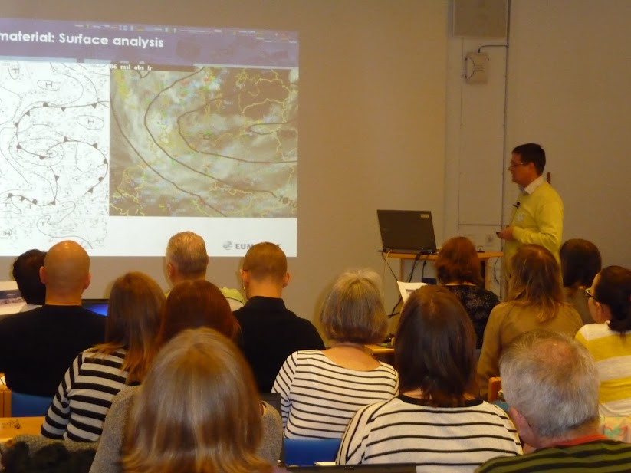
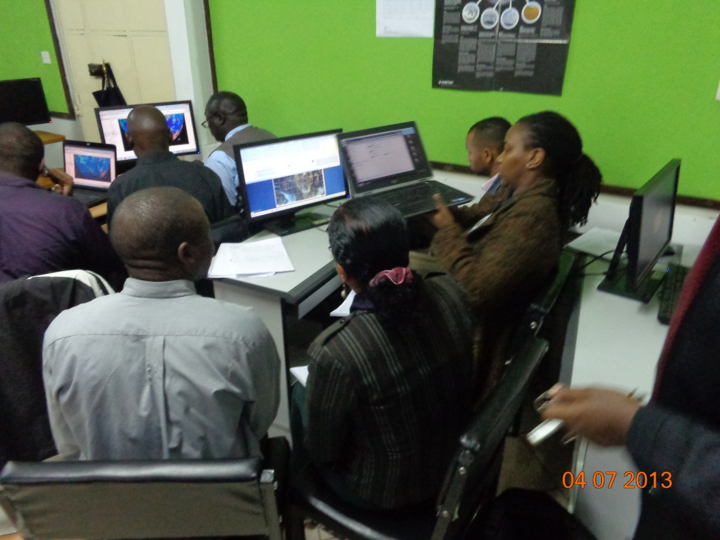

Training is a rare opportunity
High cost
Large time and resource commitment
  Travel
  Training preparation & delivery
  Lost work time
Each training effort should aim to build tangible gains in competence

Slide 4
Alternatives to Competencies
Perform a robust needs assessment
Does not happen very often
Teach what we taught last time
This can proliferate weak decisions, miss an evolution of needs
Tweak what we did last time
Continuous improvement helps, but enough?
Trainers decide what they need to teach
Can be based on faulty assumptions
Experts decide what they want to teach
Can ignore novices and operational staff

Slide 5
Competencies (and related terms) Defined
Competency
Skills
Learning needs
A high level job task or responsibility that requires a variety of skills
Distinct abilities that contribute to successful outcomes. Usually smaller scale, a building block of competency
A performance gap that can be fulfilled by training (preferable based on defined competencies)

Slide 6
More related terms
Learning outcomes
Learning objectives
Results of a training or education experience. May be intended, peripheral, or unintended
The goals of an individual learner
Training goals
The broader purpose for training (from an organizational perspective)
Learning goals
What a learner should be able to do after training. (Intended by trainers)

Slide 7
Principles of Competencies
Competency frameworks provide high-level, standard descriptions of job responsibilities
Minimum requirements for knowledge, skills and behaviors (not expert versus novice)
Focus on job tasks, NOT classifications, qualifications, or job titles (BIP-M does not describe competencies)
Exist alongside organizational processes and procedures
Are ongoing and evolve only slowly

Slide 8
Kinds of Competencies
Technical competencies
those required for a specific job responsibility
Transferable competencies or skills
Those that are applied in a variety of job or service areas
Core competencies
Those that are applied in many professions
WMO is defining this kind currently!
Transferable Skills
Core Competencies
Technical
Competencies

Slide 9
Anatomy of a Competency Framework:
Preface
1. Fundamental WMO Competency Requirements For A PWS
Forecaster
The competency requirements . . . divided into five top level competencies. Taking into consideration the following:
  (a) The nationally-defined PWS areas of responsibility;
  (b) Meteorological and hydrological impacts on society;
  (c) Meteorological and hydrological user requirements, local procedures and priorities.
A PWS Forecaster should have successfully completed the BIP-M (as defined in the revised WMO-No. 49, Volume I) and, in taking into account conditions a to c, should be able to perform the work indicated in the five top level competencies below:

Slide 10
Anatomy of a Competency Framework:
High-level Competencies
1. Analyse and monitor continually the evolving meteorological and/or hydrological situation;
2. Forecast meteorological and hydrological phenomena and parameters;
3. Warn of hazardous phenomena;
4. Ensure the quality of meteorological and hydrological information and services; and
5. Communicate meteorological and hydrological information to internal and external users.

Slide 11
Anatomy of a Competency Framework:
Description and Criteria
1. Analyse and monitor continually the evolving meteorological and/or hydrological situation
Competency Description: Observations and forecasts of weather parameters and significant weather phenomena are continuously monitored to determine the need for issuance, cancellation or amendment/update of forecasts and warnings according to documented thresholds and regulations.
Performance Criteria (or Components):
(a) Analyse and interpret data to identify weather features pertinent to the area of forecast responsibility;
(b) Monitor weather parameters and evolving significant weather
phenomena and validate current forecasts and warnings . . .
(c) Evaluate the need for amendments . . .

Slide 12
Anatomy of a Competency Framework:
Background knowledge and skills
1.1 Background knowledge and skills
(a) An understanding of the key elements of synoptic and mesoscale meteorology, dynamical and physical meteorology, and core analytical/diagnostic skills to the level of a BIP-M;
(b) Application of the theory, methods and practices of meteorological and/or hydrological analysis and diagnosis;
(c) The ability to visualize/conceptualize . . . information in multiple dimensions (spatial, temporal);
(d) The appreciation of the influence of topography, land cover, and (if relevant) bodies of water and/or snow fields on local meteorology;
(e) Interpretation in-situ and remote-sensed observations . . . ;
(f) Understanding of . . .sensors and instruments;
(g) Familiarity with the acquisition, processing and assimilation of
meteorological and hydrological data, including quality control.

Slide 13
Competencies and Training
Well-defined competencies are central to meeting organizational goals
Organizational Goals
Organizational Resources
Job Competencies
Training Needs
Training Delivery
Requirements
flow
Training
evaluation
flow

Slide 14
Development process
Task teams established
High level competencies
Detailed competency frameworks
Second level competencies can be customized by Members
WMO Technical Commisions establish teams from diverse members
Approved by WMO technical commission after wide discussion
Performance components and knowledge & skill requirements (second level)

Slide 15
WMO Competency Status
Commission | Status
Commission for Aeronautical Meteorology | Competence standards in force. Qualifications come in force December 2016. (These are MANDATORY)
EC Panel of Experts on Education and Training | Competence standards for Education and Training providers are approved. Will appear in new edition of Technical Regulations as recommended practice.
Commission for Basic Systems | Five sets of PWS approved at WMO Congress in 2015 and will appear in next Technical Regulations.
Commission for Basic Systems | WIS competencies approved and will be in new edition of Technical Regulations.
Joint WMO-IOC Commission for Oceanography and Marine Meteorology | Marine weather competencies approved and will be in Technical Regulations.
Commission for Instruments and Methods of Observation | Drafts in development covering weather observations, calibration and maintenance of instruments.
Commission for Basic Systems | Tropical Cyclone / Hurricane / Typhoon (in progress, will be developed on a regional level)
Commission for Climatology | Climate services advanced draft competency standards developed. Will go to Management Group, Fall, 2015.
Commission for Hydrology | Qualifications and competencies are in early stages.
Commission for Agricultural Meteorology | Qualifications are in early stages, competencies to follow.

Slide 16
Enabling Skills and Transferable Competencies
Satellite enabling skills
NWP enabling skills
Transferable skills are under discussion in several areas
See updates at http://training.wmo.int (under Training Activities)

Slide 17
Competency implementation
Competency assessment
Competency-based training
Competency documentation for Quality Management Systems

Slide 18
WMO Competencies for Training Providers
Competencies
Competencies
Competencies
Competencies
Competencies
Competencies

Slide 19
Competency-based training
Training needs assessment
Measure existing competency to identify required training
Curriculum planning
Learning outcomes and topics address competencies
Learning is active and practical to develop competence
Assessment, documentation, and certificates
Includes assessment of gains in knowledge and skill
Competencies addressed are stated in announcements and syllabi
Competencies addressed are communicated in transcripts and certificates

Slide 20
For updated information see
http://training.wmo.int (under Training Activities)
Questions or Comments?

Slide 21
Unused slides

Slide 22
Example: AMF competencies
An Aeronautical Meteorological Forecaster,
A. For the area and airspace of responsibility,
B. In consideration of the impact of meteorological phenomena and parameters on aviation operations, and
C. In compliance with aviation user requirements, international regulations, local procedures
  and priorities,
Should, in taking into account conditions A to C, have successfully completed the BIP-M and should be able to:
  Forecast aeronautical meteorological phenomena and parameters;
  Analyse and monitor continuously the weather situation;
  Warn of hazardous phenomena;
  Ensure the quality of meteorological information and services; and
  Communicate meteorological information to internal and external users.

Slide 23
Competency assessment
Competency is demonstrated through careful assessment approaches
  Adapted from the CAeM Competency Assessment Toolkit:
  It is based on standards (the defined competencies) and the basis for certification
  The standards include details related to actual job tasks
  The assessment is individual; no comparison to others.
  It judges whether one is competent or not yet competent.
  It is done, preferably, in real working situations - based on direct observation or simulations.
  It is an ongoing process rather than a snapshot.
  It is not directly related to the completion of specific training.
  It includes recognition of acquired competence through work experience.
  It contributes to the development of skills and abilities.
  Assessment results are documents in the QMS

Slide 24
Competencies for providers of education and training
Context
The organizational context and priorities, and stakeholder requirements;
The way in which internal and external training resources are used;
The available resources (financial, human and technological), facilities and capabilities, and the organizational structures, policies and procedures;
National and institutional legislation, rules and procedures.
Competencies
Analyse the organizational context and manage the training processes
Identify learning needs and specify learning outcomes
Determine a learning solution
Design and develop learning activities and resources
Deliver training and manage the learning event
Assess learning and evaluate the learning process

Slide 25

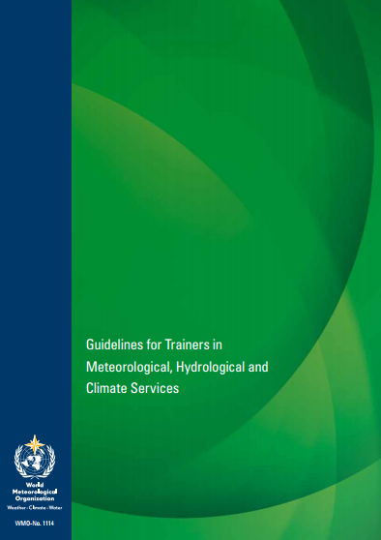
WMO Guidelines for Trainers
Support for implementation of trainer competencies, and for competency implementation in all areas

Slide 26
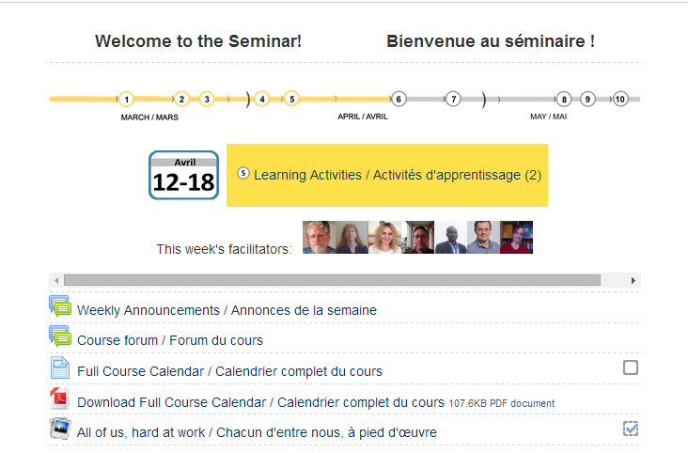
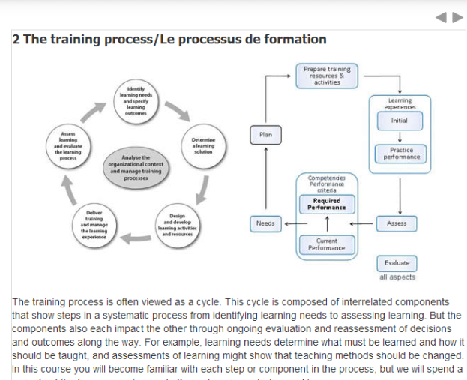
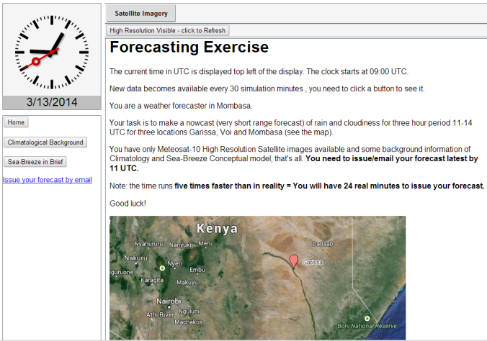
WMO Seminars for Trainers
Provide increased focus on meeting the WMO Competencies for Providers of Education and Training
Online resources will become available for open use by others
We encourage adaptation of the course

