Slide 1

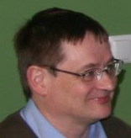
Baltic+ -- a regional initiative in teaching and training satellite data applications in meteorology
Piia Post (University of Tartu, Estonia),
Zanita Avotniece (Latvian Environment, Geology and Meteorology Centre),
Izolda Marcinoniene (Lithuanian Hydrometeorological Service),
Vesa Nietosvaara (EUMETSAT), Kai Rosin (Estonian Environment Agency),
Izabela Zablocka, Teresa Zawislak (Institute of Meteorology and Water Management – National Research Institute, Poland),
Barbara Zeiner (ZAMG, Austria)

Slide 2
About the results and conclusions of the first course of this network that took place in Tallinn
in March 2015
Keywords:
Training, network, satellite meteorology
Goals:
To analyse the first lessons learned from organizing regional training network for satellite applications in meteorology and carrying out the first course

Slide 3
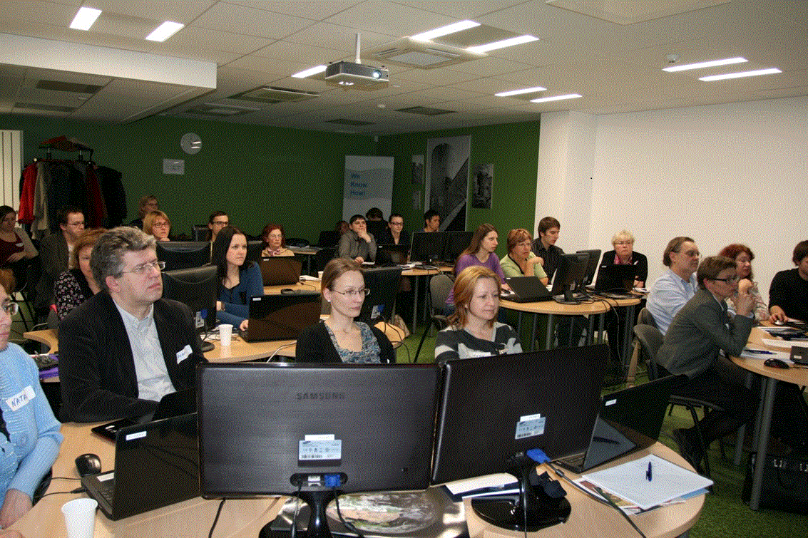
Target group: operational forecasters
from
Estonia, Latvia, Lithuania, Poland, Russia and Belarus

Slide 4
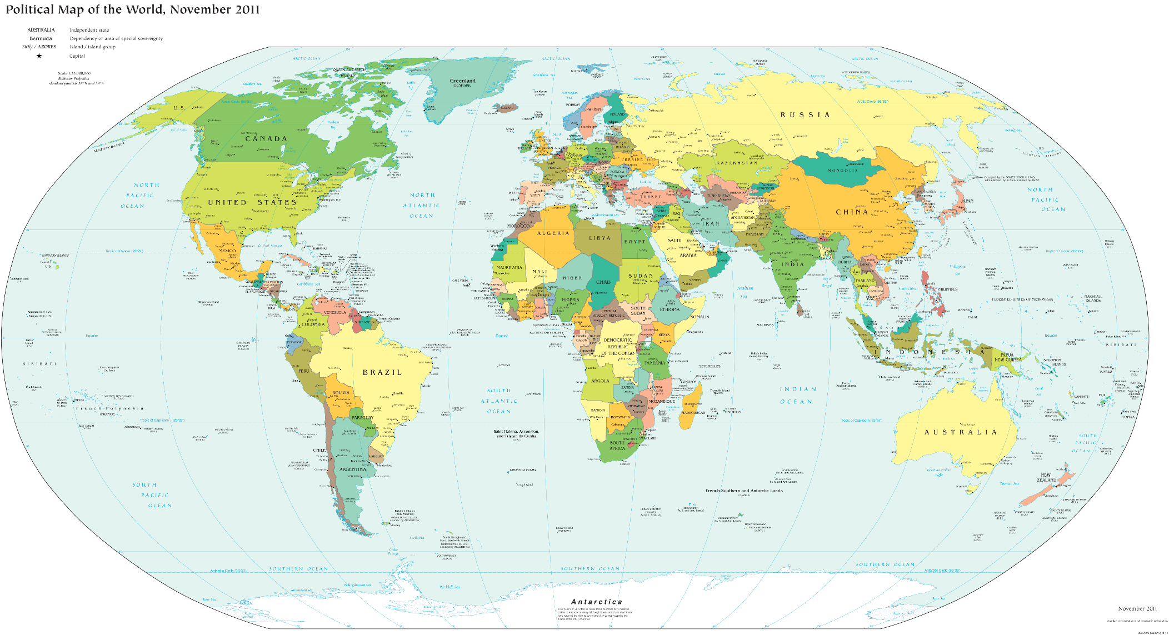

Slide 5
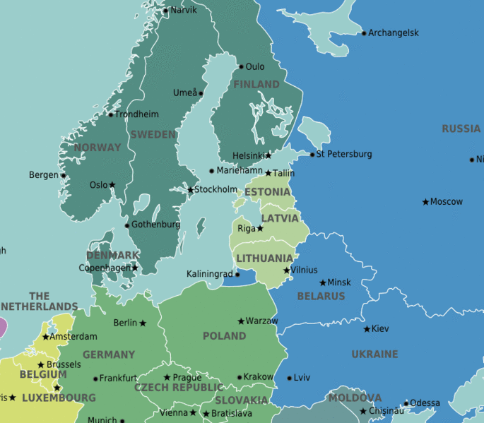
Target group: operational forecasters
from
Estonia, Latvia, Lithuania, Poland, Russia and Belarus
– from the eastern coast of the Baltic Sea
http://wikitravel.org/

Slide 6
Suggestions about themes was asked from forecasters at ESTEA and also from the representatives of participating countries
=>
Our main idea was to focus on hands-on training

Slide 7
Practical use of EUMETSAT products together with NWP data
Objectives: to improve the participants’ skills in using satellite information, NWP models and conceptual models for better forecasting of cyclone development and accompanying phenomena
Time: 7-8 instructed sessions per 1.5 hours + 2 sessions per 1.5 hours of individual work
Themes:
cyclone emerging and development (satellite products, fields from NWP models, conceptual models)
properties of cyclones and frontal structures (satellite products interpretation, vertical profiles from NWP models, conceptual models)
cyclone accompanying phenomena (satellite products, vertical profiles from NWP models, radar products, ground measurements)
nowcasting and warnings (comparison of satellite data with NWP, the use of pseudosatellite images)
forecasting of wintertime hazards (satellite and NWP data)

Slide 8
Practical use of EUMETSAT products together with NWP data
Objectives: to improve the participants’ skills in using satellite information, NWP models and conceptual models for better forecasting of cyclone development and accompanying phenomena
Time: 7-8 instructed sessions per 1.5 hours + 2 sessions per 1.5 hours of individual work
Themes:
cyclone emerging and development (satellite products, fields from NWP models, conceptual models)
properties of cyclones and frontal structures (satellite products interpretation, vertical profiles from NWP models, conceptual models)
cyclone accompanying phenomena (satellite products, vertical profiles from NWP models, radar products, ground measurements)
nowcasting and warnings (comparison of satellite data with NWP, the use of pseudosatellite images)
forecasting of wintertime hazards (satellite and NWP data)

Slide 9
Activities:
Moodle
Introductory game
Collaborative Case Study
Weather simulator
Short lectures, instructions
Labs in McIDAS (in groups and individually)
Group discussions
Individual work
Weather briefing
Wrapping up
Feedback

Slide 10
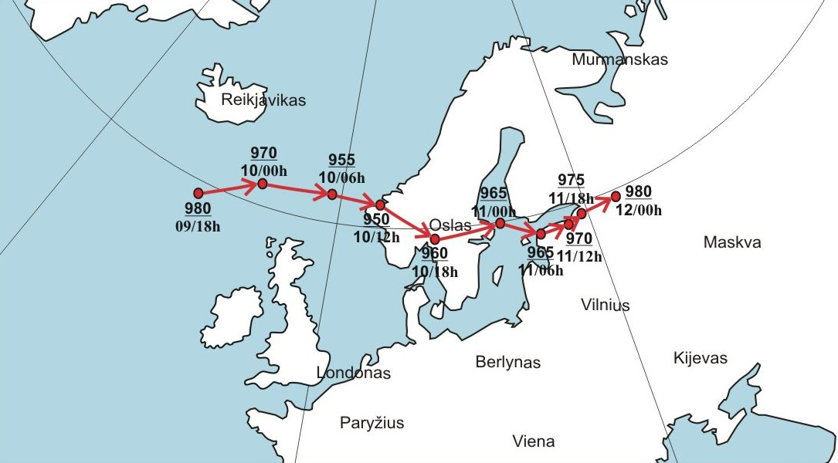
Pre-course Collaborative Case Study
Cyclone Felix in Jan 2015 – the strongest cyclone of the season in the Baltic Sea area
6 groups of learners were expected to analyse the event from different points of view

Slide 11
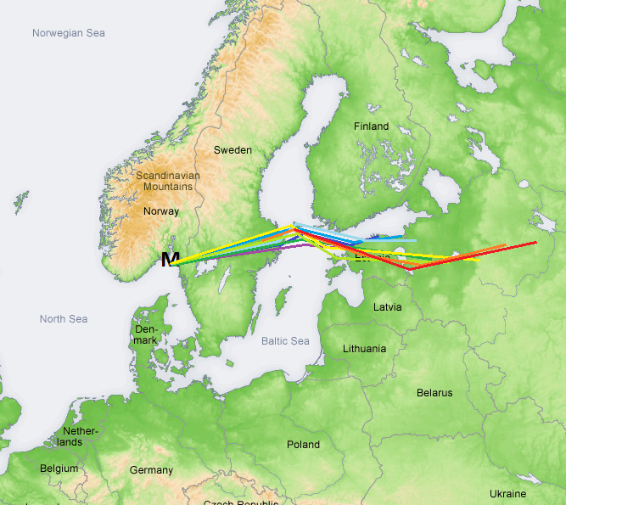
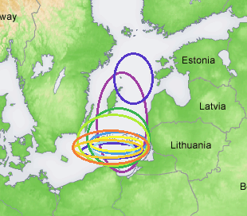
HIRLAM forecast for trajectory of Low and max mean wind
24-28 m/s
09.01.15 00UTC -----
09.01.15 06UTC -----
09.01.15 12UTC -----
09.01.15 18UTC -----
10.01.14 00UTC -----
10.01.15 06UTC -----
10.01.15 12UTC -----
10.01.15 18UTC -----
11.01.15 00UTC -----
11.01.15 06UTC -----
From Estonian model group
Notes:
SLIDE3: This slide shows the HIRLAM forecast of the cyclone trajectories and maximum mean wind area at different time bases. Purple and blue colors are calculated for the first and the low would have moved over the northern coast of Estonia. The yellow and red colours are the latest and they show the trajectory across the central Estonia. The centre of the Low was calculated near the Oslo with every base time. In the lower right corner shows the maximum mean wind areas with windspeed 24-28 m/s. We can see that at first the area reached over the Northern Baltic, later increasingly concentrated over the southern waters of Baltic.

Slide 12
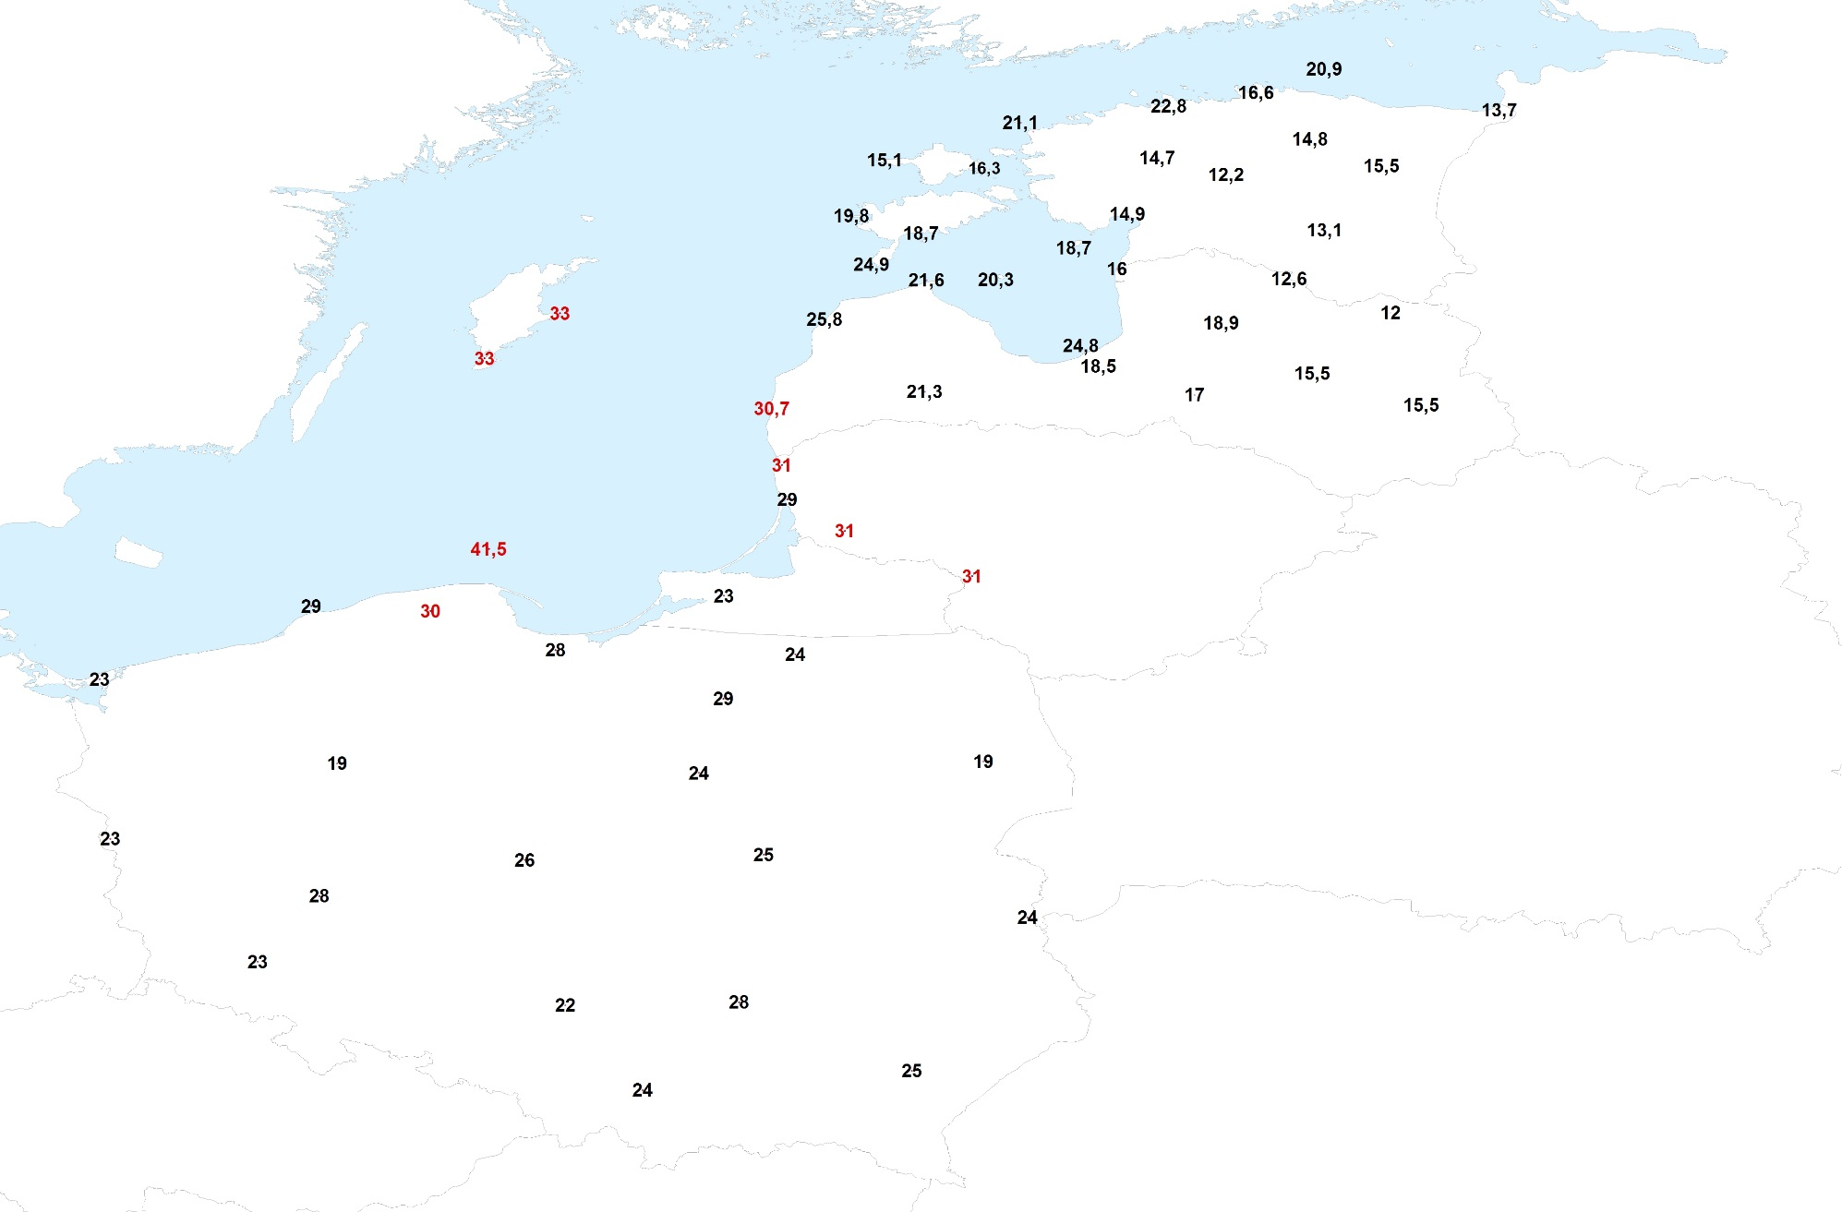
Surface observations –max wind gusts, m/s (Latvian)
warnings
Estonia | → 30 m/s in Saaremaa, Gulf of Riga and Northern Baltic
Latvia | → 33-35 m/s In Central Baltic; → 25-30 m/s in many places in Latvia
Lithuania | → 33 m/s in Klaipeda seaport; → 28-30 m/s in the western part of Lithuania
Poland | → 28-34 m/s in eastern part of Polish Coastal waters
From Latvian group (warnings)

Slide 13
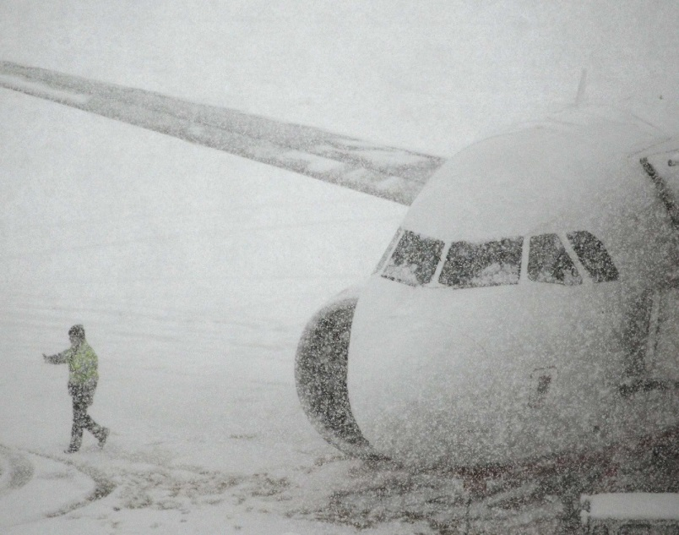
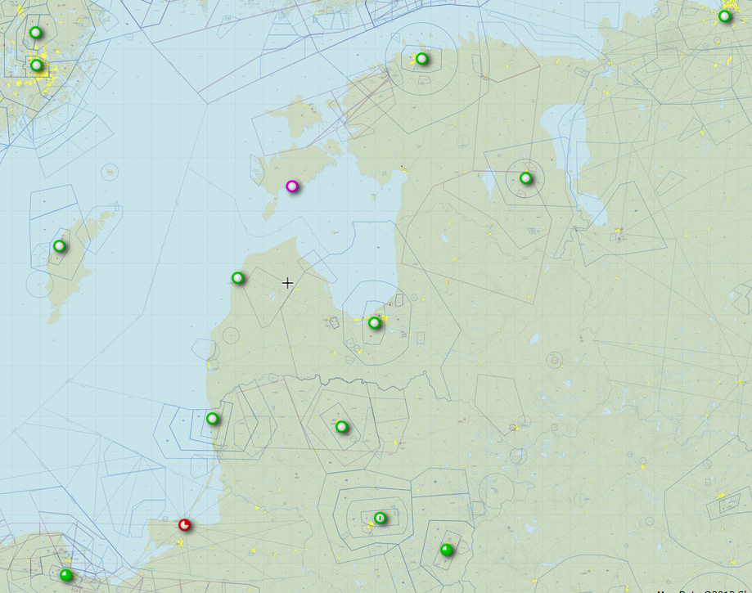
Visibility and precipitation
ULLI 111734Z
0250 +SHSN
EETN 111250Z
0600 +SHSN BLSN
EEKE 111250Z
2100 +SHSN
EETU 111750Z
3000 SN
EVVA 111450Z
3500 +RASN
EVRA 112120Z
2700 SN
11.01.2015
EYPA 111322Z
1600 -SHRA
EYVI 111205Z
0500 +SHSNRA
UMKK 111830Z:
2100 -SHSNRA
EYKA 111850Z
0500 0100W +SN BLSN
From Estonian aviation group

Slide 14
We got a lot of positive feedback from participants,
but we shall talk about criticism to improve the next year’s course
I think that instructors were good...
Anna Gheli was also very engaging
I think they are well prepaired.
useful practical work
Thank you all! Keep up at the same way!
Thanks a lot!
Thanks a lot!!!
Very good and helpful instructors

Slide 15
Feedback from learners:
„For people not familiar with satellite images there was to little explanations. For people familiar using images a lot the course to boring“
Questions:
To whom was the course focused?
Why did not the wiser participants teach less educated ones?
Solutions for the next time =>
More effective group work
Rooms that support work in different group sizes
Precourse exercises online, to harmonize the level of participants

Slide 16
Feedback from learners:
„Not wise to assume everybody know all the basics, can have a very quick rminder, it does not take long“
„A little more guidance in practical exercises“
Conclusion:
Passive position of participants towards learning => somebody has to teach me
Solutions:
Nowadays all info is available in internet.
Learners should not wait until everything is explained, they should become more active learners
Instructors should guide learners softly through well-planned assessments

Slide 17
Feedback from learners:
„Some of instructors do not like to discuss a lot about cloud features on the satellite images - maybe to little knowledge on interpretation of satellite images?“
Conclusion:
more analysis and discussion was expected
Solutions:
Assessments that expect more analysis and discussion
Enough time for dicussions, schedule should not be too tight
Longer preparation time for course so that the team could discuss about actions till details

Slide 18
The next course will be in Warssaw in March 2016
Preparations are already on the way
Theme: „Identification of low clouds and fog“
Before the course a 3-5 module online course with self-assessments to reduce differences in participant’s knowledge
Home work of participants to analyse an interesting case
Satellite picture of the day analysis

Slide 19


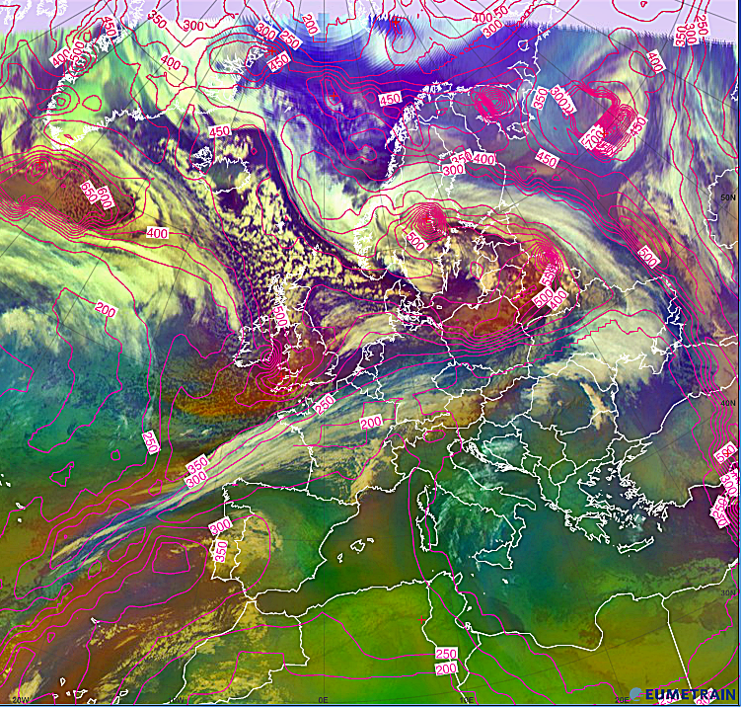

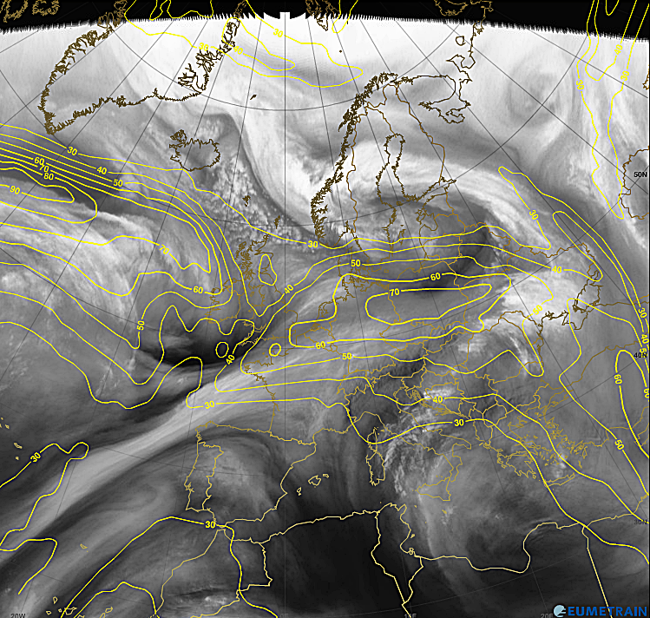
Belarus
Meteosat-10
11.01.2015
00 utc

Slide 20

=>
Financial support by EUMETSAT and Eumetcal to take part of this workshop is highly appreciated

