Slide 1
Meeting Logistics
2016 Satellite Proving Ground/User-Readiness Meeting

Slide 2
Roles
Overall meeting coordination:
Dick Reynolds
Onsite logistics and Questions/Actions Management:
Ashton Armstrong
Remote Participation Facilitation
Lon Goldstein
Timekeeper:
Dick Reynolds

Slide 3
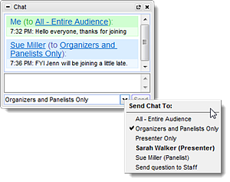
Format
Discussions
Start with in-room questions
Time-permitting: answer questions from remote audience submitted via Chat window
Questions submitted in chat window will be saved in a Questions log

Slide 4
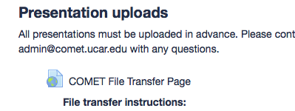
Website
http://tinyurl.com/SatProvingGround2016
Webinar connection information
Questions log and Action Items links
Presentations upload link
Presentations archives (updated end of each day)

Slide 5
Ground Rules
Stay on schedule
Use microphones
— always… (So remote folks can hear)
Identify yourself when asking questions
Pass around handheld mics

Slide 6
Ground Rules (continued)
Remote participants post questions to chat window
Remote presenters please be sure to join webinar 15 min in advance
All presentations will be shown from main computer - files are due 24 hrs in advance
Contact virtual-admin@comet.ucar.edu for problems with webinar

