Slide 1

GOES-R Series
Mode & Mesoscale Domain Request
Standard Operating Procedure (SOP)
Daniel Nietfeld

Slide 2
Acknowledgements
Matt Seybold – GOES-R PRO
Kathryn Miretzky – GOES-R PRO
Tim Schmit – NESDIS/STAR - CIMSS
Dan Lindsey – NESDIS/STAR - CIRA
Patrick O’Reilly – NOAA/NWS/NCEP SDM
Reginald Ready - NOAA/NWS/NCEP SDM
Jamie Kibler & Mike Turk – NESDIS/SAB
Bill Ward – NOAA/NWS/Pacific Region

Slide 3
Flexibility of the ABI
Two Primary Modes of Operation:
Mode 3 “flex mode”
  Default Mode (per NWS request)
  Full Disk (FD) domain every 15 mins
  Contiguous US (CONUS) domain every 5 mins
  2 Mesoscale domains every 1 minute
or
  1 Mesoscale domain every 30 seconds
Mode 4: Full Disk (FD) every 5 mins
Regardless of Mode, all 16 Bands are produced

Slide 4
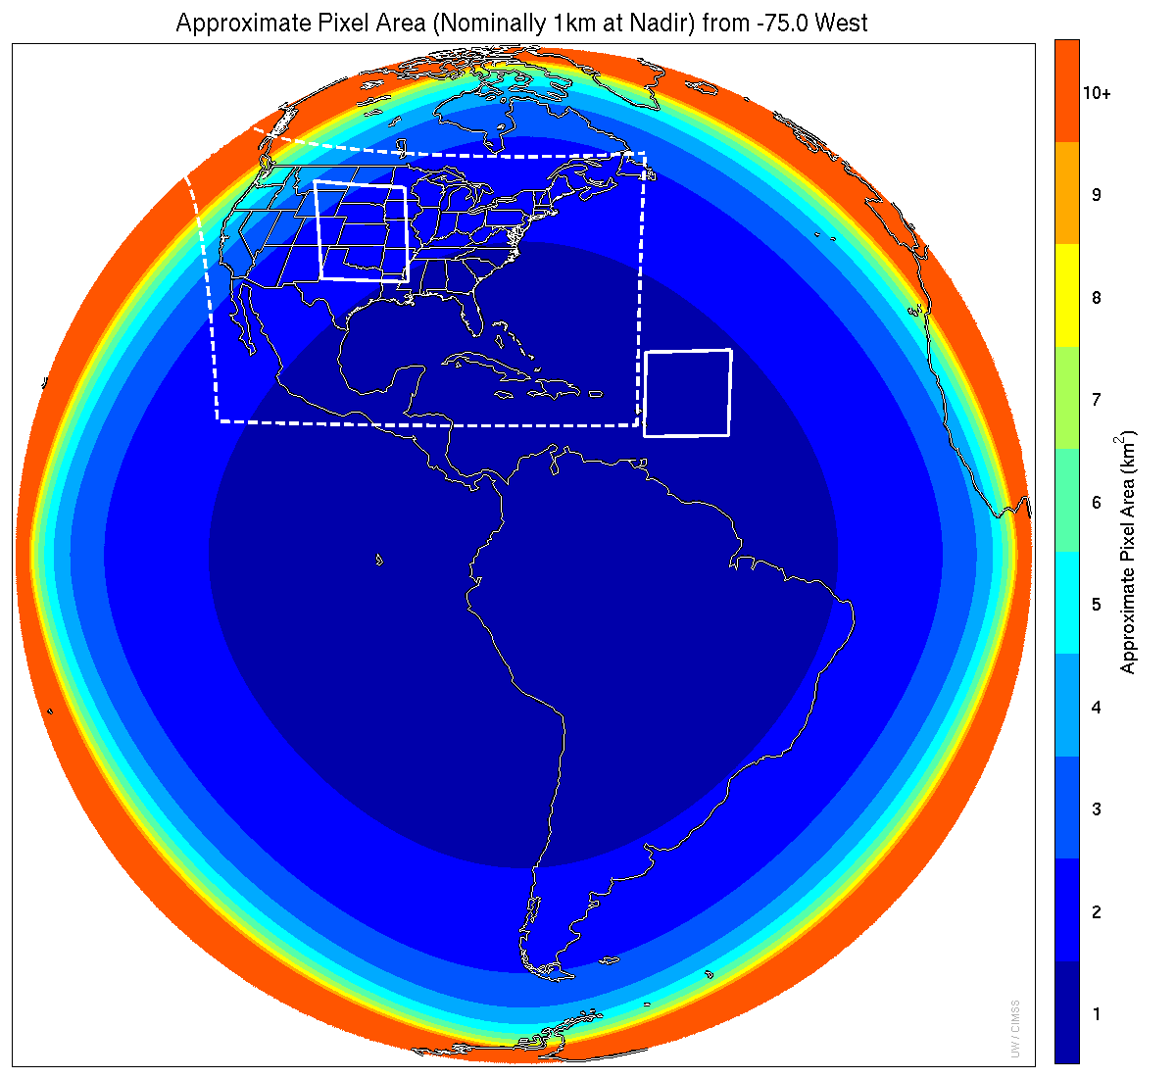
Meso-scale box locations are movable
1 min
5 min
1 min
15 min
MODE 3
Courtesy of Tim Schmit
Notes:
1-km² spatial resolution at satellite nadir. Pixel Areas are approximate. Each bin is rounded to the nearest 1km² until we get to 9.5km² and then all are binned into the red 10+ area. So the first, dark blue, ring covers pixel areas from 1 to 1.49km² and is labeled “1”, above 1.5 to below 2.5km² goes into the next ring and is called “2”, etc. GOES-East location. Proposed CONUS sector, approved by the NWS NOAT. Two meso-scale image sectors shown; these are selectable. The same central lat/lon used for these mesoscales produces a different sized and shaped area for different satellite locations.

Slide 5
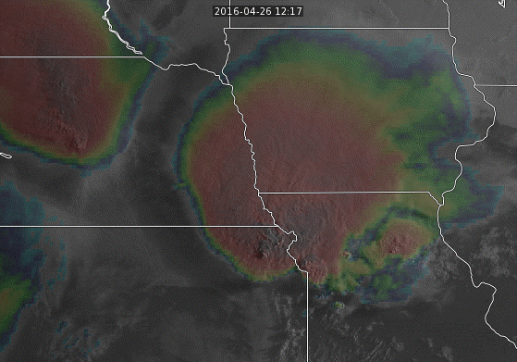

Why 1-Minute Scans?
Numerous ~1-minute “super rapid scan” periods of evaluation (from GOES-14) have shown great benefit to analyzing and diagnosing high-impact weather events.
Convective Initiation
Convection Evolution
Fire Elements
Fog/Stratus Evolution
Volcanic Ash Dispersion
Many others…
Courtesy of SSEC

Slide 6
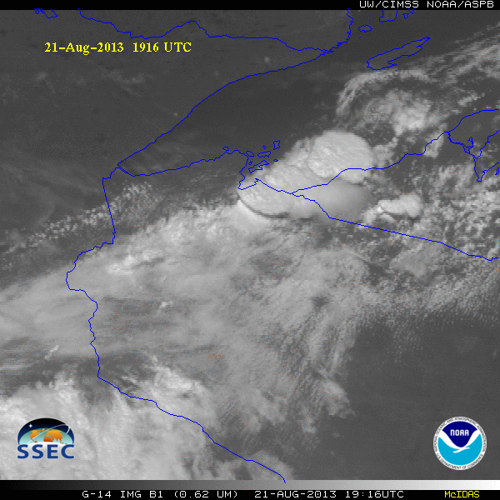
GOES-14 Super Rapid Scan Operations to Prepare for GOES-R
SRSOR (Super Rapid Scan Operations for GOES-R) from GOES-14 imager
Data between mid-August and September 24th and late October 2012; and two days in June and 12 days in mid-August, 2013; and mid-May, 2014, May and August 2015 and parts of 2016:
  http://cimss.ssec.wisc.edu/goes/srsor/GOES-14_SRSOR.html
  http://cimss.ssec.wisc.edu/goes/srsor2013/GOES-14_SRSOR.html
  http://cimss.ssec.wisc.edu/goes/srsor2014/GOES-14_SRSOR.html
  http://cimss.ssec.wisc.edu/goes/srsor2015/GOES-14_SRSOR.html
  http://cimss.ssec.wisc.edu/goes/srsor2016/GOES-14_SRSOR.html
GOES-14 provided very unique data and offered a glimpse into the possibilities that will be provided by the ABI on GOES-R in one minute mesoscale imagery
Many phenomena were observed
The users can’t wait for 1-min data!
GOES-14 visible image showing rapid convective development

Slide 7
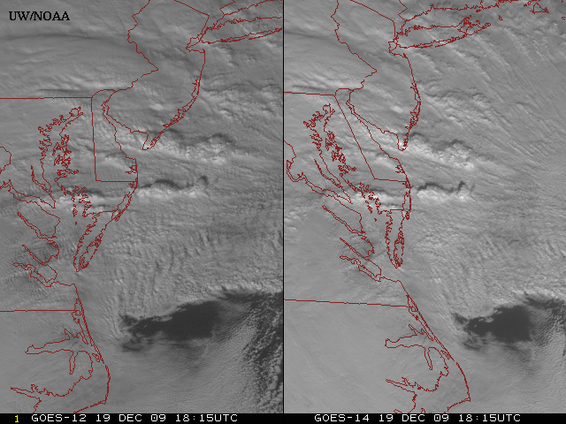
New GOES: Sample “1-min” imagery
GOES-12
GOES-14
See “what is happening”, not “what has happened”.
Courtesy Tim Schmidt
Notes:
Note the number of different levels of motion you can see (the cyclonic low level circulation over the ocean through the breaks in the higher clouds)... and you can't distinguish those on the GOES-12 loop.

Slide 8
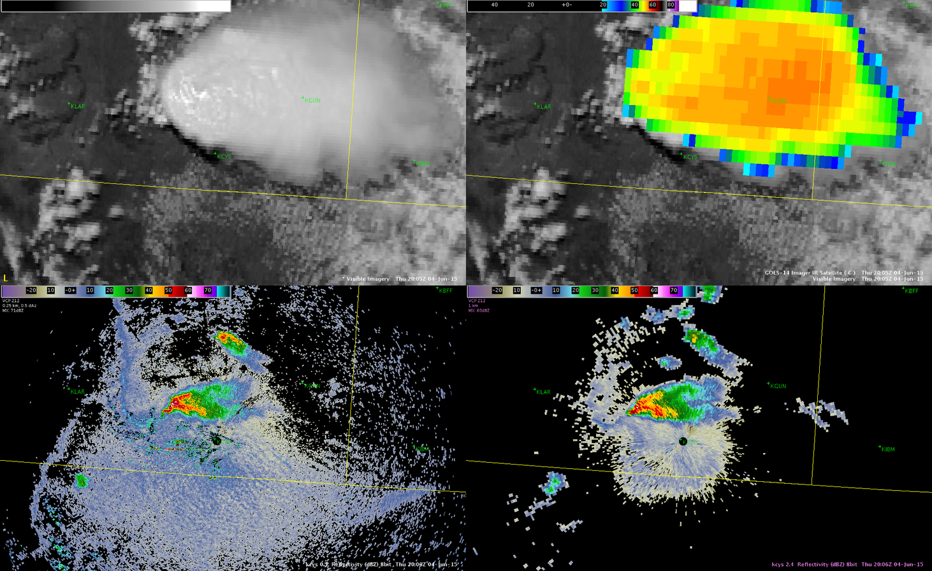
4 June 2015 2005-2141 UTC
GOES-14 Visible Imagery (0.65 μm; top left), GOES-14 VIS/IR Imagery (0.65/10.7 μm; top right), KCYS 0.5° Reflectivity (bottom left), and KCYS 2.4° Reflectivity (bottom right)
Notes:
So what is going on? The feature of interest obviously appears before weakening appears in reflectivity and severe hail reports. You will also notice in this long loop that once the feature appears the first time, the storm never “recovers” and has the same structure that it did before the feature first appeared.
It is possible this is midlevel outflow, on the VISIT blog Dan Bikos calls this a gravity wave. I suppose there is some support to this because after the initial “feature” appears, the cumulus is suppressed between the dashed red lines. What it comes down to is that, the storm was strong and well organized, the feature appears, storm reports come out, and the storm decays. We don’t definitively know what it is or how often it occurs, but its possible that when this feature appears the warning forecaster may be able to anticipate rapid changes in strength may occur.

Slide 9
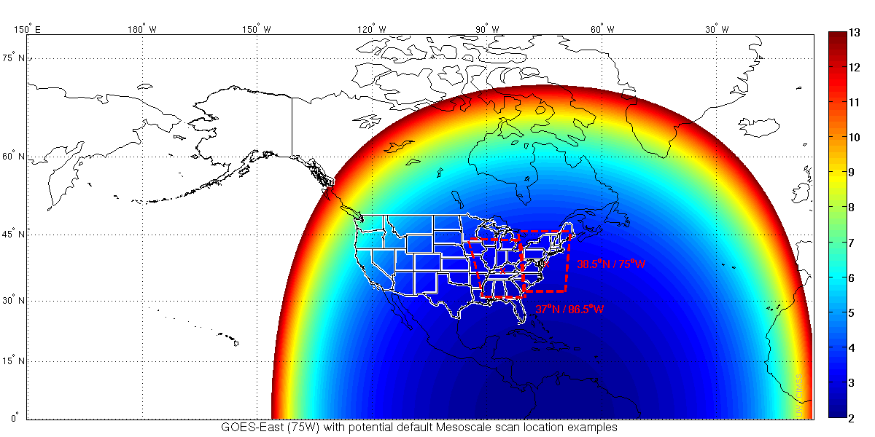
Mesoscale Domain Sector (MDS)
Locations… where to scan
Courtesy of Tim Schmit

Slide 10
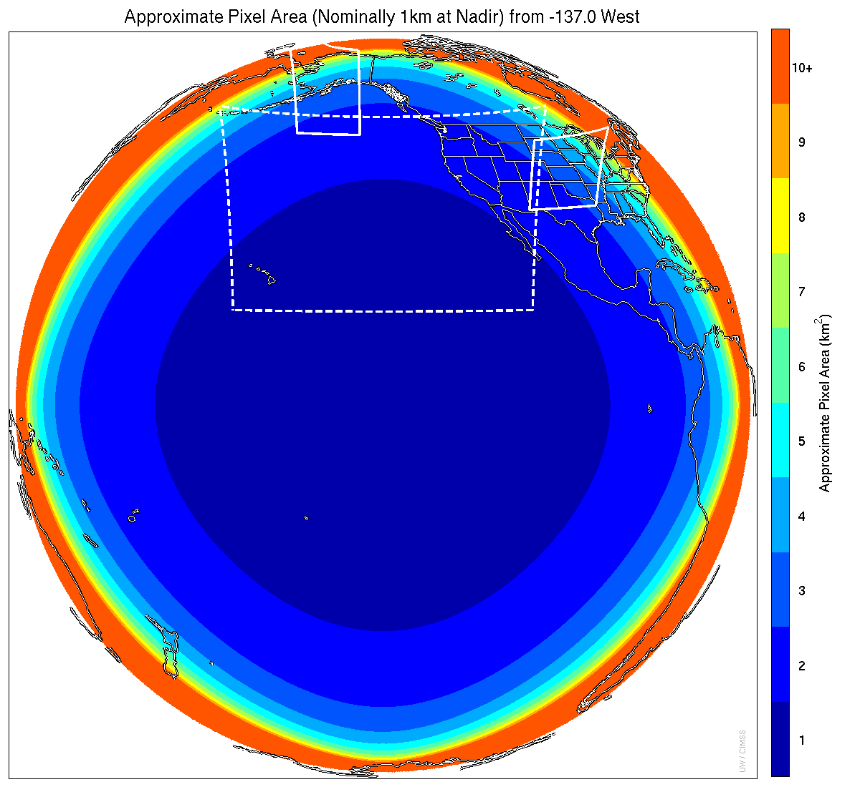
With 2 ABIs (GOES E & W)
= 4 Meso Domain Sectors
Courtesy of Tim Schmit

Slide 11
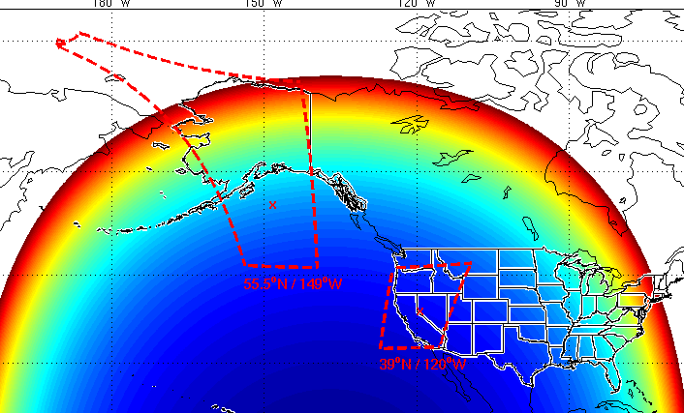
Default “Parked” Positions
GOES East (& Central):
Commercial Airline
Route Corridors
GOES West:
Commercial Airline
Route Corridors + AK?
Courtesy of Tim Schmit

Slide 12
Why Aviation Flight Corridors?
Line up with highest population areas
Aviation industry highly sensitive to clouds / fog / IFR-LIFR conditions
They can be quickly moved off of those parked locations for 24 higher priority reasons
Alternative was to leave where it was moved, which seemed to be a less efficient way to use the MDSs

Slide 13
Requests are the key
Any time a MDS is moved out of the parked location to a new position will be the result of a request by one of the operational entities listed below:
Any NCEP National Center (e.g. SPC, NHC, etc.)
Regional Focal Point (representing WFOs)
NESDIS Satellite Applications Branch (SAB)

Slide 14
Request Flow
The Request Flow
Requesting
Entity
NCEP
SDM
ESPC
Help Desk
SOCC
CDA
If conflicting requests… refer to Priority Listing
NCEP SDM is a
KEY player in
this process!

Slide 15
Multiple Request Situations:
SDM will Follow Priority List
SPC High or Moderate Risk
Volcanic eruptions impacting the US or US Territories
SPC Enhanced Risk
Major Hurricane (CAT 3-5) forecast to make landfall to US or US Territories Day 1 or 2
Event or circumstance with national importance requiring elevated DSS (e.g… Super Bowl, Olympics, large hazmat event, etc…)
SPC Extreme Fire Weather criteria
Hurricane (CAT 1-2) forecast to make landfall to US or US Territories Day 1 or 2
SPC Marginal or Slight Risk
SPC Critical Fire Weather
WPC High or Moderate Risk of rainfall exceeding flash flood guidance or WFO issuance of Flash Flood Watch
LIFR Conditions (widespread) at Large and/or Medium FAA Hub Airports
Winter Storm Warning criteria (including blizzard and ice storm warning criteria)
Tropical Storm forecast to make landfall to US or US Territories Day 1 or 2
Volcanic eruptions not impacting US or US Territories, but within MDS-capable areas*
Observed or forecast blowing dust conditions of ¼ mile or less visibility
LIFR or worse conditions (widespread) over small FAA Hub Airports
Winter Weather Advisory criteria
SPC General Thunder
SAB responsibility interests for non-US/non-Canadian high impact weather conditions*
Canadian Operational Need (requested from Canada per MoU)
Operations request from non-US/Canadian interests*
Satellite test activities
US research interests (non-operational, and coordinated through CIRA/CIMSS/SPoRT)
Canadian research interests per MoU
Non-US/Canadian research interests (non operational, and coordinated through CIRA/CIMSS/SPoRT)
* See Mode 4 Requests

Slide 16
Factors for Considering Priority
Impact of phenomenon
Temporal evolution of phenomenon (how quickly does it form, evolve, dissipate, etc…)
Do satellite observations significantly help analyze and diagnose the phenomenon?
Have SRSRO studies shown 1-minute observations are beneficial?
  Tropical Systems vs. Fire Weather Evolution

Slide 17
NCEP SDM
Will NOT initiate MDS position changes
Will take requests for MDS position changes
Will prioritize those requests
Will relay the requests down the line (to ESPC Help Desk)
Will have final say in MDS locations / actions

Slide 18
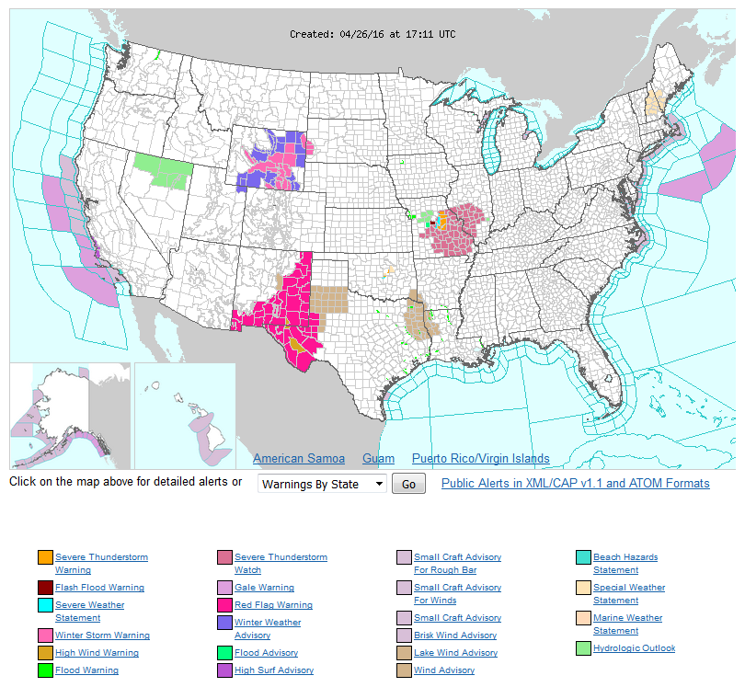
Quick Example/Scenario

Slide 19
Priority List
SPC High or Moderate Risk
Volcanic eruptions impacting the US or US Territories
SPC Enhanced Risk
Major Hurricane (CAT 3-5) forecast to make landfall to US or US Territories Day 1 or 2
Event or circumstance with national importance requiring elevated DSS (e.g… Super Bowl, Olympics, large hazmat event, etc…)
SPC Extreme Fire Weather criteria
Hurricane (CAT 1-2) forecast to make landfall to US or US Territories Day 1 or 2
SPC Marginal or Slight Risk
SPC Critical Fire Weather
WPC High or Moderate Risk of rainfall exceeding flash flood guidance or WFO issuance of Flash Flood Watch
LIFR Conditions (widespread) at Large and/or Medium FAA Hub Airports
Winter Storm Warning criteria (including blizzard and ice storm warning criteria)
Tropical Storm forecast to make landfall to US or US Territories Day 1 or 2
Volcanic eruptions not impacting US or US Territories, but within MDS-capable areas*
Observed or forecast blowing dust conditions of ¼ mile or less visibility
LIFR or worse conditions (widespread) over small FAA Hub Airports
Winter Weather Advisory criteria
SPC General Thunder
SAB responsibility interests for non-US/non-Canadian high impact weather conditions*
Canadian Operational Need (requested from Canada per MoU)
Operations request from non-US/Canadian interests*
Satellite test activities
US research interests (non-operational, and coordinated through CIRA/CIMSS/SPoRT)
Canadian research interests per MoU
Non-US/Canadian research interests (non operational, and coordinated through CIRA/CIMSS/SPoRT)
* See Mode 4 Requests

Slide 20
Quick Example/Scenario
3
4
5
1
2
6

Slide 21
Stacking and Lining UP
30 second scan (2 MDS overlaid) can be achieved with both MDSs if no additional phenomenon need coverage
2 MDSs can be adjacent for a large phenomenon (e.g. long squall line) if no additional phenomenon with higher priority need coverage

Slide 22
Included with Each Request:
Which satellite (East/West)
Center Point lat/lon
Start date/time
End date/time
Reason, or phenomenon

Slide 23
Research-Related Requests
Coordinated through CIRA, CIMSS, SPoRT, DoD, NESDIS-STAR
Above agency coordinates with NESDIS-SAB
SAB coordinates with SDM
Priority is below anything operational

Slide 24
At end of Request Period
SOCC will move the MDS back to the default position, unless another Request has been received.

Slide 25
Mode 4 Requests
Full Disc every 5 minutes
No Meso Domain Sectors
Active phenomenon too numerous to be covered by CONUS or 2 MDS areas:
  Multiple active volcanoes
  Multiple hurricanes/tropical systems
Largely driven by SAB awareness of non-CONUS activity

Slide 26
Meso-scale box locations are movable
1 min
5 min
1 min
15 min
MODE 3
Courtesy of Tim Schmit
Notes:
1-km² spatial resolution at satellite nadir. Pixel Areas are approximate. Each bin is rounded to the nearest 1km² until we get to 9.5km² and then all are binned into the red 10+ area. So the first, dark blue, ring covers pixel areas from 1 to 1.49km² and is labeled “1”, above 1.5 to below 2.5km² goes into the next ring and is called “2”, etc. GOES-East location. Proposed CONUS sector, approved by the NWS NOAT. Two meso-scale image sectors shown; these are selectable. The same central lat/lon used for these mesoscales produces a different sized and shaped area for different satellite locations.

Slide 27
Other Details…
ABI can switch MDS locations in a matter of seconds (well under 1 minute), so no need for advanced notice
Minimal impact from eclipse periods
Plan may evolve with experience using Mode 3

Slide 28
Finalizing SOP within NWS
Content is written
Submission to NCEP SDM for feedback
Submission to NWS NOAT for feedback
Final adjustments and modifications
NWS NOAT endorsement/approval

Slide 29
Thank You
Suggestions for the Plan ?
Questions ?
dan.nietfeld@noaa.gov

