Slide 1
Overview of JPSS and GOES-R Data Assimilation in Global Numerical Weather Prediction Models
Presented by Jim Yoe
NWS National Centers for Environmental Prediction (NCEP)
and Joint Center for Satellite Data Assimilation (JCSDA)
Based on work by: A. Collard, J. Derber, G. Dimego, M. Ek, Ileana Genkova, D. Groff, R. Grumbine, D. Keyser, Eric Maddy, X. Su, W. Wolf, W. Zheng
Satellite Proving Ground & User Readiness May 11, 2016

Slide 2
Overview
S-NPP Foundation for JPSS
Anticipated adaptations and advances for JPSS
Legacy GOES and Himiwari Foundation for GOES-R
Anticipated adaptations and advances for GOES-R
Summary

Slide 3
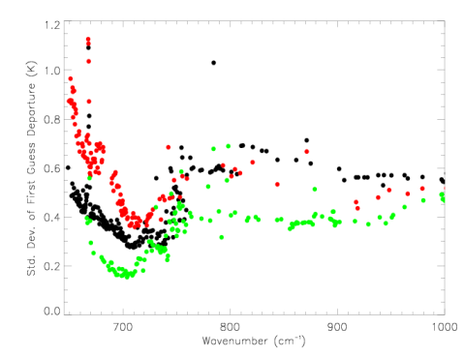
S-NPP Foundation for JPSS
New Sounders
ATMS operationally assimilated since May 2012 in GFS
CrIS operationally assimilated in GFS since August 2013
399 BUFR channels received
Extremely low noise (right)
Use 84 sensitive to:
T, cloud, CO2, surface
Robust current PM-orbit sounder configuration – neutral marginal impacts
Recent ensemble-based FSOIs show impacts of CriS comparable to AIRS, IASI; ATSM- AMSU (D. Groff)
AIRS
IASI
CrIS

Slide 4
S-NPP Foundation for JPSS (cont’d)
S-NPP VIIRS
VIIRS SST Product
netCDF files being run as development product by NCEP/EMC
Generating verification statistics
Anticipated implementation September 2016
Based on June 3 code hand-off; else
Delay until next implementation

Slide 5
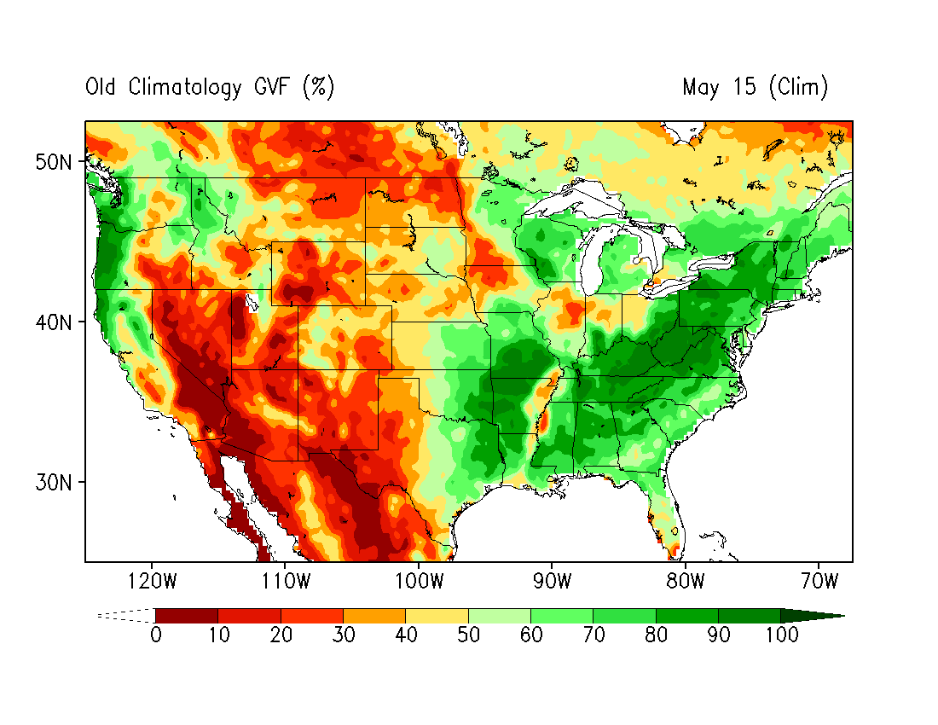
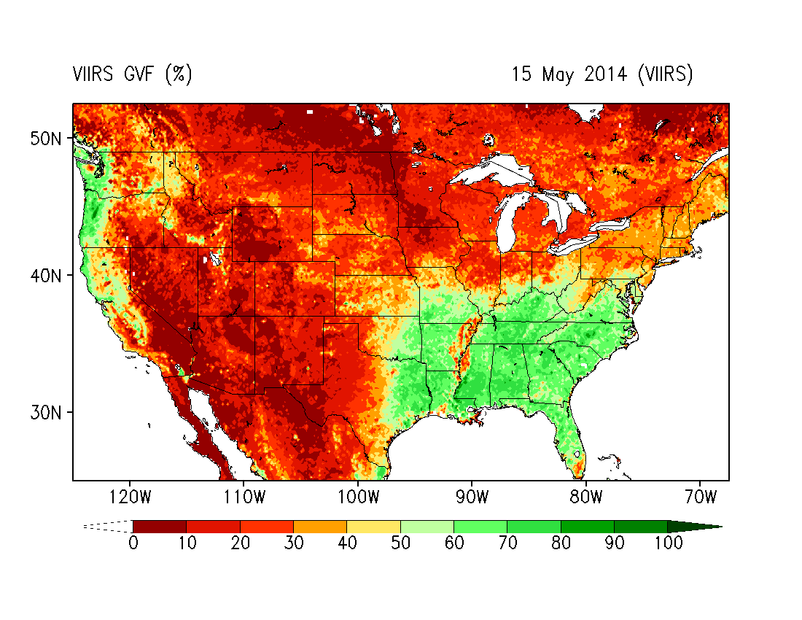
Incorporation of near real-time Suomi NPP Green Vegetation Fraction into the NCEP Models
Comparison of GVF between VIIRS and Clim 15 May 2014
Clim
VIIRS
5yr mean AVHRR GVF in Ops NCEP models
Near real-time VIIRS GVF
(NOAA/NESDIS/STAR)

Slide 6
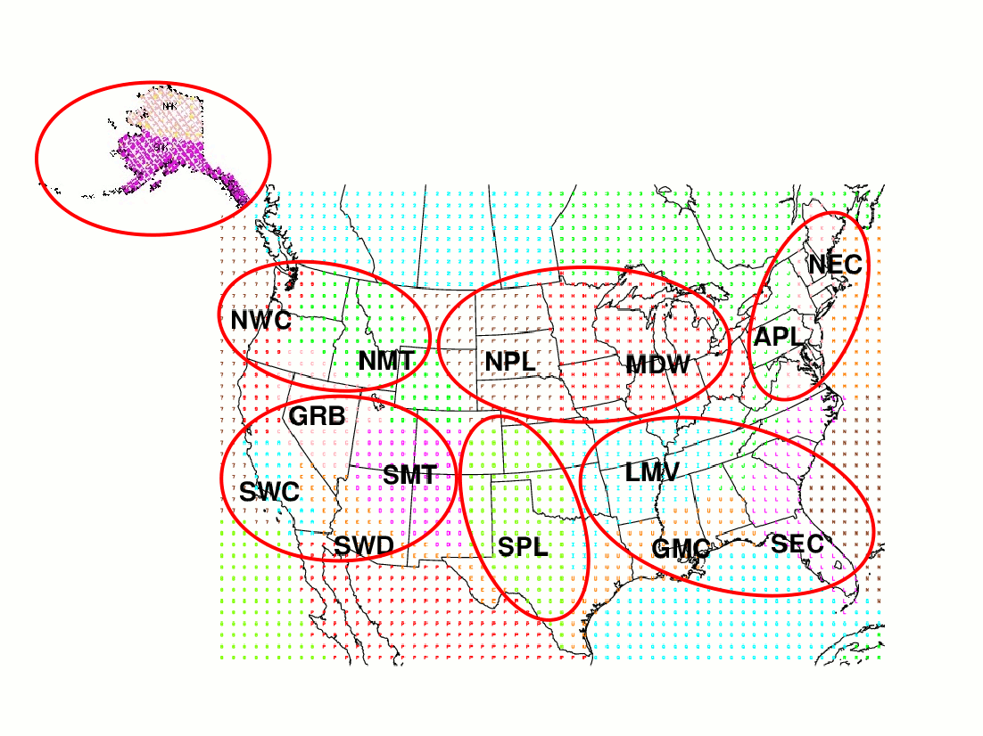
Forecast Verification Statistics (FVS) regions
+: improve; -: degrade; 0: neutral
0+
++
++
++
++
--
0+
In general, the near real-time GVF shows a positive impact to reduce errors of 2-m air temperature in the GFS.
Notes:
6

Slide 7
Adaptations & Advances for JPSS
J1 Launch in Feb 2017
In the event of a P.M. Polar gap could assimilate at L + 90 days
Exploit use of low-latency JPSS data for ATMS and CrIS
Assimilate CrIS Water Vapor Channels
All-sky radiances
CrIS Full Spectral Resolution
VIIRS SST to RTOFS
BUFR will be needed
SST-sensitive radiance assimilation – BUFR/data handling

Slide 8
Foundation for GOES-R
Atmospheric Motion Vectors (AMVs)
Legacy Sources (GOES, MTSAT)
Advanced Himiwari Imager (AHI) product from Japan via GTS
AHI winds demonstrate better O-B than MTSAT counterparts, operationally assimilated
(See WV wind examples, next slide)
Direct Assimilation of L1B imager radiances
Status of Gap Mitigation Work

Slide 9
WV

Slide 10
Assessment of AHI with 4DEnsVar System
Experiment period: Aug. 01 ~ Sep. 24, 2015
CNTRL: Current operational global observing system
H8AMV: 1) + H8 AMVs (same setup as MT-SAT 2 and on top of MT-SAT 2 AMVs)
H8RAD: 1) + AHI IR from three water vapor channels
H8AMVRAD: 1) + 2) + 3)
Assimilated channels
All radiance experiments use a split window SST check, 2K gross check, and modified version of Haixia Liu’s SEVIRI code (AWG cloud mask + EUMETSAT mask) to cloud-mask and super-ob AHI radiances at 24km.

Slide 11
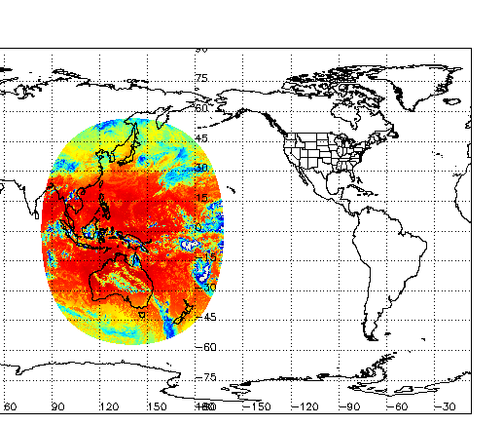
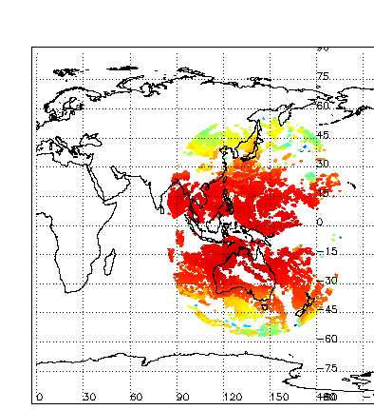
More aggressive mask
All Sky
Default mask
a
b
c
4DEnsVar-radiance assimilation uses the more aggressive cloud mask with hourly dumps of AHI radiances (6 full disks at +/-3hrs around synoptic time) and super-obbed to 24km

Slide 12
Summary of H8 AHI assessment in GSI
Himawari-8 AHI (water vapor channels and AMVs) have been evaluated with NOAA hybrid 4DEnsVar system.
The results have shown that Himawari-8 has the positive impact on RH analysis and forecast at the higher pressure levels centered around 100-hPa.
Preliminary assessment also shows neutral to marginal positive impact from Himawari-8 on the Height and Tropical Wind forecast (see below).
Exp | P500 Height AC at Day-5 |  |  | P850 Tropical Wind RMSE |  | P200 Tropical Wind RMSE
 | G2 | NH | SH | Day-1 | Day-3 | Day-1 | Day-3
CTRL | 0.881 | 0.883 | 0.882 | 2.733 | 3.667 | 4.808 | 7.005
H8AMV | 0.883 | 0.880 | 0.885 | 2.734 | 3.672 | 4.811 | 7.047
H8RAD | 0.881 | 0.876 | 0.885 | 2.739 | 3.679 | 4.804 | 7.014
H8AMVRAD | 0.882 | 0.880 | 0.885 | 2.742 | 3.674 | 4.811 | 7.019

Slide 13
Adaptations & Advances for GOES-R
GOES-R Launch in October 2016
Availability of BUFR AMV and L1B products via operational path will take time to implement
Availability of BUFR’d data via STAR demo system more immediate
Continued development for L1B radiance assimilation (extension of Gap Mitigation work) at NCEP/EMC with JCSDA support

Slide 14
Summary
Poised to repeat rapid operational assimilation of J1 ATMS and CrIS TDR/SDR in Global Forecast System
Extend to take advantage of low-latency and full spectral data
Poised to extend assimilation of legacy GOES AMV winds ABI-based products
Initial challenge accessing AMV s in BUFR for GDAS/GFS
Poised to build on preliminary work with H8/AHI to develop assimilation of ABI L1B radiances
Questions ?

Slide 15
Back-ups

Slide 16
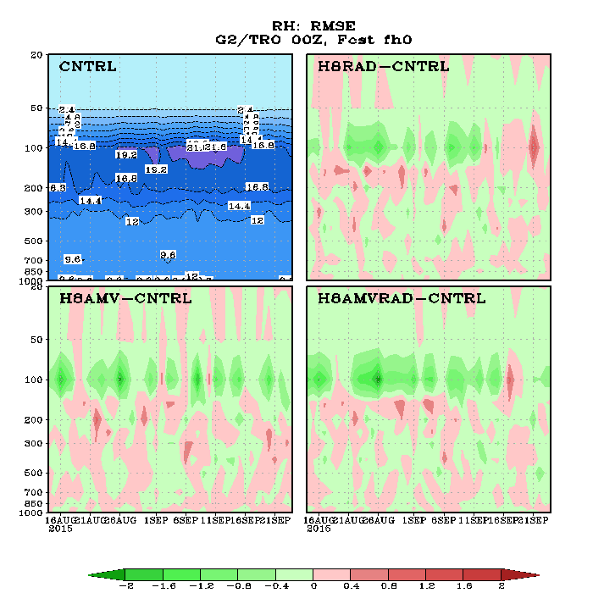
Post-Assimilation Geophysical Assessment
—— RH Analysis in the tropics
Assimilation of AHI AMVs, AHI imager radiances and AHI AMVs+radiances improves Tropical upper-tropospheric RH analysis RMSE against comparison against ECMWF

Slide 17
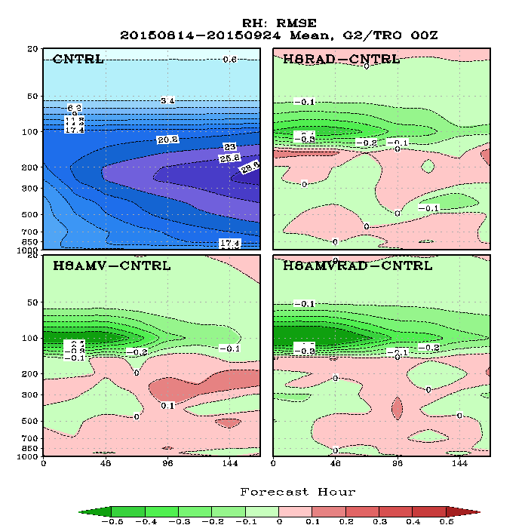
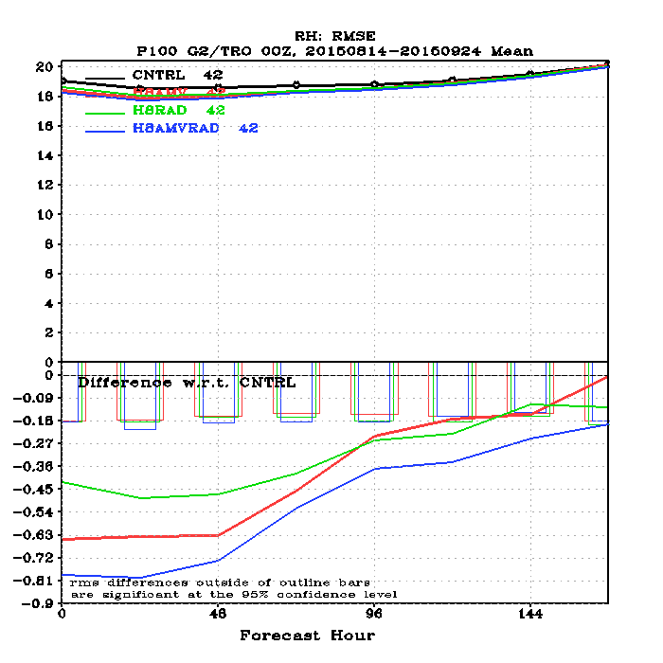
Post-Assimilation Geophysical Assessment Against ECMWF
—— RH Forecast in the tropics
Assimilation of AHI AMVs, AHI radiances and the AHI AMVs + radiances improves short-term and long term Tropical UT RH forecasts.

